Slide 1

Nursing
Information Session
DISCLAIMER: Information Subject to Change The information provided in this document has a publication date and is subject to change without notice. Please refer to the SSC website for the most up-to-date information. Date Published: August 12, 2025

Slide 2

General Contact Information
Dr. Lori Hunter – Program Manager
Email: hunterll@seminolestate.edu
Ph: 407.404.6158
Ms. Susan Kitner – Nursing Admissions
Email: nursing@seminolestate.edu
Ph: 407.404.6196
Notes:
2

Slide 3
Summary of Info Session
Summary of Info Session
Overview of Traditional & Concurrent Programs
Admission Process & Requirements to Apply
Prerequisites
TEAS
Nursing Application & Submission Dates
Selection Process
Program Hours
Number of Seats
Notes:
3

Slide 4
ZOOM Procedures
Please stay “muted” during webinar
At the end of the webinar, use the “hand raising” control to raise your hand to ask a question.
When your name is called, “unmute” yourself. After your question is answered, lower your hand and “mute” yourself
We will not be using the CHAT feature
Notes:
4

Slide 5

SSC Nursing Program Tracks
1. TRADITIONAL (Full Time) - Associate of Science (AS) Nursing Degree (SSC)
2. TRADITIONAL (Part Time) - Associate of Science (AS) Nursing Degree (SSC)
3. CONCURRENT (Full Time) –Associate of Science (AS) Nursing Degree (SSC) and a Bachelor of Science (BS) Nursing Degree (UCF)
Students may not switch programs once they began a program
(Examples: Traditional to Concurrent or Part-Time to Full-Time Traditional)
All prerequisites must be completed before a student can begin the nursing programs.
Notes:
5

Slide 6


Stop and listen

Slide 7

Background Check
** Background Check **
SSC’s community clinical facilities have requirements:
  Must be free of offenses that could potentially disqualify them from working in a healthcare environment
  Must be cleared by the facilities for any arrest in any state
Students who DO NOT have a criminal background:
After being provisionally admitted, all students will be required to submit a SSC approved criminal background check
Students who have a criminal background:
Process for clearance can take 3+ months. Must be pre-cleared by the Coordinator of Healthcare Programs to apply. Email to begin process: nursingclearance@seminolestate.edu Submit signed pre-clearance form the same day the nursing application is submitted via email to: nursing@seminolestate.edu Applications without the form will not be processed.
Notes:
7

Slide 8

BASIC FINANCIAL AID INFO
Be aware of the SSC’s financial aid important dates/deadlines
Include Seminole State’s school code on your FAFSA: 001520
For Concurrent nursing students: also include UCF’s code: 003954
Concurrent Nursing students receive financial aid through Seminole State
Be aware of all UCF’s FA important dates/deadlines
UCF fee payment extended beyond first payment date listed on UCF academic calendar (for students who qualify)
Concurrent students not receiving their financial aid at UCF will have their file updated after add/drop period
Notes:
8

Slide 9
Financial Aid
Eligibility requirements
Step-by-step instructions on how to apply for financial aid
Application for Financial Aid (FASFA)
FAQ’s (what does financial aid cover, federal school code, etc.)
See the Financial Aid webpage:
https://www.seminolestate.edu/financial-aid/faq
Financial Aid Office
Ph: 407.708.2045
fahelp@seminolestate.edu
PART-TIME NURSING STUDENTS: Students with less than half-time enrollment may or may not be eligible for Financial Aid.
Notes:
9

Slide 10

Are you requesting clinical accommodations?
(See Core Performance Standards pg. 9 in the RN Info Packet)
All requests for clinical accommodations must be submitted to SSC and will be reviewed in consultation with our clinical partners.
The request must be filed with the Coordinator of Healthcare Programs (CHP) at: nursingclearance@seminolestate.edu & must include a detailed description of the requested accommodation(s).
After review, the CHP will notify the student of the reasonable accommodations to be made by the clinical partners and will clear the student to enroll.
Failure to follow this procedure will delay/prevent implementation of any reasonable accommodations or clinical placement.
Requests seeking academic accommodations will be forwarded to the Disability Support Services office for review and response.
SSC rule: Students can take the test 3X in a 12 month period - 31 days between retakes
UCF rule: Students can take the test 3X in a calendar year (Jan-Dec) - 30 days between retakes
Official TEAS score must be in your student record prior to submitting a nursing application
If TEAS is taken at SSC, score will be posted to SSC’s student record
If TEAS is taken at another college, student must pay $27 to ATI Testing to send official TEAS score to SSC
Notes:
10

Slide 11

Previous Nursing Program Policy
Previous Nursing Program Policy
  Students who have attended a nursing program at another college/university:
  Must have earned a grade of “C” or higher in all nursing coursework
  Must submit a letter of good standing from the Dean or Director of Nursing at that program directly to the Dean of Nursing at SSC.
  The letter MUST include these 2 statements in order to be considered:
  (1) The student left the program in good academic standing.
  (2) The student is eligible to return to the program.
  SSC must approve the student before applying to the nursing program.
  If accepted, the student would not receive any credit for previous nursing coursework.
Notes:
11

Slide 12
UP-FRONT COSTS
Approximately $2000-$3000 in addition to tuition can be expected during your first 2 semesters.
You will be purchasing:
  Textbooks (which will be used throughout the program)
  Lab Kit
  Uniforms/Shoes
  Additional costs:
    Background Check/Drug Screening
    Immunizations
Notes:
12

Slide 13

Resources for Nursing Students
Raider Support Services
https://www.seminolestate.edu/raider-support
Student Scholarships
https://www.seminolestate.edu/foundation/scholarships
Destination Graduation
https://www.seminolestate.edu/newsroom/article/5804/destination-graduation-helps-students-stay-the-course
Financial Support Services
https://www.seminolestate.edu/non-traditional/childcare/financial-support
Notes:
13

Slide 14
Academic Success Center
(ASC)
  Access to a variety of exam study guides
  TEAS remediation
  Math and science tutoring
  Open computer lab
  Online tutoring
  Improve study & test taking skills
  https://www.seminolestate.edu/academic-success
Notes:
14

Slide 15
TEAS
(Test of Essential Academic Skills)
Nursing Entrance Exam
MUST have a minimum of 78% total adjusted score to apply to program(s)
Effective 09/01/2025, all TEAS exams must be taken In Person, no remote testing. If a student completed their TEAS prior to 09/01/25, their score is valid for 2 years regardless of the method of completion.
ALL students MUST take the TEAS – regardless of level of education
Cost: $80-$95 - Pay at cashier’s office
Official TEAS score must be in your SSC student record prior to submitting a nursing application
If applying for concurrent program, TEAS score MUST be in both student records - SSC & UCF
Tests taken at SSC - score will be posted to your SSC student record in approximately 2 days
Students can take the TEAS at any institution. The student will need to pay a fee (approximately $30) to ATI Testing to have the TEAS score sent to SSC. (this process takes a week)
Student’s responsibility: Contact the testing center to confirm your score was received and posted to your student record.
Testing Center
407.708.2020
testingcenter@seminolestate.edu
Notes:
15

Slide 16
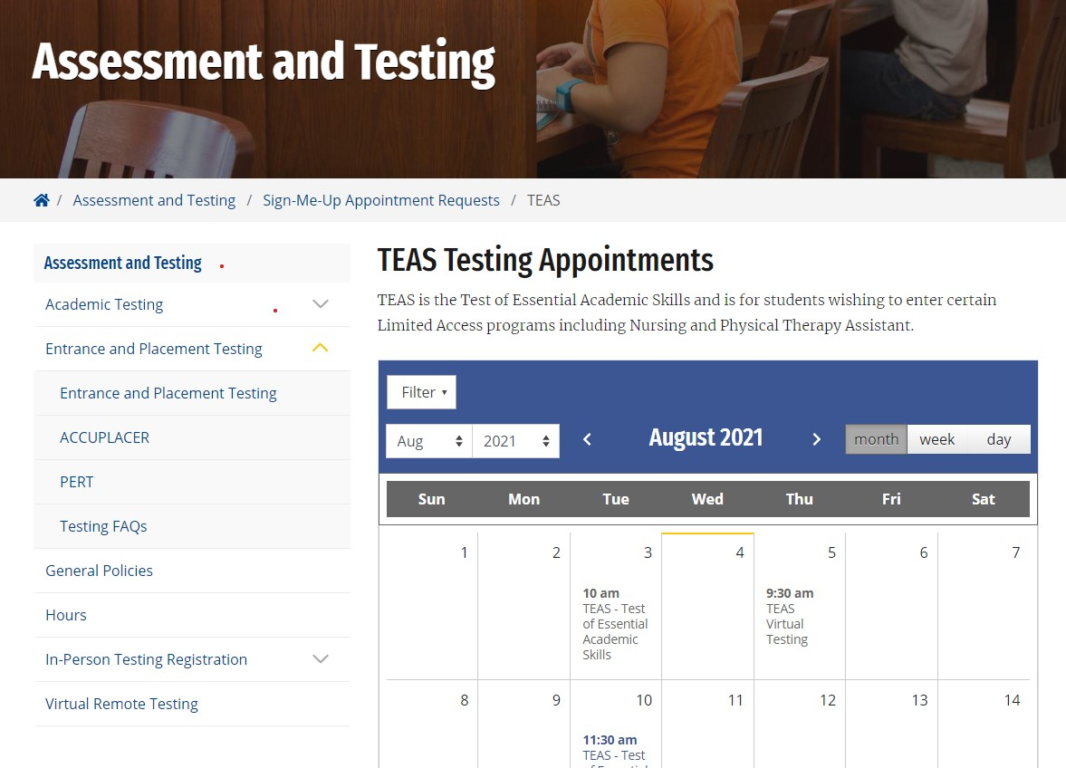
TEAS - must have appointment
Must schedule an appointment to take the test
On the SSC website, search “TEAS Testing Appointments”
Limited testing appointments
Notes:
16

Slide 17

TEAS Re-Take Policy
TEAS RE-TAKE POLICY
Scores are valid for 2 years.
SSC re-take policy: Effective 9/1/2025
Students can take the test 3 times in a calendar year (Jan.-Dec.) with a minimum of 30 days between retakes.
UCF re-take policy: same as Seminole State College
Notes:
17

Slide 18
TEAS Prep Resources
TEAS Preparation Resources
ATI Testing (atitesting.com)
  -Purchase Study Manual
  -Purchase Practice Tests
SSC Library
  -TEAS Study Manuals (in library)
  -TEAS Preparation Test (Access Through Library Database)
  -Access to Mometrix ELibrary, an online test prep resource
  Link: the Mometrix e-Library system
SSC Bookstore
-Purchase TEAS Study Manual
Academic Success Center
  -Tutoring & Study Groups
  -Access to Exam Study Guides
UCF TEAS Review Course
  -30-hour, 10 session course;
  -Visit UCF’s website for information
Notes:
18

Slide 19
Admission Process to SSC
Apply to the college
Submit official transcripts
Submit residency documents
(if Florida resident)
4. Meet with an advisor
5. Apply to the nursing program(s)
Notes:
19

Slide 20
1. Apply to the College
Complete Seminole State College admission application
  - Transfer students: Submit admission application 3 months prior to applying to the nursing program
  Associate of Science-Nursing (AS/RN):
    Select degree seeking, the “degree to go directly into the workforce” (Associate of Science), then select Nursing (students that plan to apply to the concurrent program must be AS-RN degree seeking when they submit a nursing application.
    Associate of Arts – Pre-Nursing:
    First time in college or transfer students planning to apply to the concurrent program
  DO NOT select the SSC RN-to-BSN program
  (this degree is AFTER you earn your AS-RN or have an RN license)
Notes:
20

Slide 21

APPLICATION SUBMISSION
DATES
 | Summer 2026 Admit | Fall 2026 Admit | Spring 2027 Admit
Nursing Application Deadlines | January 19-25, 2026 (full-time & part-time programs) | May 11-17, 2026 (full-time & part-time programs) | August 24-30, 2026 (full-time & part-time programs)
Notes:
21

Slide 22
3. VERY IMPORTANT STEP: Immediately submit Florida
residency documents if you are a Florida resident
2. Submit Transcripts
To get credit for AP, IB, or AICE courses, students must order those documents/test scores directly from the source.
SSC cannot give the student credit for these courses based on viewing the courses on another institution’s transcript..
Official Transcripts must be submitted 3 months prior to
applying to nursing program
  HS Transcripts/GED (order from school or Board of Education)
  College/University (order from school or Parchment)
  CLEP & AP (Order from College Board)
  IB (Order from IBO)
  AICE (Order from Cambridge International)
Send ALL TRANSCRIPTS to:
Seminole State College of Florida - Records Department
100 WELDON BLVD., SANFORD, FL 32773
Notes:
22

Slide 23
4. Meet with Assigned Advisor
It is essential to meet with your assigned advisor
  Review prerequisites or obtain an educational plan to finish prerequisites
Transcripts must be in student’s record prior to meeting with an advisor
  It takes 30 business days to evaluate transcripts
AS-RN students: make an appointment with your assigned nursing advisor
  Must be an active AS-RN degree seeking student to make an appointment
  Includes transfer students with plans to apply to the concurrent program
AA pre-nursing students: meet with your AA assigned advisor.
Link to Navigate to make an appointment (must have SSC live email):
https://www.seminolestate.edu/counseling/appointments
Notes:
Explain illegal repeat
23

Slide 24
Program Requirements
Must be completed BEFORE submitting a nursing application
Must be admitted to SSC (apply to SSC 3 months prior)
TEAS Exam 78% or higher (score must be in student’s record)
Transcripts MUST be in student’s record
Prerequisites:
  Must complete prerequisite courses with a grade of “C” or higher
  Must have a minimum 2.50 prerequisite GPA
Grade Forgiveness
No illegal repeats, see policy: https://www.seminolestate.edu/catalog/student-info/records/grade-forgiveness-policy
Notes:
24

Slide 25
WHY TRADITIONAL?
Shortest path to apply (10 Prerequisites & TEAS)
Shortest path to RN license
5 semesters (full-time) or 7 semesters (part-time)
Become employed as an RN, and then earn a BSN
Significant cost savings (state college tuition rates)
Notes:
25

Slide 26
Prerequisites
Traditional Program
Students with courses in progress when they apply for a seat in the program will be evaluated on an individual basis.
BSC2010C (or 1010C) | General Biology I (4 credits with a lab)
BSC2093C* | Anatomy & Physiology I (4 credits with a lab)
BSC2094C* | Anatomy & Physiology II (4 credits with a lab)
MCB2010C | Microbiology (4 credits with a lab)
ENC1101 or 1102 | English I or English II
MAC1105 | College Algebra
PSY2012 | Gen Psychology
HUMXXXX | Core Humanities (choose 1 of 6) See Next Slide
HUN2202** | Human Nutrition & Diet Therapy
POS2041 or AMH 2020 or AMH2010*** | U.S. Federal Government or AMH 2020 US History 1865 to present Or AMH2010 US History to 1877
* UCF Courses ZOO3733C Human Anatomy and PCB3703C Human Physiology are equivalent to BSC2093C A&P I and BSC2094C A&P II. Mis-matched courses not accepted effective 1/1/2026 (example: BSC1085C & BSC2094C)
** HUN1201 Human Nutrition + HUN2015 Diet Therapy = HUN2202 (also accepted HUN3011 & HUN2990)
*** Students starting the RN-AS program with a catalog year of 2023 will be required to complete a civics literacy course AND assessment. Effective 1/1/26, AMH2010 US History to 1877 will be accepted for civics literacy.
Notes:
26

Slide 27
Core Humanities Courses (select one)
(must have to satisfy SSC)
HUM2020 Experiencing the Humanities
PHI2010 Intro to Philosophy
ARH1000 Art Appreciation
LIT2000 Intro to Literature
MUL2010 Music Appreciation
THE2000 Theatre Appreciation
Notes:
27

Slide 28
Why Concurrent?
Working on AS-RN (SSC) and BSN (UCF) simultaneously
Dual-enrollment program at SSC and UCF, earning 2 degrees:
  Steps: ASN → NCLEX → RN License → BSN
ASN nursing courses with SSC are “in-person courses” at the SSC Altamonte Springs campus, and students have clinicals 2 days per week
BSN nursing courses with UCF are 100% online
Total length of program: 6 semesters (includes ASN & BSN courses)
BSN conferred 1 semester after AS-RN is earned
Notes:
28

Slide 29
Additional Application to UCF (Concurrent Program)
Complete Seminole State Admission Application
Complete UCF Admission Application
- Nursing Pending
- Be certain your UCF record is active for the term in which you are applying to begin the nursing program specifically.
Notes:
29

Slide 30
UCF PROGRAM REQUIREMENTS
In Addition to Items for the Traditional Program
General admission to UCF and Seminole State College (3 months before submitting a nursing application)
AA Degree or completion of UCF’s 36-hour general education component
Cumulative GPA: Minimum of 3.0
TEAS Score: 78% Adjusted Total Score must be sent to both SSC and UCF
  $29.99 for each delivery request
Foreign language Requirement
  Began AA degree studies in Fall 2014 or later, automatically satisfies the foreign language requirement with the AA.
  If courses were begun prior to Fall 2014, must provide proof of:
  2 years of the same language in high school –or- 2 semesters of same language in college -or-proof
  of a proficiency test (FLATS)
  A bachelor’s degree will also satisfy the foreign language requirement
International students on an F-1 educational visa are not eligible as the program is mostly online which does not meet the F-1 visa criteria of only allowing one online course each semester
Notes:
30

Slide 31
General Admission to UCF
Are you eligible for Direct Connect to UCF?
DirectConnect to UCF guarantees admission (consistent with university policy) to UCF with an associate degree (A.A.) or articulated (A.S.) degree from one of our partner state colleges which includes Seminole State College
More information - Get Started https://directconnect.ucf.edu/
Ph: 407.823.4547 (for a quicker response)
Notes:
31

Slide 32
Prerequisites - Concurrent Program
CHM1032 (3 credit hour course) BSC2010C | Foundations of Chemistry (highly recommended) or other approved physical or life science; General Biology I (must have to satisfy SSC)
MCB2004 or MCB2010C* (UCF prereq) | Microbiology
ZOO3733C or BSC2093C* (UCF prereq) | Human Anatomy or Anatomy & Physiology I1
PCB3703C or BSC2094C* (UCF prereq) | Human Physiology or Anatomy & Physiology II
ENC1101 or ENC 1102 | English I or English II (must have to satisfy SSC)
MAC1105 | College Algebra (must have to satisfy SSC)
PSY2012 (UCF prereq) | General Psychology
DEP2004 (UCF prereq) | Developmental Psychology
POS2041 or AMH2020 or AMH2010*** | U.S. Federal Government or U.S. History 1865 to present or U.S. History to 1877
STA2014 or STA2023 (UCF prereq) | Principles of Statistics
HUN3011 or HUN2202 **(UCF prereq) | Human Nutrition (UCF) or HUN2202 Human Nutrition & Diet Therapy
HUMXXXX | Core Humanities (must have to satisfy SSC) See Next Slide
  * Science courses must be 4 credits (or course 3 credits + lab 1 credit). Effective 1/1/26: Mis-matched A&P courses not accepted by SSC. (Example: BSC2085C & BSC2094C)
  ** HUN1201 or HUN2201 Human Nutrition + HUN2015 Diet Therapy = HUN2202
  *** Students starting the RN-AS program in catalog year Fall 2023 will be required to complete a civics literacy course AND assessment. Effective 1/1/26, AMH2010 US History to 1877 will be accepted for civics literacy.
Students can be enrolled in one UCF nursing prerequisite at the time they submit a nursing application.
Notes:
32

Slide 33
Quick Review
Is CHM 1032 Foundations of Chemistry required or recommended?
Recommended for concurrent applicants (may make your application more competitive)
Students MUST have BSC2010C General Biology I to satisfy SSC
Are you clear about the Nutrition/Diet Therapy requirement?
HUN2202 Human Nutrition/Diet Therapy (also HUN3011 and HUN2990) will meet both institutions’ requirements
HUN1201 Human Nutrition (or HUN2201) + HUN2015 Diet Therapy = HUN2202
Notes:
33

Slide 34
Apply to the nursing program
5. Apply to the Nursing Program
NURSING
APPLICATION
PROCESS
Notes:
34

Slide 35
APPLICATION FORM
The SSC nursing application form is available on the nursing webpage only during the acceptance dates: https://www.seminolestate.edu/nursing/deadlines
Students applying for the SSC traditional programs MUST submit an SSC nursing application
Students applying for the SSC/UCF concurrent program MUST submit both an SSC nursing application AND a UCF nursing application
Your official TEAS score MUST be posted to your SSC student record
Complete the online application form and submit through the SSC portal.
Notes:
35

Slide 36
APPLICATION SUBMISSION
Submit your nursing application during one of the three application windows.
After submitting your nursing application check your email frequently in case you are contacted for additional documents.
We will only contact you through your SSC live email account and phone # in your student record.
Emails regarding acceptance/denial are sent to your SSC live email account approximately 6-8 weeks after the deadline.
Return your signed acceptance documents by the deadline to accept a seat in the program.
Notes:
36

Slide 37
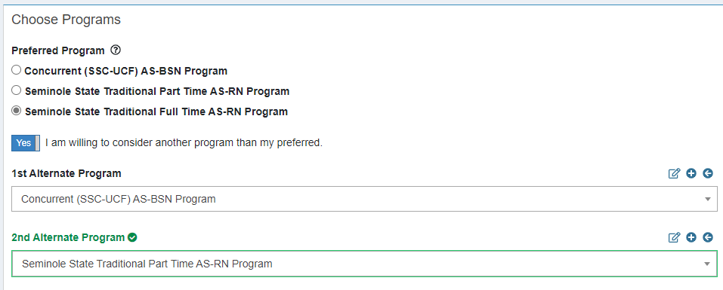
APPLICATION FORM
MUST have an SSC email account and enter name and student ID# to begin the application.
Your offer/denial letter will be emailed to your SSC live email account
Select the program (or programs) you wish to be considered for
Notes:
37

Slide 38
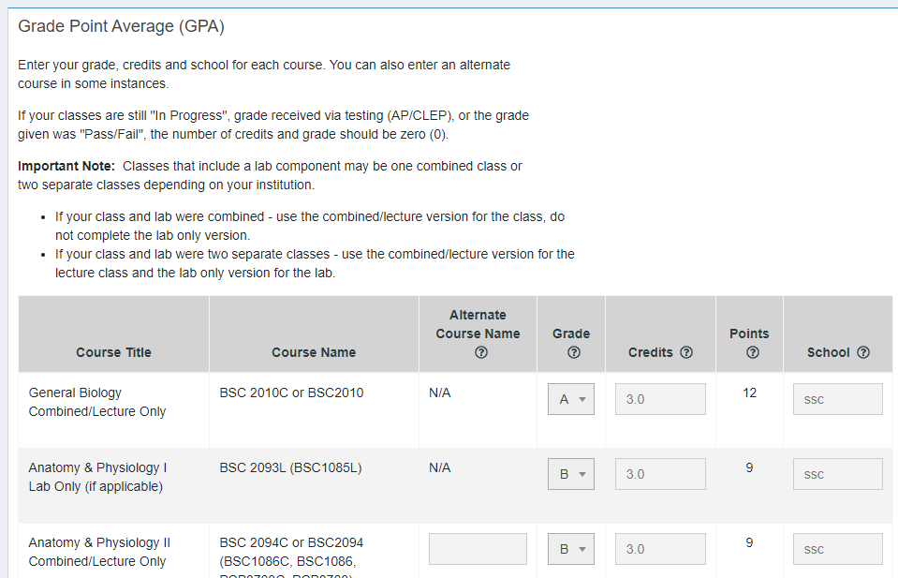
APPLICATION FORM chart
Enter your info on the chart: grades, # of credits, and school
Read carefully prior to filling out chart
Notes:
38

Slide 39
APPLICATION FORM (former program or background)
Answer Yes or No – if yes, you must be pre-approved by the Dean of Nursing to submit a nursing application.
Criminal Background Check Information
__Yes __ No I have been arrested in Florida or another state.
If Yes, I have had my background pre-cleared by the Nursing Dept. and I have emailed my signed pre-clearance form to nursing@seminolestate.edu prior to submitting this application. If you have not been previously cleared, you will need to do this prior to submitting a nursing application. It is an extensive process that can take 3+ months to complete. If you have not been previously cleared, your application will not be processed. Please contact nursingclearance@seminolestate.edu for specific instructions.
Notes:
39

Slide 40
How to Apply
To the Concurrent Program?
Must be accepted to both SSC and UCF
Must submit TWO nursing applications
College Admission (apply 3 months prior to submitting a nursing application)
Seminole State College
UCF
Nursing Application (apply during application window)
Seminole State College (online)
UCF (online)
Notes:
40

Slide 41
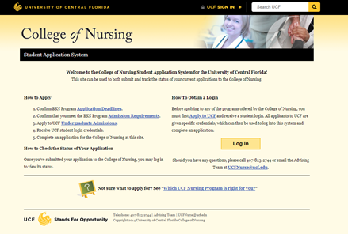
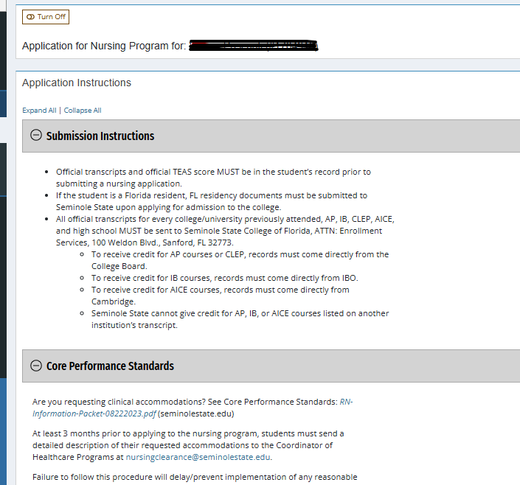
UCF Application Form
Link: https://applications.nursing.ucf.edu/Default.aspx?ReturnUrl=%2f
Link:
https://www.seminolestate.edu/nursing/generic-program
Notes:
41

Slide 42
Clinical compliance
CLINICAL COMPLIANCE
After accepting your seat, immediately begin compliance tasks (fingerprinting, drug/alcohol screening, proof of immunizations, etc.).
Place mandatory meetings (bootcamp, orientation, FIT test, BLS, etc.) on your calendar.
Students must provide proof of health insurance. The program does not support any particular insurer, but some students have suggested the following insurers to meet insurance needs:
  IFS (Insurance for international students only): https://www.insuranceforstudents.com/
  Florida Marketplace Coverage: https://www.healthcare.gov
Notes:
42

Slide 43

Very Important Info
VERY IMPORTANT INFORMATION
Students in the part-time and full-time programs attend core nursing classes together.
At the beginning of each semester, students are given a list of nursing courses to register for. In addition, they are given their clinical schedule. Clinicals are randomly assigned and cannot be changed.
Students can not select the days/times/hours for courses such as “only morning” or “only evening.” Students are also unable to select clinical days/clinical sites.
Each semester students receive a new course list and clinical schedule.
We suggest that students in the full-time programs only work if absolutely necessary, no more than 12-15 hours per week.
Notes:
43

Slide 44
PROGRAM HOURS
TRADITIONAL Full-time (5 semesters)
Schedule: In-person
  lectures, lab, and clinicals
Lectures/Lab
  8:00 am-9:00 pm
Clinicals
  1-2 days/week
  Begin as early as 6:30 am
  10-12 hours
  any day of week
  May include holidays & weekends
TRADITIONAL Part-time (7 semesters)
Schedule: In-person
  lectures, lab, and clinicals
Lectures/Lab
  8:00 am-9:00 pm
Clinicals
  1-2 days/week
  Begin as early as 6:30 am
  10-12 hours
  Friday, Saturday, or Sunday as able
  May include holidays & weekends
UCF Full-time BSN (6 semesters)
  100% BSN (UCF) Online Courses
Notes:
44

Slide 45

Curriculum Sequence
SSC Traditional Programs
Full-Time 5 semesters
Semester | Course | Credits
1 | NUR 1060C Health Assessment NUR 1022C Foundations of Nursing NUR 1003L Nursing Skills | 3 5 2
2 | NUR 1210C Concepts of Basic Med/Surg Nursing NUR 2520C Concepts in Mental Health Nursing | 6 3
3 | NUR 2241C Advanced Concepts in Med Surg Nursing | 6
4 | NUR 2440 Concepts of Maternal/Child Nursing | 6
5 | NUR 2244C Complex Concepts in Med Surg Nursing NUR 2943C Practicum & Client Care Management | 4 3
Part-Time 7 semesters
Semester | Course | Credits
1 | NUR 1060C Health Assessment | 3
2 | NUR 1022C Foundations of Nursing NUR 1003L Nursing Skills | 5 2
3 | NUR 1210C Concepts of Basic Med/Surg Nursing | 6
4 | NUR 2520C Concepts of Mental Health Nursing | 3
5 | NUR 2231C Advanced Concepts in Med Surg Nursing | 6
6 | NUR 2440C Concepts of Maternal/Child Nursing | 6
7 | NUR 2244C Complex Concepts in Med Surg Nursing NUR 2943C Practicum & Client Care Management | 4 3
Notes:
45

Slide 46
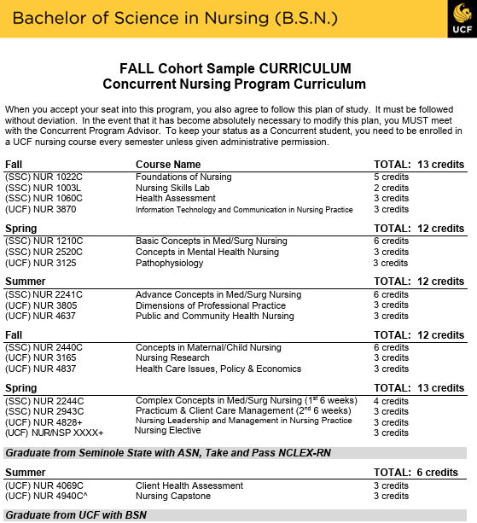
Sample Concurrent curriculum
Sample Curriculum - UCF
Concurrent Program
Awarded ASN, sit for NCLEX-RN
Must have RN license; awarded BSN
Notes:
46

Slide 47

Selection Process
Students are selected for the SSC AS-RN program based on:
Prerequisite GPA
TEAS score
Students with courses in progress when they apply for a seat in the program will be evaluated on an individual basis
Students are selected for the SSC/UCF AS-BSN concurrent program based on:
Comparison of cumulative GPA, science prereq GPA, non-science prereq GPA
TEAS score
Students with all prerequisites completed are more competitive
Students may be enrolled in one UCF prerequisite course at time of application

Slide 48
WHAT IF YOU ARE ACCEPTED?
Students will receive an offer/denial letter (via email) approximately 6-8 weeks from the application deadline from SSC (& UCF if concurrent applicant)
Several forms MUST be signed & emailed to SSC by a deadline to accept the seat in the program (UCF applicants must also respond to UCF)
Attend SSC Bootcamp & Orientation
  SSC Nursing has a dual orientation for traditional & concurrent students
  Attendance is MANDATORY – Plan accordingly
  Students will be provided date/time of orientations upon acceptance
Notes:
48

Slide 49
WHAT IF YOU ARE NOT ACCEPTED?
Students are eligible to re-apply to any program for future terms
Students seeking the concurrent program, who have indicated on their SSC nursing application that they would also like to be considered for the SSC AS-RN program, will be considered based on the AS-RN selection process.
Notes:
49

Slide 50
Review
REVIEW – VERY IMPORTANT INFO
What is the minimum TEAS score to apply to the NP?
How many nursing applications for the concurrent program?
How am I notified of acceptance or denial?
Do I have to be accepted as a college student to apply to the NP?
When does your TEAS score need to be in your SSC and/or UCF student record?
How do I request Thursday clinical days?
Notes:
50

Slide 51
RN-to-BSN Program
SSC RN-to-BSN Program
(Post-Licensure BSN Completion Program)
How it works?
Provisional acceptance for all SSC ASN graduates
11 courses (30 credit hours) IF student has general education requirements met (or an AA degree) – all online
Can finish in 12 months (students can opt for a slower progression)
Affordable – most CF employers pay tuition for employees (no out-of pocket expenses)
Cost effective – pay low state college tuition rates
Work as a RN while earning your BSN
Why BSN?
Increased nursing opportunities and potential to earn a higher salary
May be required within 3 years by employer
Notes:
51

Slide 52
ADDITIONAL QUESTIONS?
SSC Nursing Information:
Ms. Susan Kitner, Nursing Admissions
Email: nursing@seminolestate.edu
Phone: 407-404-6196
Dr. Lori Hunter, ASN Program Manager
Email: hunterll@seminolestate.edu
Phone: 407-404-6158
Office: ALT 3rd floor
UCF Nursing Information:
Ms. Patricia (Patti) Riva,
UCF Academic Program Coordinator
Email: patricia.riva@ucf.edu
Phone: 407-404-6089
Office: ALT 426
Dr. Chris Deatrick, Academic Advisor
  Email: Christine.deatrick@ucf.edu
  Phone: 407-823-5133
  Office: ALT campus (A-426)
UCF College of Nursing: 407-823-2744
Notes:
52

Slide 53
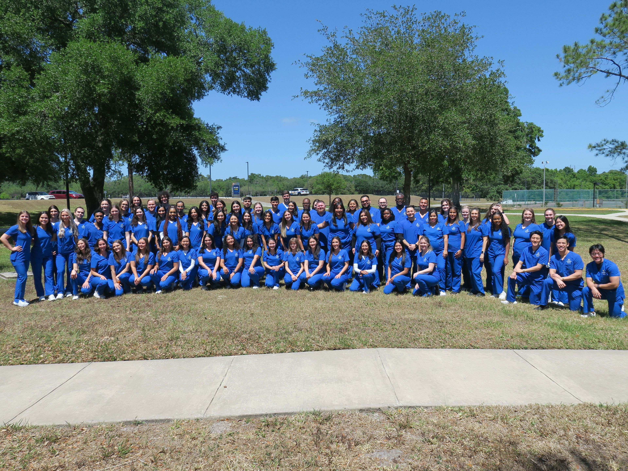
Thank you for Attending!

