Slide 1

Click here to start the practice.
Reading Practice for ESOL
High Intermediate Students

Slide 2
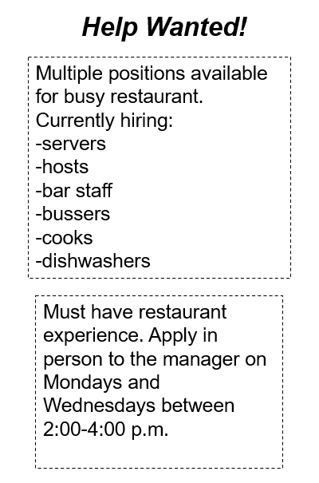
Questions 1 & 2
1. For which position is the restaurant
NOT hiring?
A. server
C. hostess
B. manager
D. cook
2. How should one apply for a job?
A. Call the manager
on Monday
C. Go into the
restaurant in
person
B. Apply online
D. Ask one of the
other servers for
help

Slide 3
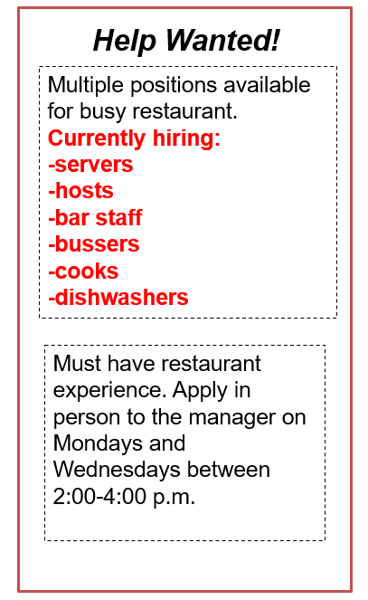

Return to Question #2
CORRECT!
Notes:
3

Slide 4
Go to Questions #3 and #4
Help Wanted!
Multiple positions available for busy restaurant.
Currently hiring:
-servers
-hosts
-bar staff
-bussers
-cooks
-dishwashers
CORRECT!
Must have restaurant experience. Apply in person to the manager on Mondays and Wednesdays between 2:00-4:00 p.m.
Notes:
4

Slide 5
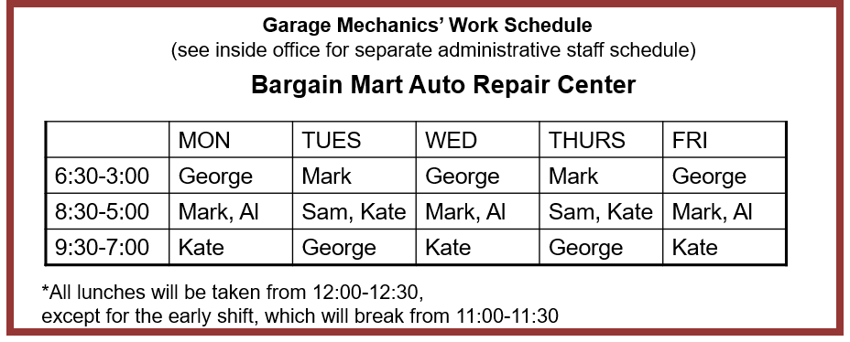
Questions 3 & 4
3. This is a work schedule for:
4. At what time does George eat lunch on Wednesdays?
A. All Bargain Mart employees
A. 12:00-12:30
B. All Repair Center employees
B. 11:00-11:30
C. The Auto Repair Center
Administrative staff
C. 11:30-12:00
D. The Auto Repair Center
Garage staff
D. 12:30-1:00
Notes:
5

Slide 6
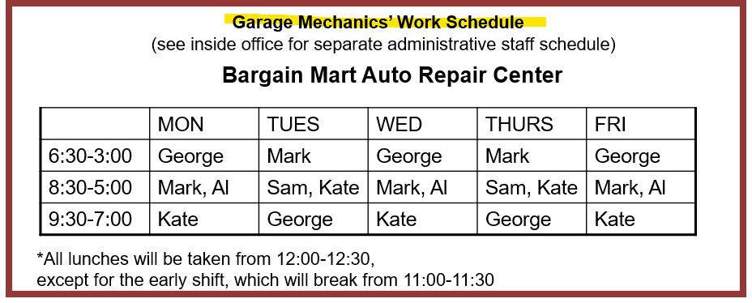
Return to Question #4
CORRECT!
Notes:
6

Slide 7
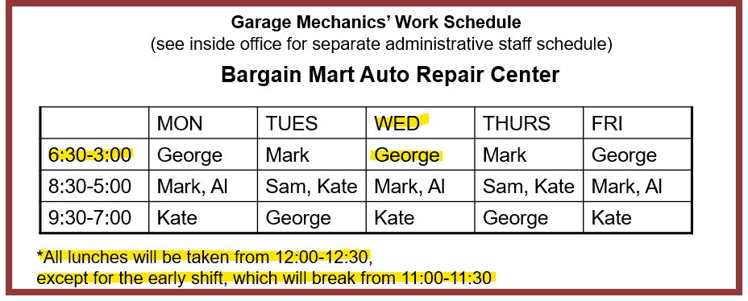
Go to Questions #5 and #6
CORRECT!
Notes:
7

Slide 8
Questions 5 & 6
A Hard-Working Family
Jiang May, her husband, Yao, and their daughter, Wei, arrived in the United States four years ago.
At first, none of them spoke English, but Jiang May and Yao have been studying in an adult program for the last two years, and Wei, who is in the fifth grade, is attending an American school, where she uses English all through the day. Her best subject is science, though, and she would like to become a doctor when she grows up. All of them are feeling more confident about their English ability!
In their home country, Jiang May was a teacher, and Yao owned his own restaurant, where he
worked as the manager and also cooked sometimes. In the United States, Jiang May works
in a hair salon, and Yao works in a factory at night. Both are hoping to get better jobs in the future,
and plan to open their own restaurant together as soon as they are able.
5. What does Wei hope to do in the future?
6. Where have Jiang May and her
husband been studying English?
A. Work as a manager
A. In an adult school in the United States
B. Work as a doctor
B. In an adult school in their home country
C. Work as a teacher
C. In elementary school in their home country
D. Own her own restaurant
D. In special classes at their jobs

Slide 9
Return to Question #6
A Hard-Working Family
Jiang May, her husband, Yao, and their daughter, Wei, arrived in the United States four years ago.
At first, none of them spoke English, but Jiang May and Yao have been studying in an adult program for the last two years, and Wei, who is in the fifth grade, is attending an American school, where she uses English all through the day. Her best subject is science, though, and she would like to become a doctor when she grows up. All of them are feeling more confident about their English ability!
In their home country, Jiang May was a teacher, and Yao owned his own restaurant, where he
worked as the manager and also cooked sometimes. In the United States, Jiang May works
in a hair salon, and Yao works in a factory at night. Both are hoping to get better jobs in the future,
and plan to open their own restaurant together as soon as they are able.
CORRECT!

Slide 10
Go to Questions #7 and #8
A Hard-Working Family
Jiang May, her husband, Yao, and their daughter, Wei, arrived in the United States four years ago.
At first, none of them spoke English, but Jiang May and Yao have been studying in an
adult program for the last two years, and Wei, who is in the fifth grade,
is attending an American school, where she uses English all through the day.
Her best subject is science, though, and she would like to become a doctor when she grows up.
All of them are feeling more confident about their English ability!
In their home country, Jiang May was a teacher, and Yao owned his own restaurant, where he
worked as the manager and also cooked sometimes. In the United States, Jiang May works
in a hair salon, and Yao works in a factory at night. Both are hoping to get better jobs in the future,
and plan to open their own restaurant together as soon as they are able.
CORRECT!

Slide 11
Questions 7 & 8
Classifieds
7. In which apartment complex is it all
right to have a dog or cat?
SHADY PINE – Quiet waterfront loc. 2 bd 2ba, patio w/view, cls to schools, lib, shop, etc. Only $750/mo
A. Clear Springs
C. Manzanita
Court
B. Orange Grove
D. West End
ORANGE GROVE – grt 2-st twnhs, w/d & new appl, cent h/a, access to pool. $1000/mo, no anim. Sec dep req’d.
WEST END – 3bd 3 ba apt, very spac, perf for familes. New paint/flrs, sm pets ok. Must sign 12 mo lease. $875/mo
8. Which apartment complex pays for
gas and electricity as part of the rent?
A. Manzanita
Court
C. Shady Pine
MANZANITA COURT – Cute studio in wond. comm. Gym, clubhs, jac, etc. All utilities include. Avail 3-1. $525/mo.
B. Clear Springs
D. West End
CLEAR SPRINGS – Must see! Beaut. 2 bd/2ba, gar, wd fl, many amen. Will go fast-only $725/mo.
Notes:
11

Slide 12
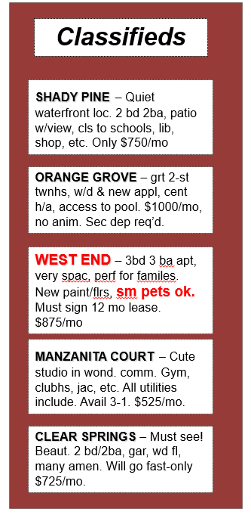
Return to Question #8
CORRECT!
Notes:
12

Slide 13
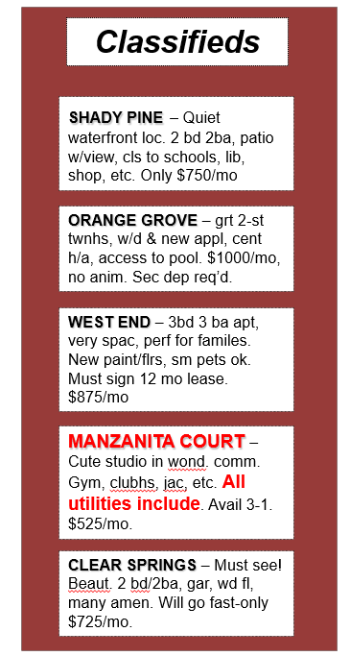
Go to Questions #9 and #10
CORRECT!
Notes:
13

Slide 14
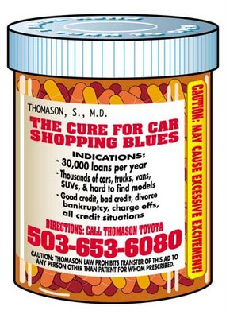

Questions 9 & 10
9. How many pills a day does
Ali need to take?
A. two
C. fifty
Main St. Pharmacy
123 Main St,
Anytown, WA 12345
(203) 555-1982
#9876 Filled 3-1-08
Kingston, Ali
Take 2 capsules twice daily for 2 weeks.
Warnings: May cause nausea. Eat food or drink milk immediately prior to taking medication.
Omnivex 50 mg/56
No Refills left
B. four
D. fourteen
10. What should Ali do to
avoid an upset stomach?
Eat or drink
something before
taking the medication.
C. Make sure to
take all medication.
B. Call the doctor
for a refill.
D. Eat or drink
something after
taking the medication.
Notes:
14

Slide 15
Return to Question #10
Main St. Pharmacy
123 Main St,
Anytown, WA 12345
(203) 555-1982
#9876 Filled 3-1-08
Kingston, Ali
Take 2 capsules twice daily
for 2 weeks.
Warnings: May cause nausea. Eat food or drink milk immediately prior to taking medication.
Omnivex 50 mg/56
No Refills left
CORRECT!
Notes:
15

Slide 16
Go to Questions #11 and #12
CORRECT!
Main St. Pharmacy
123 Main St,
Anytown, WA 12345
(203) 555-1982
#9876 Filled 3-1-08
Kingston, Ali
Take 2 capsules twice daily for 2 weeks.
Warnings: May cause nausea. Eat food or drink milk immediately prior to taking medication.
Omnivex 50 mg/56
No Refills left
Notes:
16

Slide 17
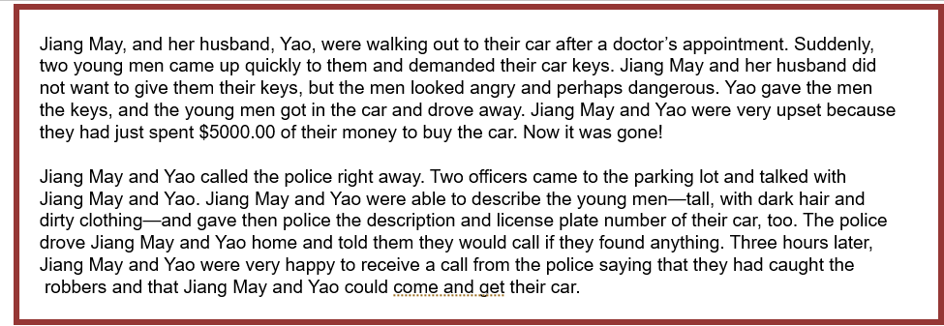
Questions 11 & 12
11. Why were Jiang May and Yao so upset?
12. What happened at the end of the story?
A. Robbers got caught by the police.
A. Jiang May and Yao stayed in the parking
lot for over three hours.
B. They don’t like going to doctor’s
Appointments.
B. Jiang May and Yao decided to take the
bus everywhere.
C. Robbers stole their car.
C. Jiang May and Yao had to buy a new car.
D. The police took a long time to help them .
D. Jiang May and Yao got their car back.

Slide 18
Return to Question #12
Jiang May, and her husband, Yao, were walking out to their car after a doctor’s appointment. Suddenly,
two young men came up quickly to them and demanded their car keys. Jiang May and her husband did
not want to give them their keys, but the men looked angry and perhaps dangerous. Yao gave the men
the keys, and the young men got in the car and drove away. Jiang May and Yao were very
upset because they had just spent $5000.00 of their money to buy the car. Now it was gone!
Jiang May and Yao called the police right away. Two officers came to the parking lot and talked with
Jiang May and Yao. Jiang May and Yao were able to describe the young men—tall, with dark hair and
dirty clothing—and gave then police the description and license plate number of their car, too. The police
drove Jiang May and Yao home and told them they would call if they found anything. Three hours later,
Jiang May and Yao were very happy to receive a call from the police saying that they had caught the
robbers and that Jiang May and Yao could come and get their car.
CORRECT!

Slide 19
Go to Question #13
Jiang May, and her husband, Yao, were walking out to their car after a doctor’s appointment. Suddenly,
two young men came up quickly to them and demanded their car keys. Jiang May and her husband did
not want to give them their keys, but the men looked angry and perhaps dangerous. Yao gave the men
the keys, and the young men got in the car and drove away. Jiang May and Yao were very upset because
they had just spent $5000.00 of their money to buy the car. Now it was gone!
Jiang May and Yao called the police right away. Two officers came to the parking lot and talked with
Jiang May and Yao. Jiang May and Yao were able to describe the young men—tall, with dark hair and
dirty clothing—and gave then police the description and license plate number of their car, too. The police
drove Jiang May and Yao home and told them they would call if they found anything. Three hours later,
Jiang May and Yao were very happy to receive a call from the police saying that they had caught the
robbers and that Jiang May and Yao could come and get their car.
CORRECT!

Slide 20
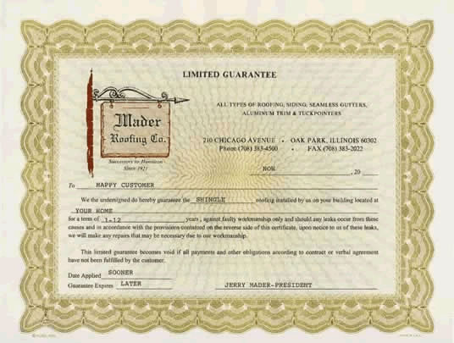
Question 13
BARGAIN MART JEWELRY WARRANTY
If any Bargain Mart gemstone should chip or
break under ordinary circumstances (excluding normal wear and tear), then Bargain Mart will repair or replace the item at our option, at no charge, excluding labor costs.
The customer is advised to return the damaged piece of jewelry along with the sales receipt to the store where the purchase was made. The retailer will then forward the item to Bargain Mart for servicing or replacement, if necessary. This warranty is good for three years from the purchase date. Extended warranties are available for purchase.
13. What do customers need to do to repair or replace a broken piece of jewelry?
A. Take the damaged item back
to the store where it was bought.
C. Buy another warranty after
three years.
B. Buy a new piece of jewelry.
D. Send the damaged item
directly to Bargain Mart.
Notes:
20

Slide 21
Go to Questions #14 and #15
BARGAIN MART JEWELRY WARRANTY
If any Bargain Mart gemstone should chip or
break under ordinary circumstances (excluding normal wear and tear), then Bargain Mart will repair or replace the item at our option, at no charge, excluding labor costs.
The customer is advised to return the damaged piece of jewelry along with the sales receipt to the store where the purchase was made. The retailer will then forward the item to Bargain Mart for servicing or replacement, if necessary. This warranty is good for three years from the purchase date. Extended warranties are available for purchase.
CORRECT!
Notes:
21

Slide 22
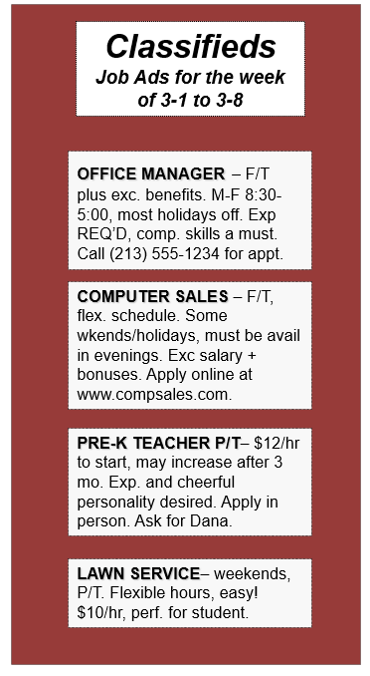
Questions 14 & 15
14. Which job offers health benefits?
A. Office Manager
C. Lawn Service
B. Computer Sales
D. Pre-K Teacher
15. For which job do you need to
apply over the internet?
Office
Manager
C. Lawn
Service
Computer
Sales
Pre-K
Teacher
Notes:
22

Slide 23
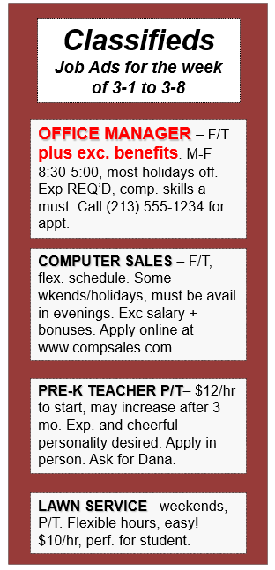
Return to Question #15
CORRECT!
Notes:
23

Slide 24
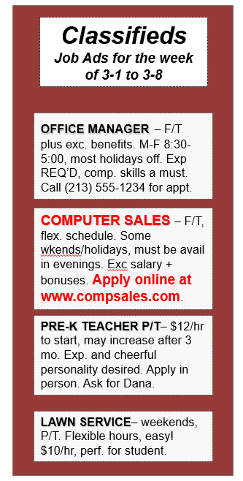
Go to Questions #16 and #17
CORRECT!
Notes:
24

Slide 25
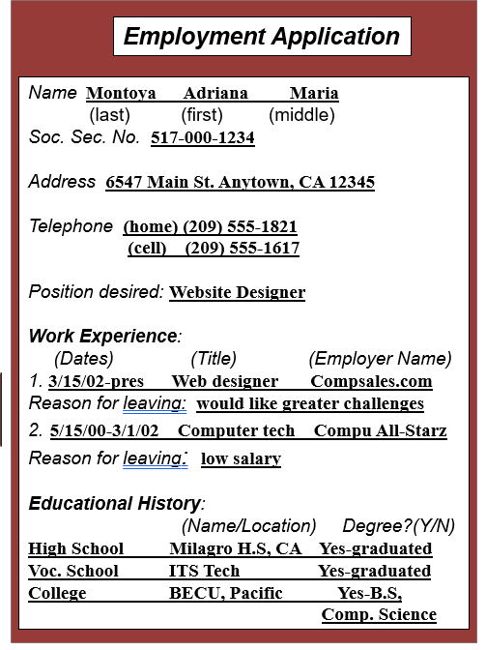
Questions 16 & 17
16. What is Adriana’s highest level
of education?
A. High School
C. Technical
School
B. Vocational
School
D. College
17. For how many years did
Adriana work as a computer tech?
Approximately
6 years
C. She has never
worked as a
computer tech
B. Approximately
2 years
For 3 years in
Vocational School
Notes:
25

Slide 26
Return to Question #17
Employment Application
Name Montoya Adriana Maria
(last) (first) (middle)
Soc. Sec. No. 517-000-1234
Address 6547 Main St. Anytown, CA 12345
Telephone (home) (209) 555-1821
(cell) (209) 555-1617
Position desired: Website Designer
Work Experience:
(Dates) (Title) (Employer Name)
1. 3/15/02-pres Web designer Compsales.com
Reason for leaving: would like greater challenges
2. 5/15/00-3/1/02 Computer tech Compu All-Starz
Reason for leaving: low salary
Educational History:
(Name/Location) Degree?(Y/N)
High School Milagro H.S, CA Yes-graduated
Voc. School ITS Tech Yes-graduated
College BECU, Pacific Yes-B.S,
Comp. Science
CORRECT!
Notes:
26

Slide 27
Go to Questions #18 and #19
Employment Application
Name Montoya Adriana Maria
(last) (first) (middle)
Soc. Sec. No. 517-000-1234
Address 6547 Main St. Anytown, CA 12345
Telephone (home) (209) 555-1821
(cell) (209) 555-1617
Position desired: Website Designer
Work Experience:
(Dates) (Title) (Employer Name)
1. 3/15/02-pres Web designer Compsales.com
Reason for leaving: would like greater challenges
2. 5/15/00-3/1/02 Computer tech Compu All-Starz
Reason for leaving: low salary
Educational History:
(Name/Location) Degree?(Y/N)
High School Milagro H.S, CA Yes-graduated
Voc. School ITS Tech Yes-graduated
College BECU, Pacific Yes-B.S,
Comp. Science
CORRECT!
Notes:
27

Slide 28
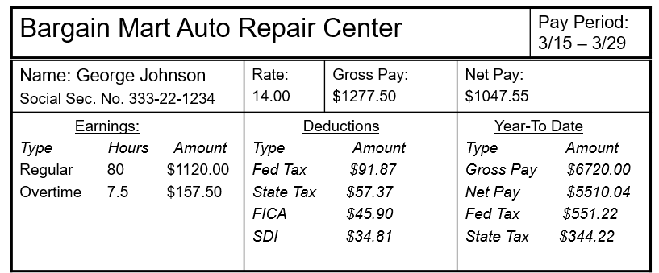
Questions 18 & 19
18. How much has been taken out for
state taxes so far this year?
19. What was George’s net pay for this pay period?
A. $57.37
A. $5510. 04
B. $344.22
B. $1277.50
C. $91.87
C. $1047.55
D. $157.50
D. $1120.00

Slide 29
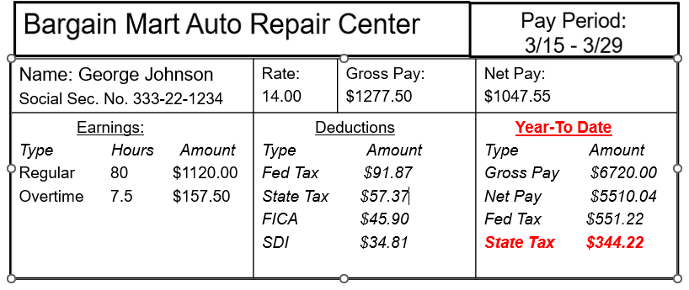
Return to Question #19
CORRECT!

Slide 30
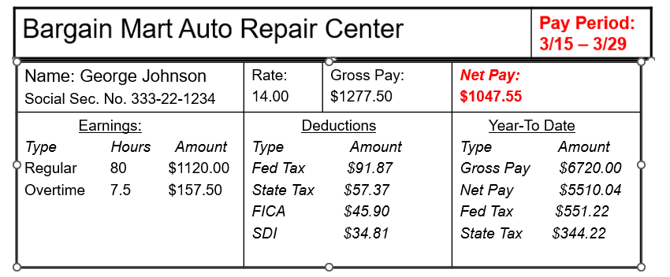
Go to Question #20
CORRECT!

Slide 31
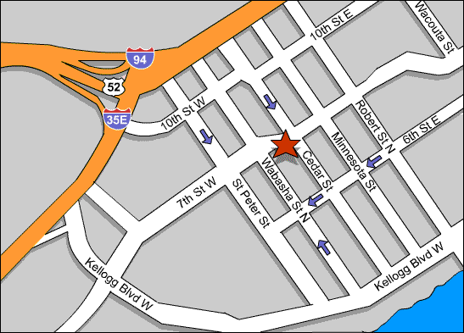
Question 20
Cedar Hospital
20. Carlos needs to get from the Apartment Complex to St. Peter’s Church. What is the best route for him to take?
He should turn right on Robert
St, then right on 10th St. E.
C. He should turn right on Robert
St, then left on 7th St. W.
B. He should take 6th St. E to Wabasha
St. N and turn left
D. He should take 6th St. E for 3
blocks and turn left

Slide 32
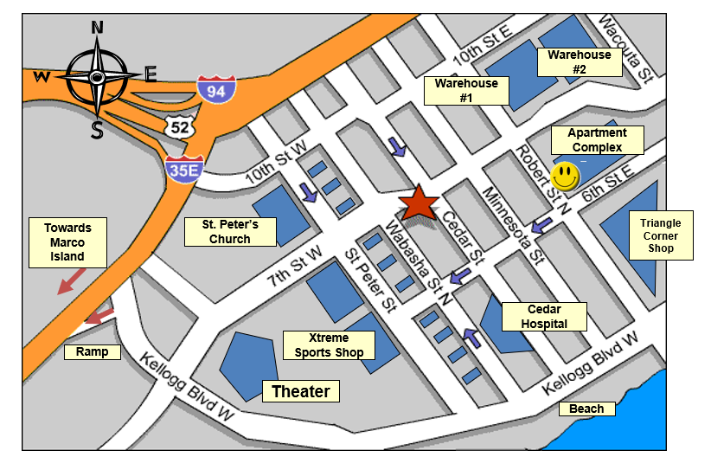
Go to next slide
CORRECT!

Slide 33


Go to Credits
Congratulations!
You have successfully completed the
Seminole State College - ELS Department’s
English Reading Practice Test!

Slide 34
CREDITS
English Language Studies Department
Project Producers
Nissa Hopkins
Marco Yepez
Web Support
Edith Morales
Anna Flores
Les Lusk

