Slide 1

Go to next slide
Reading Practice for ESOL Low Intermediate Students

Slide 2
Question 1
A New Life
Felipe Sanchez, his wife, Altagracia, and their two children moved to Texas from Venezuela three years ago. Though Felipe was a dentist in Venezuela, and Altagracia was a lawyer in Venezuela, in the United States, they are owners of a small coffee shop. They would like to work in their professions, but they need to go back to school to study more English. Their sons, Rodrigo and Martin, are in fifth and seventh grade. They are doing well in their English studies.
1. Where does Felipe work?
A. At his son’s school
B. As a dentist
C. At his coffee shop
D. In a law office

Slide 3

Go to Question # 2
A New Life
Felipe Sanchez, his wife, Altagracia, and their two children moved to Texas from Venezuela three years ago. Though Felipe was a dentist in Venezuela, and Altagracia was a lawyer in Venezuela, in the United States, they are owners of a small coffee shop. They would like to work in their professions, but they need to go back to school to study more English. Their sons, Rodrigo and Martin, are in fifth and seventh grade. They are doing well in their English studies.
CORRECT!

Slide 4
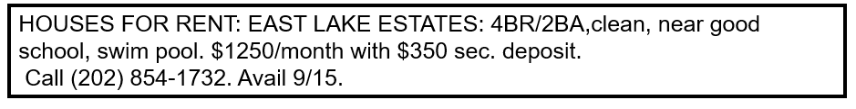
Question 2
2.
How much is the monthly rent?
A. $1250.00
B. $350.00
C. September 15th
D. $915.00

Slide 5
Go to Questions #3 and #4
HOUSES FOR RENT:
EAST LAKE ESTATES: 4BR/2BA,clean, nr good school,
swim pool. $1250/month with $350 sec. deposit.
Call (202) 854-1732. Avail 9/15.
CORRECT!

Slide 6
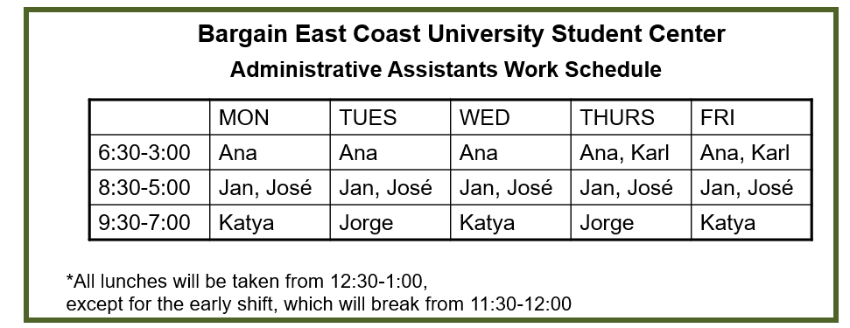
Questions 3 & 4
3. What time does Karl take his lunch?
4. José works:
12:30
C. 6:30
Full-time
C. Part-time
B. 11:30
D. 12:00
B. On Fridays
D. Two days
a week

Slide 7
Return to Question #4
Bargain East Coast University Student Center
 | MON | TUES | WED | THURS | FRI
6:30-3:00 | Ana | Ana | Ana | Ana, Karl | Ana, Karl
8:30-5:00 | Jan, José | Jan, José | Jan, José | Jan, José | Jan, José
9:30-7:00 | Katya | Jorge | Katya | Jorge | Katya
*All lunches will be taken from 12:30-1:00,
except for the early shift, which will break from 11:30-12:00
CORRECT!

Slide 8
Go to Question #5
Bargain East Coast University Student Center
Administrative Assistants Work Schedule
 | MON | TUES | WED | THURS | FRI
6:30-3:00 | Ana | Ana | Ana | Ana, Karl | Ana, Karl
8:30-5:00 | Jan, José | Jan, José | Jan, José | Jan, José | Jan, José
9:30-7:00 | Katya | Jorge | Katya | Jorge | Katya
*All lunches will be taken from 12:30-1:00,
except for the early shift, which will break from 11:30-12:00
CORRECT!

Slide 9
Question 5
Kim and Yung Park are married and have two children. They moved from Korea to the United States three years ago. They lived in San Francisco for the first year and then they moved to Orlando.
Kim works in a restaurant at night. Yung works in a daycare during the day. Yung was a teacher in her country and Kim was an accountant. They both want to get better jobs. Kim is studying English now. Yung will begin studying English next month.
5.
Who is studying English?
A. Three years ago
B. Yung
C. Orlando
D. Kim

Slide 10
Go to Question #6
Kim and Yung Park are married and have two children. They moved from Korea to the United States three years ago. They lived in San Francisco for the first year and then they moved to Orlando.
Kim works in a restaurant at night. Yung works in a daycare during the day. Yung was a teacher in her country and Kim was an accountant. They both want to get better jobs. Kim is studying English now. Yung will begin studying English next month.
CORRECT!

Slide 11
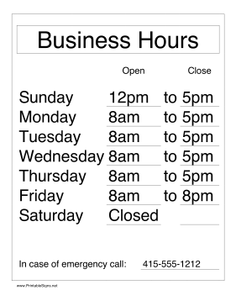
Question 6
6.
What day is the store open for five hours?
A. Saturday
B. Sunday
C. Monday
D. Friday

Slide 12
Go to Question #7
Sunday 12pm to 5pm
CORRECT!

Slide 13
Question 7
APARTMENTS FOR RENT:
CRYSTAL LAKES 2BR/2BA, $1000, ldry, wood flrs,
swim pool (212) 854-1732
OAK VIEW 2 BR/1BA, lg patio, $975 + util, no pets,
avail now (212) 847-2730
HIGH GATE 3BR/2 BA, nr schls, xlnt cond, no pets,
$1175, eves (212) 725-1844
SUN VALLEY 2BR/1 BA, $975, near mall, small porch,
avail now, (212) 854-2341
1.
2.
3.
4.
7.
Which apartments are available now?
A. Apartments 2 and 3
B. Apartments 1 and 4
C. Apartments 2 and 4
D. Apartments 1 and 3

Slide 14
Go to Questions #8 and #9
APARTMENTS FOR RENT:
CRYSTAL LAKES 2BR/2BA, $1000, ldry, wood flrs,
swim pool (212) 854-1732
OAK VIEW 2 BR/1BA, lg patio, $975 + util, no pets,
avail now (212) 847-2730
HIGH GATE 3BR/2 BA, nr schls, xlnt cond, no pets,
$1175, eves (212) 725-1844
SUN VALLEY 2BR/1 BA, $975, near mall, small porch,
avail now, (212) 854-2341
1.
2.
3.
4.
CORRECT!

Slide 15
Question 8
8. Which job is full time?
A. Bookstore
cashier
C. Student
assistant
Classifieds
Job Ads for the week of 10-1 to 10-8
B. Bank teller
D. None
BOOKSTORE CASHIER
P/T, Mon-Wed-Fri, early shift. Exc hourly pay, store discount. Call (555) 922-1877 to apply
9. How does one apply for the cashier job?
BANK TELLER
F/T, $13.50/hr to start. Benefits after 3 mo. Flex schedule, some sat. shifts. Apply in person, 1515 Main St.
A. Call:
(555) 922-1877
C. Ask for Shirley
B. Go in person
D. Call:
(555) 276-9012
STUDENT ASSISTANT
Work around classes, great sched. Light admin duties, good exper. Call (555) 276-9012, ask for Shirley.

Slide 16
Return to question # 9
Classifieds
Job Ads for the week of 10-1 to 10-8
BOOKSTORE CASHIER
P/T, Mon-Wed-Fri, early shift. Exc hourly pay, store discount. Call (555) 922-1877 to apply
CORRECT!
BANK TELLER
F/T, $13.50/hr to start. Benefits after 3 mo. Flex schedule, some sat. shifts. Apply in person, 1515 Main St.
STUDENT ASSISTANT
Work around classes, great sched. Light admin duties, good exper. Call (555) 276-9012, ask for Shirley.

Slide 17
Question 9
8. Which job is full time?
A. Bookstore
cashier
C. Student
assistant
Classifieds
Job Ads for the week of 10-1 to 10-8
B. Bank teller
D. None
BOOKSTORE CASHIER
P/T, Mon-Wed-Fri, early shift. Exc hourly pay, store discount. Call (555) 922-1877 to apply
9. How does one apply for the cashier job?
BANK TELLER
F/T, $13.50/hr to start. Benefits after 3 mo. Flex schedule, some sat. shifts. Apply in person, 1515 Main St.
A. Call:
(555) 922-1877
C. Ask for Shirley
B. Go in person
D. Call:
(555) 276-9012
STUDENT ASSISTANT
Work around classes, great sched. Light admin duties, good exper. Call (555) 276-9012, ask for Shirley.

Slide 18
Go to Questions # 10 and #11
Classifieds
Job Ads for the week of 10-1 to 10-8
BOOKSTORE CASHIER
P/T, Mon-Wed-Fri, early shift. Exc hourly pay, store discount. Call (555) 922-1877 to apply
CORRECT!
BANK TELLER
F/T, $13.50/hr to start. Benefits after 3 mo. Flex schedule, some sat. shifts. Apply in person, 1515 Main St.
STUDENT ASSISTANT
Work around classes, great sched. Light admin duties, good exper. Call (555) 276-9012, ask for Shirley.

Slide 19
Question 10
Employment Application
Name: Ezelle Geneviève Renee______________
(last) (first) (middle)
Soc. Sec. No.: 512-000-4321
Address: 2538 5th St. Apt. #432. Anytown, FL 54321
Telephone: (home) (212) 555-1628_______________
(cell) (212) 555-1922________________
Position desired: Restaurant manager___________
Work Experience:
(Dates) (Title) (Employer Name)
1. 5/15/04-2008 Café manager Lulu’s café ____
Reason for leaving: the restaurant closed_________
2. 5/15/00-3/1/02 Waitress Carl’s Steak House
Reason for leaving: needed more hours__________
Educational History:
(Name/Location) Degree?(Y/N)
High School Milagro H.S, CA Yes-graduated
Voc. School Yum Chef School Yes-graduated
College BECU, Pacific No , studying_
Hospitality_
10. For which job is Geneviève applying?
Chef
C. Waitress
B. Restaurant
manager
D. Café manager
11. What year did Geneviève start
her first job?
A. 2004
C. 2000
B. 2008
D. 2003

Slide 20
Return to Question #11
Employment Application
Name: Ezelle Geneviève Renee______________
(last) (first) (middle)
Soc. Sec. No.: 512-000-4321
Address: 2538 5th St. Apt. #432. Anytown, FL 54321
Telephone: (home) (212) 555-1628_______________
(cell) (212) 555-1922________________
Position desired: Restaurant manager___________
Work Experience:
(Dates) (Title) (Employer Name)
1. 5/15/04-2008 Café manager Lulu’s café ____
Reason for leaving: the restaurant closed_________
2. 5/15/00-3/1/02 Waitress Carl’s Steak House
Reason for leaving: needed more hours__________
Educational History:
(Name/Location) Degree?(Y/N)
High School Milagro H.S, CA Yes-graduated
Voc. School Yum Chef School Yes-graduated
College BECU, Pacific No , studying_
Hospitality_
CORRECT!

Slide 21
Question 11
Employment Application
Name: Ezelle Geneviève Renee______________
(last) (first) (middle)
Soc. Sec. No.: 512-000-4321
Address: 2538 5th St. Apt. #432. Anytown, FL 54321
Telephone: (home) (212) 555-1628_______________
(cell) (212) 555-1922________________
Position desired: Restaurant manager___________
Work Experience:
(Dates) (Title) (Employer Name)
1. 5/15/04-2008 Café manager Lulu’s café ____
Reason for leaving: the restaurant closed_________
2. 5/15/00-3/1/02 Waitress Carl’s Steak House
Reason for leaving: needed more hours__________
Educational History:
(Name/Location) Degree?(Y/N)
High School Milagro H.S, CA Yes-graduated
Voc. School Yum Chef School Yes-graduated
College BECU, Pacific No , studying_
Hospitality_
10. What job is Genevieve applying for?
Chef
C. Waitress
B. Restaurant
Manager
D. Café Manager
11. What year did Genevieve start
her first job?
2004
C. 2000
B. 2008
D. 2003

Slide 22
Go to Questions #12 and #13
Employment Application
Name: Ezelle Geneviève Renee______________
(last) (first) (middle)
Soc. Sec. No.: 512-000-4321
Address: 2538 5th St. Apt. #432. Anytown, FL 54321
Telephone: (home) (212) 555-1628_______________
(cell) (212) 555-1922________________
Position desired: Restaurant manager___________
Work Experience:
(Dates) (Title) (Employer Name)
1. 5/15/04-2008 Café manager Lulu’s café ____
Reason for leaving: the restaurant closed_________
2. 5/15/00-3/1/02 Waitress Carl’s Steak House
Reason for leaving: needed more hours__________
Educational History:
(Name/Location) Degree?(Y/N)
High School Milagro H.S, CA Yes-graduated
Voc. School Yum Chef School Yes-graduated
College BECU, Pacific No , studying_
Hospitality_
CORRECT!

Slide 23
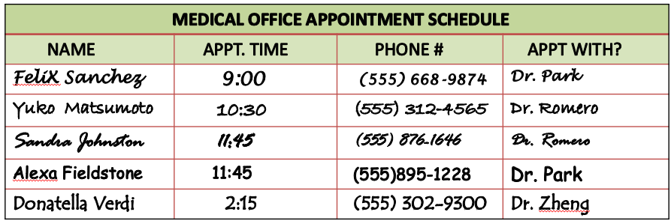
Questions 12 & 13
12. Who has an appointment at
11:45 with Dr. Park?
13. How many people have an
appointment with Dr. Zheng?
Felix
C. Alexa
one
C. two
B. Sandra
D. Yuko
B. three
D. none

Slide 24
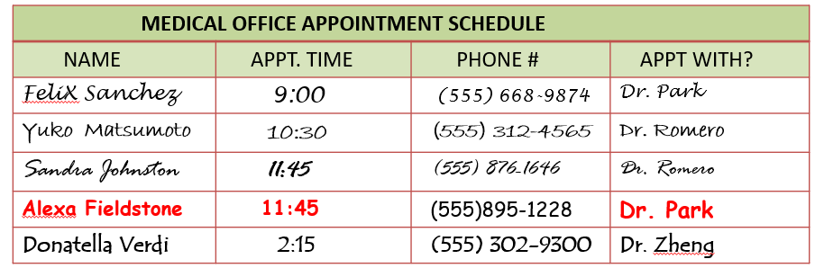
Return to Question #13
CORRECT!

Slide 25
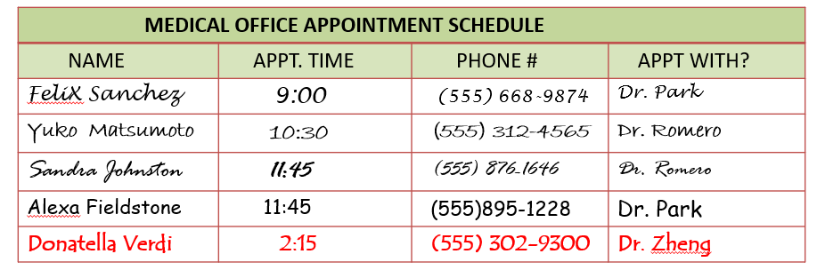
Go to Questions #14 and #15
CORRECT!

Slide 26
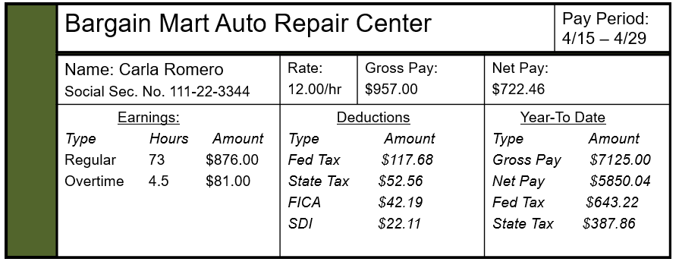
Questions 14 & 15
14. What was Carla’s overtime pay?
15. What is Carla’s salary?
$12.00
C. 4.5
$957.00
C. $12.00
an hour
B. $876.00
D. $81.00
B. 73 hours
a week
D. $5850.04

Slide 27
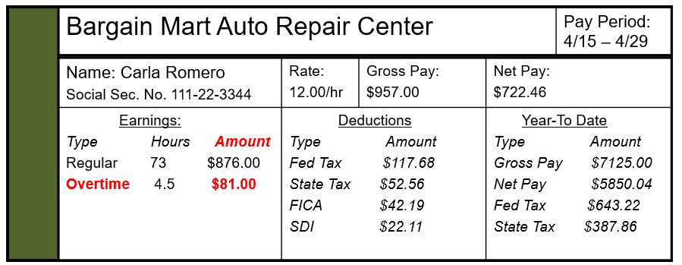
Return to Question #15
CORRECT!

Slide 28
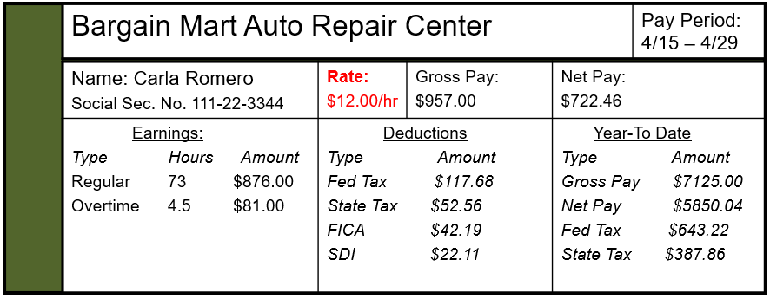
Go to Question #16
CORRECT!

Slide 29
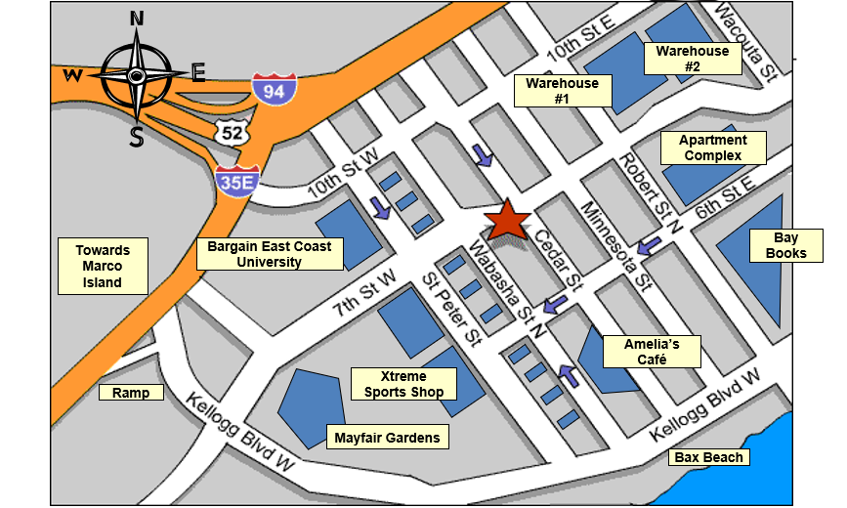
Question 16
16. Francesca needs to get from Cedar Street to Bax Beach. How should she go?
A. Go straight down Cedar St and cross Kellogg Blvd.
C. Turn right on 7th St. W and left
on Minnesota St.
B. Turn left of 7th St W and cross
Kellogg Blvd.
D. Go up Cedar St. and cross
10th St. W

Slide 30
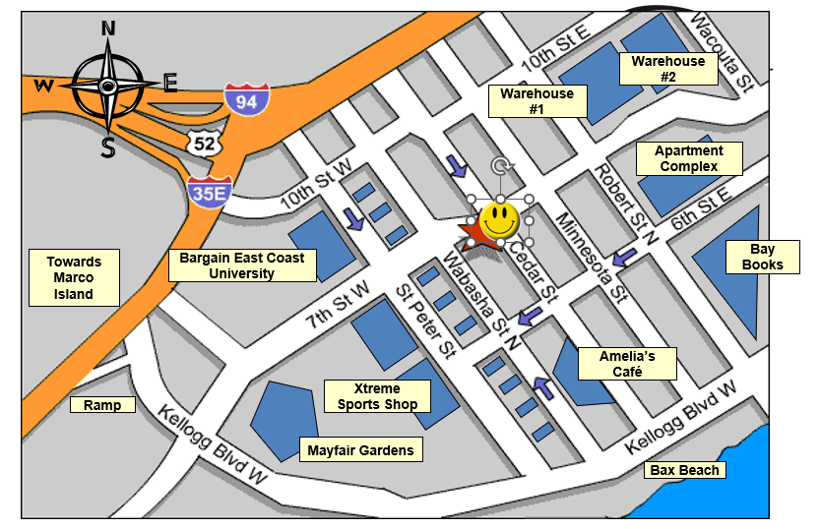
Go to Questions # 17 and #18
CORRECT!

Slide 31
Question 17
RENTAL APPLICATION
1) Applicant’s Name: _________________________________________________
(last) (first) (middle)
2) Present Address _______________________________________________
3) City __________________ State ____ __ Zip Code _______________
4) Telephone(s) ______________________________________________________
5) Present Landlord _____________________________ How long? _______
6) Marital Status:
Single
Married
Divorced
7) Husband’s place of employment __________________________________
8) Wife’s place of employment _____________________________________
9) How many children living at home? ________
10) Ages of children: _____________________________________________
11) Any pets?
Yes What kind? _________________________________
No
12) Car owner?
Yes Kind of car(s) ________________________________
No
13) Desired move-in date _____________________
Month Day
17. On which line do you write
where you live now?
A. Line 8
B. Line 2
C. Line 13
D. Line 7

Slide 32

Go to Question # 18
RENTAL APPLICATION
1) Applicant’s Name: _________________________________________________
(last) (first) (middle)
2) Present Address ______________________________________________
3) City __________________ State ____ __ Zip Code _______________
4) Telephone(s) ______________________________________________________
5) Present Landlord _____________________________ How long? _______
6) Marital Status:
Single
Married
Divorced
7) Husband’s place of employment __________________________________
8) Wife’s place of employment _____________________________________
9) How many children living at home? ________
10) Ages of children: _____________________________________________
11) Any pets?
Yes What kind? _________________________________
No
12) Car owner?
Yes Kind of car(s) ________________________________
No
13) Desired move-in date _____________________
Month Day
CORRECT!

Slide 33
Question 18
RENTAL APPLICATION
1) Applicant’s Name: _________________________________________________
(last) (first) (middle)
2) Present Address _______________________________________________
3) City __________________ State ____ __ Zip Code _______________
4) Telephone(s) ______________________________________________________
5) Present Landlord _____________________________ How long? _______
6) Marital Status:
Single
Married
Divorced
7) Husband’s place of employment __________________________________
8) Wife’s place of employment _____________________________________
9) How many children living at home? ________
10) Ages of children: _____________________________________________
11) Any pets?
Yes What kind? _________________________________
No
12) Car owner?
Yes Kind of car(s) ________________________________
No
13) Desired move-in date _____________________
Month Day
18. What should you write
on line 5 ?
A. Where you
work now
B. Your spouse’s
name
C. The name of the
owner of
where you live now
D. Your address

Slide 34
Go to Questions
#19 and #20
RENTAL APPLICATION
1) Applicant’s Name: _________________________________________________
(last) (first) (middle)
2) Present Address _______________________________________________
3) City __________________ State ____ __ Zip Code _______________
4) Telephone(s) ______________________________________________________
5) Present Landlord _____________________________ How long? ______
6) Marital Status:
Single
Married
Divorced
7) Husband’s place of employment __________________________________
8) Wife’s place of employment _____________________________________
9) How many children living at home? ________
10) Ages of children: _____________________________________________
11) Any pets?
Yes What kind? _________________________________
No
12) Car owner?
Yes Kind of car(s) ________________________________
No
13) Desired move-in date _____________________
Month Day
CORRECT!

Slide 35
Questions 19 & 20
Medical History
Please answer these questions about yourself before seeing the doctor:
Have you ever been hospitalized, had major operations, or had a serious illness? If yes, explain:
Have you had any allergic reactions to drugs? If yes, please list:
Are you under any medical treatment now?
Has there been a change in your health in the past year?
Is there a history of heart problems in your family?
Are you pregnant?
Are you now taking drugs or medications?
If so, please list:
8. What is the reason for your visit today?
Where should you write
why you are at the doctor’s?
20. This form is about:
A. Line 8
C. Line 3
A. Choosing
a doctor
C. Your health
background
B. Line 1
D. Line 7
B. Your doctor’s
history
D. Your health
insurance

Slide 36
Return to Question #20
Medical History
Please answer these questions about yourself before seeing the doctor:
Have you ever been hospitalized, had major operations, or had a serious illness?
If yes, explain:
Have you had any allergic reactions to drugs?
If yes, please list:
Are you under any medical treatment now?
Has there been a change in your health in the past year?
Is there a history of heart problems in your family?
Are you pregnant?
Are you now taking drugs or medications?
If so, please list:
8. What is the reason for your visit today?
CORRECT!

Slide 37
Next slide
Medical History
Please answer these questions about yourself before seeing the doctor:
Have you ever been hospitalized, had major operations, or had a serious illness?
If yes, explain:
Have you had any allergic reactions to drugs?
If yes, please list:
Are you under any medical treatment now?
Has there been a change in your health in the past year?
Is there a history of heart problems in your family?
Are you pregnant?
Are you now taking drugs or medications?
If so, please list:
8. What is the reason for your visit today?
CORRECT!

Slide 38

Go to Credits
Congratulations!
You have successfully completed the
Seminole State College - ELS Department’s
English Reading Practice Test!

Slide 39
CREDITS
English Language Studies Department
Project Producers
Nissa Hopkins
Mirtha Martinez
Web Support
Edith Morales
Les Lusk

