Slide 1

Introduction Slide
Reading Practice for ESOL
Foundations, Low and
High Beginning Students
Click here to start the practice.

Slide 2
Question 1
1.
A. desk
B. bathtub
C. sofa
D. floor

Slide 3

Go to Question # 2
CORRECT!

Slide 4
Question 2
4:00
A. four cents
2.
B. forty
C. four hundred
D. four o’clock

Slide 5
Go to Question # 3
CORRECT!

Slide 6
Question 3
3.
A. cup
B. plate
C. bowl
D. fork

Slide 7
Go to Question # 4
CORRECT!

Slide 8
Question 4
May 19, 1985
4.
A. address
B. first name
C. date of birth
D. telephone number

Slide 9
Go to Question # 5
CORRECT!

Slide 10
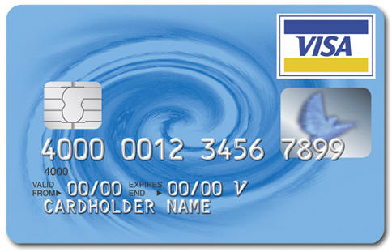
Question 5
5.
What is this?
A. a quarter
B. a dollar
C. a check
D. a credit card

Slide 11
Go to Question # 6
CORRECT!

Slide 12
Question 6
RESTAURANT
6.
What can you do here?
A. buy food
B. get clothes
C. wash your car
D. get books

Slide 13
Go to Question # 7
CORRECT!

Slide 14
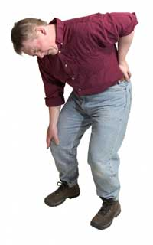
Question 7
7.
What’s the problem?
A. He has a fever.
B. His arm hurts.
C. He has a cold.
D. He hurt his back.

Slide 15
Go to Question # 8
CORRECT!

Slide 16
Question 8
8.
What are they doing?
A. cleaning
B. cooking
C. counting
D. coughing

Slide 17
Go to Question # 9
CORRECT!

Slide 18
Question 9
9.
What is she doing?
A. She’s singing.
B. She’s sleeping.
C. She’s sneezing.
D. She’s studying.

Slide 19
Go to Question # 10
CORRECT!

Slide 20
Question 10
DAILY SPECIALS:
Chicken salad: $4.99
Tuna sandwich: 5.49
Chocolate cake: $2.99
Fresh lemonade: $1.69
10.
What dessert is on the menu?
A. Tuna sandwich
B. Chocolate cake
C. Fresh lemonade
D. Chicken salad

Slide 21
Go to Question # 11
CORRECT!

Slide 22
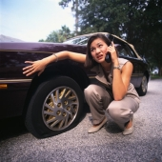
Question 11
11.
What’s wrong?
A. The tire is flat.
B. The engine is flat.
C. The door is flat.
D. The seat is flat.

Slide 23
Go to Question # 12
CORRECT!

Slide 24
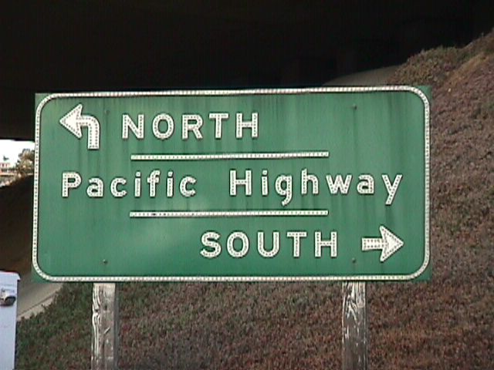
Question 12
12.
Which way is south?
A. Up
B. Down
C. To the right
D. To the left

Slide 25
Go to Question # 13
CORRECT!

Slide 26
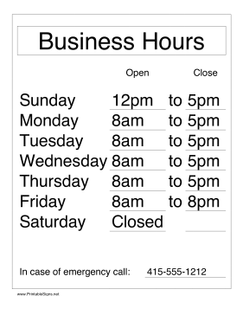
Question 13
13.
What day is the store closed?
A. Monday
B. Saturday
C. Friday
D. Tuesday

Slide 27
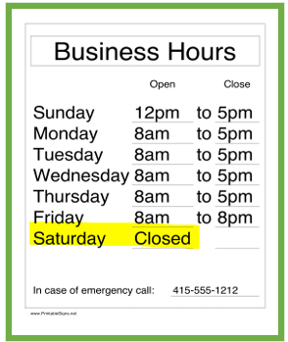
Go to Question # 14
CORRECT!

Slide 28
Question 14
SCHOOL SECRETARY NEEDED
Answering phones, some computer work.
Mon-Fri, 9-5. Apply at the English Department.
14.
What kind of job is this?
A. Secretary
B. School director
C. Teacher
D. English

Slide 29
SCHOOL SECRETARY NEEDED
Answering phones, some computer work.
Mon-Fri, 9-5. Apply at the English Department.
CORRECT!
Go to Question # 15

Slide 30
Question 15
BAYSIDE ESTATES: 3BR/2BA,clean, near good school,
swim pool. $750/month with $300 sec. deposit.
Call (555) 234-1982. Avail 10/15.
15.
When is the apartment available?
A. 3BR/2BA
B. $750
C. October 15
D. $300

Slide 31
Go to Question # 16
BAYSIDE ESTATES: 3BR/2BA,clean, near good school,
swim pool. $750/month with $300 sec. deposit.
Call (555) 234-1982. Avail 10/15.
CORRECT!

Slide 32
Question 16
APPOINTMENT SCHEDULE
NAME APPT. TIME PHONE #
Felipe Montoya 9:30 (555) 234-5678
Keiko Yamamoto 10:15 (555) 221-1659
Krystal Johnson 11:00 (555) 334-2229
Hyun-Ki Park 12:00 (555) 222-1298
Eva St. Claire 1:30 (555) 201-5553
16.
Who has the last appointment?
A. Felipe
B. Eva
C. Hyun-Ki
D. Keiko

Slide 33
Go to Question # 17
APPOINTMENT SCHEDULE
NAME APPT. TIME PHONE #
Felipe Montoya 9:30 (555) 234-5678
Keiko Yamamoto 10:15 (555) 221-1659
Krystal Johnson 11:00 (555) 334-2229
Hyun-Ki Park 12:00 (555) 222-1298
Eva St. Claire 1:30 (555) 201-5553
CORRECT!

Slide 34
Question 17
APPOINTMENT SCHEDULE
NAME | APPT. TIME | PHONE #
Felipe Montoya | 9:30 | (555) 234-5678
Keiko Yamamoto | 10:15 | (555) 221-1659
Krystal Johnson | 11:00 | (555) 334-2229
Hyun-Ki Park | 12:00 | (555) 222-1298
Eva St. Claire | 1:30 | (555) 201-5553
17.
What is Felipe’s phone number?
A. 9:30
B. 11:00
C. (555) 201-5553
D. (555) 234-5678

Slide 35
Go to Question # 18
APPOINTMENT SCHEDULE
NAME | APPT. TIME | PHONE #
Felipe Montoya | 9:30 | (555) 234-5678
Keiko Yamamoto | 10:15 | (555) 221-1659
Krystal Johnson | 11:00 | (555) 334-2229
Hyun-Ki Park | 12:00 | (555) 222-1298
Eva St. Claire | 1:30 | (555) 201-5553
CORRECT!

Slide 36
Question 18
Jacob’s Café: WORK SCHEDULE – JULY 7-14
Leona Jackson Mon-Wed-Fri 9:30-5:30
Francisco Gonzalez Sat-Sun 12:00-8:30
Abdul al-Rashid Tues-Sun 10:30-6:30
Jennifer Lee Thurs-Fri-Sat 4:00-9:00
18.
Who works on Sundays?
A. Abdul and Francisco
B. Francisco and Leona
C. Jacob and Abdul
D. Jennifer and Abdul

Slide 37
Go to Question # 19
Jacob’s Café: WORK SCHEDULE – JULY 7-14
Leona Jackson Mon-Wed-Fri 9:30-5:30
Francisco Gonzalez Sat-Sun 12:00-8:30
Abdul al-Rashid Tues-Sun 10:30-6:30
Jennifer Lee Thurs-Fri-Sat 4:00-9:00
CORRECT!

Slide 38
Question 19
Jacob’s Café: WORK SCHEDULE – JULY 7-14
Leona Jackson Mon-Wed-Fri 9:30-5:30
Francisco Gonzalez Sat-Sun 12:00-8:30
Abdul al-Rashid Tues-Sun 10:30-6:30
Jennifer Lee Thurs-Fri-Sat 4:00-9:00
19.
What’s the name of the café?
A. Jennifer’s
B. Abdul’s
C. Jacob’s
D. Jackson’s

Slide 39
Go to Question # 20
Jacob’s Café: WORK SCHEDULE – JULY 7-14
Leona Jackson Mon-Wed-Fri 9:30-5:30
Francisco Gonzalez Sat-Sun 12:00-8:30
Abdul al-Rashid Tues-Sun 10:30-6:30
Jennifer Lee Thurs-Fri-Sat 4:00-9:00
CORRECT!

Slide 40

Question 20
20.
What does this mean?
A. No smoking
B. No parking
C. No school
D. No driving

Slide 41
Go to next slide
CORRECT!

Slide 42

Go to Credits
Congratulations!
You have successfully completed the
Seminole State College - ELS Department’s
English Reading Practice Test!

Slide 43
CREDITS
Seminole State College
English Language Studies Department
Project Producer
Nissa Hopkins
Web Support
Edith Morales
Anna Flores
Les Lusk

