Slide 1



Slide 1
P E T&T PROJECTS
English Language Studies Department www.seminolestate.edu/adult-ed/els/

Slide 2

Slide 2
Reading Comprehension Skills Practice
There are many different skills which can aid your reading comprehension and help you to more accurately interpret a reading passage. Some of the skills include:
-Inferences (drawing logical conclusions)
-Scanning and Key Word Recognition
-Part of Speech and Context Clues
-Time Management (specifically used in timed tests)
English Language Studies Department www.seminolestate.edu/adult-ed/els/

Slide 3
Slide 3
Reading Comprehension Skills Practice
In this tutorial, you will learn about:
and apply your new skills by answering practice questions.
Time Management
Ready to begin?
Let’s start!!
English Language Studies Department www.seminolestate.edu/adult-ed/els/

Slide 4

Slide 4
Time Management (in timed tests)
To be successful in any timed test, one must learn to use time effectively.
English Language Studies Department www.seminolestate.edu/adult-ed/els/

Slide 5

Slide 5
Time Management (in timed tests)
Time: A system of measurement of sequential events that have a relation with the past, present and future.
English Language Studies Department www.seminolestate.edu/adult-ed/els/

Slide 6

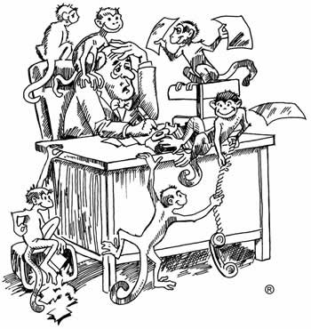
Slide 6
Time Management (in timed tests)
Management: the act of controlling or handling any affair or matter successfully.
English Language Studies Department www.seminolestate.edu/adult-ed/els/
Notes:
6

Slide 7

Slide 7
Time Management
Therefore, time management refers to practices that individuals follow to make better use of their time.
English Language Studies Department www.seminolestate.edu/adult-ed/els/

Slide 8
Slide 8
Time Management (in timed tests)
Tips for managing your time during tests:
Collect and Organize
Process and Prioritize
Do and Review
Collect and Organize:
Prepare for the test to the best of your ability so that you may feel confident that you collected all the information you need.
English Language Studies Department www.seminolestate.edu/adult-ed/els/
Notes:
8

Slide 9
Slide 9
Time Management (in timed tests)
Tips for managing your time during tests:
Collect and Organize
Process and Prioritize
Do and Review
2. Process and Prioritize:
First, answer the questions that you are reasonably sure about.
Do not waste time by staying stuck on a question. Go back and answer the questions you are uncertain about after you have completed the rest of the test.
English Language Studies Department www.seminolestate.edu/adult-ed/els/
Notes:
9

Slide 10
Slide 10
Time Management (in timed tests)
Tips for managing your time during tests:
Collect and Organize
Process and Prioritize
Do and Review
3. Do and Review:
Once you have finished the test, try to review your answers carefully. Remember that your first answer is usually your best guess!
English Language Studies Department www.seminolestate.edu/adult-ed/els/
Notes:
10

Slide 11
Slide 11
Time Management (in timed tests)
Also, remember:
1. Read the directions carefully. This can eliminate time-wasting confusion.
2. Try to control you stress level so as to not let the pressure take over.
3. Watch out for interruptions and distractions that could cost you time.
4. It is also very important to answer every
question! A blank answer is always wrong, but
a guessed answer has a chance of being
correct.
English Language Studies Department www.seminolestate.edu/adult-ed/els/
Notes:
11

Slide 12
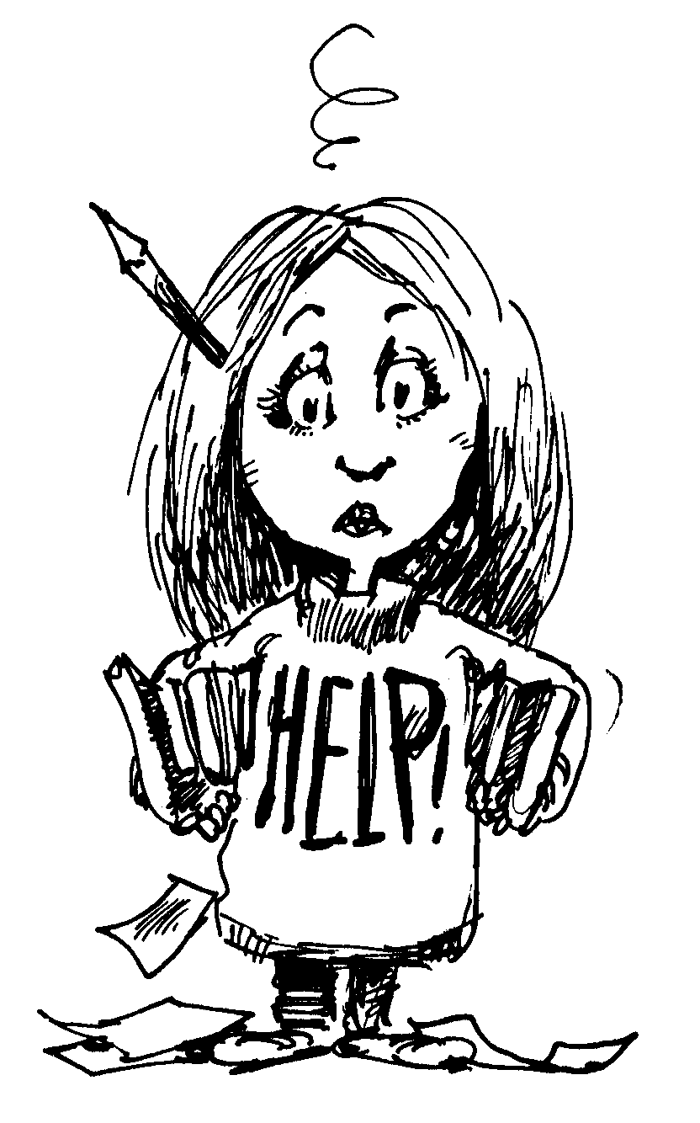
Slide 12
-Time Management (in timed tests)
Example situation:
You have 50 minutes to take the test.
The test has 60 multiple choice questions.
That means you can not expend more than a minute per question.
Remember to trust your preparation, answer the questions you know first and the uncertain ones after, and try to go over your work carefully if time allows.
English Language Studies Department www.seminolestate.edu/adult-ed/els/

Slide 13


Slide 13
Please practice your new skills by answering the following questions.
English Language Studies Department www.seminolestate.edu/adult-ed/els/

Slide 14

Slide 14
Time Management (in timed tests)
The following practice questions are timed, in order for you to apply your new Time Management skills!
You have two and a half minutes (2:30) to read the paragraph, and answer the questions.
If you run out of time, you can go back and try again.
English Language Studies Department www.seminolestate.edu/adult-ed/els/

Slide 15
Slide 15
Hurricanes
One of the most extreme and dangerous weather phenomenons which occurs in America is hurricanes. Hurricanes are prevalent in the Southeastern area of the United States and can also affect the whole eastern seaboard, from Florida up to the New England states, such as New Hampshire and Maine, which border the ocean. Hurricanes are especially destructive and can cause millions of dollars worth of damage to life and property. Hurricanes, which usually develop between July and October, are similar to cyclones and originally start over the waters in the Caribbean Sea. Though they sometimes pass over land without touching down, if they do make contact with the land, they carry tremendous power with heavy rain and strong winds. They are in fact categorized mainly by wind speed; there are five categories in total. A Category One storm is the weakest, with winds ranging from 74-95 miles per hour, and the wind speed increases as the categories progress. For example, in a Category Five storm—the strongest and most dangerous--has winds in excess of 155 miles per hour. Truly, hurricanes are a weather force to be respected.
1. Where do hurricanes generally start?
2. Hurricanes are categorized by:
A. Along the Eastern seaboard of the U.S.
A. Their size
B. Over the Caribbean Sea
B. The amount of rain they produce
C. In New Hampshire
C. Their wind speed
D. Only in Florida
D. Where they make contact with the land
English Language Studies Department www.seminolestate.edu/adult-ed/els/

Slide 16
Slide 16
Hurricanes
One of the most extreme and dangerous weather phenomenons which occurs in America is hurricanes. Hurricanes are prevalent in the Southeastern area of the United States and can also affect the whole eastern seaboard, from Florida up to the New England states, such as New Hampshire and Maine, which border the ocean. Hurricanes are especially destructive and can cause millions of dollars worth of damage to life and property. Hurricanes, which usually develop between July and October, are similar to cyclones and originally start over the waters in the Caribbean Sea. Though they sometimes pass over land without touching down, if they do make contact with the land, they carry tremendous power with heavy rain and strong winds. They are in fact categorized mainly by wind speed; there are five categories in total. A Category One storm is the weakest, with winds ranging from 74-95 miles per hour, and the wind speed increases as the categories progress. For example, in a Category Five storm—the strongest and most dangerous--has winds in excess of 155 miles per hour. Truly, hurricanes are a weather force to be respected.
1. Where do hurricanes generally start?
2. Hurricanes are categorized by:
A. Along the Eastern seaboard of the U.S.
A. Their size
B. Over the Caribbean Sea
B. The amount of rain they produce
C. In New Hampshire
C. Their wind speed
D. Only in Florida
D. Where they make contact with the land
English Language Studies Department www.seminolestate.edu/adult-ed/els/

Slide 17

Slide 17
CORRECT!
Return to Question #2
English Language Studies Department www.seminolestate.edu/adult-ed/els/
Notes:
5.B 1st sentece
6. C I’m suppoused all the way to the end

Slide 18
Slide 18
Hurricanes
One of the most extreme and dangerous weather phenomenons which occurs in America is hurricanes. Hurricanes are prevalent in the Southeastern area of the United States and can also affect the whole eastern seaboard, from Florida up to the New England states, such as New Hampshire and Maine, which border the ocean. Hurricanes are especially destructive and can cause millions of dollars worth of damage to life and property. Hurricanes, which usually develop between July and October, are similar to cyclones and originally start over the waters in the Caribbean Sea. Though they sometimes pass over land without touching down, if they do make contact with the land, they carry tremendous power with heavy rain and strong winds. They are in fact categorized mainly by wind speed; there are five categories in total. A Category One storm is the weakest, with winds ranging from 74-95 miles per hour, and the wind speed increases as the categories progress. For example, in a Category Five storm—the strongest and most dangerous--has winds in excess of 155 miles per hour. Truly, hurricanes are a weather force to be respected.
1. Where do hurricanes generally start?
2. Hurricanes are categorized by:
A. Along the Eastern seaboard of the U.S.
A. Their size
B. Over the Caribbean Sea
B. The amount of rain they produce
C. In New Hampshire
C. Their wind speed
D. Only in Florida
D. Where they make contact with the land
English Language Studies Department www.seminolestate.edu/adult-ed/els/

Slide 19
Slide 19
Hurricanes
One of the most extreme and dangerous weather phenomenons which occurs in America is hurricanes. Hurricanes are prevalent in the Southeastern area of the United States and can also affect the whole eastern seaboard, from Florida up to the New England states, such as New Hampshire and Maine, which border the ocean. Hurricanes are especially destructive and can cause millions of dollars worth of damage to life and property. Hurricanes, which usually develop between July and October, are similar to cyclones and originally start over the waters in the Caribbean Sea. Though they sometimes pass over land without touching down, if they do make contact with the land, they carry tremendous power with heavy rain and strong winds. They are in fact categorized mainly by wind speed; there are five categories in total. A Category One storm is the weakest, with winds ranging from 74-95 miles per hour, and the wind speed increases as the categories progress. For example, in a Category Five storm—the strongest and most dangerous--has winds in excess of 155 miles per hour. Truly, hurricanes are a weather force to be respected.
1. Where do hurricanes generally start?
2. Hurricanes are categorized by:
A. Along the Eastern seaboard of the U.S.
A. Their size
B. Over the Caribbean Sea
B. The amount of rain they produce
C. In New Hampshire
C. Their wind speed
D. Only in Florida
D. Where they make contact with the land
English Language Studies Department www.seminolestate.edu/adult-ed/els/

Slide 20
Slide 20
CORRECT!
Go to Questions #3 & #4
English Language Studies Department www.seminolestate.edu/adult-ed/els/
Notes:
5.B 1st sentece
6. C I’m suppoused all the way to the end

Slide 21
Slide 21
Babies!
One of the greatest joys and biggest milestones in one’s life is the birth of a child; this is true in every culture. As America is culturally extremely diverse, the celebrations following the birth of a child may differ greatly from one home to another. In recent years it has become acceptable , in fact, in many cases standard, in America for the father to be present at the birth of his child. Many feel that having both the mother and father present during the delivery brings the parents closer together and provides for a special memory. As for the mother, it has become popular recently to avoid any type of anesthesia and try to give birth naturally. However, this again varies from person to person, culture to culture. Many women do elect to accept pain medication to make the birthing process smoother. Although most births occur in hospitals, some women choose to give birth at home with the help of a mid-wife or nurse. Some women even receive support from a doula, or a woman who is knowledgeable about the birthing and labor process who is there to make the mother comfortable and support her during the birthing process. Certainly, there are many approaches one can take when bringing a child into the world, but all make us appreciate the miracle of life.
3. Why are more fathers present during
the birth or their child?
4. Some women choose to give
up pain medication because:
A. To support the mother and
create a special memory
A. That is the custom for everyone
in the U.S.
B. To take pain medication
B. The reading does not say
C. To become a doula
C. They don’t like the medications
at the hospital
D. Because they don’t trust the doctors
D. They want to give birth naturally
English Language Studies Department www.seminolestate.edu/adult-ed/els/

Slide 22
Slide 22
Babies!
One of the greatest joys and biggest milestones in one’s life is the birth of a child; this is true in every culture. As America is culturally extremely diverse, the celebrations following the birth of a child may differ greatly from one home to another. In recent years it has become acceptable , in fact, in many cases standard, in America for the father to be present at the birth of his child. Many feel that having both the mother and father present during the delivery brings the parents closer together and provides for a special memory. As for the mother, it has become popular recently to avoid any type of anesthesia and try to give birth naturally. However, this again varies from person to person, culture to culture. Many women do elect to accept pain medication to make the birthing process smoother. Although most births occur in hospitals, some women choose to give birth at home with the help of a mid-wife or nurse. Some women even receive support from a doula, or a woman who is knowledgeable about the birthing and labor process who is there to make the mother comfortable and support her during the birthing process. Certainly, there are many approaches one can take when bringing a child into the world, but all make us appreciate the miracle of life.
3. Why are more fathers present during
the birth or their child?
4. Some women choose to give
up pain medication because:
A. To support the mother and
create a special memory
A. That is the custom for everyone
in the U.S.
B. To take pain medication
B. The reading does not say
C. To become a doula
C. They don’t like the medications
at the hospital
D. Because they don’t trust the doctors
D. They want to give birth naturally
English Language Studies Department www.seminolestate.edu/adult-ed/els/

Slide 23
Slide 23
CORRECT!
Return to Question #4
English Language Studies Department www.seminolestate.edu/adult-ed/els/
Notes:
5.B 1st sentece
6. C I’m suppoused all the way to the end

Slide 24
Slide 24
Babies!
One of the greatest joys and biggest milestones in one’s life is the birth of a child; this is true in every culture. As America is culturally extremely diverse, the celebrations following the birth of a child may differ greatly from one home to another. In recent years it has become acceptable , in fact, in many cases standard, in America for the father to be present at the birth of his child. Many feel that having both the mother and father present during the delivery brings the parents closer together and provides for a special memory. As for the mother, it has become popular recently to avoid any type of anesthesia and try to give birth naturally. However, this again varies from person to person, culture to culture. Many women do elect to accept pain medication to make the birthing process smoother. Although most births occur in hospitals, some women choose to give birth at home with the help of a mid-wife or nurse. Some women even receive support from a doula, or a woman who is knowledgeable about the birthing and labor process who is there to make the mother comfortable and support her during the birthing process. Certainly, there are many approaches one can take when bringing a child into the world, but all make us appreciate the miracle of life.
3. Why are more fathers present during
the birth or their child?
4. Some women choose to give
up pain medication because:
A. To support the mother and
create a special memory
A. That is the custom for everyone
in the U.S.
B. To take pain medication
B. The reading does not say
C. To become a doula
C. They don’t like the medications
at the hospital
D. Because they don’t trust the doctors
D. They want to give birth naturally
English Language Studies Department www.seminolestate.edu/adult-ed/els/

Slide 25
Slide 25
Babies!
One of the greatest joys and biggest milestones in one’s life is the birth of a child; this is true in every culture. As America is culturally extremely diverse, the celebrations following the birth of a child may differ greatly from one home to another. In recent years it has become acceptable , in fact, in many cases standard, in America for the father to be present at the birth of his child. Many feel that having both the mother and father present during the delivery brings the parents closer together and provides for a special memory. As for the mother, it has become popular recently to avoid any type of anesthesia and try to give birth naturally. However, this again varies from person to person, culture to culture. Many women do elect to accept pain medication to make the birthing process smoother. Although most births occur in hospitals, some women choose to give birth at home with the help of a mid-wife or nurse. Some women even receive support from a doula, or a woman who is knowledgeable about the birthing and labor process who is there to make the mother comfortable and support her during the birthing process. Certainly, there are many approaches one can take when bringing a child into the world, but all make us appreciate the miracle of life.
3. Why are more fathers present during
the birth or their child?
4. Some women choose to give
up pain medication because:
A. To support the mother and
create a special memory
A. That is the custom for everyone
in the U.S.
B. To take pain medication
B. The reading does not say
C. To become a doula
C. They don’t like the medications
at the hospital
D. Because they don’t trust the doctors
D. They want to give birth naturally
English Language Studies Department www.seminolestate.edu/adult-ed/els/

Slide 26
Slide 26
CORRECT!
Go to Next Slide
English Language Studies Department www.seminolestate.edu/adult-ed/els/
Notes:
5.B 1st sentece
6. C I’m suppoused all the way to the end

Slide 27

Slide 27
Congratulations!
You have successfully completed the
Seminole State College of FL - ELS Department’s
Time Management Tutorial!
Go to Credits
English Language Studies Department www.seminolestate.edu/adult-ed/els/
Notes:
1. B at para 1Preheat at 400 – at para 2 350
2. C. para 2

Slide 28
Slide 28
CREDITS
Seminole State College of FL
English Language Studies Department
Project Producers
Nissa Hopkins
Marco Yepez
Elias Moskona
Web Support
Edith Morales
Anna Flores
Les Lusk
English Language Studies Department www.seminolestate.edu/adult-ed/els/
Notes:
1. B at para 1Preheat at 400 – at para 2 350
2. C. para 2

