Slide 1



Slide 1
P E T&T PROJECTS

Slide 2

Slide 2
Reading Comprehension Skills Practice
There are many different skills which can aid your reading comprehension and help you to more accurately interpret a reading passage. Some of the skills include:
-Inferences (drawing logical conclusions)
-Scanning and Key Word Recognition
-Parts of Speech and Context Clues
-Time Management (specifically used in timed tests)

Slide 3

Slide 3
Reading Comprehension Skills Practice
Scanning and Key
Word Recognition
In this tutorial, you will learn about:
and apply your new skills by answering practice questions.
Ready to begin?
Let’s start!!

Slide 4
Slide 4
Scanning and Key Word Recognition
What is meant by scanning?
Scanning is a fast-reading technique. It's a way of reading to look for specific information in a text

Slide 5
Slide 5
Scanning and Key Word Recognition
For these tasks you don't need to read or understand every word.
Scanning is also useful when studying or looking to find specific information from a book or article quickly since there is not always time to read every word.

Slide 6

Slide 6
Scanning and Key Word Recognition
Scanning and looking for
key words or items can be
used to look up a phone
number…
…read through the small ads in a newspaper…
…or for browsing TV schedules, timetables, lists, catalogs or web pages for information…

Slide 7

Slide 7
Scanning and Key Word Recognition
Hints and tips for better scanning:
Don't try to read every word. Instead let your eyes move quickly across the page until you find the key or important words you are looking for.

Slide 8
Slide 8
Scanning and Key Word Recognition
2. Use clues on the page, such as headings and titles, to help you.
These 'header' words are often in bold type at the top of each page.

Slide 9
Slide 9
Scanning and Key Word Recognition
In books, magazines, newspapers, or online resources, look for bolded or italicized words. These words are often key words, designed to help you scan more effectively.

Slide 10


Slide 10
Scanning and Key Word Recognition
4. Additionally,
many texts use
A-Z order.
These include everyday
materials such as the
phone book and indexes
to books and catalogs.

Slide 11


Slide 11
Scanning and Key Word Recognition
5. Remember, you usually scan:
-indexes
-schedules
-timetables
-advertisements
-information resources
(such as dictionaries
and phone books)
Notes:
11

Slide 12
Slide 12
Scanning and Key Word Recognition
6. You usually DON’T scan:
-full textbooks
-novels or poems
-important documents
-detailed test questions
Notes:
12

Slide 13
Slide 13
Please practice your new skills by answering the following questions.

Slide 14

Slide 14
1. On which nights could you get
delivery at 1:30 a.m.?
A. Fridays and Saturdays
B. Saturdays and Sundays
C. Thursdays and Fridays
D. Wednesdays and Saturdays
Notes:
1. B at para 1Preheat at 400 – at para 2 350
2. C. para 2

Slide 15

Slide 15
CORRECT!
Go to Question #2
Notes:
5.B 1st sentece
6. C I’m suppoused all the way to the end

Slide 16
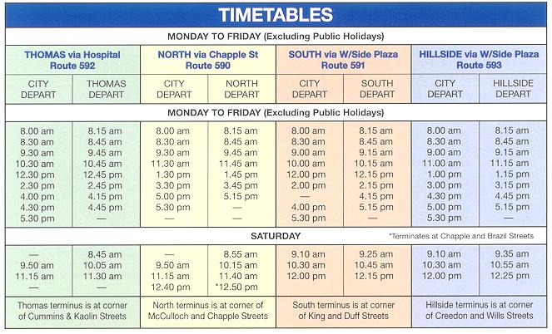
Slide 16
2. On Saturdays, Route 591 departs from the south at which of the following times?
A. It departs at 8:55 a.m.
C. It departs at 9:25 a.m.
B. It departs at 8:15 a.m.
D. It departs at 9:15 a.m.

Slide 17
Slide 17
CORRECT!
Go to Questions #3 & #4
Notes:
5.B 1st sentece
6. C I’m suppoused all the way to the end

Slide 18
Slide 18
Short and Long-Term Memory
In order to develop better learning skills, it is wise that one understand more about how the memory is structured, particularly short and long-term memory. Short-term memory is also known as working memory and is used for paying attention or completing tasks such as math computations or reading long sentences. Its’ duration is sometimes as little as 3-20 seconds. Long-term memory is where information and impressions are stored relatively permanently; the memories are stored on the basis of meaning and importance. There are many things that enter our short-term memories that are not then transferred to our long-term memories. In fact, the brain is designed to forget between 50 and 75 percent of the information that is not transferred to the long-term memory within 24 hours. Therefore, the brain carefully selects what is stored in the long-term memory.
3. How are long-term memories stored?
4. What percent of memory is forgotten
if it is not transferred to long-term memory?
A. Depending on meaning and importance
A. 20 percent
B. Doing math computations
B. Between 50 and 75 percent
C. By paying close attention
C. 24 percent
D. By transferring them to the
short-term memory
D. 3 percent

Slide 19
Slide 19
Short and Long-Term Memory
In order to develop better learning skills, it is wise that one understand more about how the memory is structured, particularly short and long-term memory. Short-term memory is also known as working memory and is used for paying attention or completing tasks such as math computations or reading long sentences. Its’ duration is sometimes as little as 3-20 seconds. Long-term memory is where information and impressions are stored relatively permanently; the memories are stored on the basis of meaning and importance. There are many things that enter our short-term memories that are not then transferred to our long-term memories. In fact, the brain is designed to forget between 50 and 75 percent of the information that is not transferred to the long-term memory within 24 hours. Therefore, the brain carefully selects what is stored in the long-term memory.
CORRECT!
Return to Question #4
Notes:
5.B 1st sentece
6. C I’m suppoused all the way to the end

Slide 20
Slide 20
Short and Long-Term Memory
In order to develop better learning skills, it is wise that one understand more about how the memory is structured, particularly short and long-term memory. Short-term memory is also known as working memory and is used for paying attention or completing tasks such as math computations or reading long sentences. Its’ duration is sometimes as little as 3-20 seconds. Long-term memory is where information and impressions are stored relatively permanently; the memories are stored on the basis of meaning and importance. There are many things that enter our short-term memories that are not then transferred to our long-term memories. In fact, the brain is designed to forget between 50 and 75 percent of the information that is not transferred to the long-term memory within 24 hours. Therefore, the brain carefully selects what is stored in the long-term memory.
CORRECT!
Go to Next Slide
Notes:
5.B 1st sentece
6. C I’m suppoused all the way to the end

Slide 21

Slide 21
Congratulations!
You have successfully completed the
Seminole State College of FL - ELS Department’s
Scanning and Key Word Recognition Tutorial!
Go to Credits
Notes:
1. B at para 1Preheat at 400 – at para 2 350
2. C. para 2

Slide 22
Slide 22
CREDITS
Seminole State College of FL
English Language Studies Department
Project Producers
Nissa Hopkins
Marco Yepez
Elias Moskona
Web Support
Edith Morales
Anna Flores
Les Lusk
Notes:
1. B at para 1Preheat at 400 – at para 2 350
2. C. para 2

