Slide 1
CRIMINAL JUSTICE TRAINING CENTER AT
SEMINOLE STATE COLLEGE

Slide 2
WELOME TO OUR
INFORMATION SESSION
This session will introduce you to the application process and training requirements for the Law Enforcement Academy.

Slide 3

Criminal Justice Training Center Faculty & Staff
Dr. Elmore Lowery Dean, Center for Public Safety
David Miller Director, Criminal Justice Training Center
Jason McDaniel Manager, Criminal Justice Training Center
Dr. Sandra Dillard Professor A.S./B.S. Degree/Dual Enrollment
Patty Hoenig Criminal Justice Instructional Coordinator
TBD Criminal Justice Specialist
407-708-2299 or 407-708-2197
www.seminolestate.edu/criminal-justice

Slide 4

PROGRAM OVERVIEW
The Seminole State College Criminal Justice Training Center is certified by the Florida Department of Law Enforcement (FDLE) as staff for the Criminal Justice Standards and Training Commission (CJSTC).
www.fdle.state.fl.us
The Criminal Justice Training Academy is a Career Certificate Program that offers 22 college credits toward an AS Degree in Criminal Justice here at Seminole State College. We believe that education is the key to success and urge you to continue your education upon completion of the Basic Recruit Training Program.
Upon successful completion of the academy, students receive a Certificate of Completion and become eligible to sit for the State Officer Certification Examination. A Certificate of Compliance is issued by the Criminal Justice Training and Standards Commission when the student is employed by an agency and fulfills all the necessary requirements to become a certified officer in the State of Florida.

Slide 5

ENTRANCE REQUIREMENTS
Be at least 19 years of age to become a law enforcement officer or 18 years of age to become a corrections deputy
Be a citizen of the United States
Be a high school graduate or its "equivalent"
Have a valid Florida driver’s license
Have no felony convictions or misdemeanor convictions involving perjury, false statements, or domestic violence
Have not received a dishonorable discharge from any of the Armed Forces of the United States (if applicable)
Have passed a PET (physical entrance test)
Have passed a physical examination by a licensed physician (MD or DO), physician assistant or licensed advanced practice registered nurse, based on specifications established by the commission
Have good moral character as determined by a background investigation under procedures established by the commission

Slide 6
ACADEMY REQUIREMENTS
Complete the Seminole State College Admissions application online, declare a program plan (LAW-VC, COTLE-VC, or LETCO-VC ), and submit official high school transcripts, college transcripts, and residency documents
(www.seminolestate.edu/admissions)
Complete and pass the CJ-BAT entrance exam at required scoring level for Corrections or Law Enforcement $39. Effective July 1, 2022, if you are a veteran with an honorable discharge or have an associates degree or higher, you are exempt from taking the CJ- BAT.
http://www.seminolestate.edu/criminal-justice/certificate-programs/cjbat-schedule
Complete the paper application to the Criminal Justice Training Center to include the physical exam test (costs vary), drug screening ($35), driving record ($16.25), and criminal history background check ($65.74). EKG and PPD tests are required (costs vary).
Complete and pass application evaluation process

Slide 7
UPCOMING ACADEMY DATES & TIMES
FALL 2026 DAY LAW ENFORCEMENT ACADEMY
October 20, 2026 – March 26, 2027 (open academy)
Application Deadline: September 11, 2026
Monday-Thursday 6:45am – 6:00pm* (times will vary)
www.seminolestate.edu/criminal-justice

Slide 8
CAREER CERTIFICATE PROGRAM PLAN
You must be enrolled in the correct program plan to attend the LE or CO academy:
  Law Enforcement = LAW-VC
  Crossover Corrections to Law Enforcement = COTLE-VC
Previous SSC students: It may be necessary to re- apply for Admissions if you are not in the correct vocational program (see above).
High school and all official transcripts are required for admission into Seminole State College. Please start the process NOW of ordering them.
If you have any questions about your admissions status, you should make an appointment with our Career Program Advisor,
Angelia Smith: 407-708-2596 or smithan@seminolestate.edu

Slide 9

Center for Public Safety Career Program Advisor
*Program Plan Change
*Career Inquiries
*Degree Audit
*Educational Plan
*Articulation Credit
*Graduation Application
https://www.seminolestate.edu/counseling/appointments/angelia.smith
Angelia N. Smith 407-708-2596 smithan@seminolestate.edu

Slide 10
Criminal Justice Standards and Training Curriculum Florida Law Enforcement Basic Recruit Training Program #2010 (2026.07 version)
HRS. | COURSE | TITLE | TUITION | FEES | TOTAL
12 | CJK0002 | Intro to Law Enforcement | $33.48 |  | $33.48
24 | CJK0016 | Communication | $66.96 |  | $66.96
64 | CJK0018 | Legal | $178.56 |  | $178.56
56 | CJK0019 | Interview/Report Writing | $156.24 |  | $158.24
40 | CJK0063 | Fundamentals of Patrol | $210.95 |  | $210.95
34 | CJK0021 | Serving Your Community | $94.86 |  | $94.86
48 | CJK0072 | Crimes Against Persons | $133.92 |  | $133.92
12 | CJK0073 | Crimes Involving Property and Society | $33.48 |  | $33.48
34 | CJK0079 | Crime Scene Follow-Up Investigations | $94.86 |  | $94.86
12 | CJK0400 | Traffic Incidents | $33.48 |  | $33.48
24 | CJK0401 | Traffic Stops | $66.96 |  | $66.96
30 | CJK0402 | Traffic Crash Investigations | $83.70 |  | $83.70
24 | CJK0403 | DUI Traffic Stops | $66.96 |  | $66.96
44 | CJK0093 | Critical Incidents | $122.76 |  | $122.76
48 | CJK0020 | Vehicle Operations | $212.23 |  | $212.23
40 | CJK0031 | First Aid for CJ | $131.55 |  | $131.55
80 | CJK0040 | CJ Firearms | $727.45 |  | $727.45
80 | CJK0051 | CJ Defensive Tactics | $258.20 |  | $258.20
60 | CJK0096 | CJ Physical Fitness | $171.65 |  | $171.65
4 | CJK0421 | Dart Firing Stun Gun | $11.16 |  | $11.16
 |  | Uniforms-Approx. |  |  | $750.00
 |  | Books/Testing Code |  |  | $115.00
770 |  |  |  | Approx. TOTAL | $3752.41
Fees are for in-state tuition and are approximate and subject to change each semester. Financial Aid is available for those who qualify.

Slide 11
UNIFORM REQUIREMENTS FOR CRIMINAL JUSTICE ACADEMY
Uniform fitting takes place at the Orientation with our vendor, All Uniform Wear.
Class A Polo shirt Grey w/ logo and name personalization
PT shirts light blue with screen print of logo and names front & back
Reflective Vest with personalization
Class A black pants
Black PT shorts (w/name & logo)
BDU Pants, Black, Unisex
Nylon BDU belt
Cap w/ logo & name
Jacket w/ logo
Dufflebag w/logo
Approximate Cost: $750.00
A complete list of uniforms and costs will be provided at Orientation.

Slide 12


FLORIDA LAW ENFORCEMENT ACADEMY BASIC TRAINING PROGRAM CURRICULUM - BLE
Law Enforcement Volume 1 (2026.07 Edition)
$20.33
High Liability Volume 2 (2026.07 Edition) $14.67
Test Access Code: $80.00
Purchase in Seminole State College Bookstore, Sanford/Lake Mary Campus,
Student Center

Slide 13


AFTER YOUR APPLICATION HAS BEEN SUBMITTED
Interview with Director and/or Manager to determine acceptance into Program/PET
Attend scheduled Criminal Justice Orientation to receive rules & regulations, schedules, registration forms, uniform ordering, etc.
After orientation: Purchase books, uniforms, register and pay for classes.
Be Prepared!
Log onto MySeminoleState and utilize this student service throughout the academy.
For more information regarding the Criminal Justice Training Center Application Process contact our office at 407-708-2299 or 407-708-2197 or email justice@seminolestate.edu
**Applications are accepted on a first-come first-serve basis. Seats are limited. Placement into the academy is based upon the information submitted in your application, your interview, and the physical entrance test.

Slide 14



VERY IMPORTANT!
Once you have a student ID #: Create a
MySeminoleState
student account to access your student registration and records.
www.seminolestate.edu

Slide 15
COLLEGE RESOURCES
*Admissions Office:
*Financial Aid:
*Business Office:
*Records & Enrollment:
*Testing & Assessment:
407-708-2050
407-708-2045
407-708-2140
407-708-2050
407-708-2020
Center for Public Safety Criminal Justice Training Center
407-708-2299 or 407-708-2187
www.seminolestate.edu/criminal-justice

Slide 16

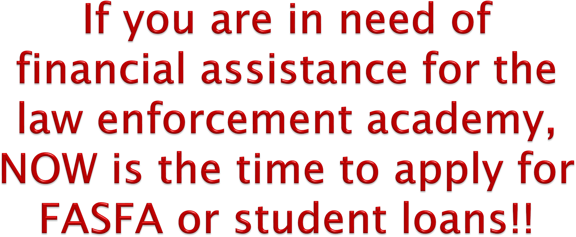
Financial Assistance
https://www.seminolestate.edu/financial-aid
Note: If you are awarded grant-funded assistance, please be aware that your uniforms are an out-of-pocket cost until you receive your aid.

Slide 17

APPLICATION DETAILS
With a copy of the CJ-BAT (basic skills assessment instrument) passing score, we will provide you with the paper application packet for the law enforcement academy.
Exemption..."As of July 1, 2022, "... a person is not required to take the basic skills assessment instrument before entering a law enforcement basic recruit training program if he or she is a veteran as defined in s. 1.01(14) or holds an associate degree or higher from an accredited
college or university."

Slide 18
APPLICATION SUBMISSION
You can drop off your application at the Center for Public Safety or please mail your completed application to:
Seminole State College
Center for Public Safety /Law Enforcement Academy 100 Weldon Boulevard
Sanford, FL 32773
Completed application includes the following: The first 5 pages completed and notarized, driving record report and a copy of any documentation you may want to provide if applicable, a copy of your driver's license, the Chain of Custody form for your drug screen, the receipt for your background check, form 75 completed by the doctor including the TB test and EKG report, a copy of your birth certificate or passport, a copy of your HS diploma or college transcripts; and DD-214 if applicable
For more information log onto:
www.seminolestate.edu/criminal-justice

Slide 19
QUESTION AND ANSWER
Please contact us via email justice@seminolestate.edu

