Slide 1

Approval to Teach
Training Document
SSAP
Course and Curriculum Development (CCD)
1/26

Slide 2
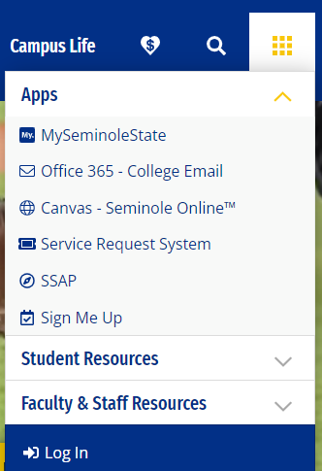
How to Submit an Approve to Teach Request
Go to the Seminole State Home page
Click on the My Apps box (9 boxes at the top right corner)
Click SSAP
Log in
Approval to Teach

Slide 3
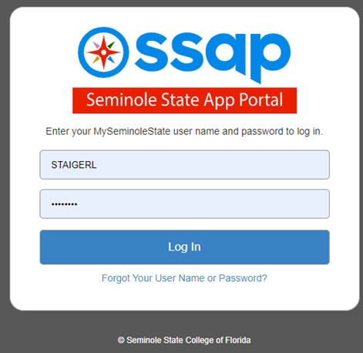
How to Submit an Approve to Teach Request page 2
Log in with your My Seminole State username and password
Approval to Teach

Slide 4
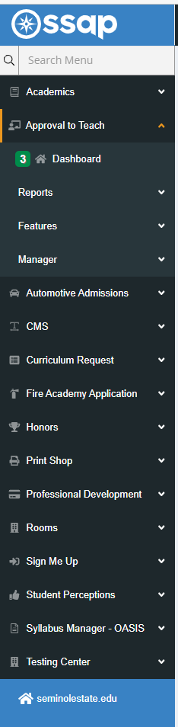
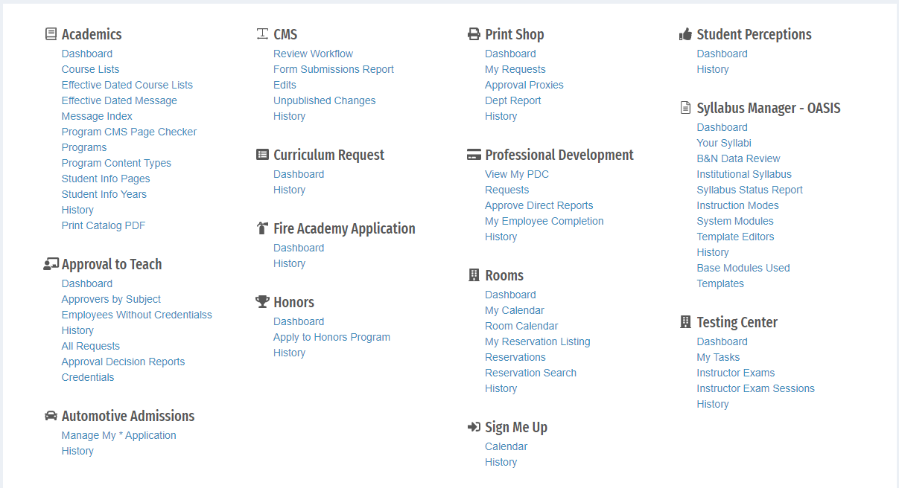
Approve to teach Dashboard
In the side menu under Approval to Teach, click Dashboard
OR
Select Dashboard from under the Approval to Teach section in the center of page
Approval to Teach

Slide 5
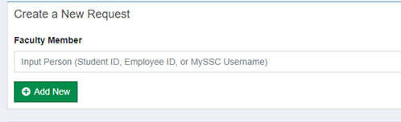
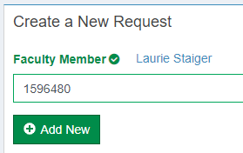
Creating a Request
Under Create a New Request
Enter the faculty members Employee ID or SSC Username
Confirm the Employee ID you entered matches the name that populates
Click Add New
Approval to Teach

Slide 6
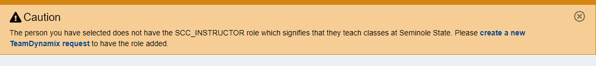
Creating a Request page 2
If person is not designated as an instructor, you will receive this error.
Approval to Teach

Slide 7
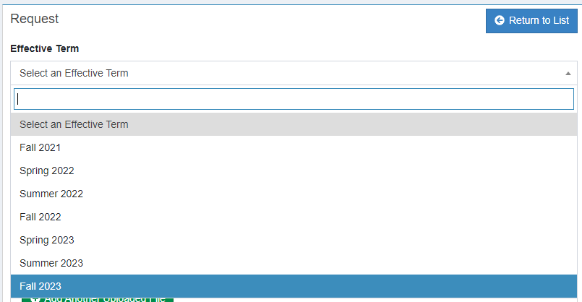
Manage Requests: Create New
Select an Effective Term
  Choose from drop down menu
  OR
  Begin typing and the list of terms will populate
Approval to Teach

Slide 8
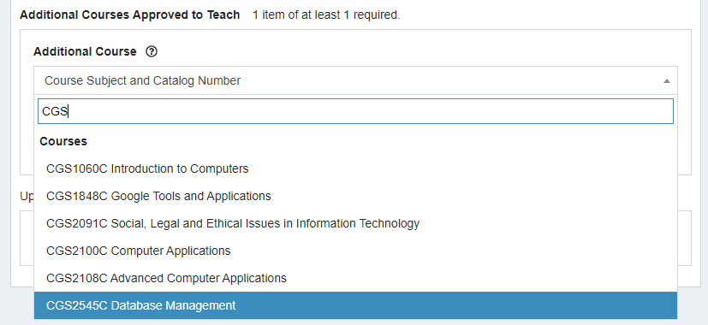
Manage Requests: Create New page 2
Enter the prefix of the course and choose the course from the list.
Approval to Teach

Slide 9
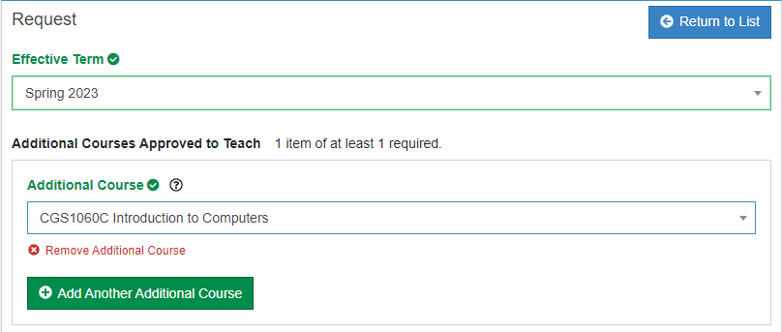
Manage Requests: Create New page 3
Click Add Another Additional Course to add more than one course in one request.
Approval to Teach
Courses Requested

Slide 10
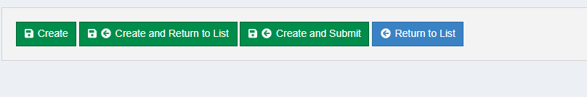
Manage Requests: Create New page 4
Click on the Create and Submit button at bottom of screen to complete.
Approval to Teach

Slide 11
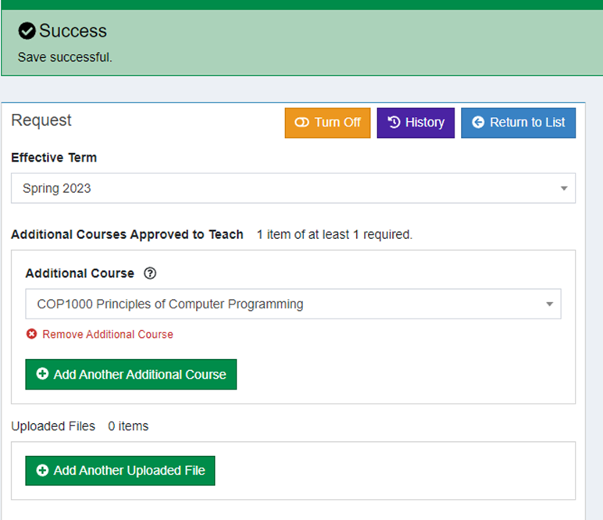
Manage Requests: Create New page 5
Message that form was submitted.
Approval to Teach

Slide 12
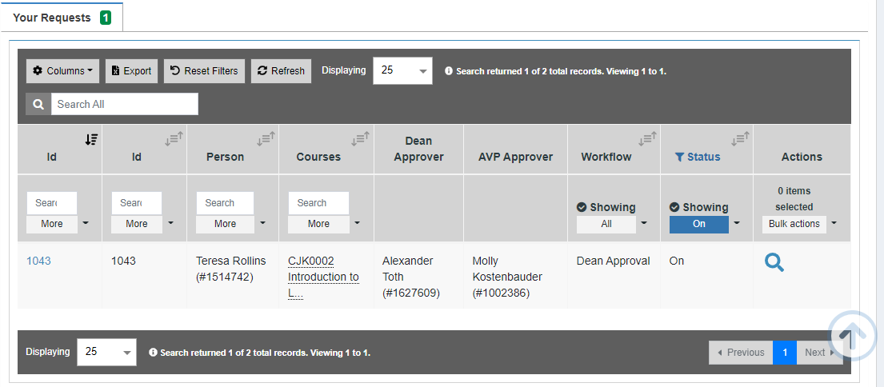
Manage Requests: Workflow
Once submitted request will go through approvals, starting with the Dean. View approval status on dashboard.
Approval to Teach

Slide 13
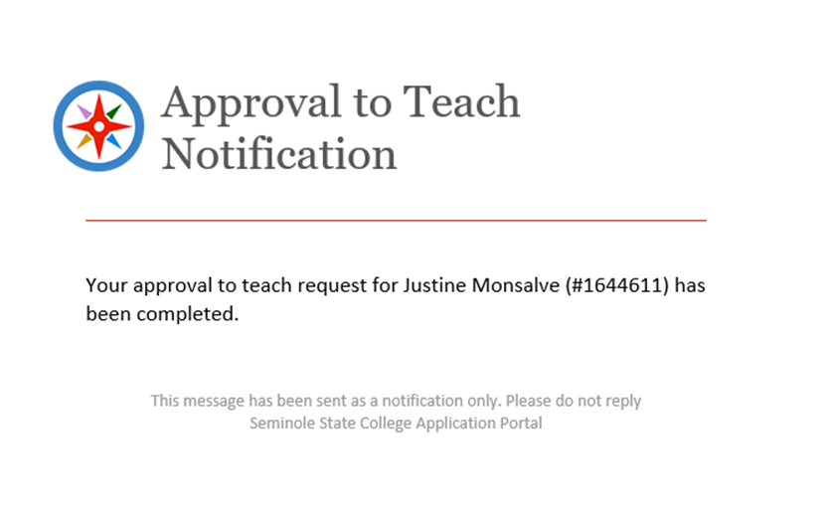
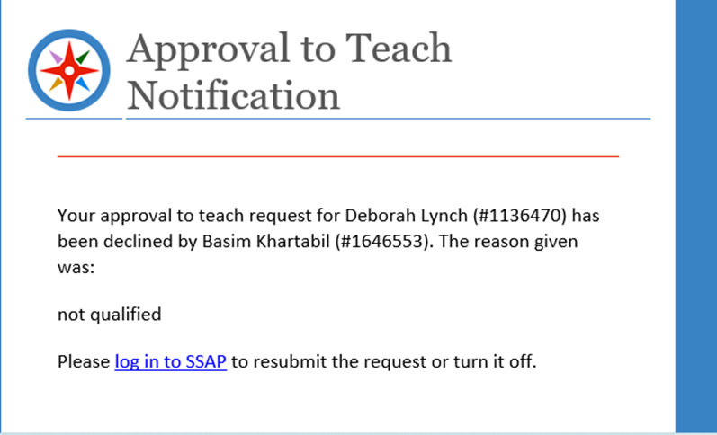
Manage Requests: Emails
Initiator email when request approved:
Initiator email when request declined:
Approval to Teach

Slide 14
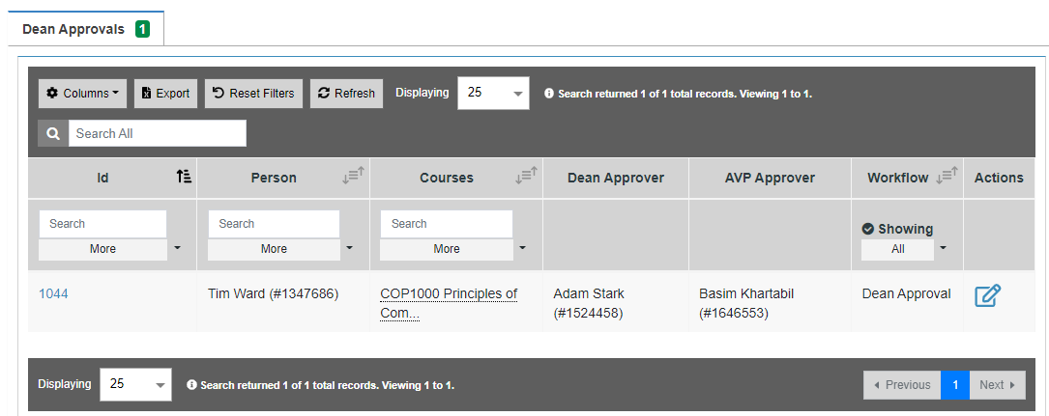

Manage Requests: Approvers
Approvers: click action button to approve or decline with reason.
Approval to Teach

Slide 15
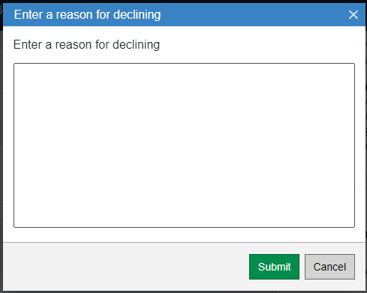
Manage Requests: Approvers page 2
Approvers: If decline is selected the system will ask for a reason.
Enter your reason and click Submit.
Approval to Teach

Slide 16
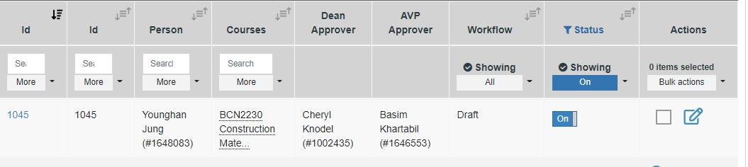

Manage Requests: Declined
When request is declined by approver, it returns to initiator as a draft.
Approval to Teach
Initiator can either change and resubmit or cancel using the Turn Off button.

Slide 17
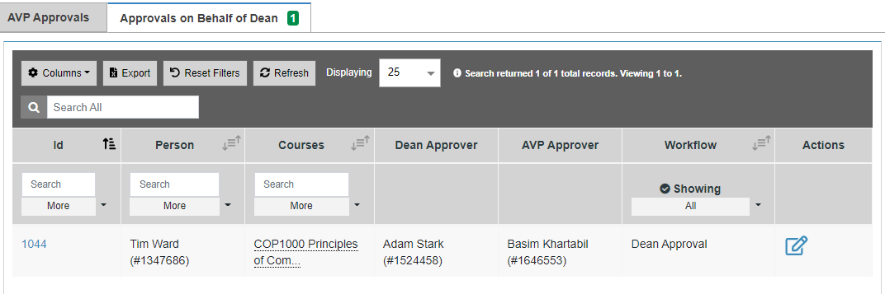
Manage Requests: Approvers page 3
Approvers: AVP can approve for the dean when necessary.
  This is to keep the process going if a Dean is out of the office.
  The AVP will not get a notification to approve on behalf of the Dean.
  The initiator will need to let the AVP know they are needing them to approve on behalf of the Dean.
  The AVP will have to approve the AVP approval next.
Approval to Teach

Slide 18

FAQ’s??
When will Approve to Teach Request in SSAP Go-Live? November 7th
Will we still be able to use the TIM system for Approve to Teach requests after November 7th? Only for in progress requests. All new requests must use SSAP after November 7, 2023.
How can I get additional training? Contact Laurie Staiger staigerl@seminolestate.edu
Can an initiator edit a request? As with TIM system, after form is submitted by initiator it cannot be edited unless declined by approver and sent back as a draft.

Slide 19
Contact Info
Laurie Staiger – staigerl@seminolestate.edu x. 2554
Ann Pohira-Vieth - pohiraa@seminolestate.edu x. 2071
Curriculum - curriculum@seminolestate.edu
The Web team has done a great deal of exceptional work but suggestions for improvement may be sent to Laurie for consideration.
This is a TEAM effort, and we will be here to make the transition as painless as possible.

Slide 20
Questions
??

