Slide 1

Zero-Based Budget Training

Slide 2
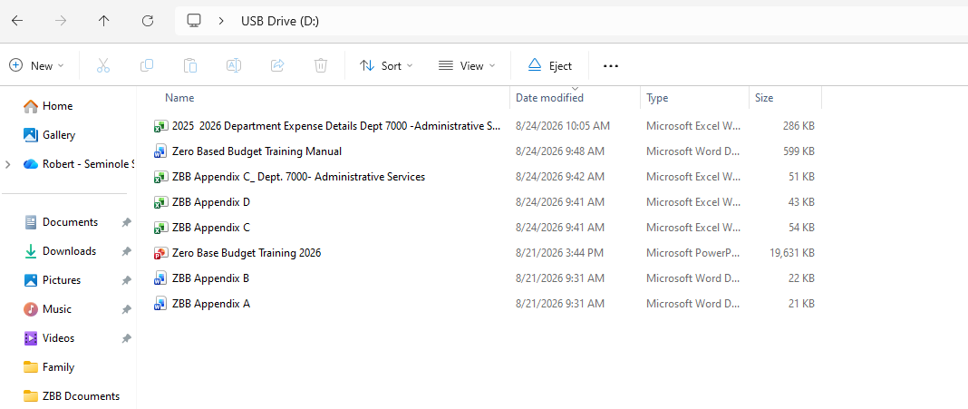

Thumb Drive Distribution and Contents

Slide 3

Zero-Based Budget (ZBB)
FY 2027-2028 modified Zero-Based Budget model
Be strategic and invest in our priorities
Incremental budget model
Much better rationale for budget realignment as opposed to across-the-board reductions

Slide 4
Zero-Based Budget (ZBB) cont.d
Enriches the review and analysis
Analyze needs and costs
Identifies and eliminates unnecessary operations
Encourages discussion on alternative courses
Eliminate the college budget deficit
Thank you!

Slide 5
ZBB Process
Forms
Appendix A – Key Activities
Appendix B – Position Key Activities
Appendix C (Two Tabs) – Expenditure Analysis
Appendix D – Contracted Services Inventory
Supplemental narrative/analysis (Department Defined)
Share Important Information
Answer questions that are required

Slide 6
ZBB Process (cont.d)
Manual
Appendix E – Departmental listing
Fund 1
Y = Required (Use class code for multiple departments under one Dept. #; Ex. Class 1430 for Upper Division/BACC)
N = Not required
M = Required as part of the fee review process (Lab Fee – Class 8000)
Fund 2, 3, 7
O = Optional
Appendix F – Expense Chart of Accounts

Slide 7
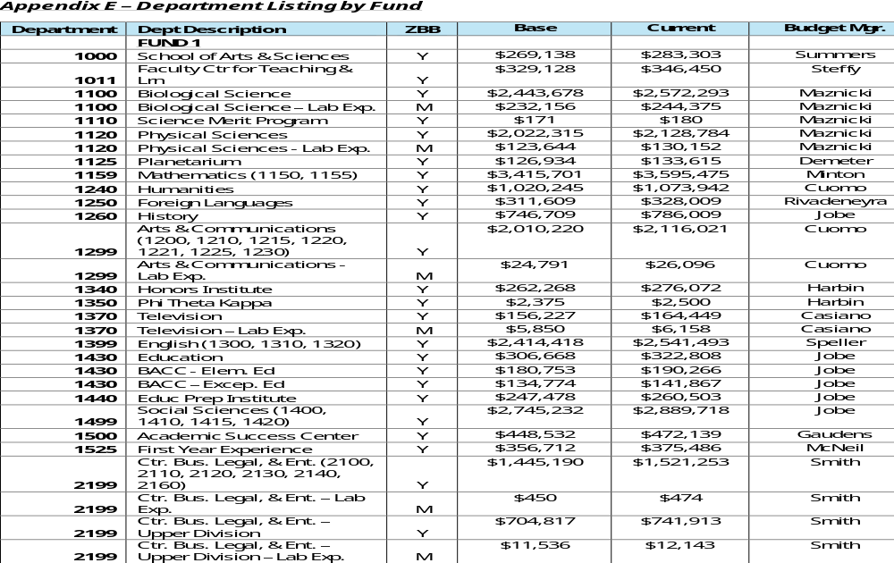
ZBB Process (Appendix E)

Slide 8
ZBB Timeline
September - Training
October/November – ZBB Department Work
December 11th – First Draft ZBB documents submitted to Budget Office
January – Budget Office follow up
February – Final Draft ZBB documents submitted to Budget Office
March – ZBB Analysis conducted by Budget Office
April – Draft Report submitted to Executive Team
May – Board of Trustees Budget Workshop

Slide 9


Worksheet Review

Slide 10
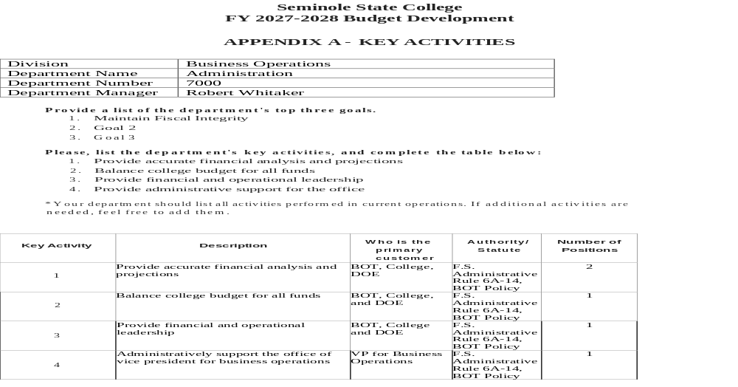
Appendix A

Slide 11
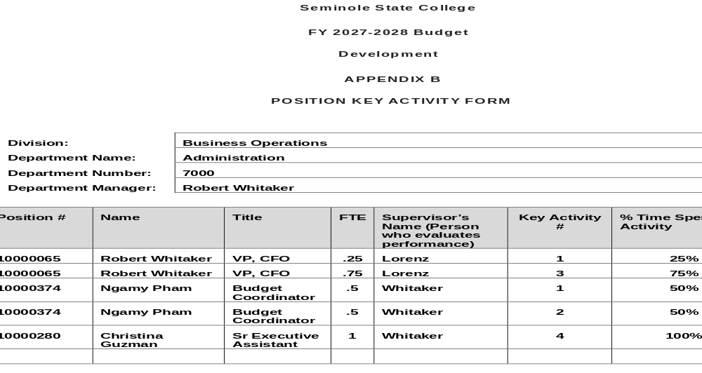
Appendix B

Slide 12
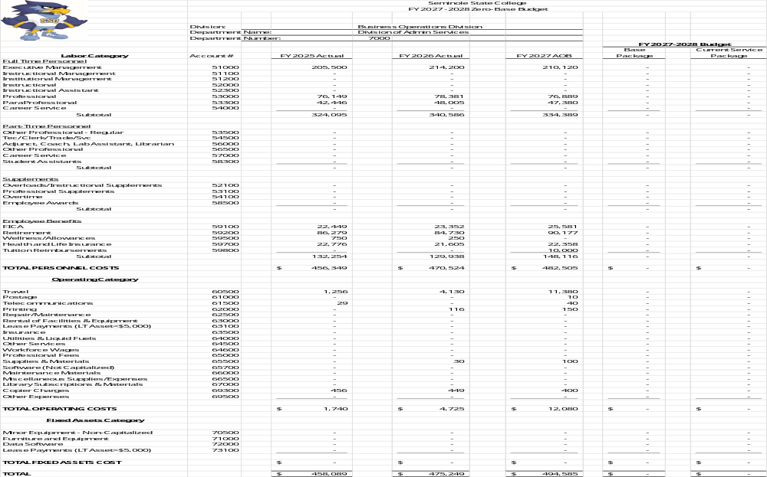
Appendix C

Slide 13
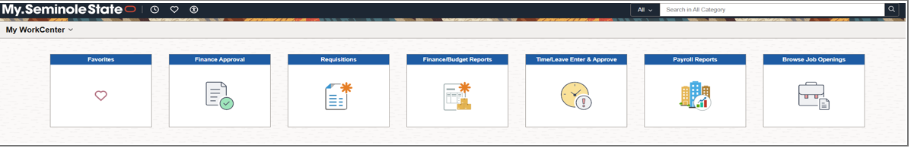
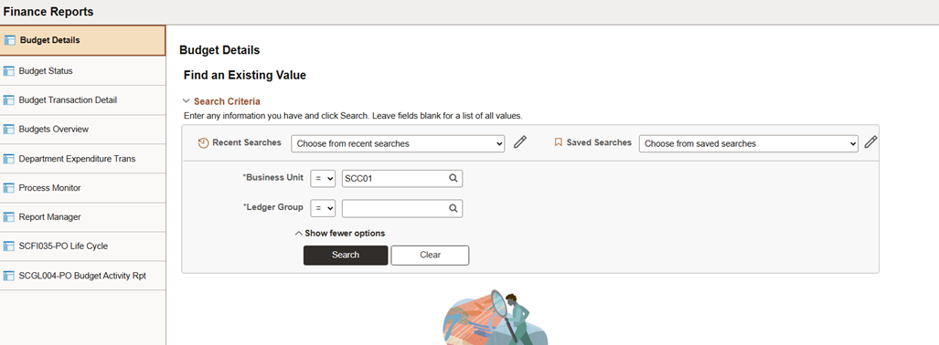
PeopleSoft Reports

Slide 14
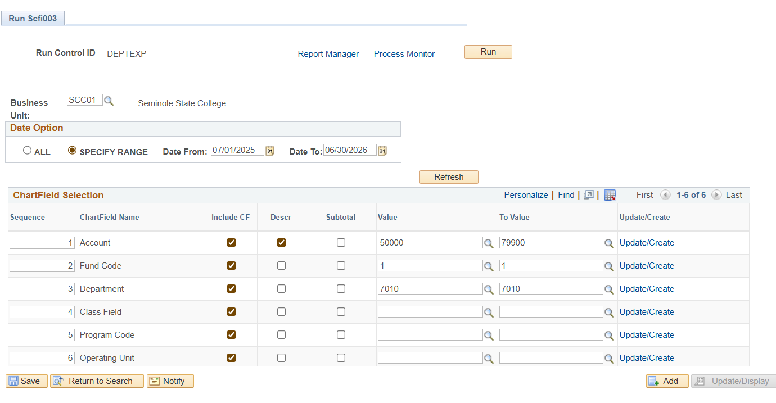
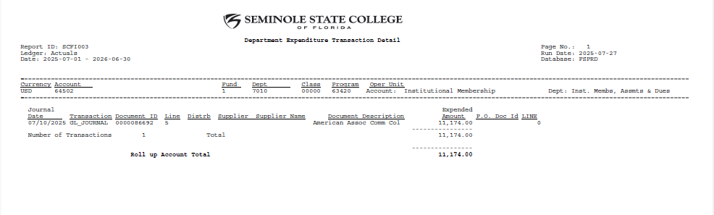
Department Expenditure Transaction Detail
The Department Expenditure Transaction Details includes the details by dates of all the expenses in the accounts for the time period in question.

Slide 15
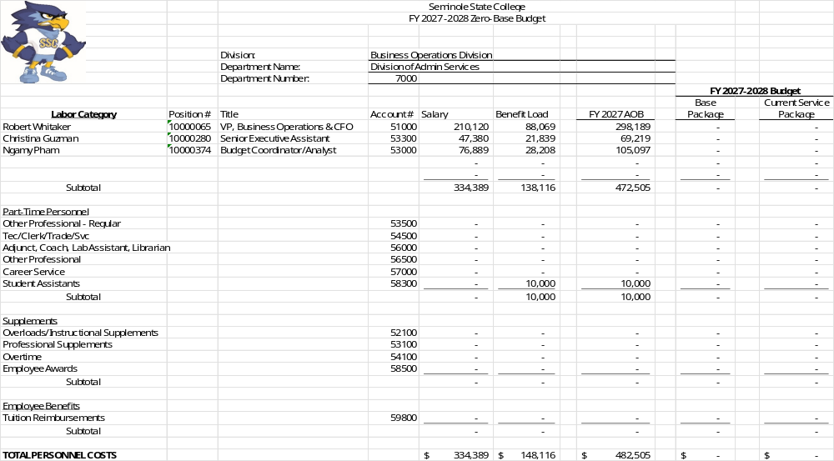
Appendix C (cont.d)

Slide 16
Appendix C (terms)
“Pool” Budgets
Adjunct – break out the budget by term, list number of courses, list # of adjunct by name
Overload – break out the budget by term, list number of courses, list # of employees
PT Labor – list # of employees, calculate the number of hours to be worked by each employee, identify the activities performed by each employee
Temp Labor – list # of employees, calculate the number of hours to be worked by each employee, identify the activities performed by each employee
OT Labor – list the # of employees, calculate # of hours to be worked by each employee. Identify the activities performed by each employee, provide a narrative to explain why OT is required for this activity.

Slide 17
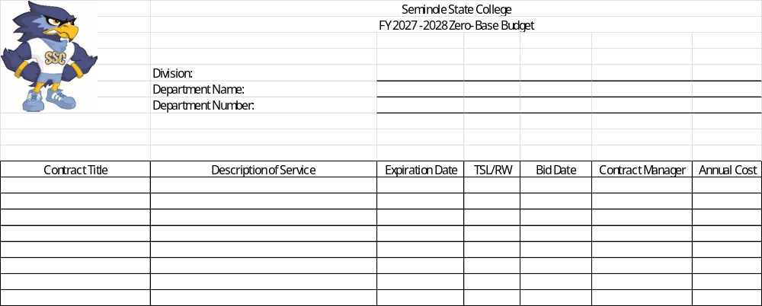
Appendix D

Slide 18
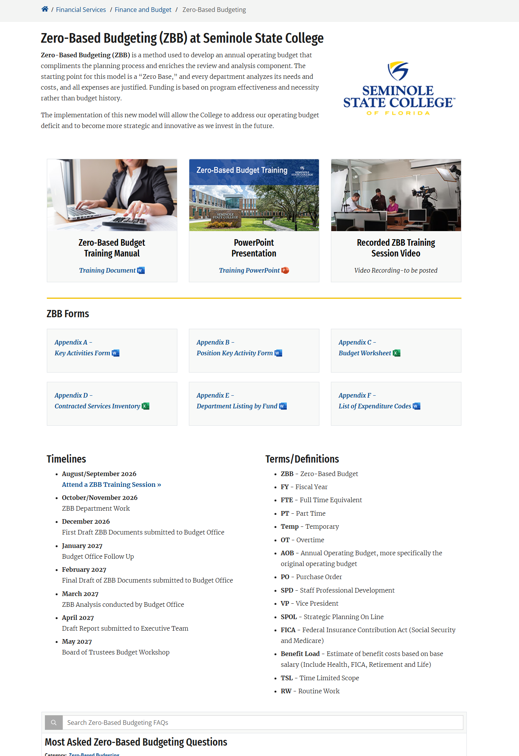
https://www.seminolestate.edu/business-services/ofb/zero-based-budget

Slide 19

QUESTIONS & ANSWERS

