Slide 1
General Biology I
Lab Practical #1 Review
Professor D. Rinne

Slide 2
Formulas
There will be NO formula sheet provided
SA of a block=2(L x W) + 2(L x H) + 2(W x H)
Volume of block= LWH
SA/V ratio= SA/V
Density = Mass/volume
*Density of Water= 1 g/ml and be able to determine if object will Sink or Float when placed in water based on the density on calculation.
Total Magnification = (ocular) x (objective lens magnification)
M₁DFV₁ = M₂DFV₂
C₁V₁ = C₂V₂
Cell Size = DFV/# cells that fit
Volume of irregular object as determined by water displacement method= Final Volume – Initial Volume

Slide 3
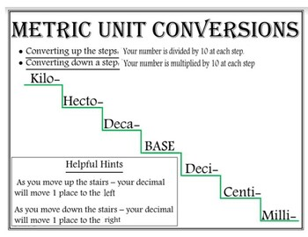
Unit Conversions
Converting Units YouTube video

Slide 4
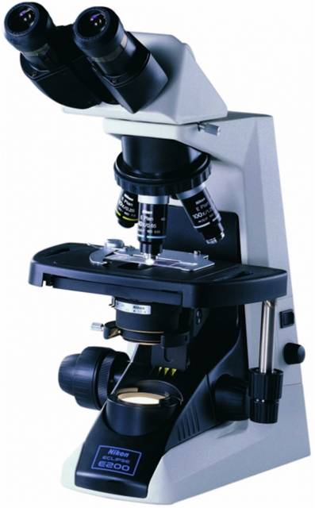
Parts of the microscope
1
2
Ocular lenses (eyepiece)
Diopter ring
Arm
Coarse adjustment focus knob
Fine adjustment focus knob
On/Off switch
Rheostat (brightness control)
Base
Revolving nosepiece
Objective lens
Stage
Mechanical stage adjustment knob
Condenser w. diaphragm lever
Illuminator (light)
9
3
10
11
6
13
7
5
4
12
14
When storing microscope:
Remove slide and clean lenses.
Stage should be at midpoint
Scanning (4x) objective lens should be in place
Mechanical stage should be flush with right side
Cord wrapped
8
Always carry with two hands , by arm and base!!

Slide 5
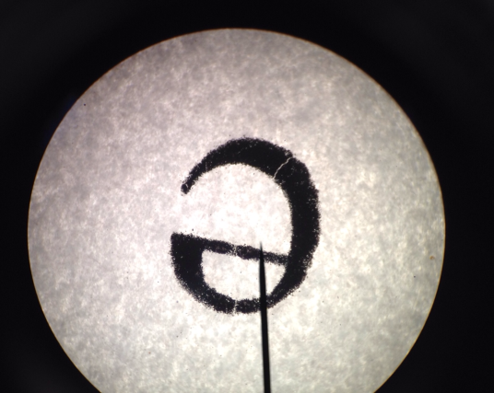
The Letter “e”

Slide 6
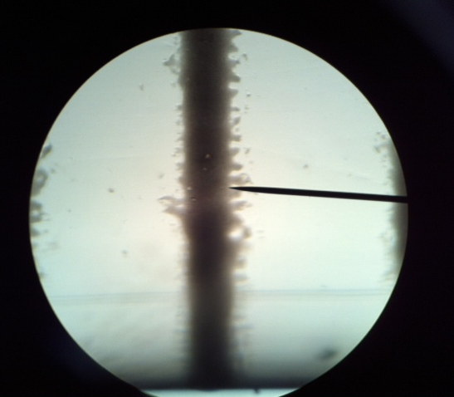
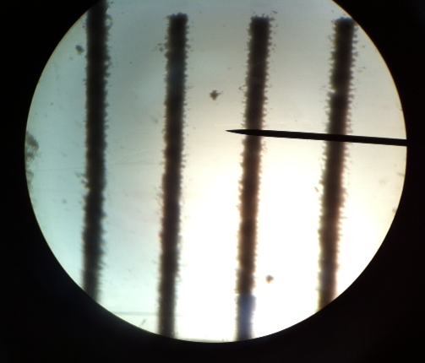
Measuring Diameter Field of View (DFV)
After focusing on the metric side of the ruler, Count the number of open spaces across the widest spot of the field of view
DFV_{4x}= 5 mm or 5000 µ
DFV_{=10x}= 2 mm or 2000 µ
Remember 1mm = 1000 µ
40x cannot be measured as it is less than 1mm, therefore you must calculate it using the formula :
M₁ x DFV₁ = M₂ x DFV₂
(4) X (5) = (40) x DFV₂
DFV₂ = 0.5mm or 500 µ

Slide 7
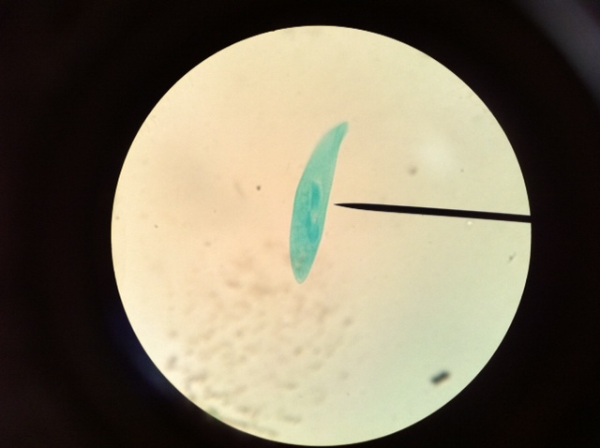
Estimating cell size
The Paramecium sp. specimen below is being viewed under the 40x objective lens
DFV_{40x}= 0.5mm or 500 µ (calculated on previous slide)
You can see from the picture above that I estimated that 10.5 cells would fill this field of view
You can see from the picture above that I estimated that 2.67 cells would fill this field of view
½
10
9
8
7
6
5
4
3
2
1
2/3
2
1
Width = DFV/# cells fit across
W= 500/ 10.5= 47.62 µ
Length= DFV/ # cells to fit across
L= 500/2.67= 187.27 µ

Slide 8
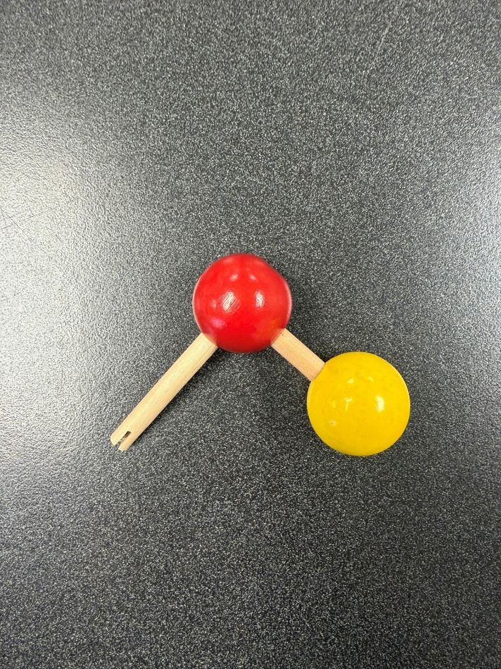
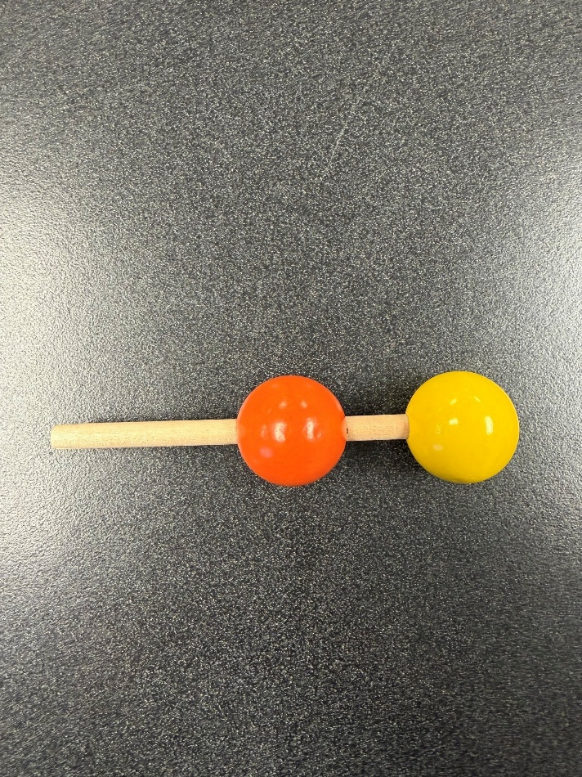
Functional Groups – pg. 2
Hydroxyl
Sulfhydryl

Slide 9
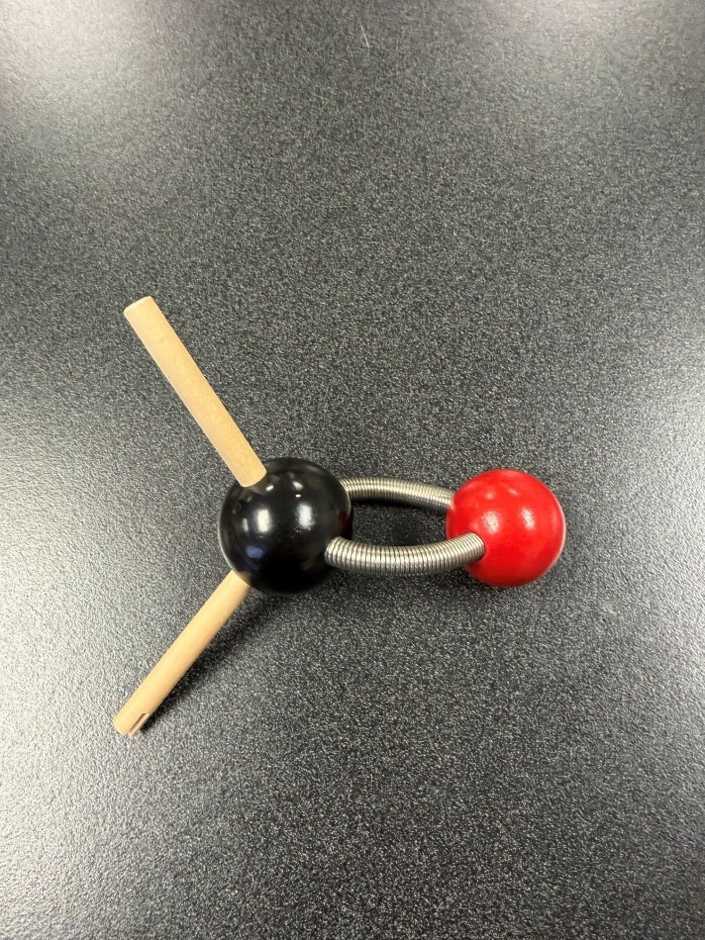
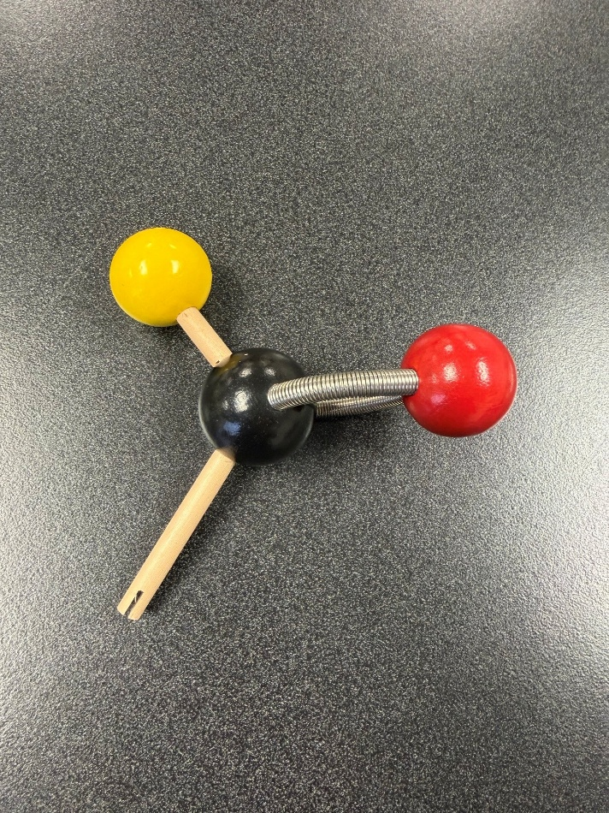
Functional Groups pg. 3
Carbonyl - Ketone
Carbonyl- Aldehyde

Slide 10
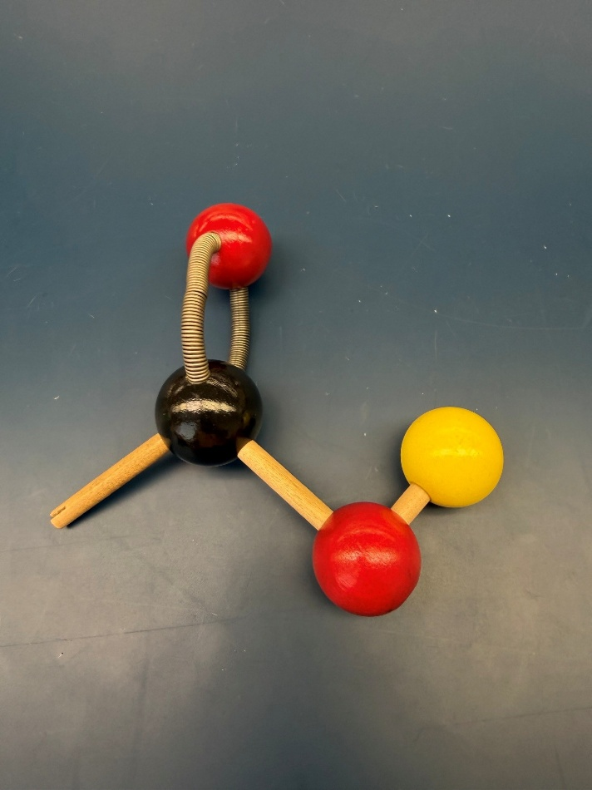
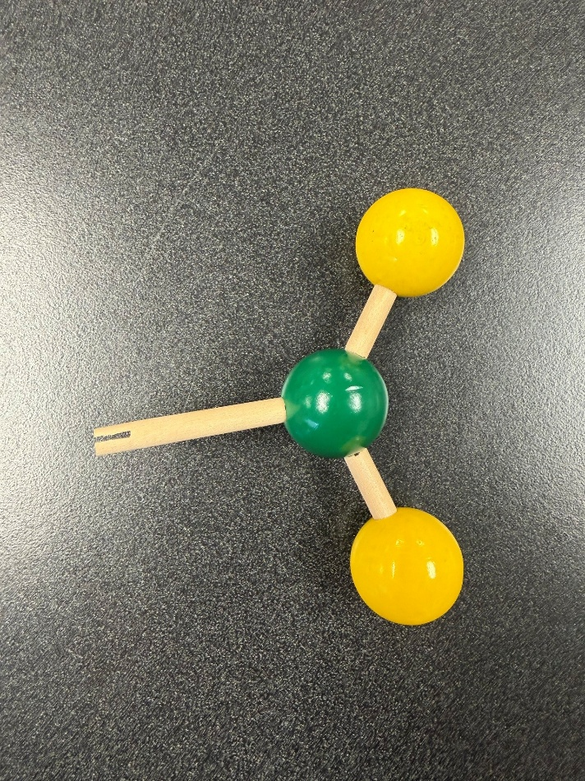
Functional Groups- pg. 4
Carboxyl
Amino

Slide 11
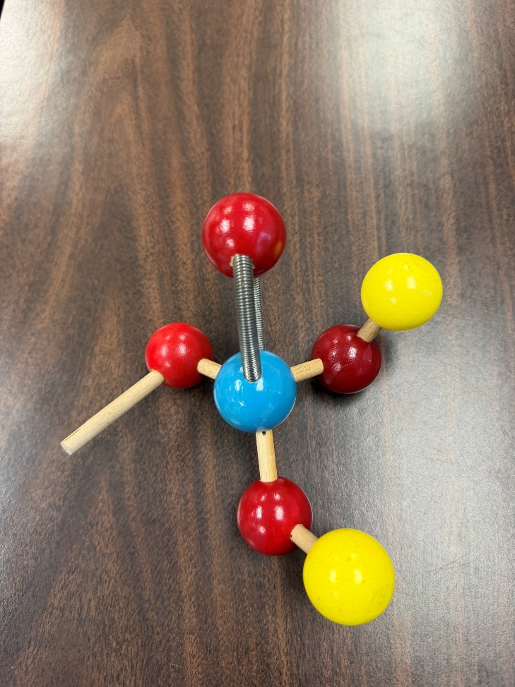
Functional Groups- pg. 5
Phosphate

Slide 12
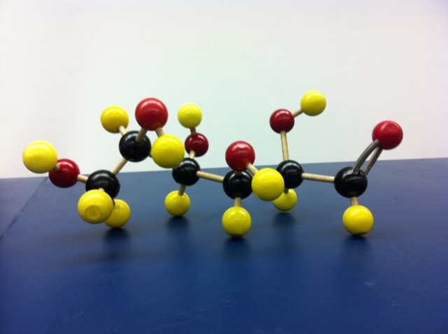
Glucose
Note the aldehyde carbonyl position.

Slide 13
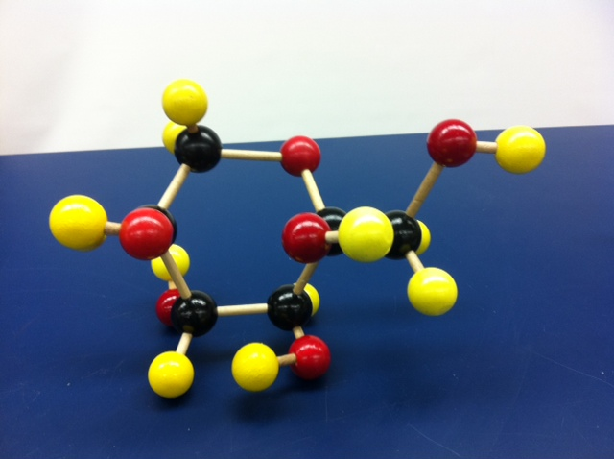
Glucose ring
Note the 6-membered ring.

Slide 14
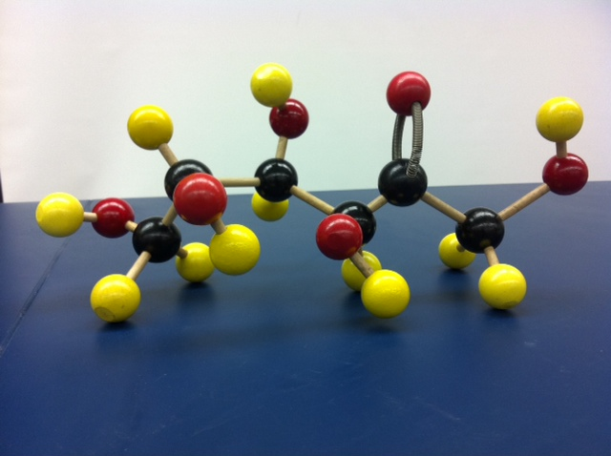
Fructose
Note the ketone position of the carbonyl functional group.

Slide 15
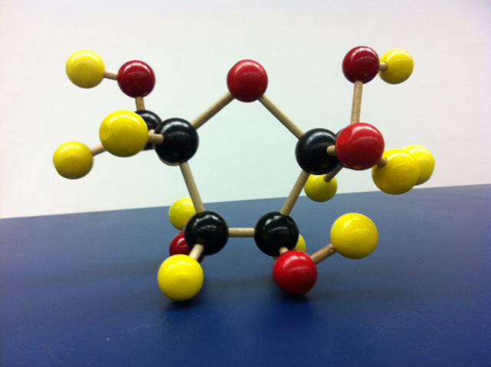
Fructose ring
Note the 5-membered ring structure.

Slide 16
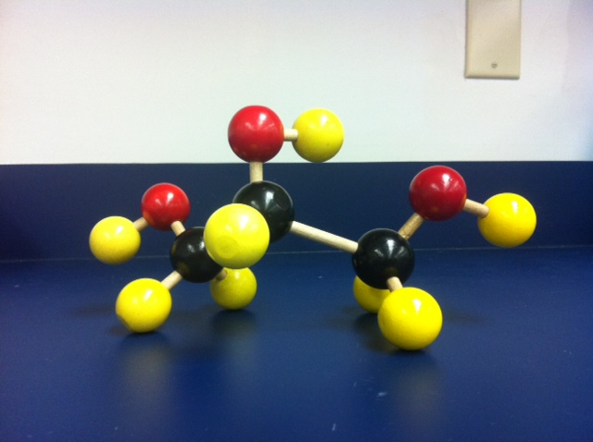
Glycerol
A 3-carbon sugar alcohol.

Slide 17
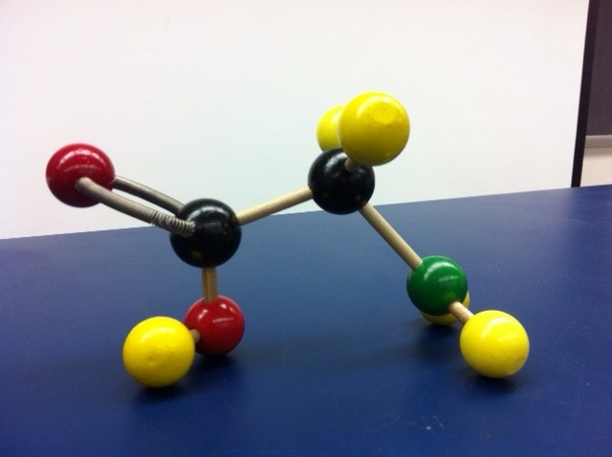
Glycine
An amino acid-notice the carboxyl group on the left of the central carbon and the amino group on the right of the central carbon. The R side group is a single hydrogen atom.

Slide 18
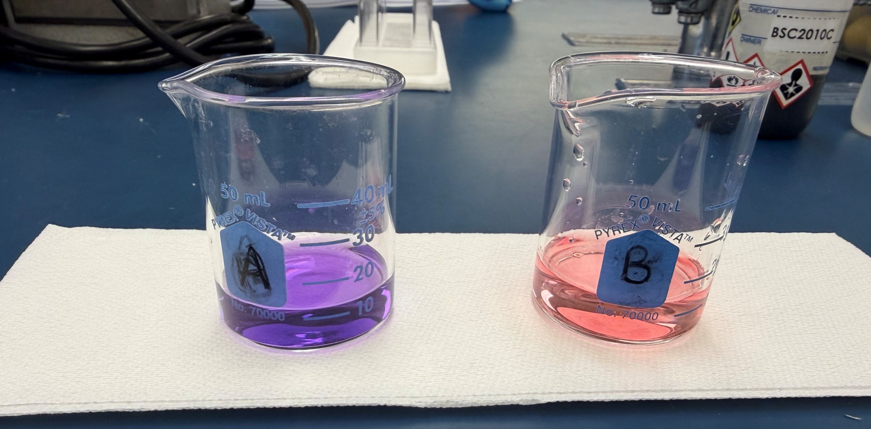
Buffers and pH
In this experiment, we observed the effects of buffers on a pH4 solution. Beaker A containing Unbuffered pH4 solution has had 1 drop of 1M NaOH (strong base) added to take the solution from an acidic pH4 (indicated by pink color) to a basic pH10 ( indicated by purple color). Beaker B containing the buffered pH4 solution required 8 drops of NaOH to change the color to purple. It then required 8 drops of HCl (a strong acid) to take it back to pink color seen here. Buffered solutions take many more drops of the acid or base to change the color of the solution from pink to purple and back to pink again as compared to unbuffered solutions. THINK: How many drops would you expect to expect to need to make Beaker A turn pink again? And which substance would you use?
The pH indicator used is Bogen’s Universal Indicator.

Slide 19
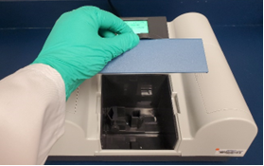
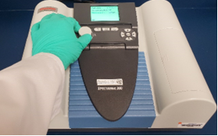
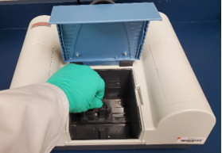
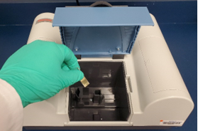
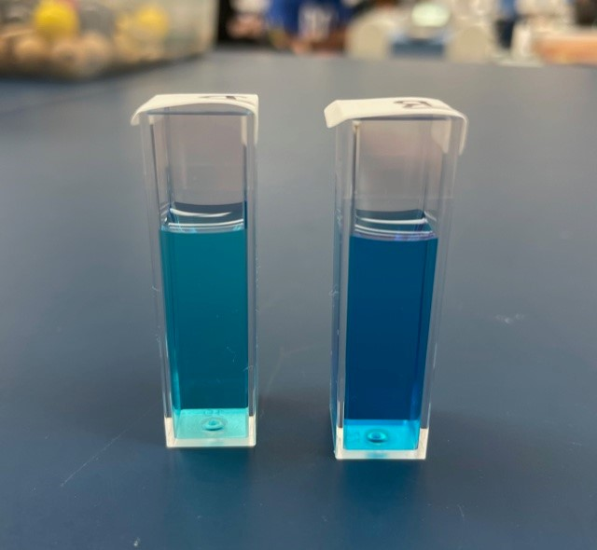
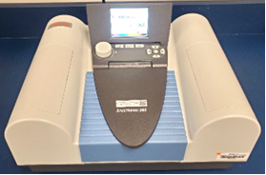
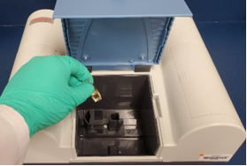
Using the Spectrophotometer
Steps to Using the Spectrophotometer
1. Turn on the spectrophotometer using the power switch on the rear of the instrument. Confirm the cuvette chamber is empty and press “Enter”. Allow the instrument to finish initializing. | 2. Highlight the “Spec 200E Modern Interface” and press “Enter”. Highlight “Measurement Mode” then use the left/right arrow buttons to select “%T”. Next, highlight “Measurement λ” and use the adjustment dial and left/right arrow buttons to set the desired wavelength to 540nm. Highlight “GO” and press “Enter”.
3. Place your blank cuvette in the cuvette chamber and completely close the chamber lid. Press the “0.00” button to calibrate the instrument with the blank. Wait until value on screen changes to 100.0 %T. | 4. Remove the blank and insert a cuvette with your sample as shown.
5. Close the cover and read the transmittance result (%T) on the screen. | 6. Record your transmittance readings (%T) in your lab manual. And remove the sample from the chamber.

Slide 20
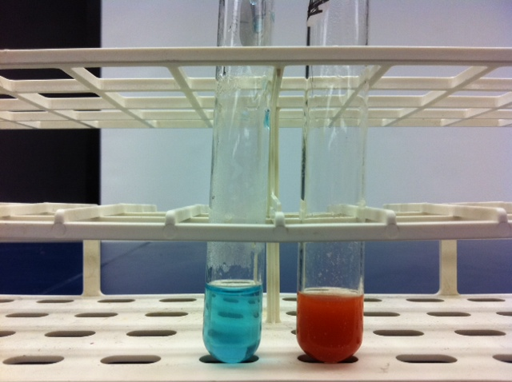
Benedict’s test
* remember Benedict’s requires 2 min. of heat in water bath before reading result
Negative result on the left= no simple sugars present
Positive result on the right= simple sugars present

Slide 21
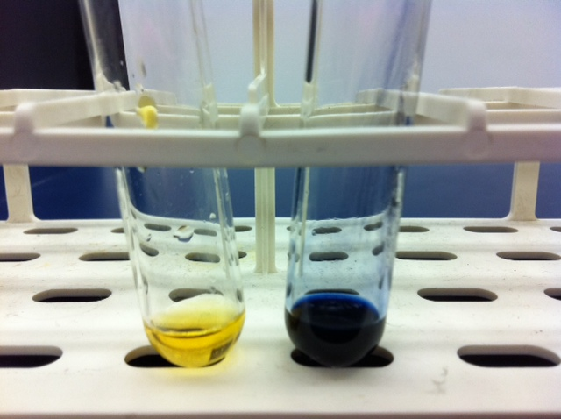
IKI test
Negative result on the left= no starch present
Positive result on the right= starch present

Slide 22
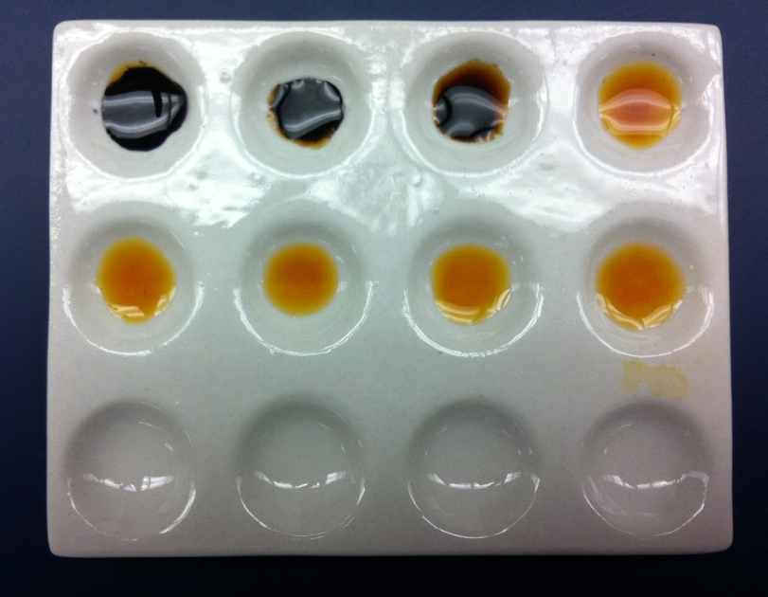
Starch Hydrolysis
Start = 0 min. before hydrolysis
Time=8 min. after hydrolysis is complete
Follow the arrows from start (0 min.) through the completion of the hydrolysis at 8 min. You will see that IKI starts out positive indicating the presence of starch. Over time, the result becomes less positive and eventually becomes negative. What happened to the starch? (HINT: what happens to big polymers during hydrolysis? ) How did we confirm that in fact that was what happened to the starch? (HINT: what did the Benedict’s reagent results show?)

Slide 23
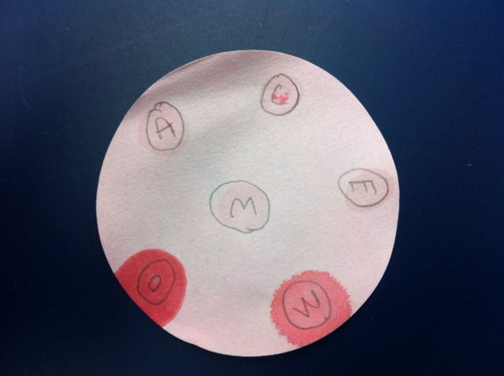
Lipid detection using Sudan IV
Negative control
Slight
Sudan IV binds to lipids when present. Whole milk, vegetable oil and chicken broth were positive for lipids as indicated by the red/orange color. All other substances were negative for lipids.

Slide 24
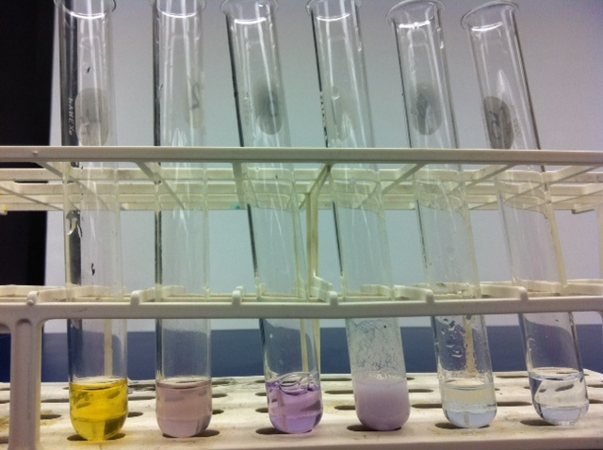
Biuret test
Result: - + + + - -
Will turn purple/violet in the presence of protein. Distilled water is the negative control, as seen on the far right.

Slide 25
USING A DICHOTOMOUS KEY
Practice using the dichotomous key below to identify the following four pictures of salamanders.
1a. Hind limbs are present………………………..……. go to step 2
1b. Hind limbs absent…………………………………….. Siren
2a. External gills present in adults………………….Mud puppy
2b. External gills absent in adults………………….. Go to step 3
3a. Large size ( over 7cm long)………………..…. Go to step 4
3b. Small Size ( under 7cm long) ………..…..… Go to step 5
4a. Body background black, large, white spots irregular in shape and size, completely covering body and tail…………………………………Tiger salamander
4b. Body background black, small round, white spots in a row along each side from head to tail………………………………………….………..Spotted Salamander
5a. Body background black with white spots……………………………….….………………..…Go to step 6
5b. Body background light with dark spots and or lines on body………….………………Go to step 7
6a. Small, white spots on a black background in a row along each side from head to tip of tail……………………………………………Jefferson Salamander
6b. Small, white spots scattered throughout black background from head to tip of tail……………………………………..………….……Slimy salamander
7a. Large, irregular black spots on a light background extending from head to tip of tail……………………………………………....……Marbled salamander
7b. No large irregular black spots on a light background………………………………………………………………………………………..…………..go to step 8
8a. Round spots scattered along back and sides of body, tail flattened like a tadpole……………………………………………….……….Newt
8b. Without round spots and tail is not flattened like a tadpole………………….………………………………………………………………….….go to step 9
9a. Two dark lines bordering a broad, light mid-dorsal stripe with a narrow median dark line extending from the head onto the tail……Two-lined salamander
9b. Without two dark lines running length of body………………………………………………………………………………………………………….………………….....Go to step 10
10a. A light stripe with a running length of body and bordered by a dark pigment extending downward on the sides………………...……. Red-backed salamander
10b. A light stripe extending the length of the body, a marked constriction at the base of the tail…………….…………………………………..….. Four-toed salamander

Slide 26
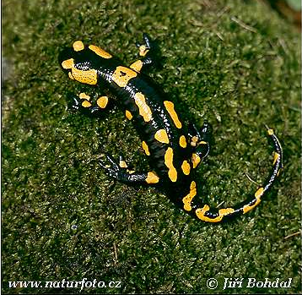
Tiger salamander
(9 cm long)

Slide 27
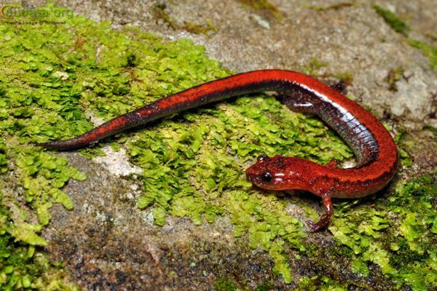
Red-backed salamander
(5cm long)

Slide 28
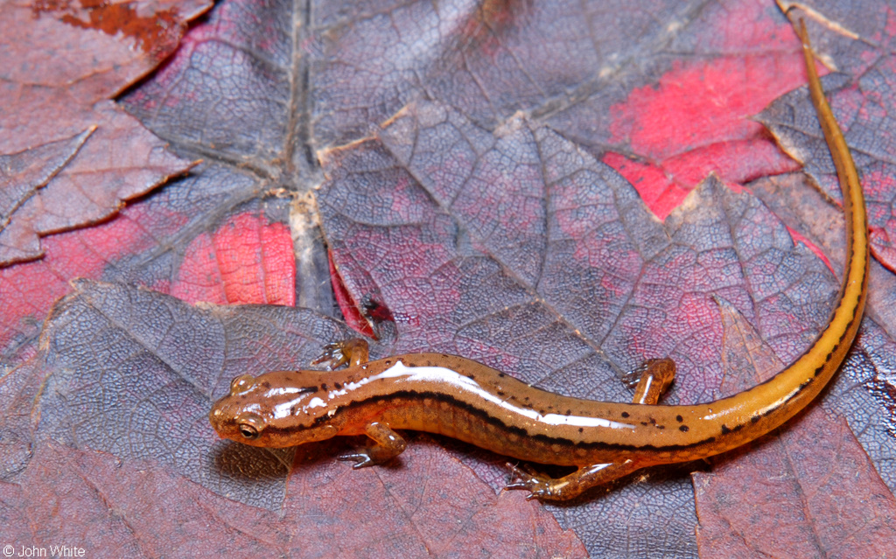
Two-lined salamander
5 cm long

Slide 29
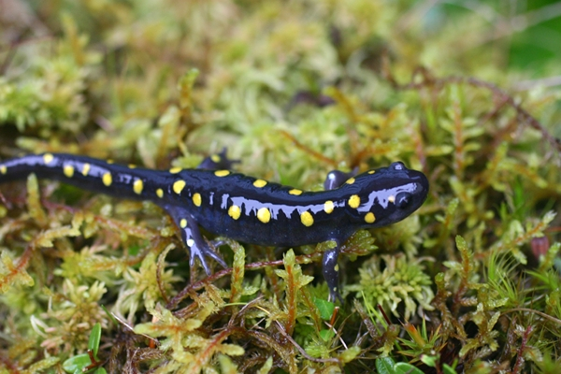
Spotted salamander
(11 cm long)

Slide 30
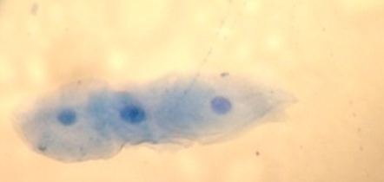
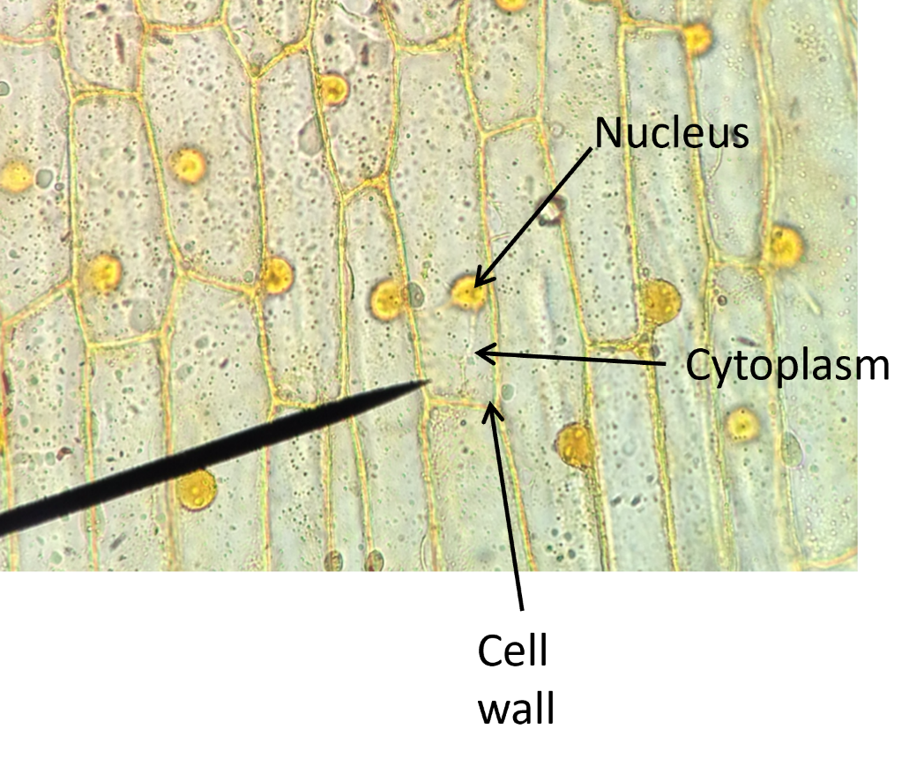
Stained Cells
Stained Human Cheek cells
Stained onion cells
Cytoplasm
Nucleus
Plasma membrane

Slide 31
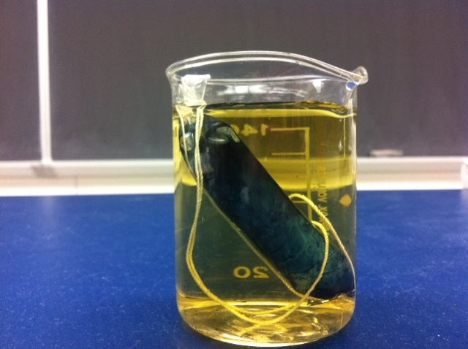
Model cell experiment: simulating simple diffusion across a membrane surface
Which substance/s were able to diffuse across a membrane?
Which substance/s were unable to diffuse? Why not?

Slide 32
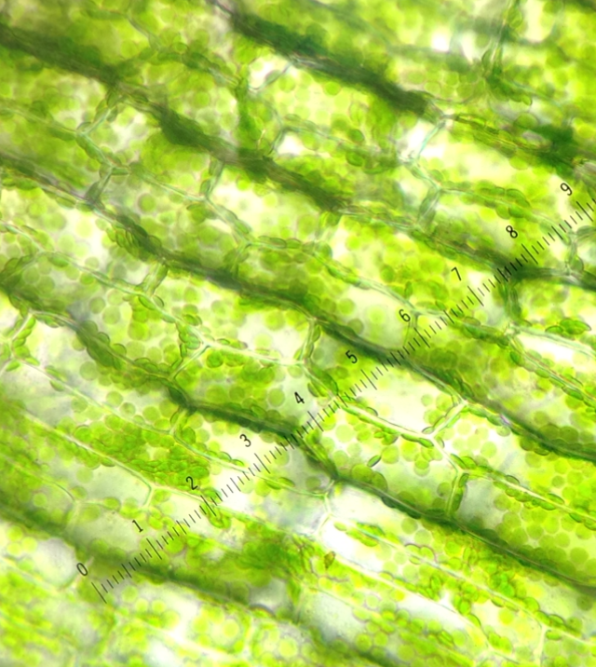
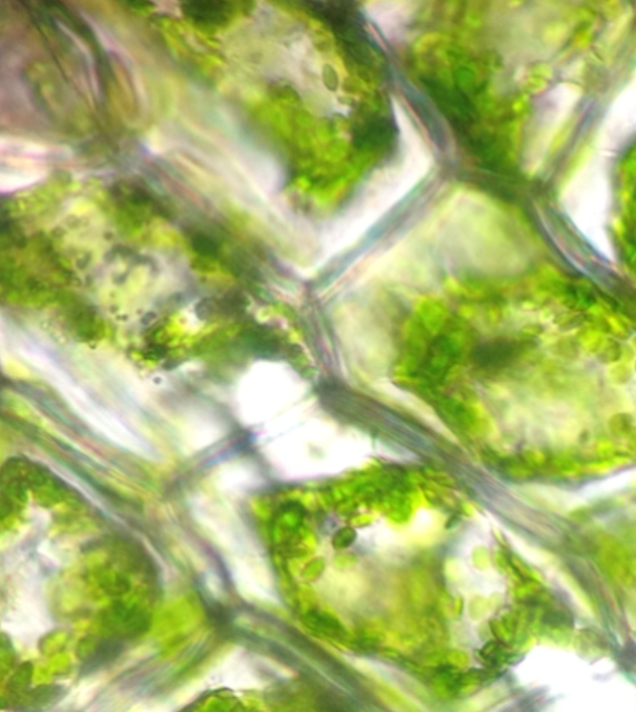
Osmosis in Elodea
Hypotonic solution (dH₂O)
Hypertonic solution (5% saline)
Cell wall
Plasma membrane
When the plant cell is placed in a hypotonic solution the cell gains water and becomes turgid. You should have also been able to see the cytoplasmic streaming.
When the plant cell is placed in a hypertonic solution the cell loses water and becomes plasmolyzed. The plasma membrane which was not visible before now pulls back from the cell wall.

Slide 33
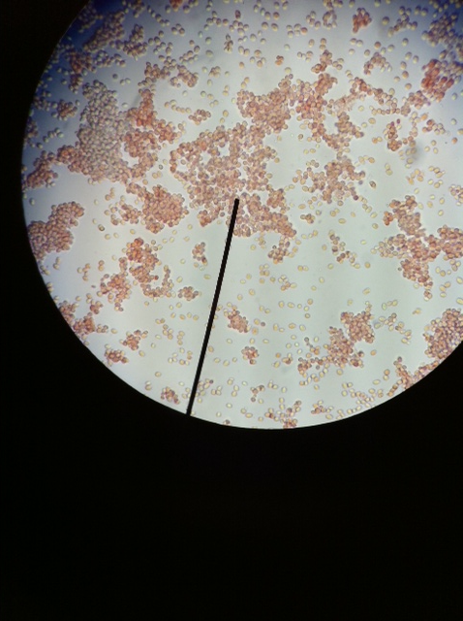
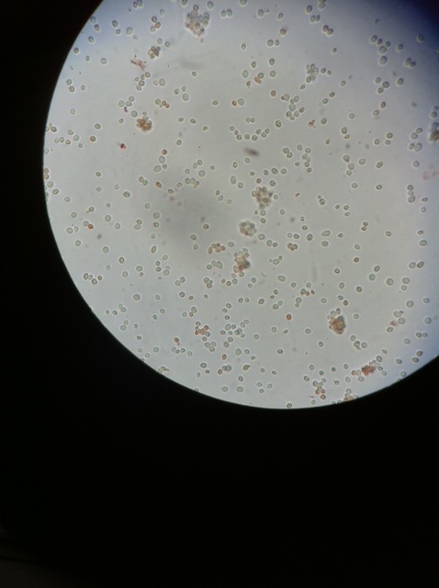
Passive/active transport in yeast
Heat-treated yeast cells
Not heat-treated yeast cells
Notice majority of the yeast cells in this picture are clear. The Congo Red passively diffuses into the cells but the live yeast cells actively pumps the Congo Red back out.
Notice majority of the yeast cells in this picture are red. The Congo Red is able to passively diffuse into the cells but the heat-treated (dead) yeast cells can no longer actively pump the Congo Red back out.

Slide 34
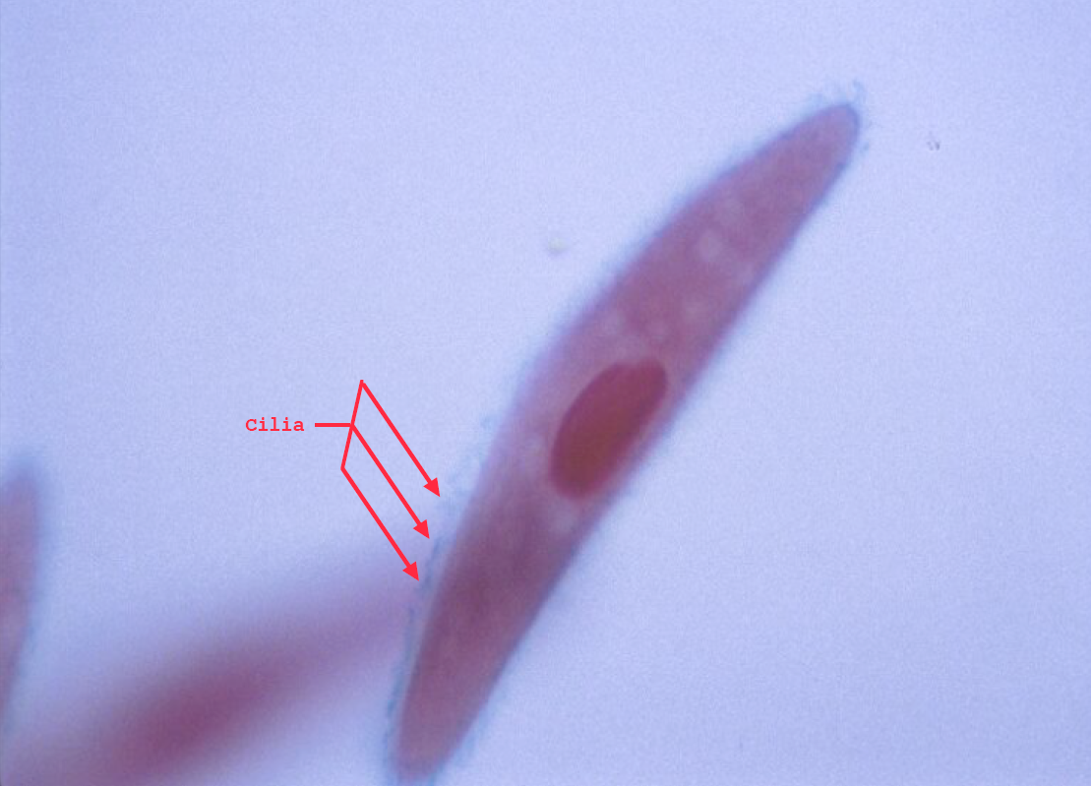
Paramecium sp.
100x
The only thing you will really be able to see inside the cells is the nucleus. You may also be able to see a haze like appearance of the cilia on the outside of the cell. Occasionally you may be able to see the oral groove.
Photo by H. Williams

Slide 35
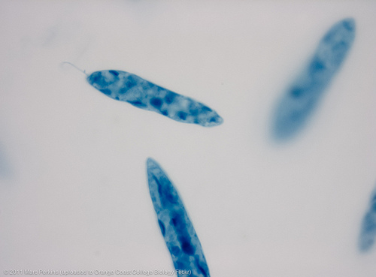
Euglena sp.
You will most likely not be able to see the flagella. However, you should see a lot more inside of the cell than you with the Paramecium sp. You will see the dark stained, large nucleus and all of the chloroplasts.

Slide 36
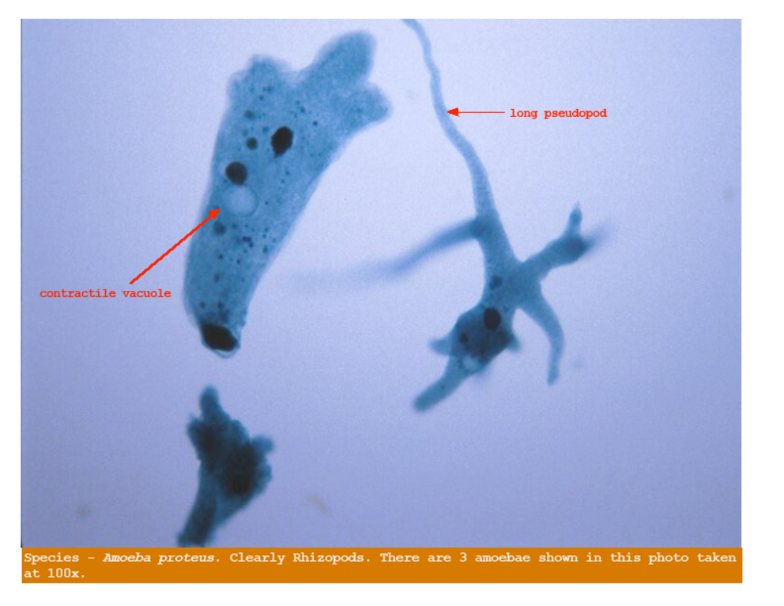
Amoeba sp.
Very irregular shape. Pseudopod (cytoplasmic extensions of microfilaments) used for movement and feeding.
Photo by H. Williams

