Slide 1
Mock Lab Practical #1
MCB2010C Microbiology

Slide 2
Lab Regulations
According to the lab regulations:
1. What PPE is required for all labs in microbiology?
2. What should you do first, if you are injured or spill a culture containing bacteria?

Slide 3
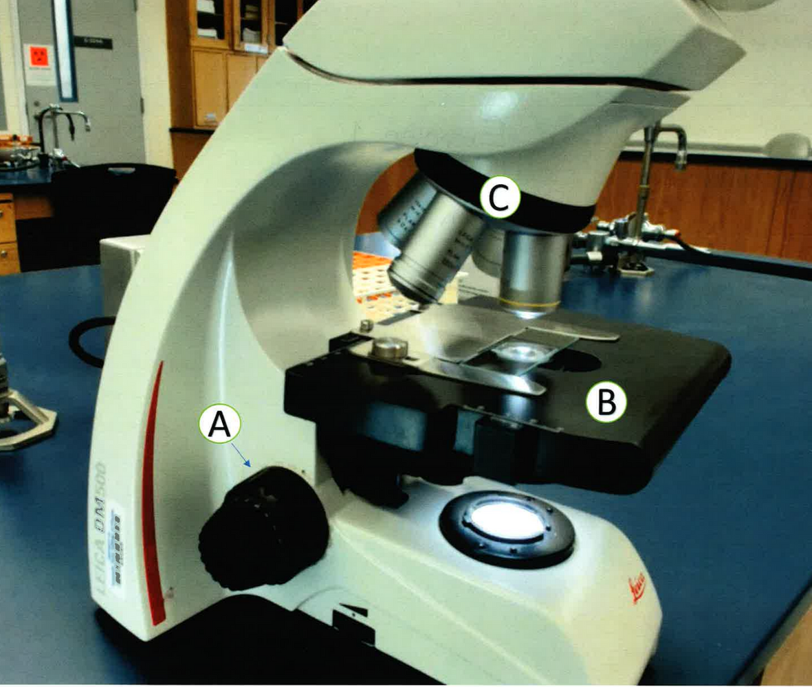
Brightfield Microscopy
3. Identify the microscope part labeled A.
4. Identify the microscope part labeled B.
5. Identify the microscope part labeled C.

Slide 4
Brightfield Microscopy - pg. 1
6. List 2 ways you can increase the resolution.
A)

Slide 5
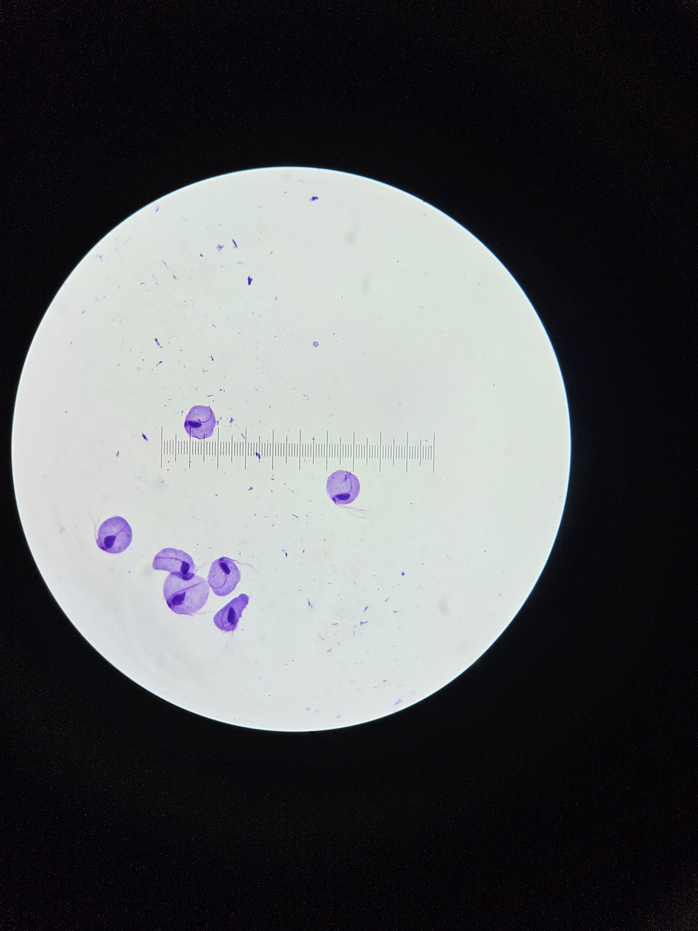
Brightfield Microscopy - pg. 2
7. A microscope has an ocular magnification of 10x. What is the total magnification of a specimen when viewing with the 40x objective lens.
8. What is the size of specimen A shown using the 40X objective? Show your answers with the correct units.
A
B
40x

Slide 6
Darkfield Microscopy
9. What does the background look like in darkfield microscopy?
10. What do the specimens look like in darkfield microscopy?
11. What bacterial morphology (shape) is darkfield microscopy is most useful for and why?

Slide 7
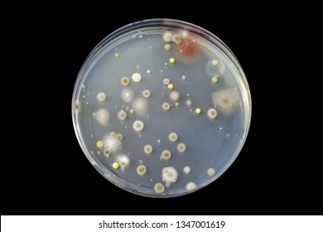
Ubiquity of Microorganisms
12. Describe the appearance of a mold colony in the image shown.
13. Describe the appearance of a bacterial colony in the image shown.

Slide 8
Aseptic Technique- pg. 1
14. List 3 reason why aseptic technique must be used in lab?

Slide 9
Aseptic Technique - pg. 2
15. Write down the correct steps for transferring a culture from a broth to broth?
16. When transferring culture Broth to Broth, which type of inoculating tool is used?

Slide 10
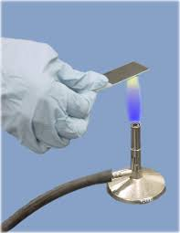
Smear Preparation - pg. 1
17. A student prepared a bacterial smear, heat-fixed the slide, and then stained it. When the student examined the slide under the microscope, no bacterial cells were visible. What mistake during the heat-fixing process could have caused this result? Explain why.
18. What is the purpose of air drying before heat fixing?

Slide 11
Smear Preparation - pg. 2
19. List the steps for preparing a smear from a culture growing on a solid medium.

Slide 12
Smear Preparation - pg. 3
20. List the steps for preparing a smear from a culture growing in a liquid medium.

Slide 13
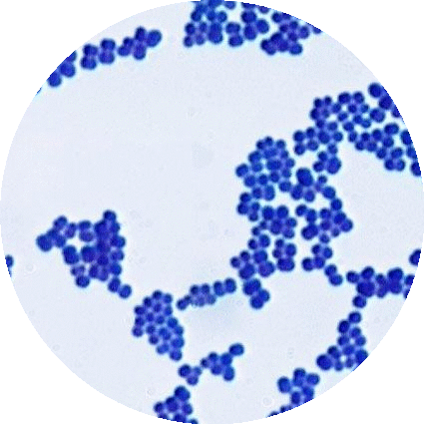
Simple Staining
21. What type of stain is used in simple stain image shown acidic (anionic) or basic (cationic)?
22. Why does this stain color the cells?
23. Describe the shape and arrangement of this organism based on the picture below.

Slide 14
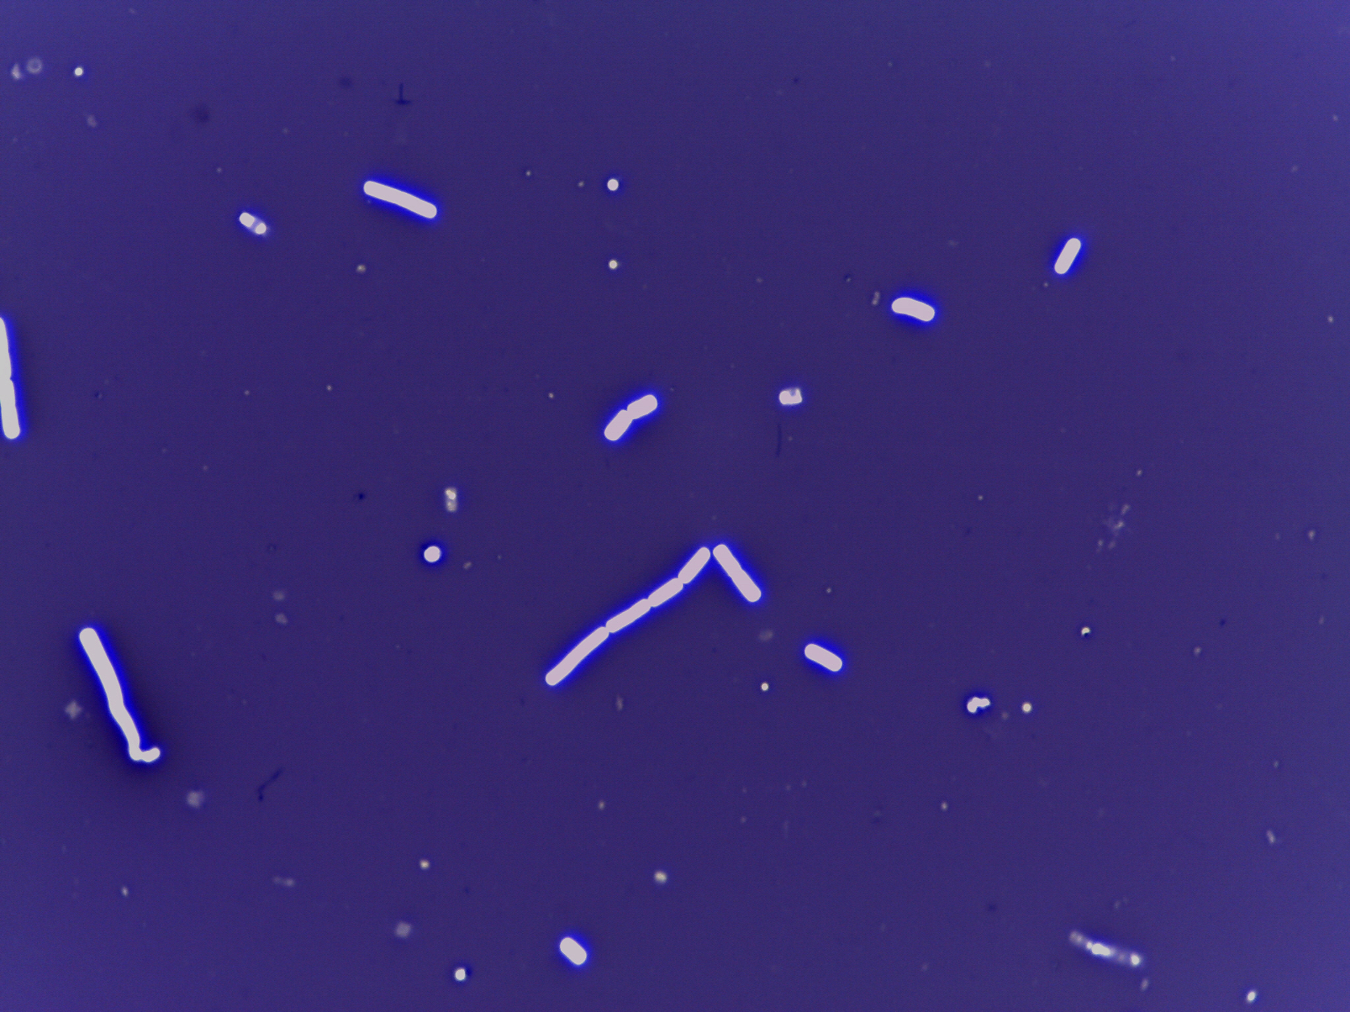
Negative Staining
24. What type of stain is used in negative stain image shown acidic (anionic) or basic (cationic)?
25. Why doesn't this stain color the cells?
26. Describe the shape and arrangement of this organism based on the image.
27. What is the name of the organism based on the image. Genus and species, no abbreviation.

Slide 15
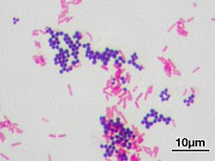
Gram Staining - pg. 1
28. Write the steps of Gram Staining?
29. What shape are the Gram negative and Gram positive cells in the image shown?
30. Name two organisms used in the gram stain exercise (Genus and species, no abbreviations)

Slide 16
Gram Staining - pg. 2
After the second step of adding Gram’s iodine Gram positive and Gram negative appear what color?
What can you expect to see if you forget to use the mordant in Gram staining?
33. What step of Gram staining has the most critical timing and why?

Slide 17
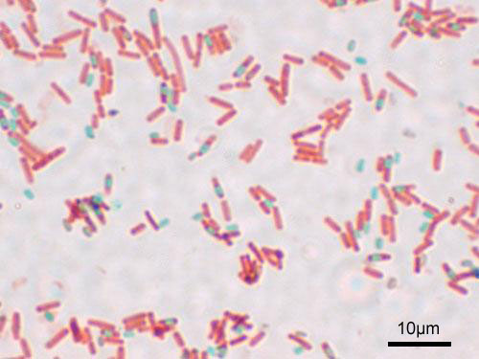
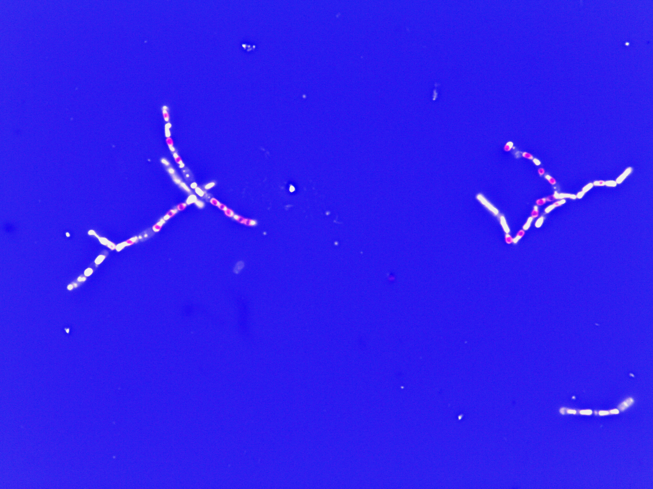
Endospore Staining
34. Compare the final appearance of endospores and vegetative cells in both the Schaeffer–Fulton and Dorner methods.
35. Why is heat applied during the spore staining process?

Slide 18
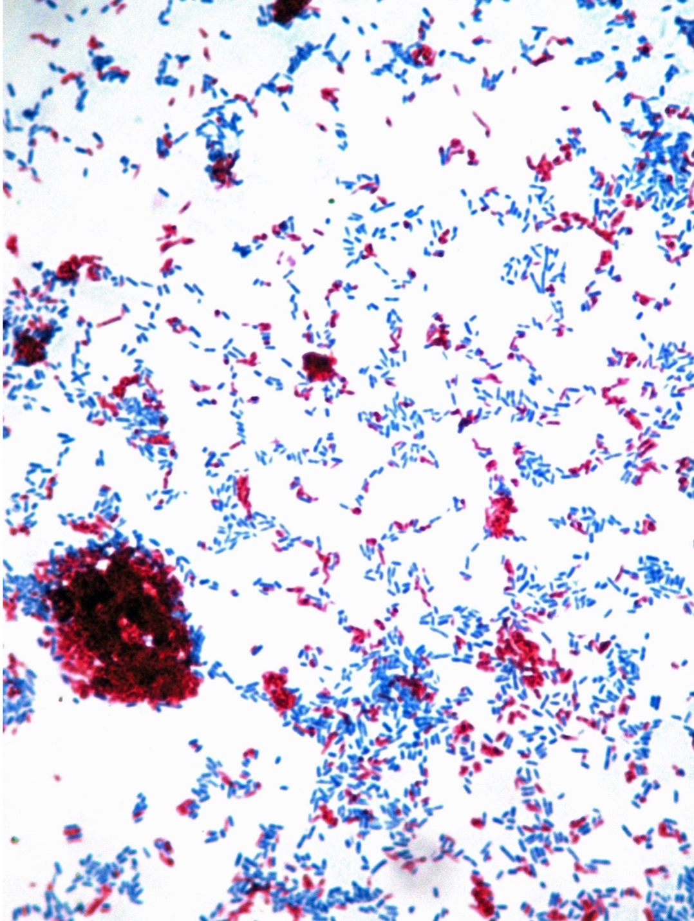
Acid-fast Staining - pg. 1
36. What is the primary stain used in the Ziehl–Neelsen method, and what type of organisms is it designed to detect?
37. Why is heat applied during the Ziehl–Neelsen staining process, and how does it affect the penetration of the dye?

Slide 19
Acid-fast Staining - pg. 2
38. After acid-alcohol decolorization, what color will acid-fast bacteria appear compared to non acid-fast bacteria?
39. Name the genus and species of the acid-fast bacteria used in this lab. (No Abbreviation)

Slide 20
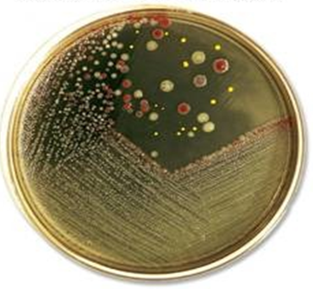
Pure Culture Techniques
40. Was the proper quadrant streak technique used in this image. Explain answer.
41. Describe the steps that you would take to isolate a pure culture form the plate and confirm its purity.

Slide 21
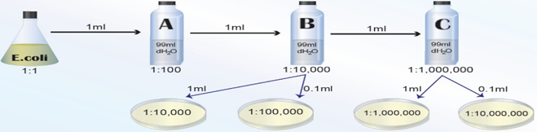
Enumeration of Bacteria - pg. 1
42. Solve for Original Cell Density:
If 267 colonies were counted on the plate in which 0.1 ml was plated out of bottle C in figure below.

Slide 22
Enumeration of Bacteria - pg. 2
Explain the relationship between the percentage (%) light Transmittance (T) and the optical Density (O.D).
44. Differentiate between direct and indirect methods of bacterial enumeration and give one example of each.
45. Determine the optical density of a bacteria sample with a % of transmittance of 23.5.

Slide 23
Basic Microbiology Media - pg. 1
46. What is the purpose of Trypticase Soy Agar (TSA)?
47. How does Blood Agar (BA) differentiate between types of hemolysis?
48. What group of organism are selected for by TSA with 10% NaCl?

Slide 24
Basic Microbiology Media - pg. 2
49. What is the purpose of Mannitol in Mannitol Salt Agar (MSA)?
50. What is the selective agent in MacConkey (MAC) agar, and how does the medium differentiate between lactose fermenters and non lactose fermenters?

Slide 25
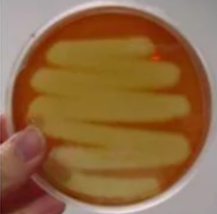
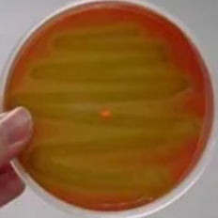
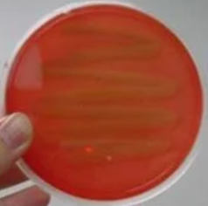
Basic Microbiology Media - pg. 3
51. Identify all the different types of hemolysis
52. Provide the Genus and species of the organisms growing on plate A and plate C (No Abbreviation).
A
B
C

Slide 26
Motility Determination
List two methods to identify motility?
List advantages of each method.
55. Which organism used in this lab was motile?
(Genus and species, no abbreviation)

Slide 27
Effects of Oxygen on Growth
  56. Describe the growth patterns of obligate aerobes, facultative anaerobes, and obligate anaerobes in
Fluid Thioglycolate medium.
57. Identify a Genus and species in each growth patterns.
(No abbreviation)

