Slide 1
Lab Practical #2 Review
General Biology I
Professor D. Rinne

Slide 2
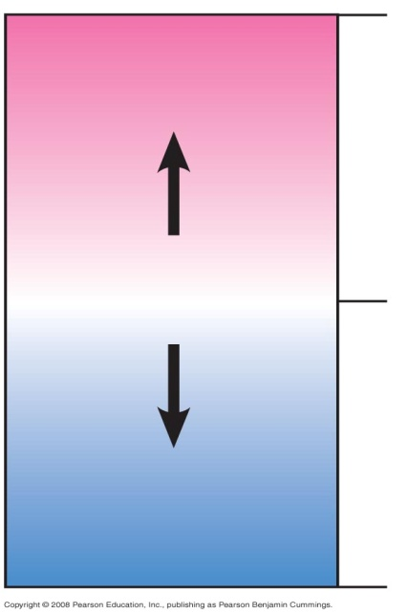
What is the effect of pH on catalase activity?
pH | Net Pressure (kpa)
4 | 0
7 | 2.212
10 | 1.34
12 | 0
0
Acidic
[H⁺] > [OH–]
Neutral
[H⁺] = [OH–]
7
Individual/group/class data may vary. Interpret the data table and figure above. What do the results indicate? What is the optimal pH for catalase?
Basic
[H⁺] < [OH–]
14

Slide 3
What is the effect of temperature on catalase activity?
Temperature (◦C) | Net Pressure (kpa)
0 (ice) | 0.4535
21 (room) | 3.84
40 | 5.3015
80 | 1.7835
Individual/group/class data may vary. Interpret the data table and figure above. What do the results indicate? What is the optimal temp. for catalase?

Slide 4
What is the effect of substrate concentration on catalase activity?
Substrate Concentration (%) | Net Pressure (kpa)
0 (dH₂O) Control | -.05
0.375 | 2.4
0.75 | 7.8
1.5 | 14.2
Individual/group/class data may vary. Interpret the data table and figure above. What do the results indicate? What happens to enzyme activity as substrate concentration increases?

Slide 5
What is the effect of enzyme (blood) concentration on catalase activity?
What is the effect of inhibitors on enzyme activity?
Blood Concentration (%) | Net Pressure (kpa)
0 (dH₂O) Control | 0.0165
0.75 | 0.687
1.5 | 1.1565
3.0 | 3.15
3.0 (and CuSo₄ Inhibitor) | 0.3855
Individual/group/class data may vary. Interpret the data table and figure above. What do the results indicate? What happens to enzyme activity as enzyme concentration increases? What happens to enzyme activity when an inhibitor is present?

Slide 6
Photosynthesis/Cellular Respiration in Plant leaves
LIGHT OFF
LIGHT ON
LIGHT OFF
LIGHT ON
Cellular respiration
Organic molecules + Oxygen Water + Energy + CO₂
Photosynthesis
Water + Light + CO₂ Organic Molecules + Oxygen
Hint: Recall that Carbon dioxide is made in cellular respiration and used in photosynthesis
Looking at the graph, you can see that during periods of the light being OFF, CO₂ levels rapidly increase, confirming that cellular respiration is taking place ONLY. Photosynthesis cannot occur without light. During periods in which the light is ON, CO₂ levels decline, as photosynthesis begins using CO₂. Keep in mind that although photosynthesis in now taking place, cellular respiration has NOT stopped.

Slide 7
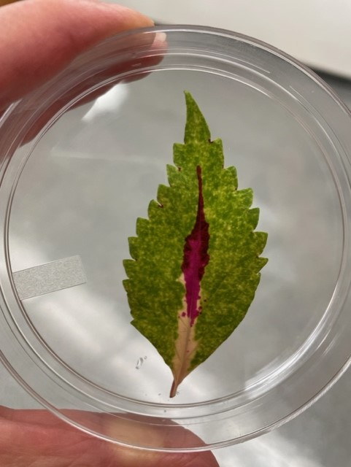
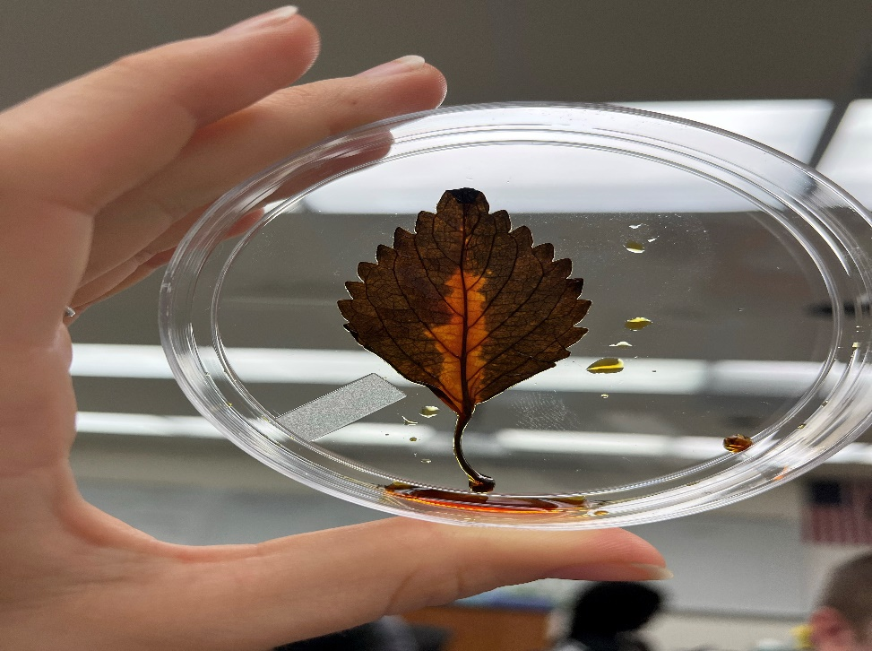
Relationship between photosynthesis and starch
If plants use chlorophyll to carry out photosynthesis…
AND photosynthesis makes sugars…
AND starch is a sugar…
AND IKI tests for starch…
Then IKI can indicate where photosynthesis is taking place!
Pink areas contain anthocyanin-NOT a photosynthetic pigment --and therefore, do not
test positive with IKI
Green areas contain chlorophyll and therefore test positive with IKI
After
Before

Slide 8
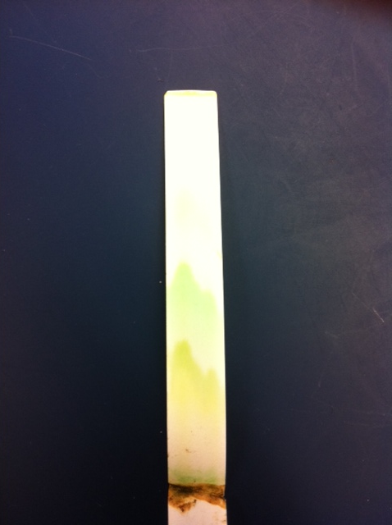
Paper Chromatography
Molecules separate according to size…which ones travel farthest? The pigments with the smallest molecular weight or the largest? (HINT: Imagine carrying a 70 lb. suitcase and head out for a run? How far did you get?)
  Carotenoids: dark yellow
  Xanthophylls: light yellow
  Chlorophyll a: dark green
  Chlorophyll b: light green
C
X
A
B
Origin

Slide 9
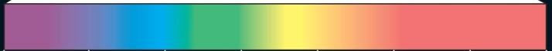
What does the absorption spectrum generated for these plant pigments indicate?
Which wavelength(s) of light does each pigment absorb best?
How does absorbance correlate to the color in which the pigment appears (i.e.transmittance)?
Wavelength (nm) | Chlorophyll a | Chlorophyll b | Xanthophylls | Carotene
400 | 0.035 | 0.024 | 0 | 0.02
425 | 0.082 | 0.044 | 0.015 | 0.028
450 | 0.051 | 0.052 | 0.022 | 0.038
475 | 0 | 0.035 | 0.009 | 0.031
500 | 0 | 0.011 | 0 | 0.019
525 | 0 | 0.008 | 0 | 0.012
550 | 0 | 0.012 | 0 | 0.008
575 | 0.012 | 0.014 | 0 | 0.005
600 | 0.012 | 0.014 | 0 | 0.004
625 | 0.018 | 0.017 | 0 | 0.003
650 | 0.035 | 0.027 | 0 | 0.003
675 | 0.044 | 0.018 | 0 | 0.005
700 | 0.004 | 0.008 | 0 | 0.004

Slide 10
Cell Cycle
Includes Interphase and M Phase (Mitosis and Cytokinesis)

Slide 11
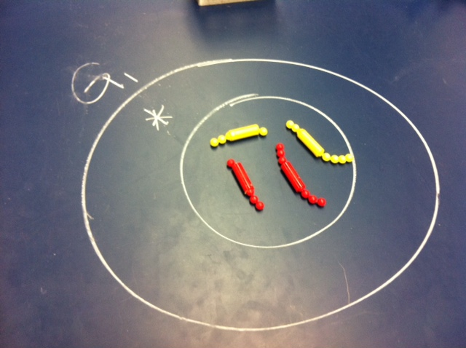
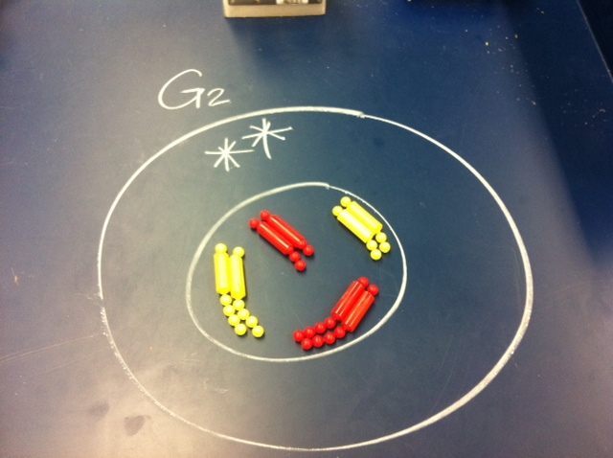
Interphase
S

Slide 12
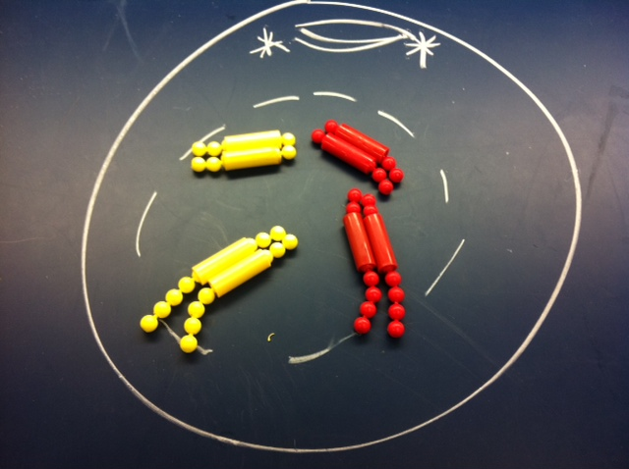
Prophase

Slide 13
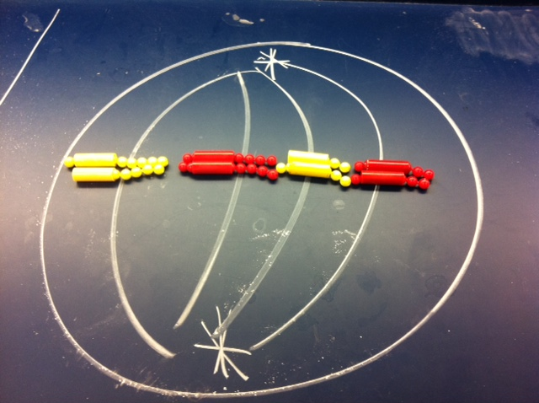
Metaphase

Slide 14
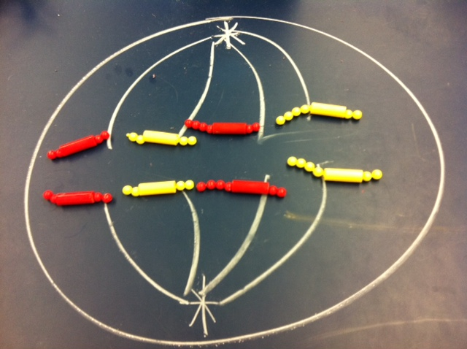
Anaphase

Slide 15
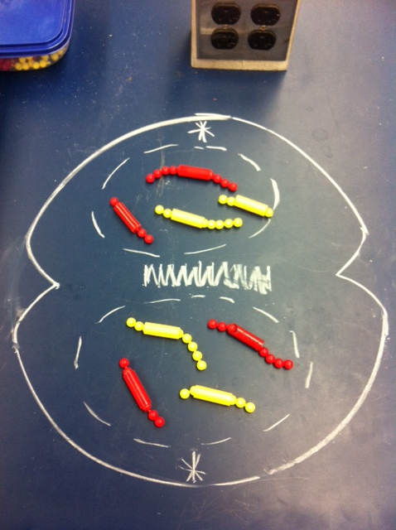
Telophase & Cytokinesis

Slide 16
MEIOSIS

Slide 17
Interphase of Meiosis
S

Slide 18
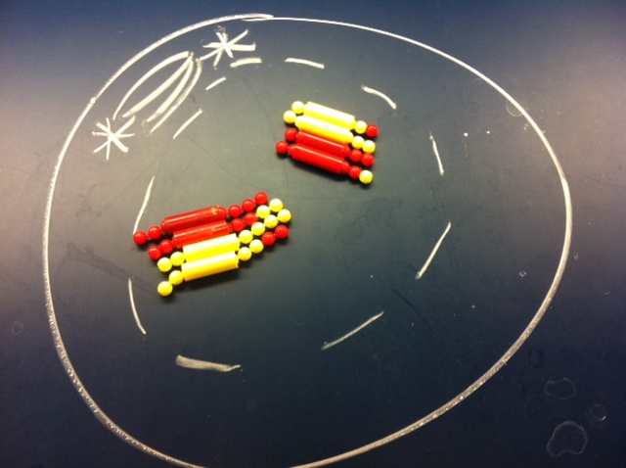
Prophase I

Slide 19
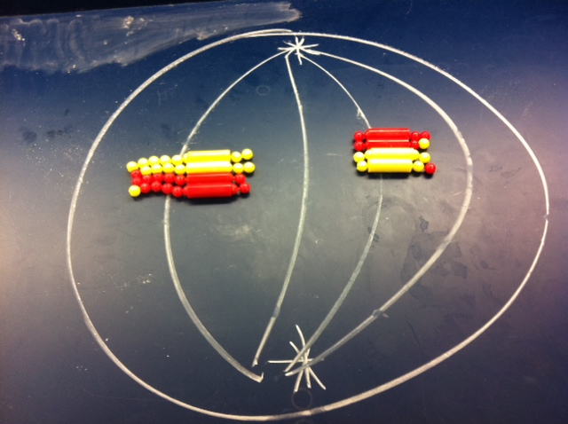
Metaphase I

Slide 20
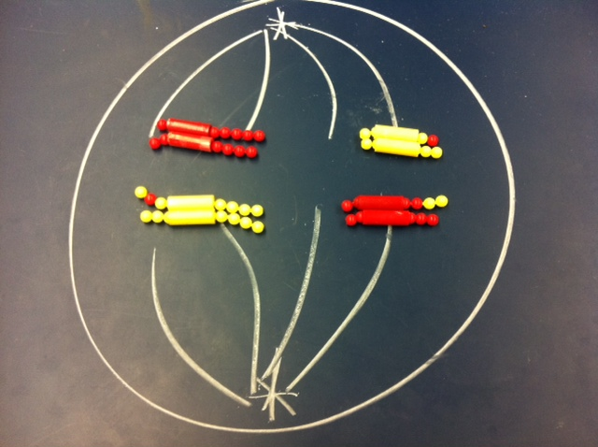
Anaphase I

Slide 21
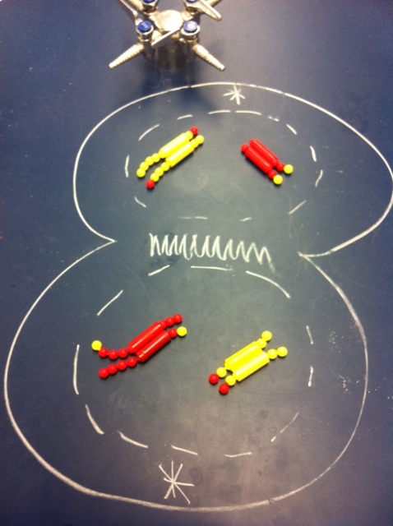
Telophase I & Cytokinesis

Slide 22
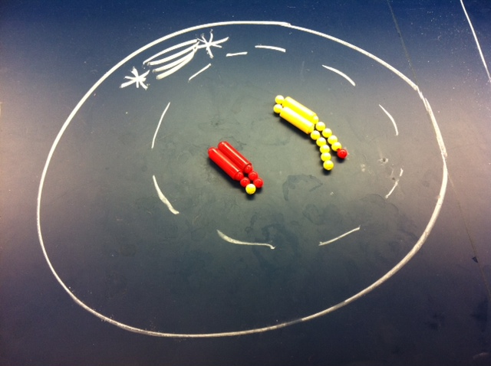
Prophase II

Slide 23
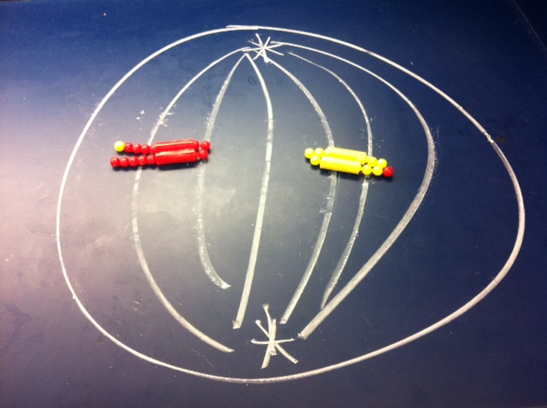
Metaphase II

Slide 24
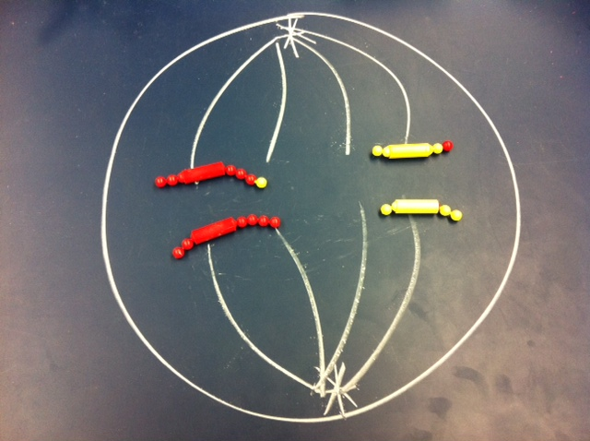
Anaphase II

Slide 25
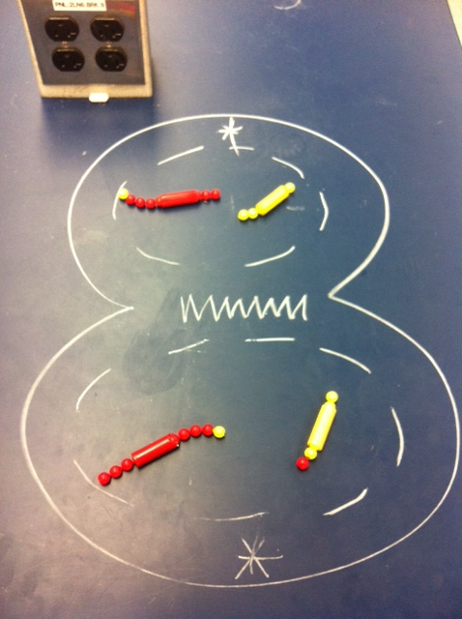
Telophase II & Cytokinesis

Slide 26
Chromosome = a single DNA molecule
Duplicated chromosome = a chromosome which has made an extra copy of itself to prepare for division, consists of 2 sister chromatids attached at the centromere
Chromo… what?
# of chromosome here= 4
# of chromatids here= 8
# of chromosome here= 4
During S phase, all chromosomes replicate their DNA and will now consist of 2 sister chromatids attached. As long as the chromatids are still connected to one another they are considered one chromosome. It is not until the chromatids are pulled apart from one another that they become full-fledged chromosomes.

Slide 27
Challenge yourself: How many chromatids and/or chromosomes in each picture?

Slide 28
Diploid vs. haploid
Diploid (2n) cells will have two complete sets of chromosomes (i.e. both members of a homologous pair will be present). Having a yellow and red chromosome in a cell is NOT enough to be diploid…the chromosomes must be of the same length.
Diploid 2n=4
Haploid (n=2)
This cell is diploid because there are 2 matching pairs here. There is a short red and short yellow. There is a long red and long yellow.
At first glance, it may appear that this cell is diploid because there is a chromosome of each color. However, this is not a matching pair.

Slide 29
Challenge YOURSELF
In the following pictures, I will show 3 pictures of cells taken from the same phase from different cycles (Mitosis, Meiosis I and Meiosis II). Your goal is to be able to distinguish which stage you are in and why.

Slide 30


Prophase Comparison
Nuclear envelope breaking down
Mitotic spindle begins to form
Mitosis
Meiosis I
Meiosis II
No crossing over or synapsis here
Yellow bead on red chromosome and red bead on yellow indicates that crossing over has already occurred.
Cell is haploid which indicates that you must be in meiosis II not Meiosis I.
Synapsis and crossing over occurring here
NOTE: This is only one example of a cell in Prophase II. Remember, due to independent assortment, it is random how the pairs line up at the metaphase plate and therefore, there are several possible combinations. They could even be the same color chromosomes.

Slide 31
Metaphase Comparison
Chromosomes attached to microtubules and lined up at
middle of cell (metaphase plate)
Mitotic spindle is complete
Mitosis
Meiosis I
Meiosis II
Individual chromosomes lined up at the middle
Synapsed homologous pairs lined up at the middle.
The cell is diploid in Meiosis I.
Individual chromosomes lined up at the middle. However, unlike mitosis, there is evidence that crossing over has previously occurred. The cell is haploid in Meiosis II.
NOTE: Remember independent assortment of chromosomes means that it is random how the pairs line up at the middle. It is possible that each pair could line up the same way (e.g. yellow on top for both).
NOTE: This is only one example of a cell in Metaphase II. Remember, due to independent assortment, it is random how the pairs line up at the metaphase plate and therefore, there are several possible combinations. They could also be the same color chromosomes.

Slide 32
Anaphase Comparison
Microtubules are shortening/lengthening the cell
Mitosis
Meiosis I
Meiosis II
Separation of chromatids here. Each chromatid now considered an individual chromosome.
Synapsed homologous pairs separated here.
The cell is diploid in Meiosis I.
Separation of chromatids here. Each chromatid now considered an individual chromosome.However, unlike mitosis, there is evidence that crossing over has previously occurred. The cell is haploid in Meiosis II.
NOTE: Remember due to the independent assortment in metaphase I, there are several possibilities of how these cells could look

Slide 33
Telophase & Cytokinesis Comparison
Cleavage furrow or cell plate forming
Nuclear envelope reforming at opposite poles
Mitosis
Meiosis I
Meiosis II
NOTE: Remember due to the independent assortment in metaphase I, there are several possibilities of how these cells could look
This division will result in 2 identical daughter cells.
There is evidence that crossing over has previously occurred which indicates meiosis. Chromatids are still connected by centromere so it must be meiosis I. When this division is complete there will be 2 non-identical daughter cells which are haploid. This is why all of Meiosis II is haploid.
There is evidence that crossing over has previously occurred which indicates meiosis. Chromatids have already being separated which means it must be meiosis II. Unlike mitosis, when this division is complete there will be 2 non-identical daughter cells which are haploid.

Slide 34
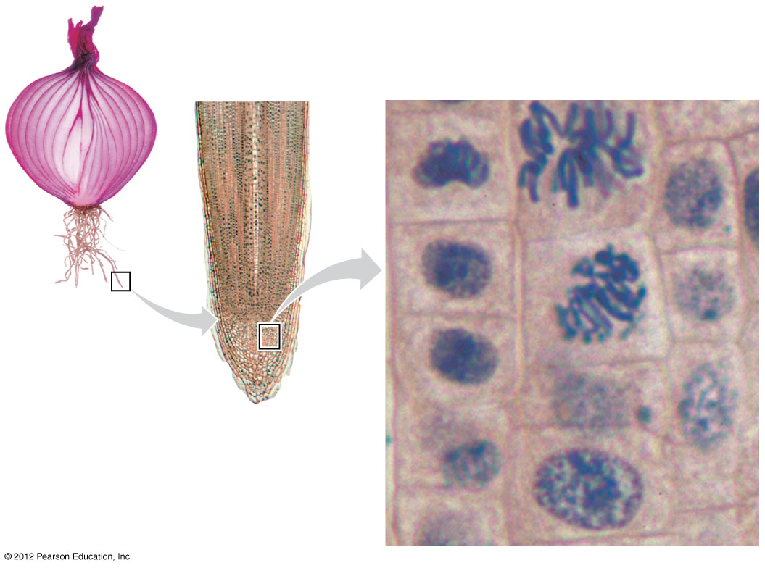
Mitosis- onion root tip

Slide 35
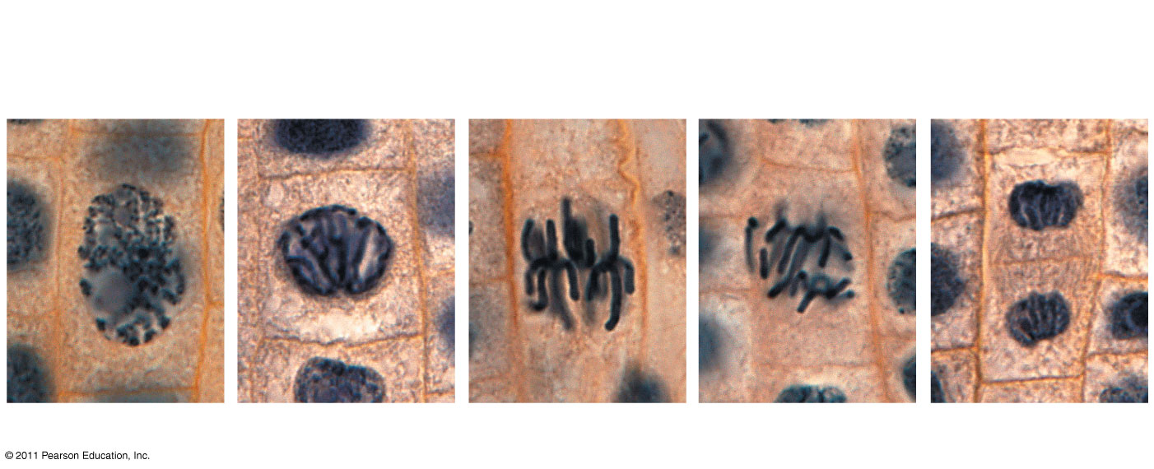
Plant Mitosis- onion root tip
Chromatin
condensing
Nucleus
Nucleolus
Chromosomes
Cell plate
1
Prophase
2
Prometaphase
Metaphase
4
Anaphase
5
Telophase
Notes:
Figure 12.11 Mitosis in a plant cell.

Slide 36
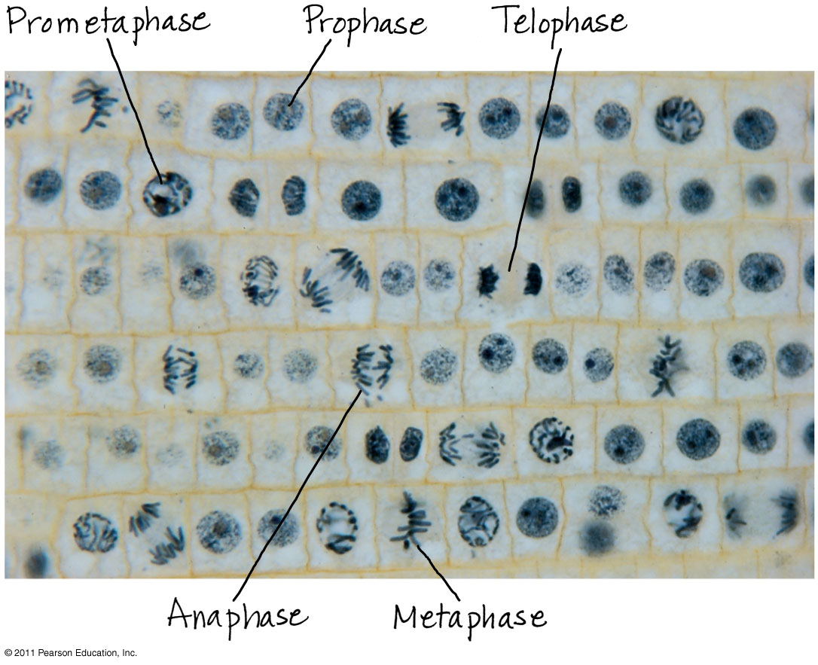
Plant Mitosis- microscope image
Notes:
Figure 12.UN05 Appendix A: answer to Test Your Understanding, question 7

Slide 37
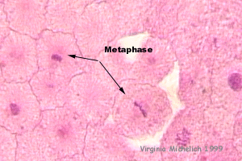
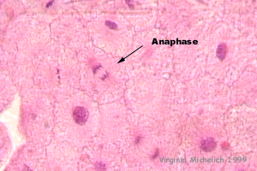
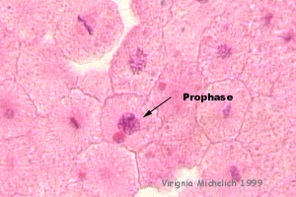
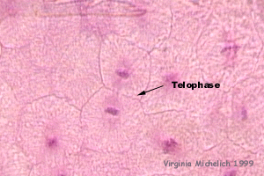
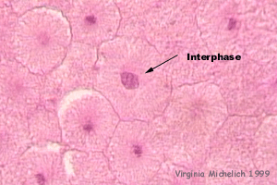
Mitosis-fish blastula

Slide 38
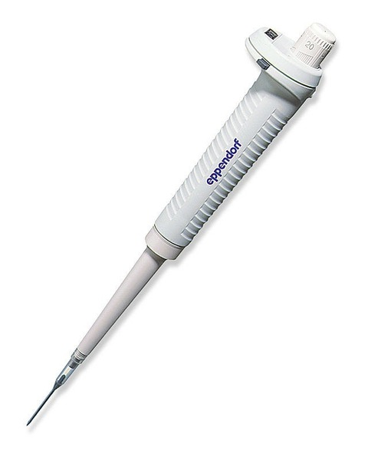
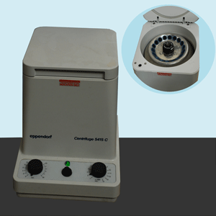
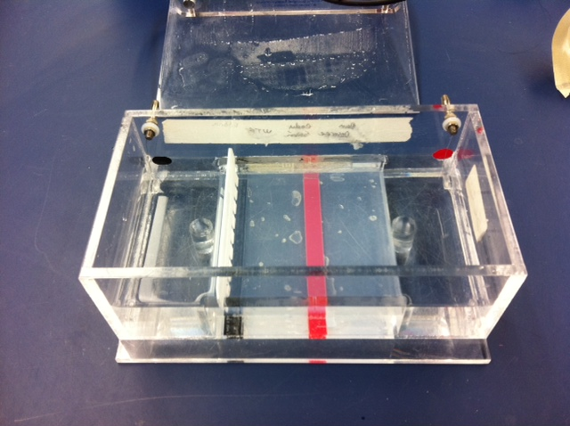
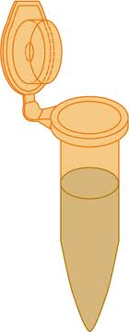
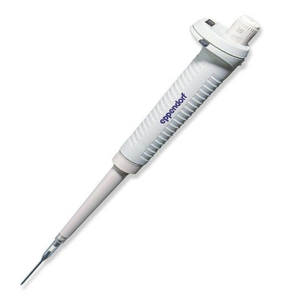
DNA Fingerprinting
1. Add loading dye to DNA sample with or without restriction enzyme
2. Centrifuge sample
3. Place tray in chamber and fill with buffer until gel is covered
4. Load samples into the wells in the gel
5. Place cover on and turn on voltage

Slide 39
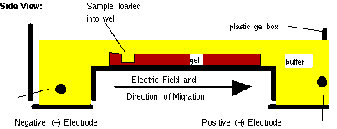
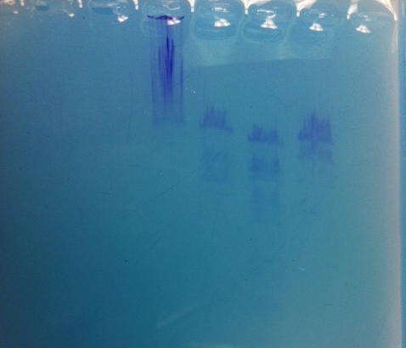
Agarose Gel Electrophoresis Sample Result
Because DNA is negatively charged, the DNA is pulled towards the positive electrode
Uncut DNA
DNA fragments separate out according to size (i.e. smaller fragments traveler farther distances from the well)
Largest fragment
Smallest fragment
# of bands produced= # of fragments of DNA # of recognition sites= # of fragments -1

Slide 40
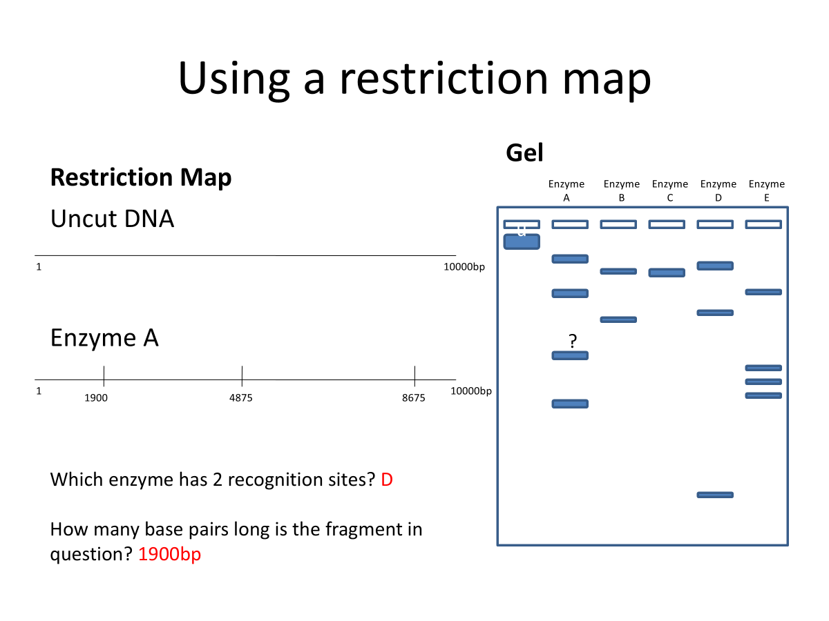
Using a restriction map
Restriction Map
Gel
Which enzyme has 2 recognition sites? D
How many base pairs long is the fragment in question? 1900bp

