Slide 1
The Skeletal System
The Axial Skeleton
The Vertebral Column and Thoracic Cage
Photographed by:
Dr. Syed Arif Humayun
Dr. Laila Nimri
Labeled and Made Accessible by:
Dr. Laila Nimri
Edited by:
Dr. Maya Byfield Mr. James Henry
Dist. Prof. Mary Dolnack Dr. Syed Arif Humayun
Dr. Essa Farah Dr. Laila Nimri

Slide 2
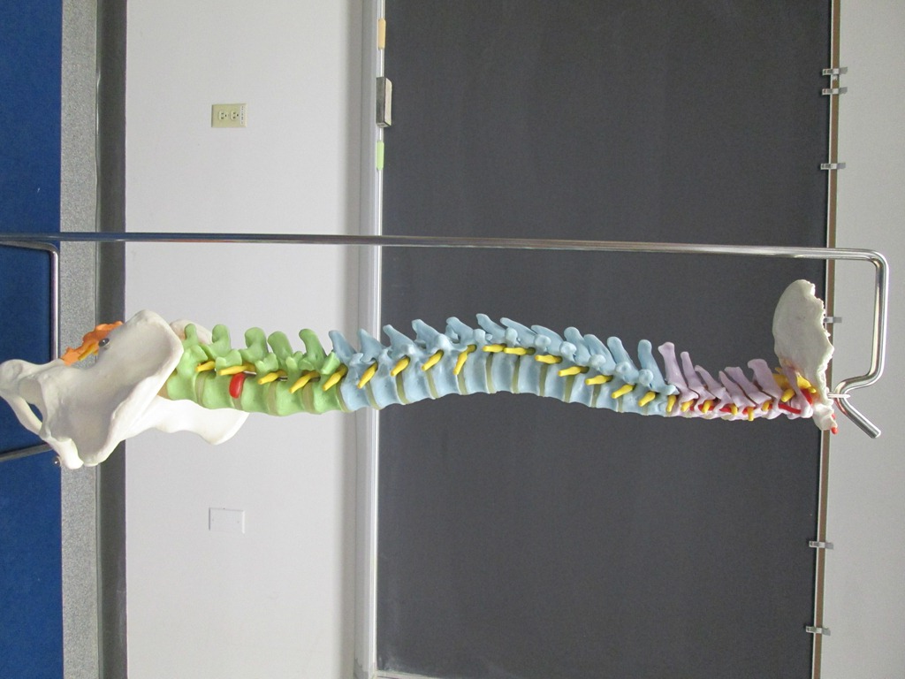
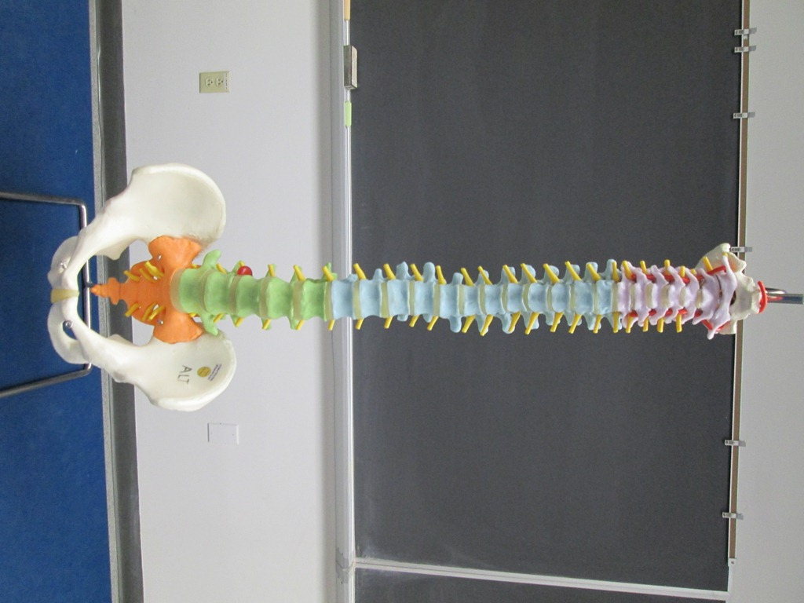
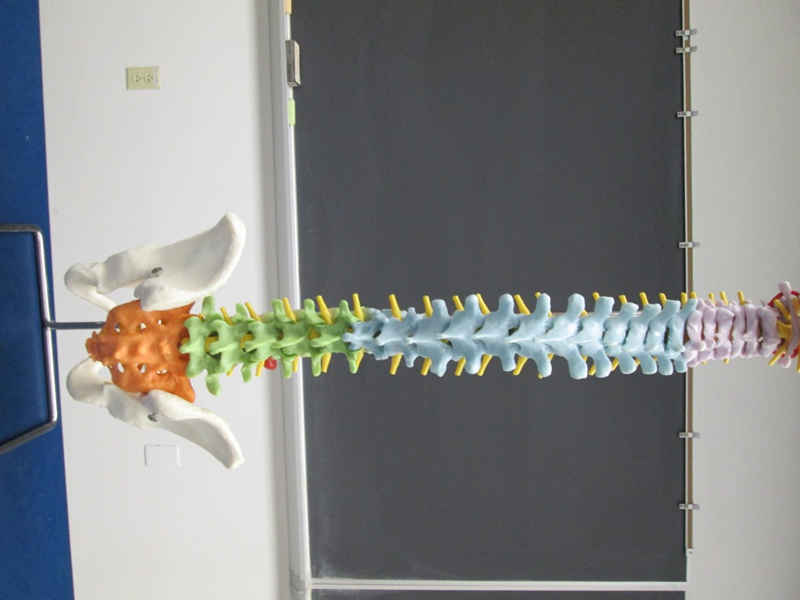
Vertebral Column
Secondary
(Cervical)
curvature
Primary
(Thoracic)
curvature
Secondary
(Lumbar)
curvature
Primary
(Sacral)
curvature
Anterior view
Posterior view

Slide 3
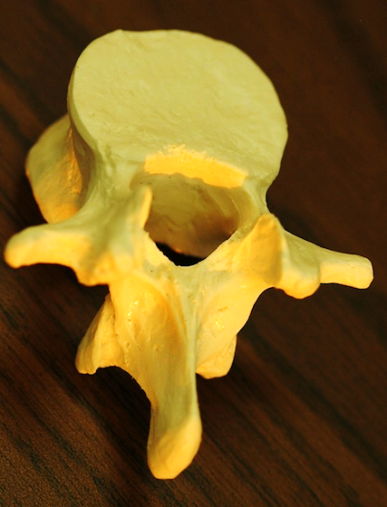
Vertebral Anatomy
(Superior view of a lumbar vertebra)
Body
Vertebral foramen
Pedicle
Superior articular facet
Vertebral arch
Superior articular process
Lamina
Transverse process
Inferior articular process
Spinous process

Slide 4
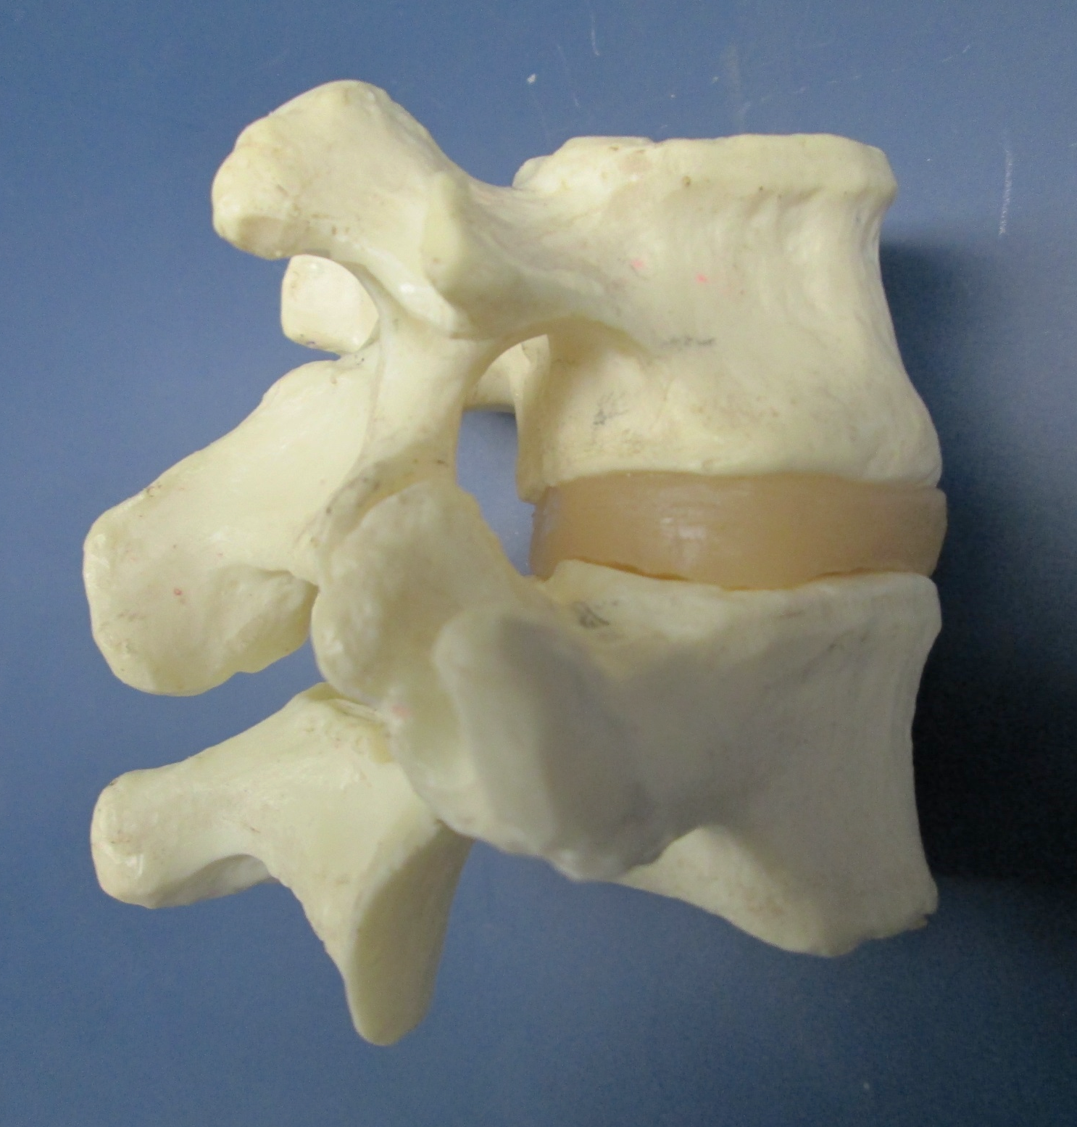
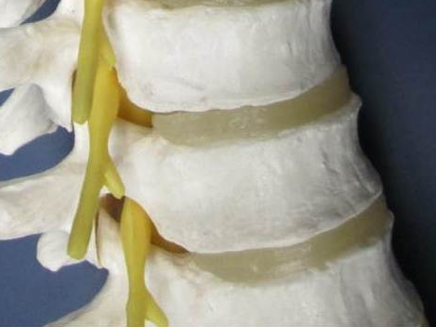
Articulation Between Lumbar Vertebrae
(Lateral view)
Superior articular process
Transverse process
Body
Intervertebral foramen
Intervertebral disc
Inferior
articular process
Inferior articular facet

Slide 5
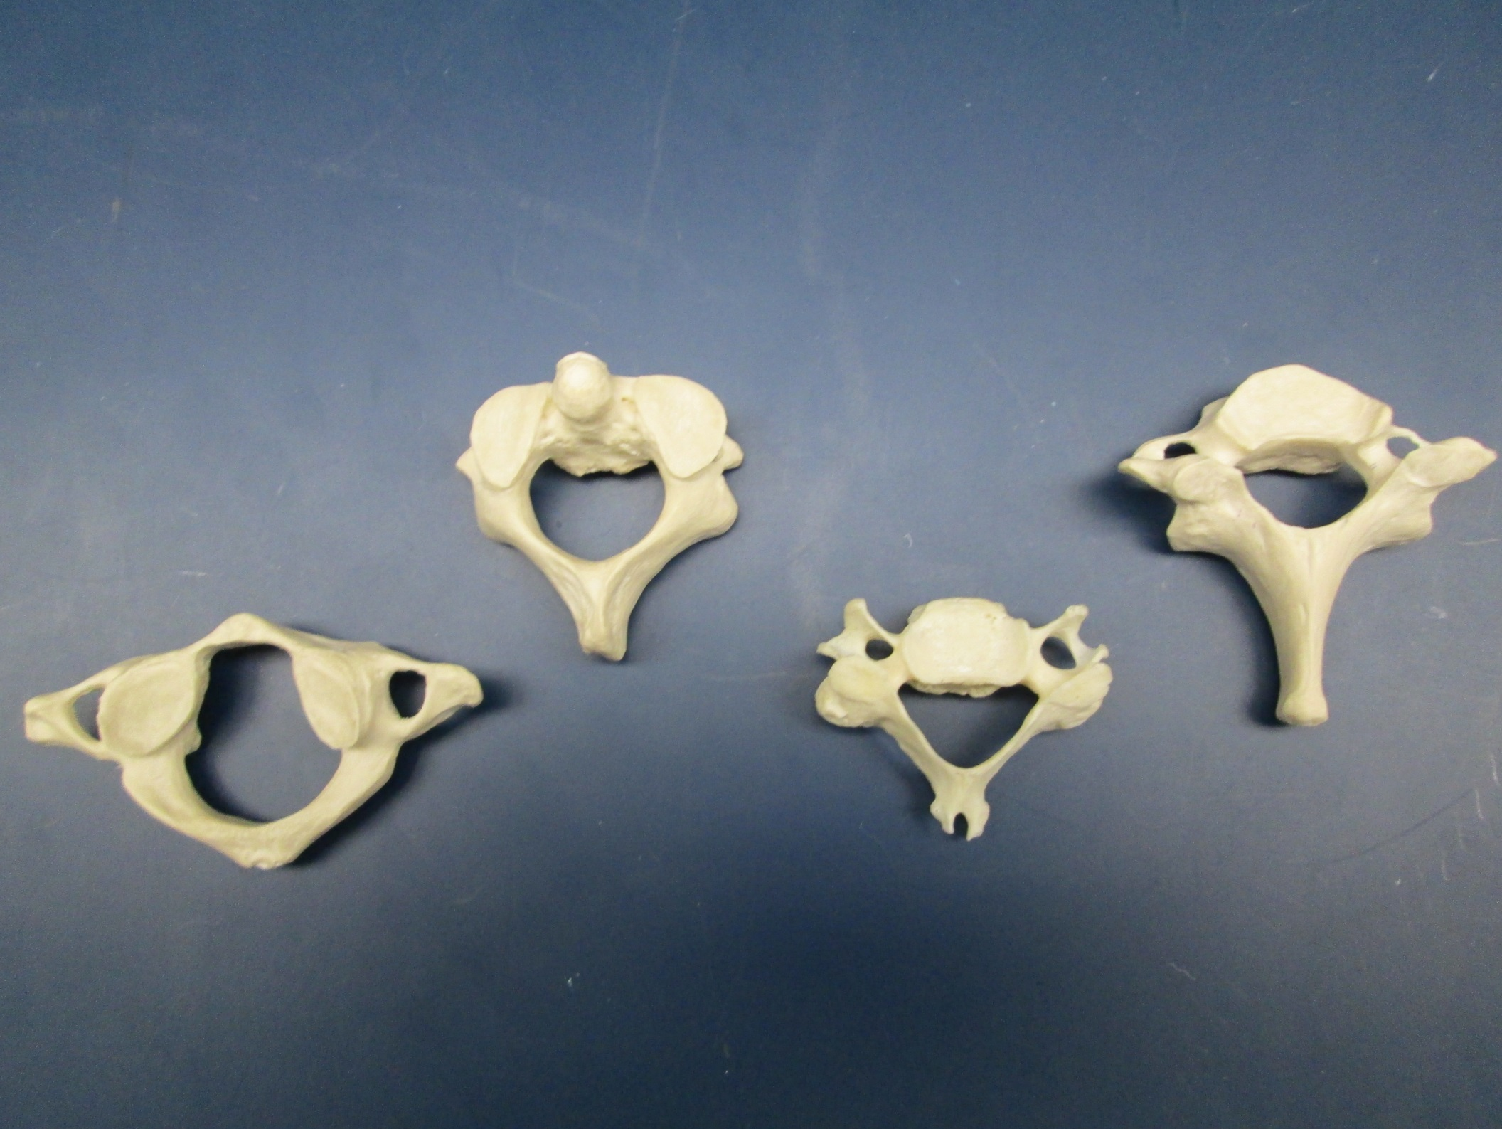
Cervical Vertebrae (1 of 2)
C₁
C₃ – C₆
C₂
C₇

Slide 6
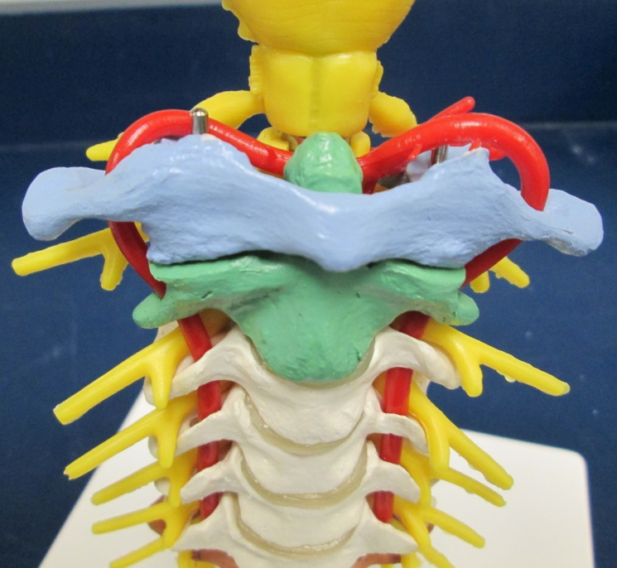
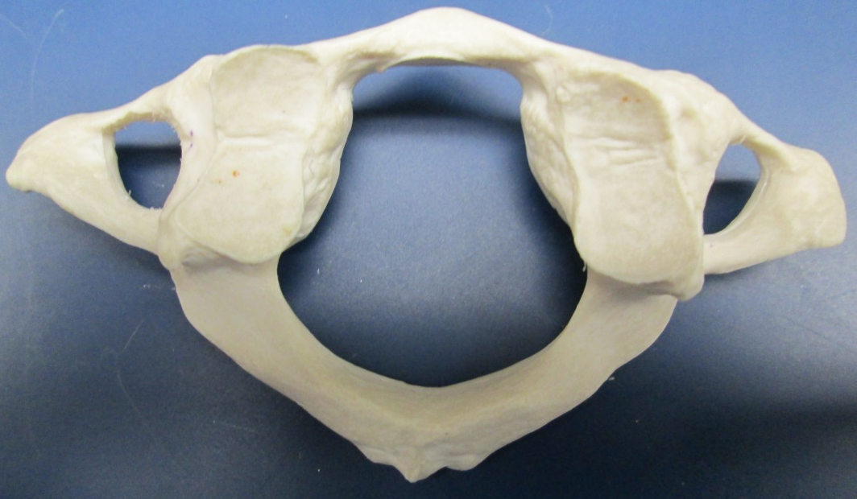
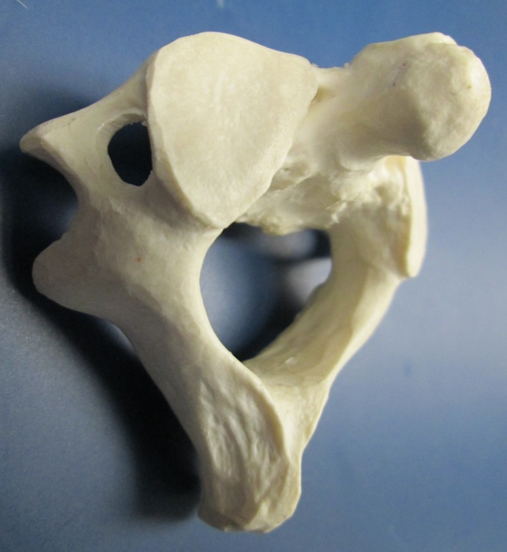
Cervical Vertebrae (2 of 2)
Transverse foramina
C₁ = Atlas
Articulation between Atlas & Axis
(Anterior view)
Dens
C₂ = Axis

Slide 7
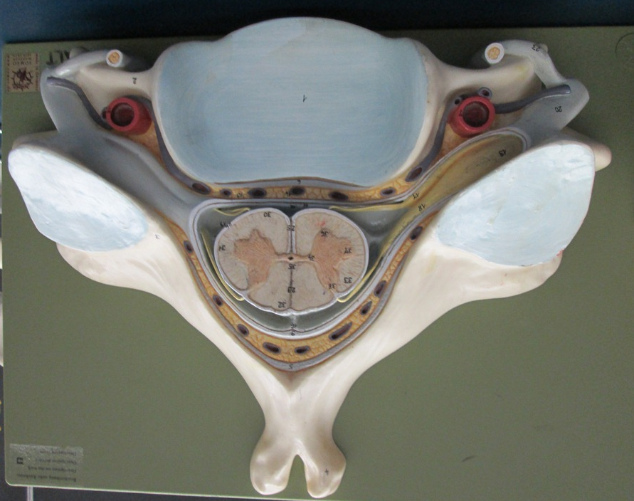
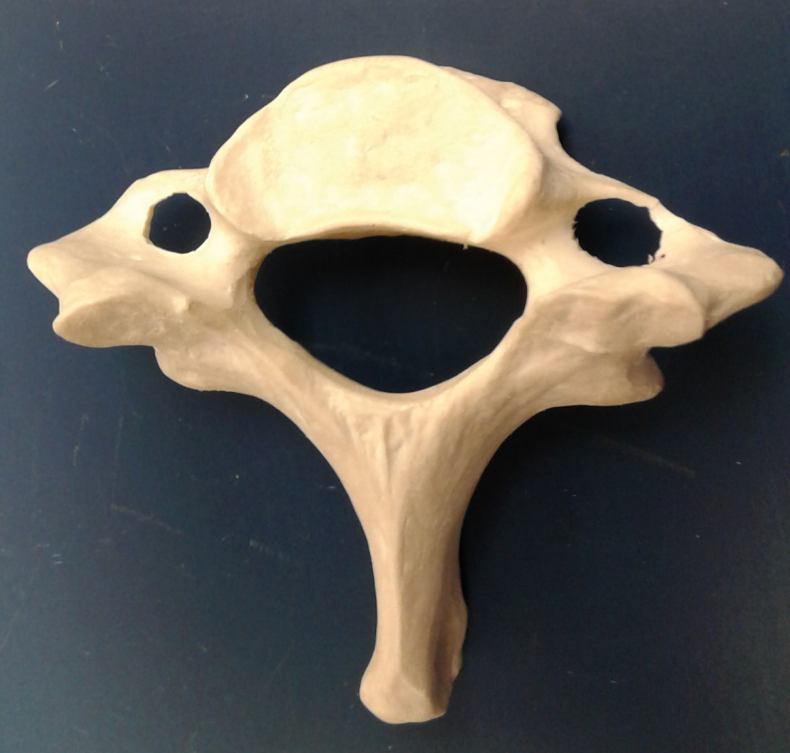
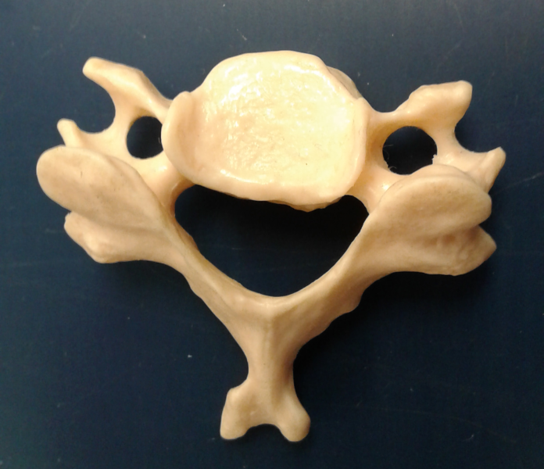
Cervical Vertebrae (3 of 3)
C₇ = Vertebra prominens
Bifid spinous process
C₃ – C₆

Slide 8
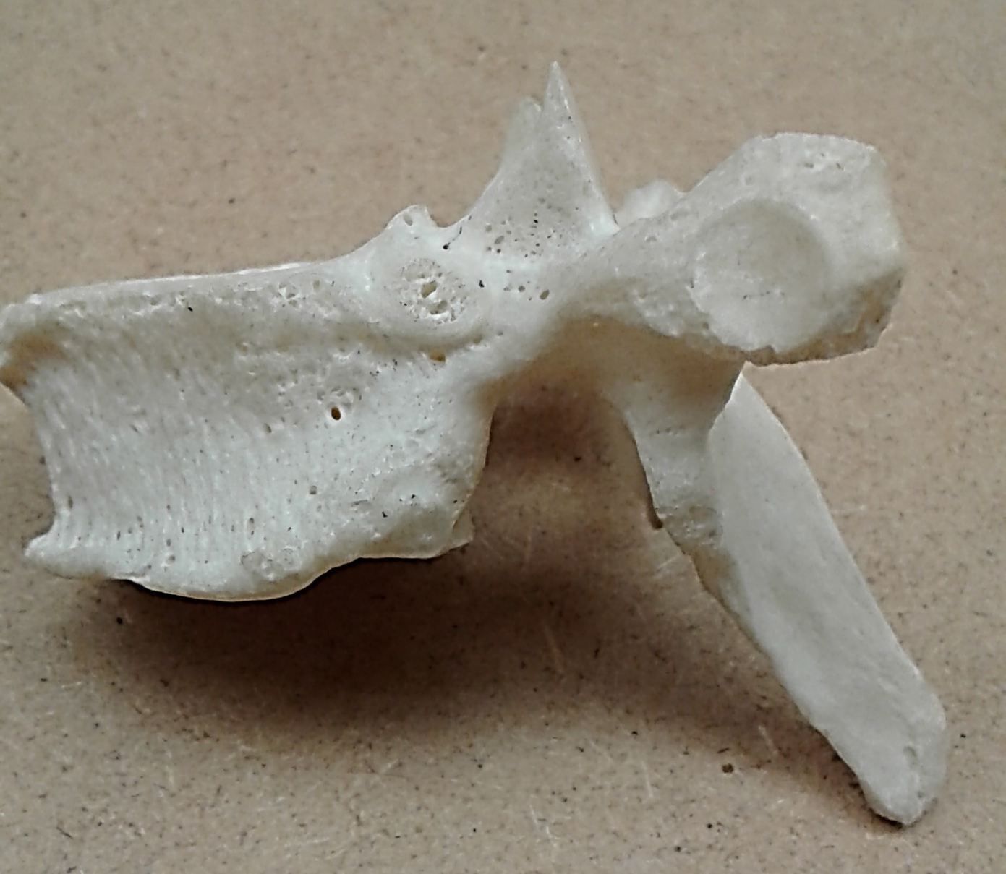
Thoracic Vertebra (Lateral View) (1 of 2)
Transverse costal facet
Costal demifacets

Slide 9
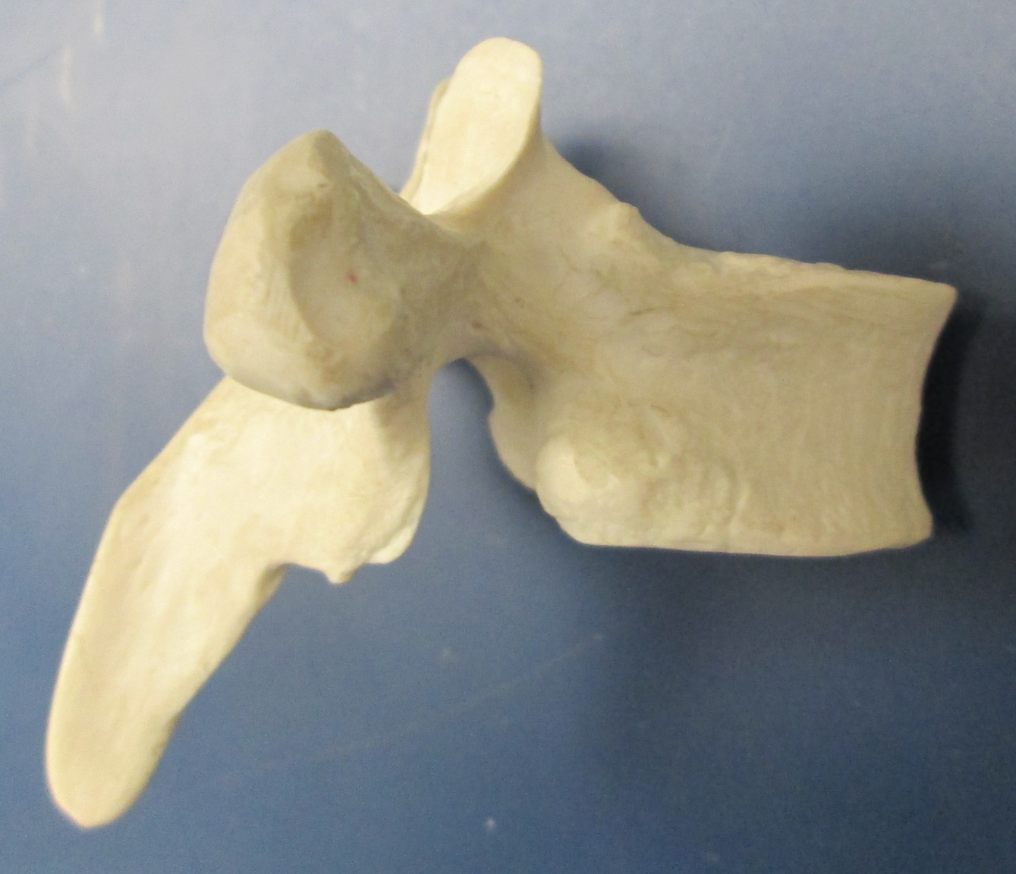
Thoracic Vertebra (Lateral View) (2 of 2)
Transverse costal facet
Costal demifacets

Slide 10
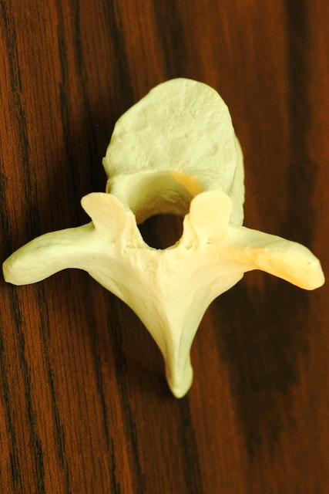
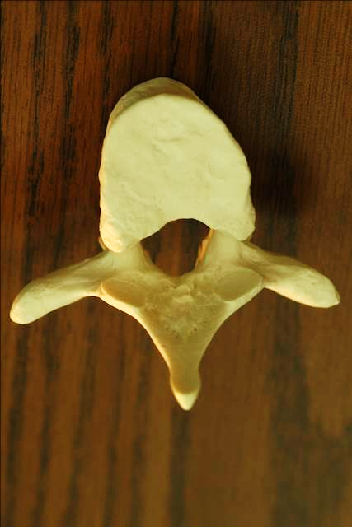
Typical Thoracic Vertebra
Superior View
Inferior View

Slide 11
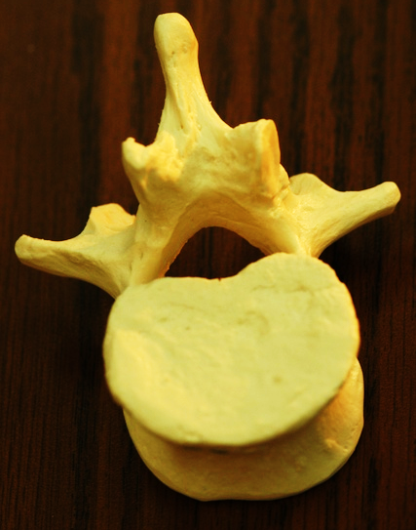
Typical Lumbar Vertebra
Superior View
Inferior View

Slide 12
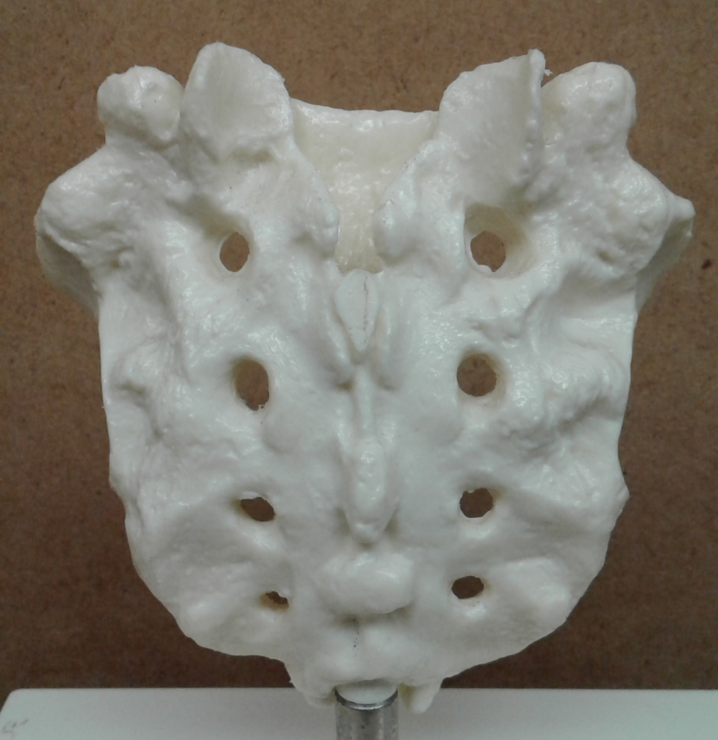
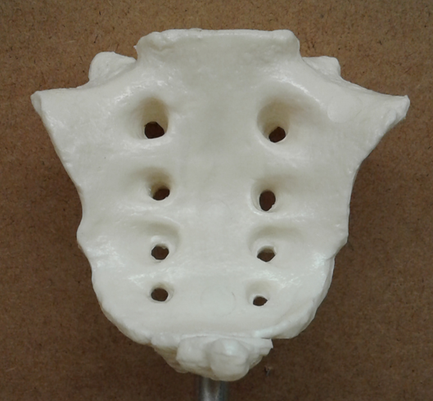
Sacrum (1 of 2)
Posterior View
Anterior View

Slide 13
Sacrum (2 of 2)
Auricular surface
Posterior View
Median sacral crest
Sacral promontory
Sacral hiatus
Posterior View
Anterior View

Slide 14
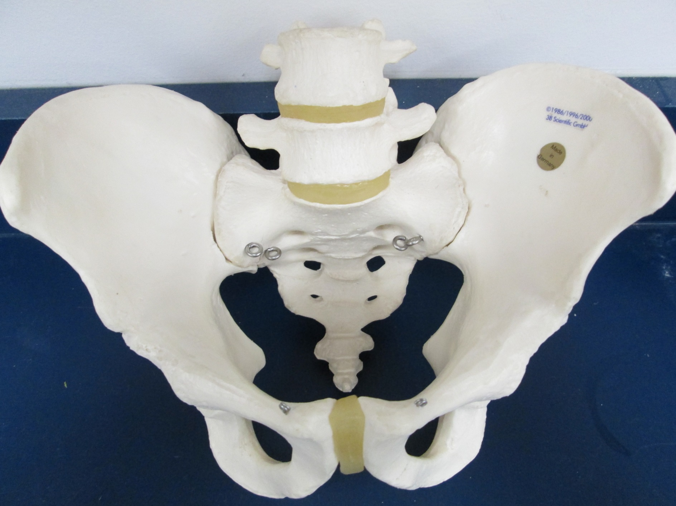
Coccyx

Slide 15
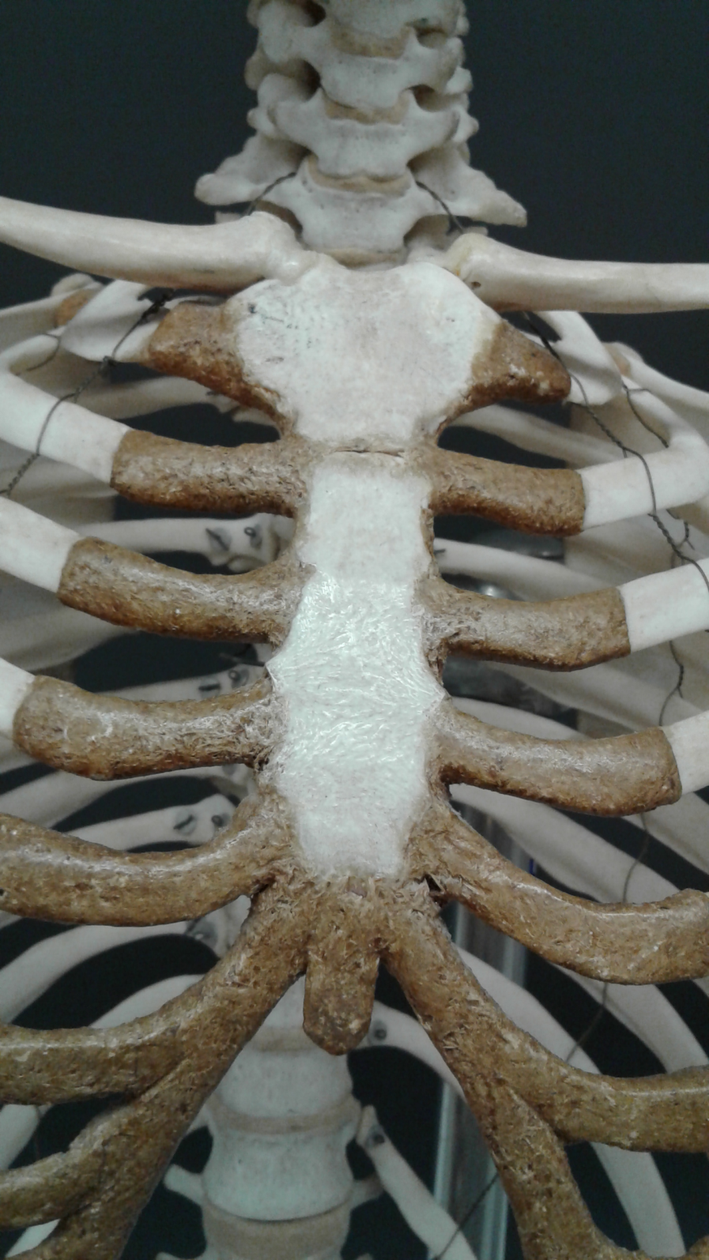
Sternum
Manubrium
Body
Xiphoid process

Slide 16
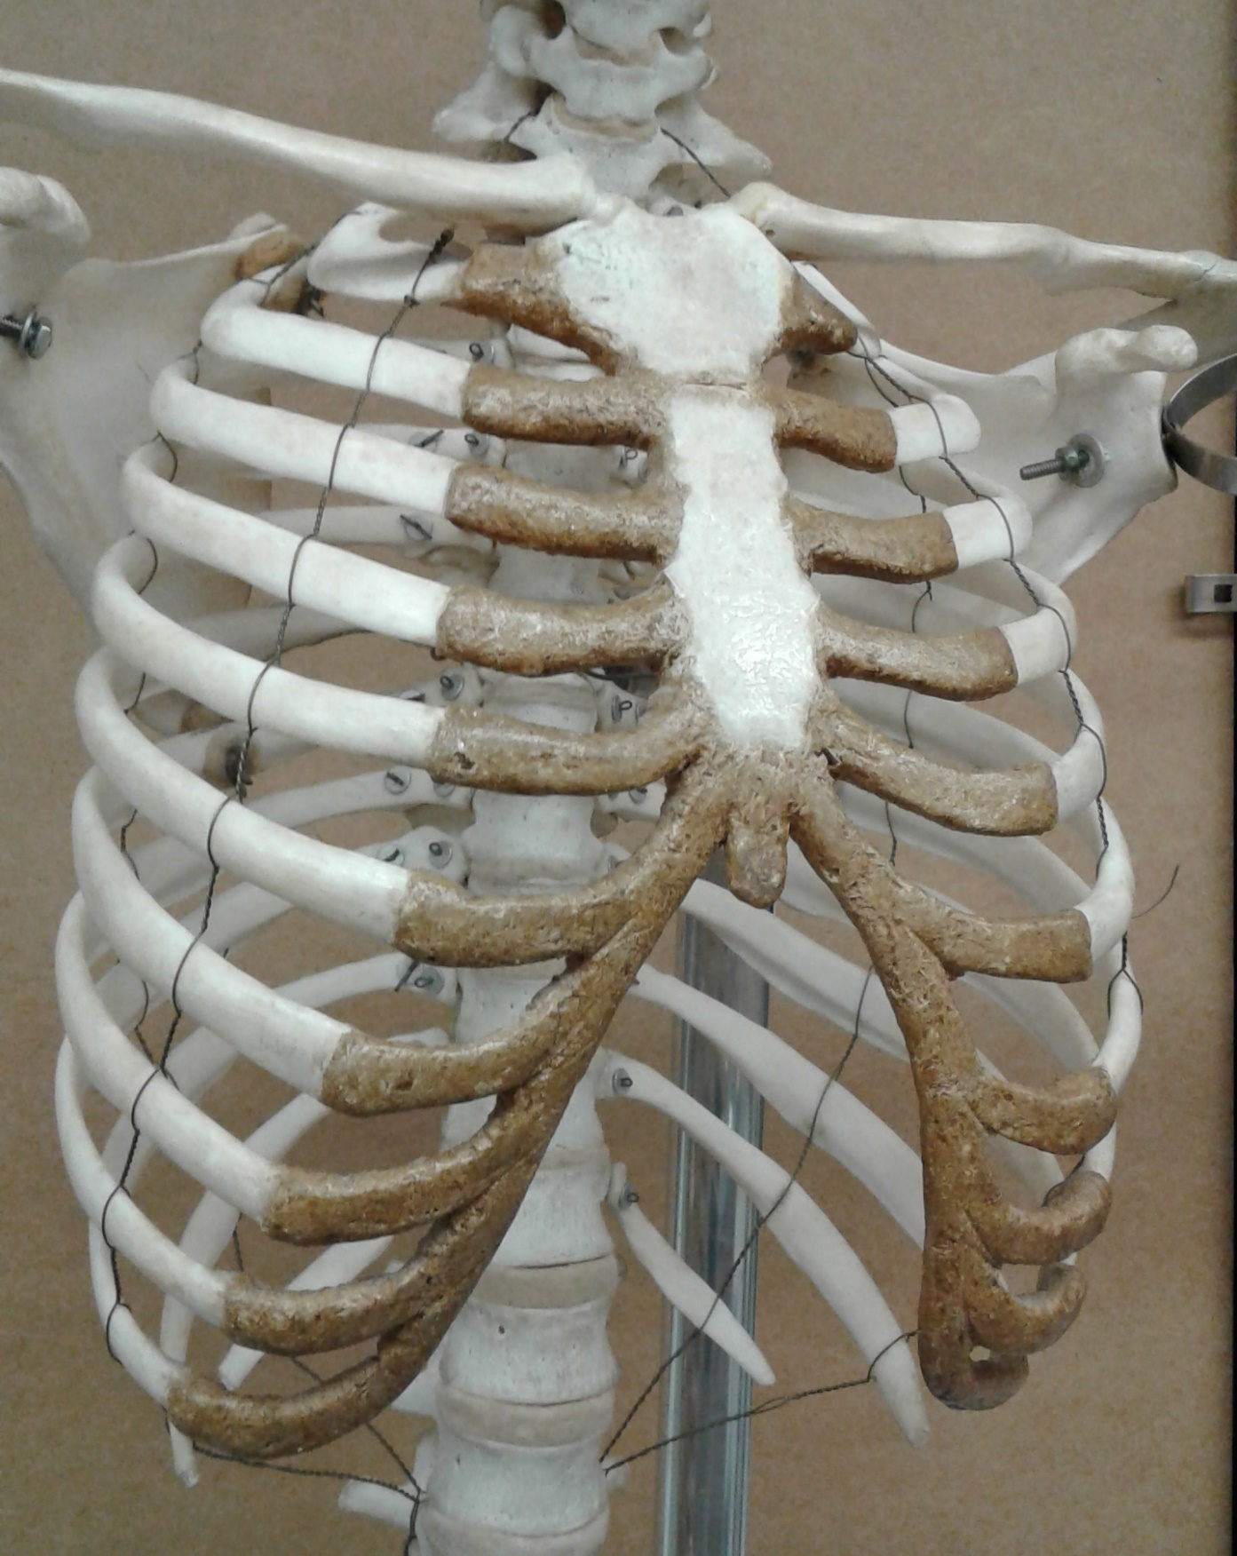
Ribs
True ribs:
Vertebrosternal (pairs 1 - 7)
False ribs:
Vertebrochondral (pairs 8 - 10)
Vertebral (floating)
(pairs 11 & 12)
1
2
3
4
Costal cartilage
5
6
Costochondral joint
7
8
9
11
10
12

