Slide 1
The Skeletal System
The Axial Skeleton
The Skull
Photographed by:
Dr. Syed Arif Humayun
Dr. Laila Nimri
Labeled and Made Accessible by:
Dr. Laila Nimri
Edited by:
Dr. Maya Byfield Mr. James Henry
Dist. Prof. Mary Dolnack Dr. Syed Arif Humayun
Dr. Essa Farah Dr. Laila Nimri

Slide 2
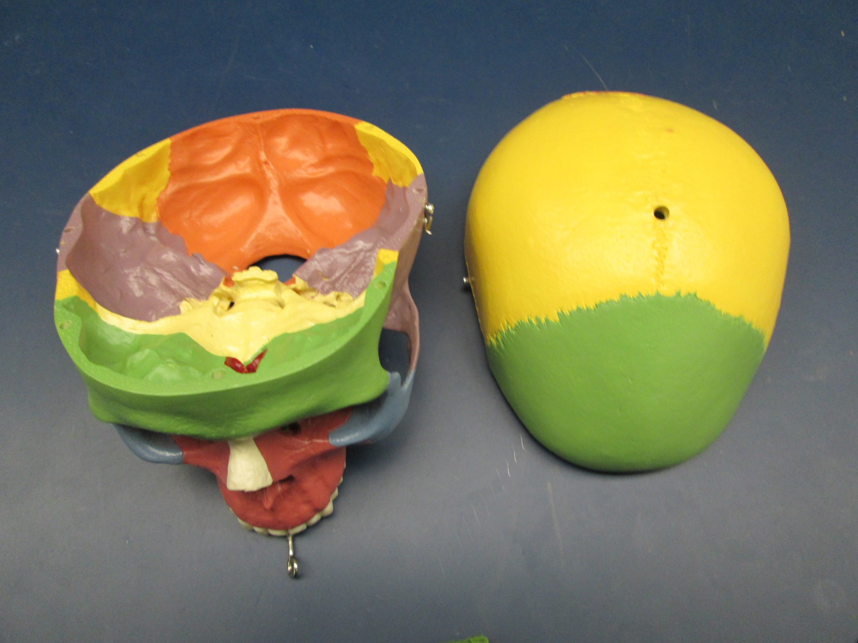
Skull Parts
1- Cranium = Cranial Base + Calvaria
2- Facial Bones

Slide 3
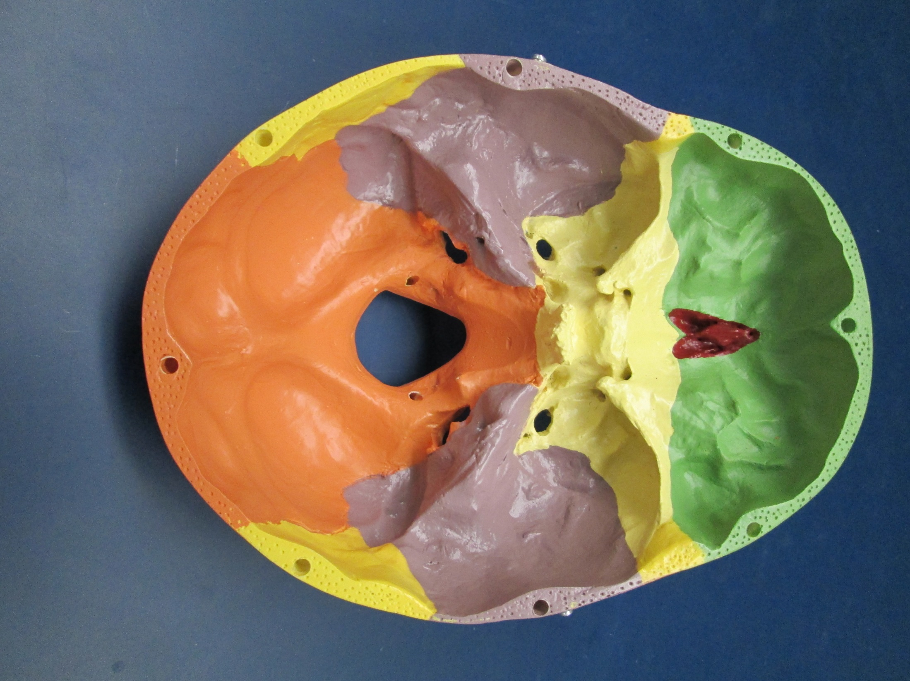
Cranial Fossae
Posterior
Middle
Anterior

Slide 4
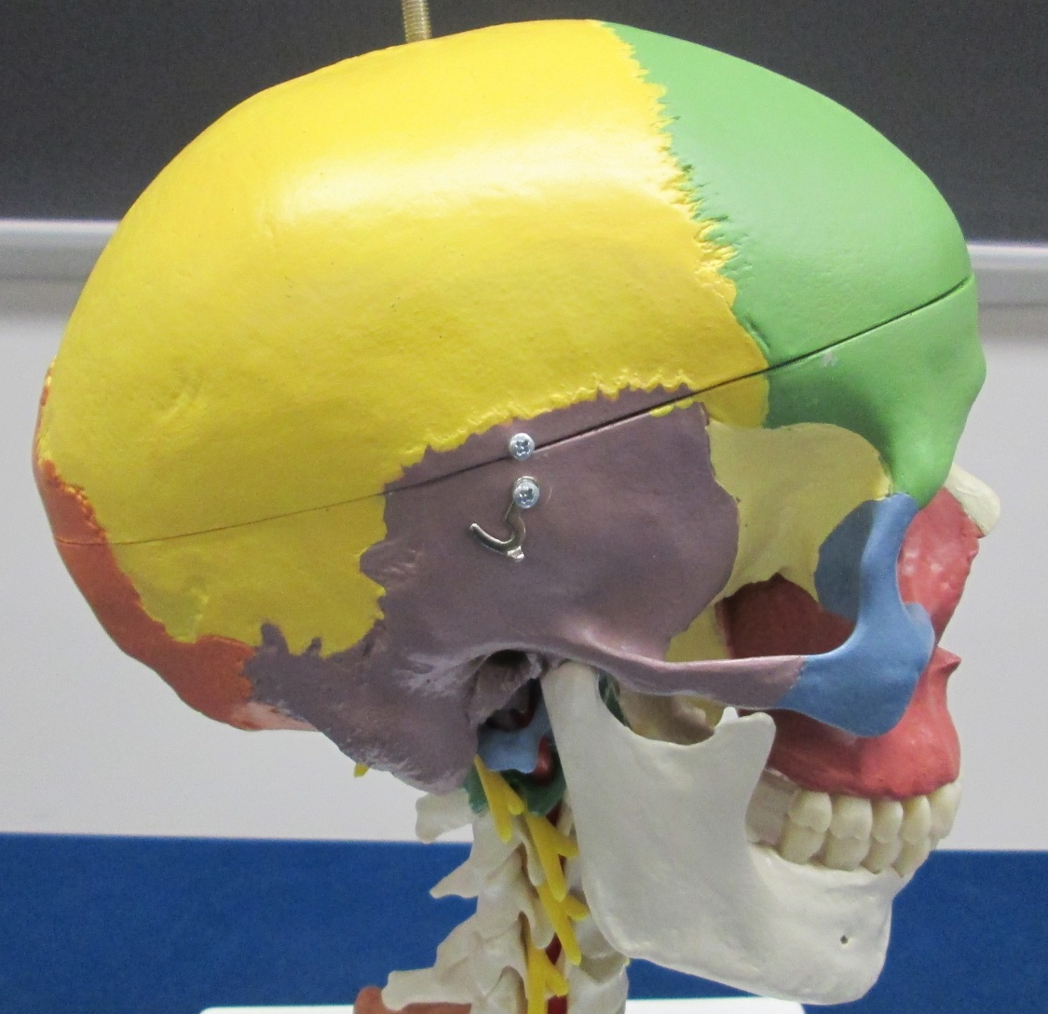
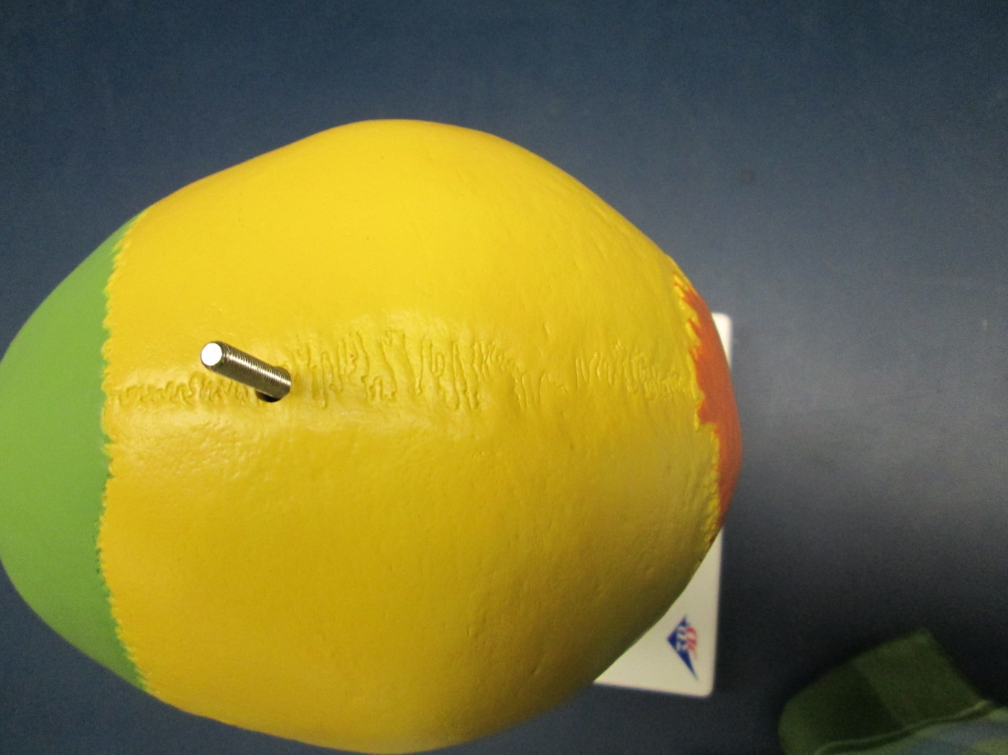
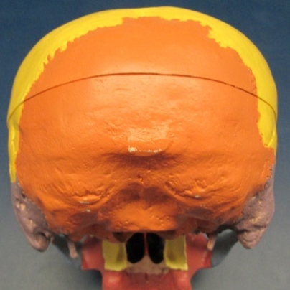
Sutures
Coronal
Squamous
Sagittal
Lambdoid

Slide 5
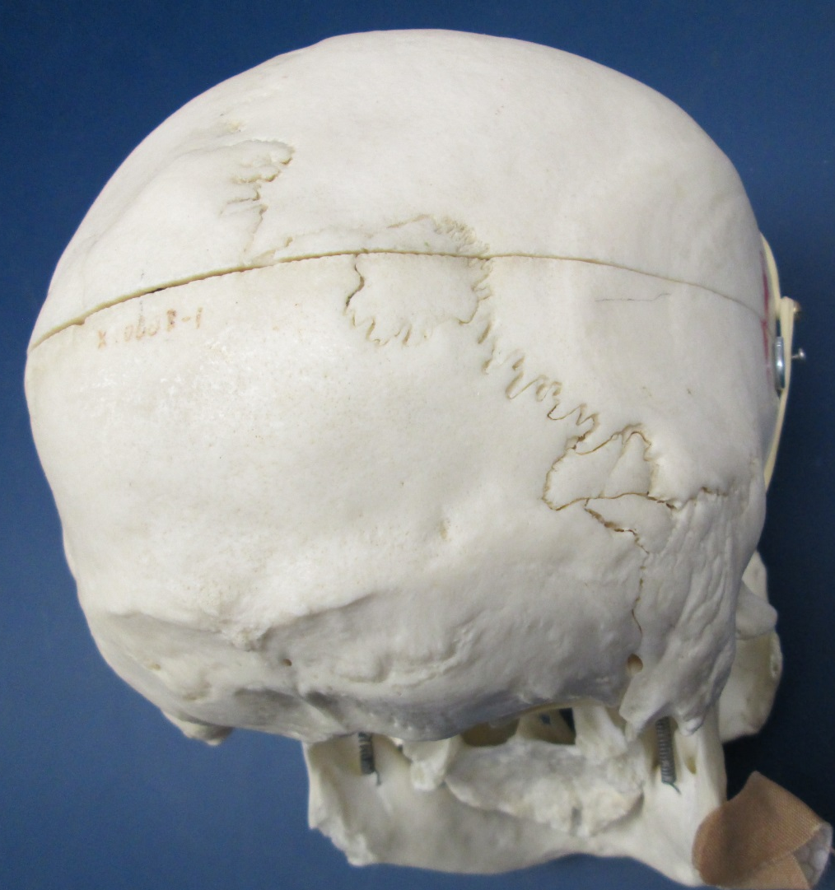
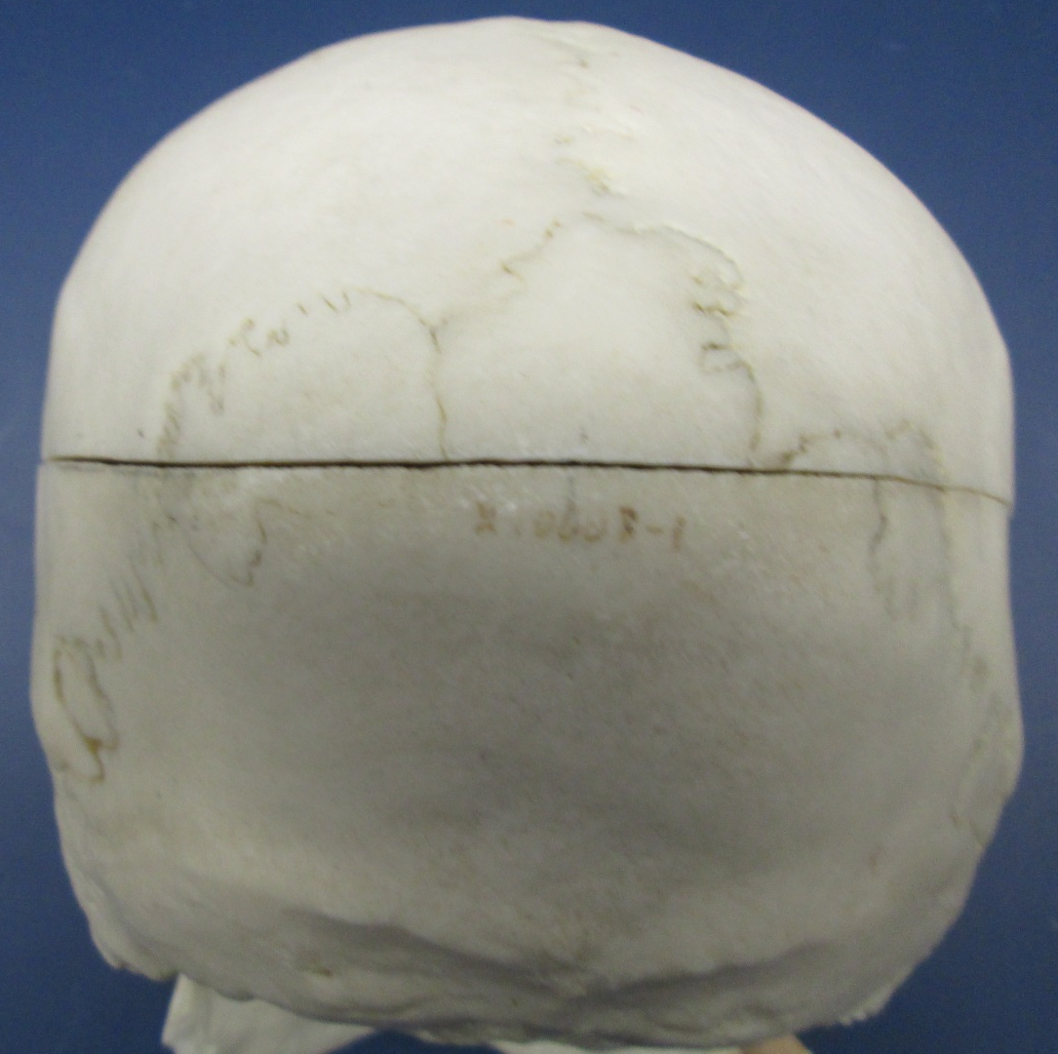
Sutural (Wormian) Bones*
*
*
*
*
*
*
*
*

Slide 6
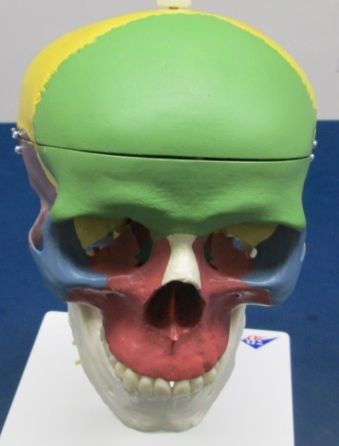


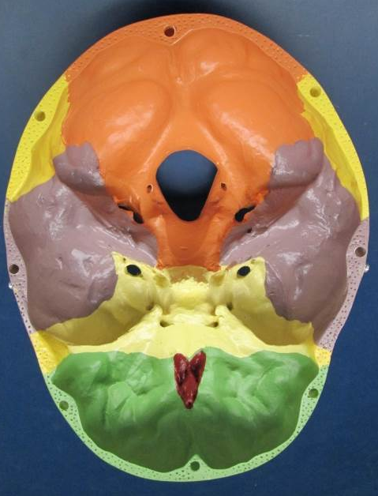
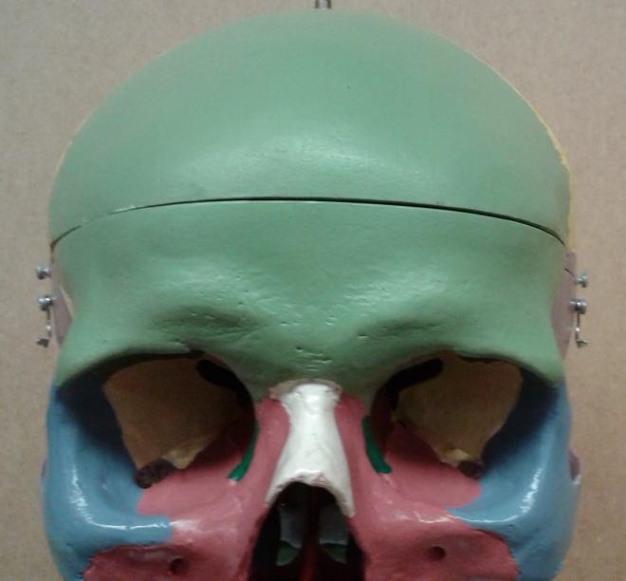
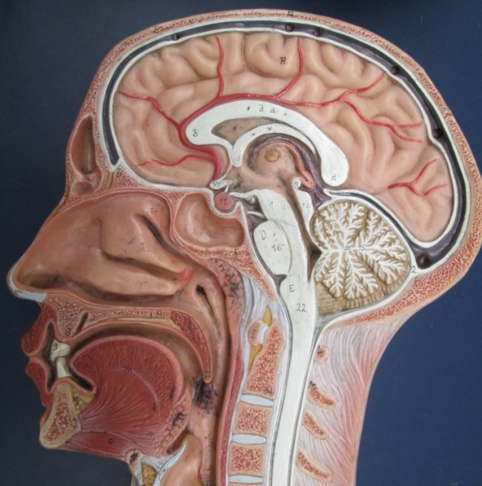
Frontal Bone*
*
*
*
*
Frontal sinus
Supraorbital margin

Slide 7

Parietal Bones*
*
*
*

Slide 8
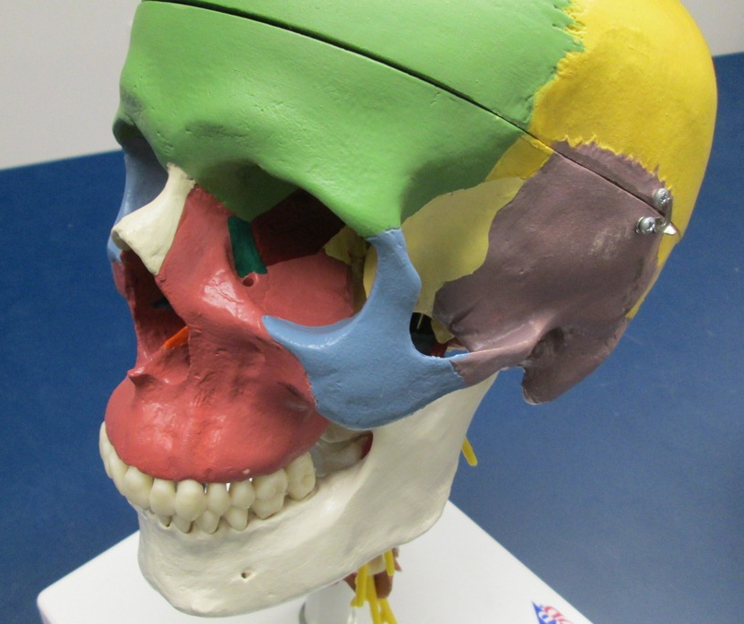
Temporal Bone (1 of 4)
Squamous part
Zygomatic process

Slide 9
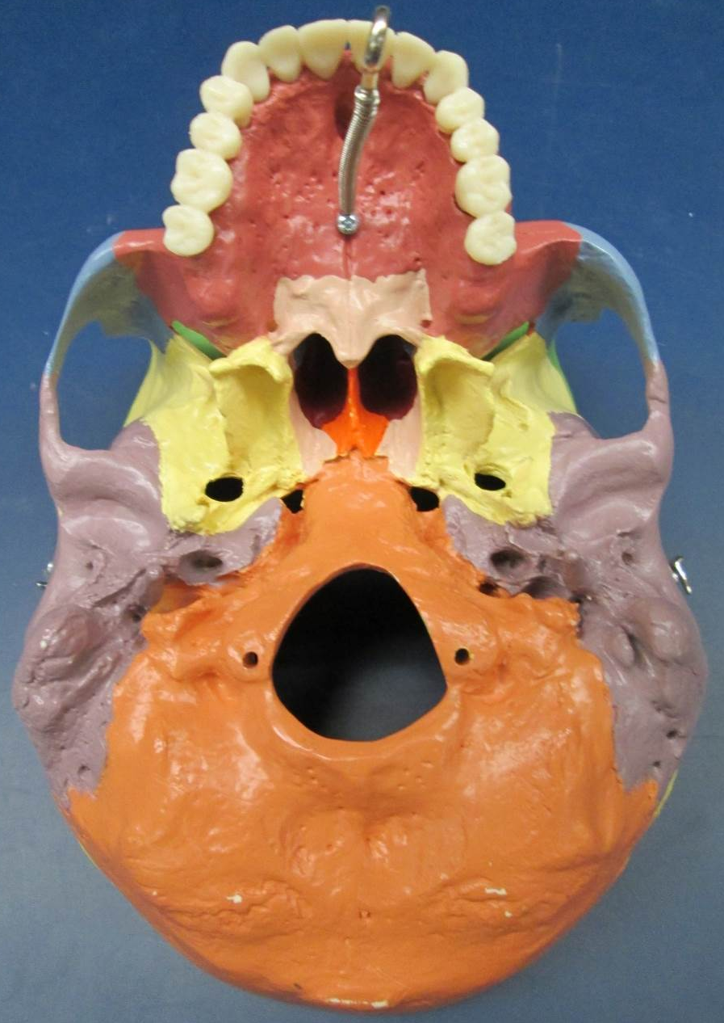
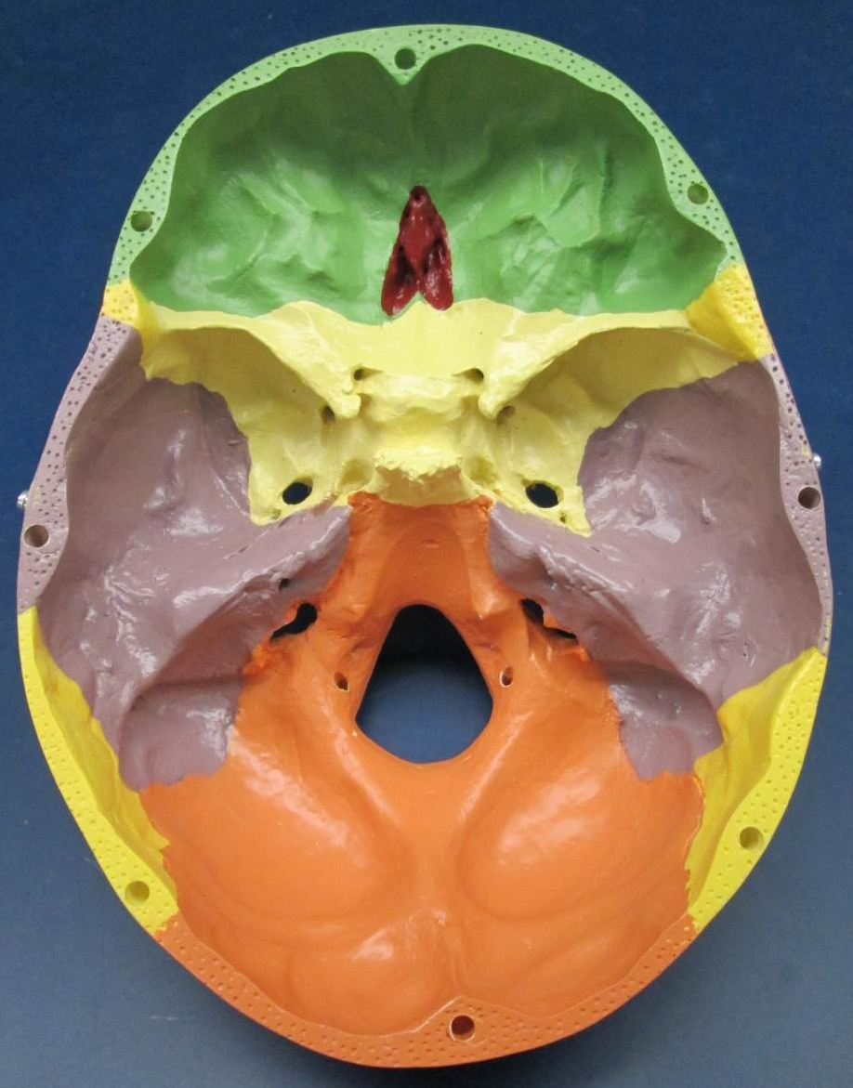
Temporal Bone (2 of 4)
Petrous part

Slide 10
Temporal Bone (3 of 4)
Jugular foramen

Slide 11
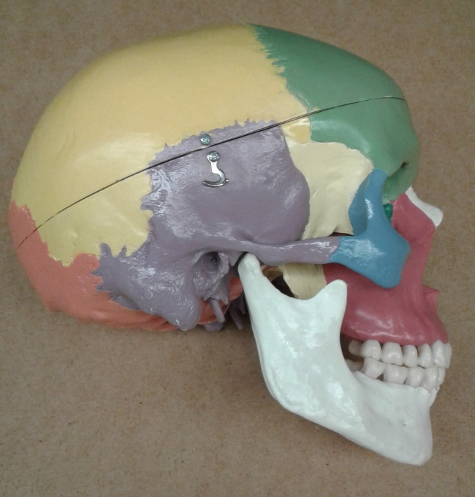
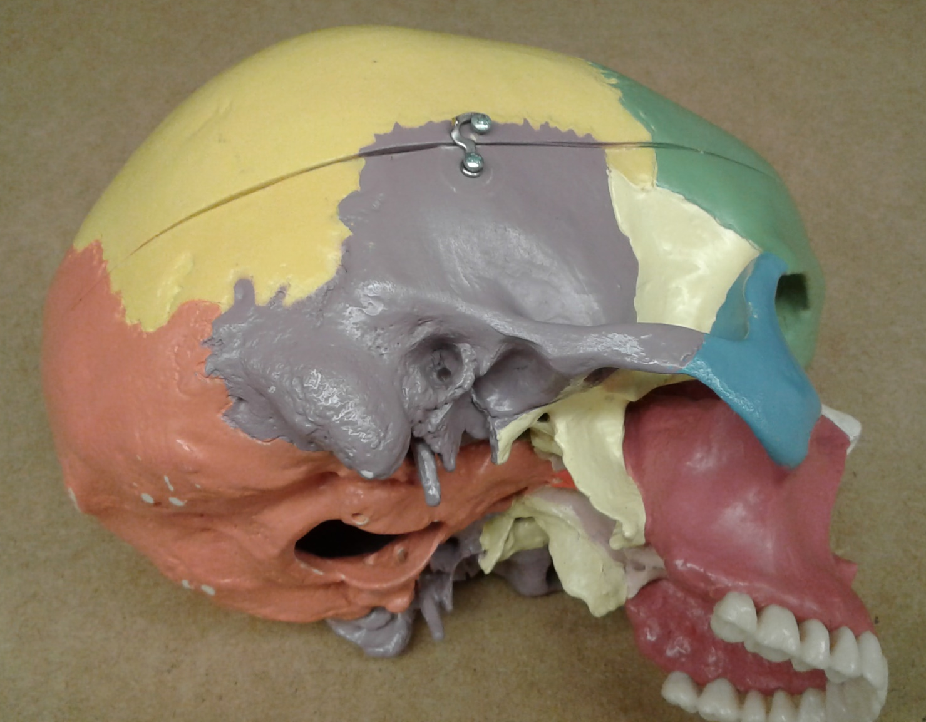
Temporal Bone (4 of 4)
Mandibular fossa
External acoustic meatus
Mastoid processes
Styloid processes

Slide 12

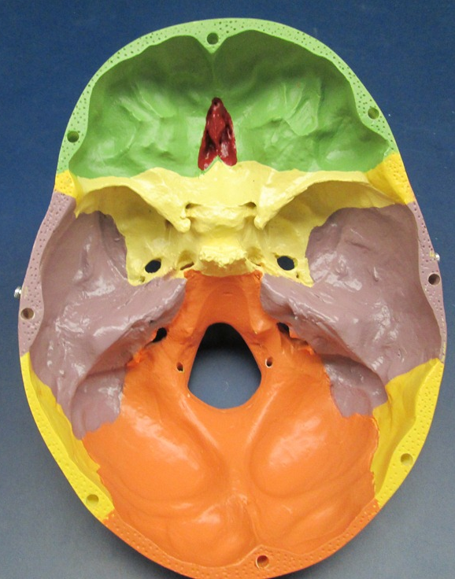
Occipital Bone* (1 of 2)
*
*

Slide 13
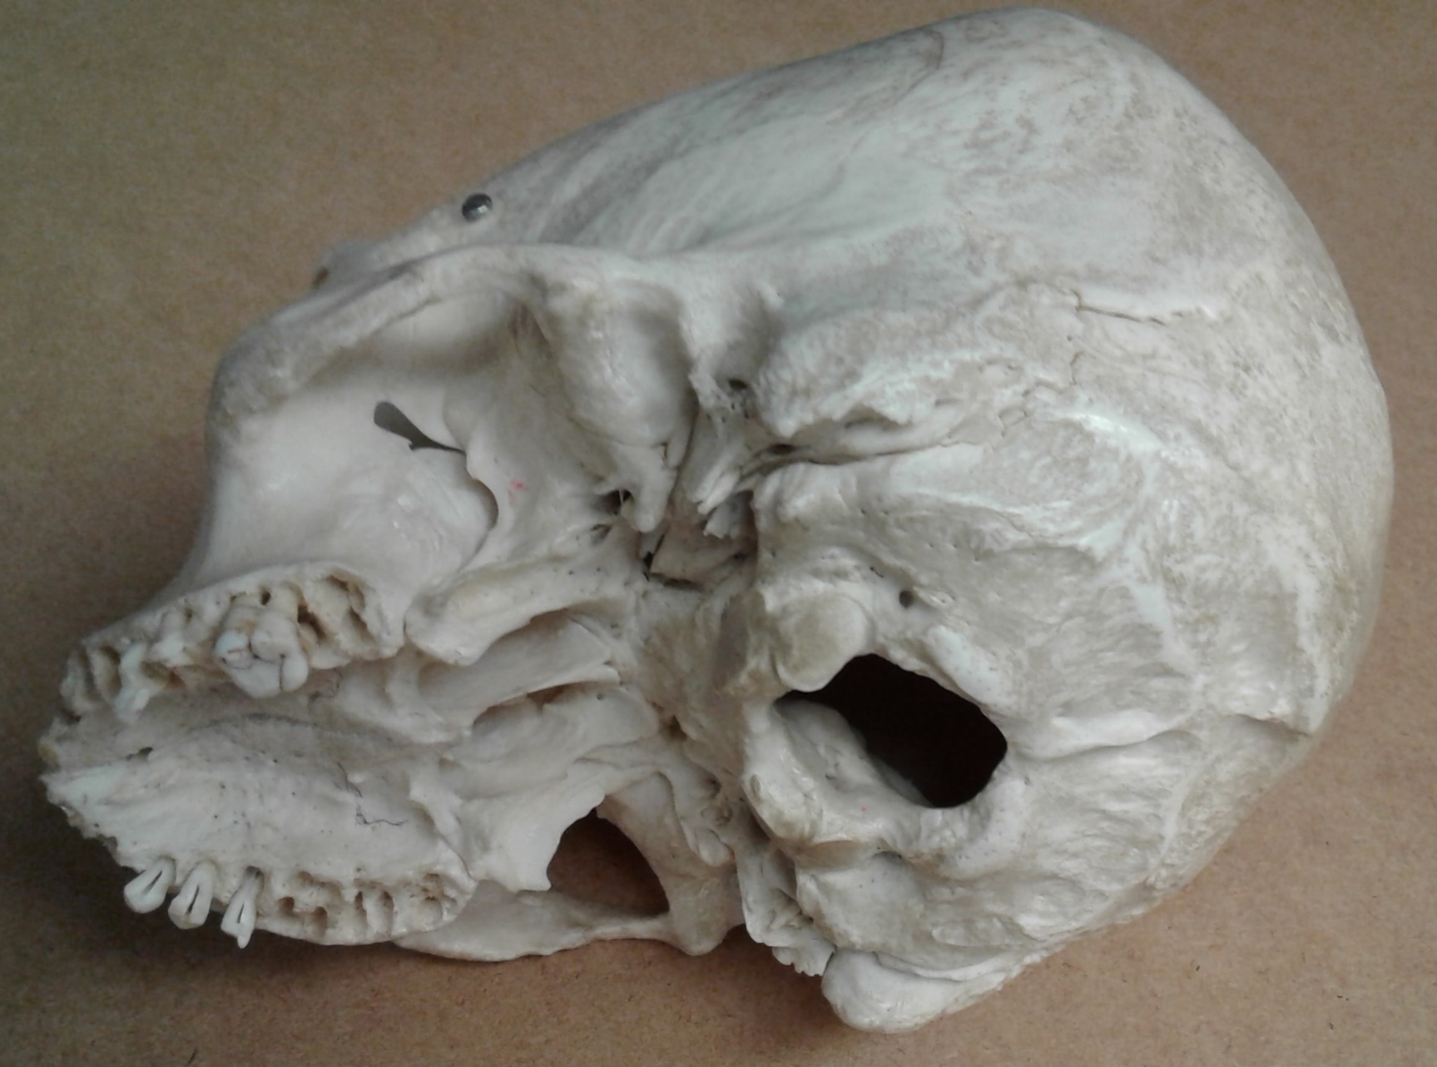
Occipital Bone (2 of 2)
Foramen magnum
External occipital protuberance
Occipital condyles

Slide 14
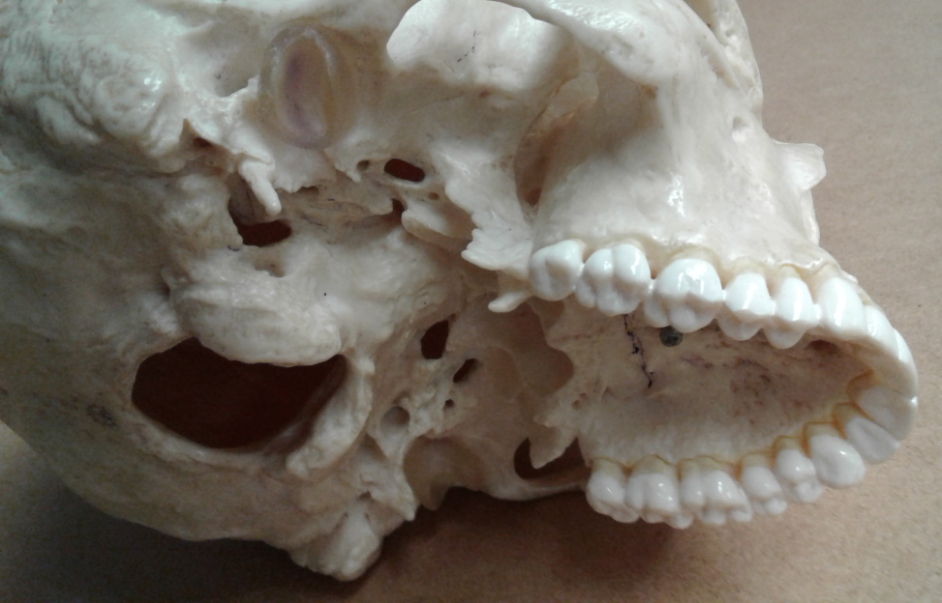
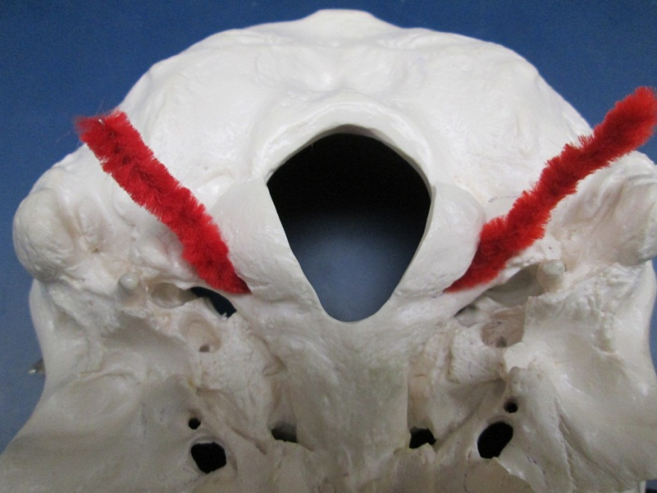
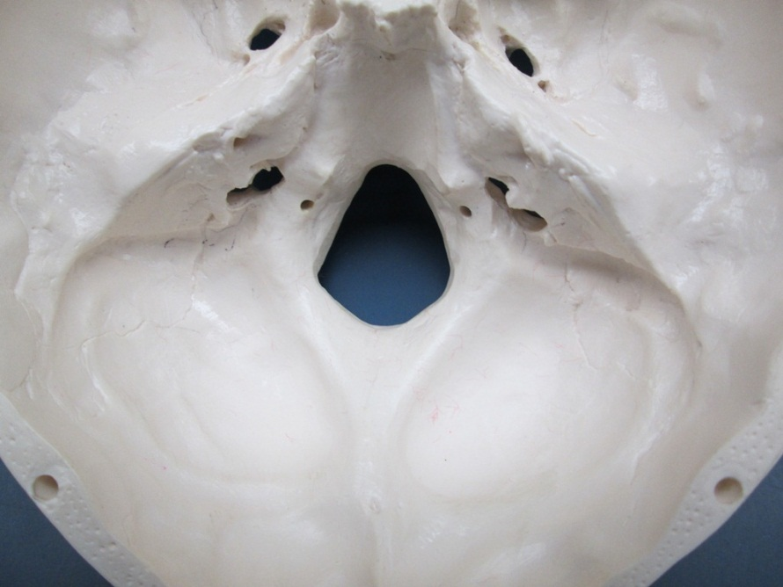
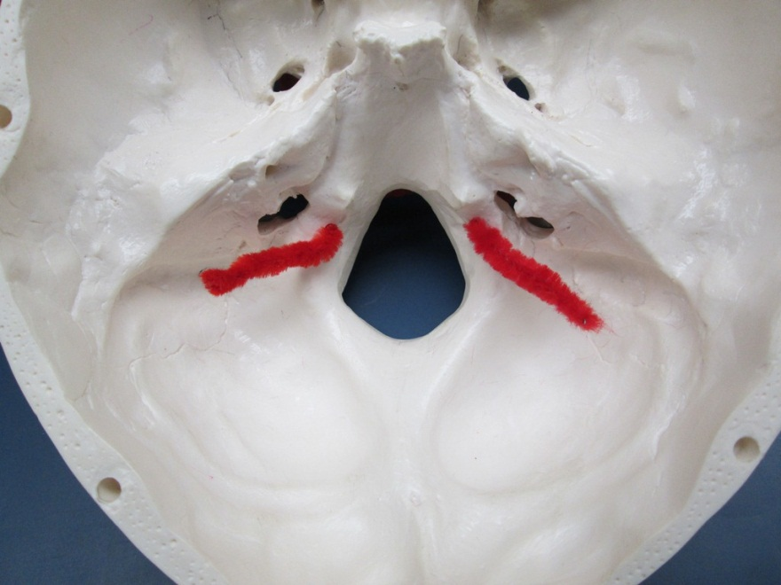
Hypoglossal Canals of the Occipital Bone
(where the pipe cleaners emerge from and at the tips of the pointers)

Slide 15

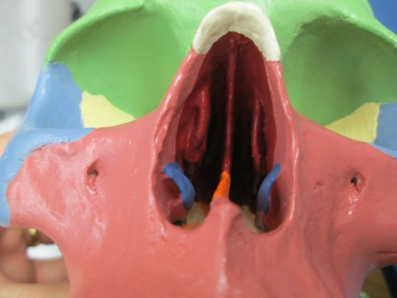
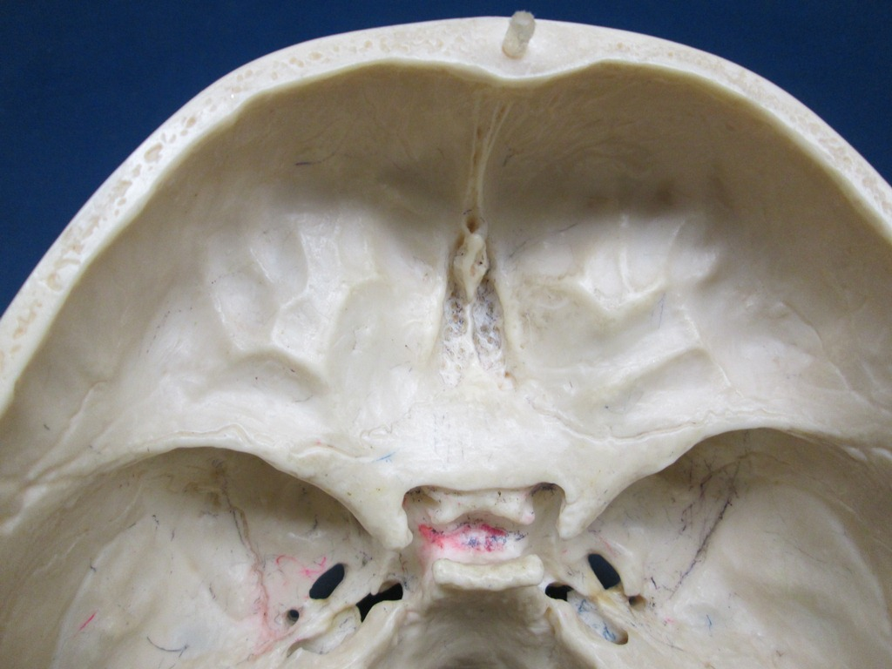
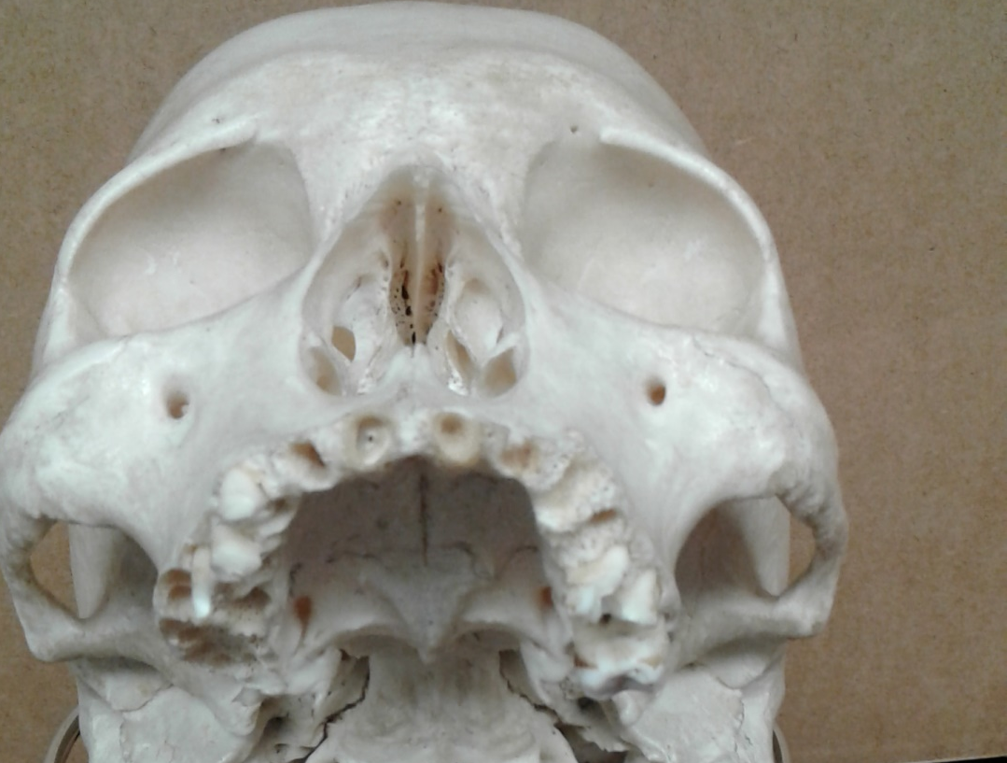
Ethmoid Bone (1 of 3)
Crista galli
Cribriform plate
Perpendicular plate
(Superior View of the Cranial Base)
View of the roof of the nasal cavity

Slide 16
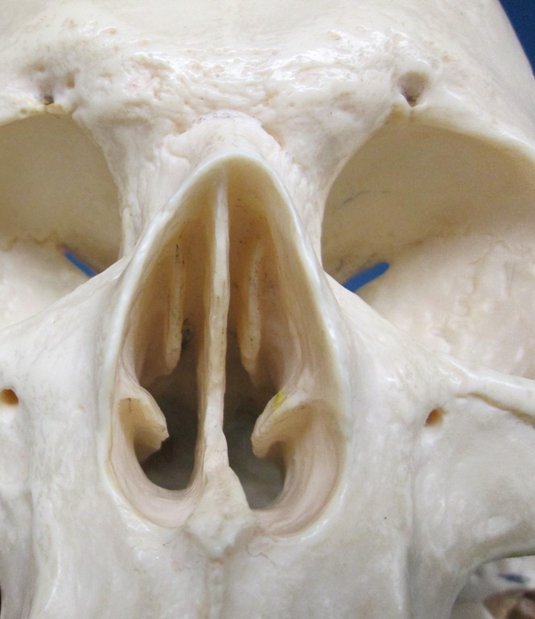
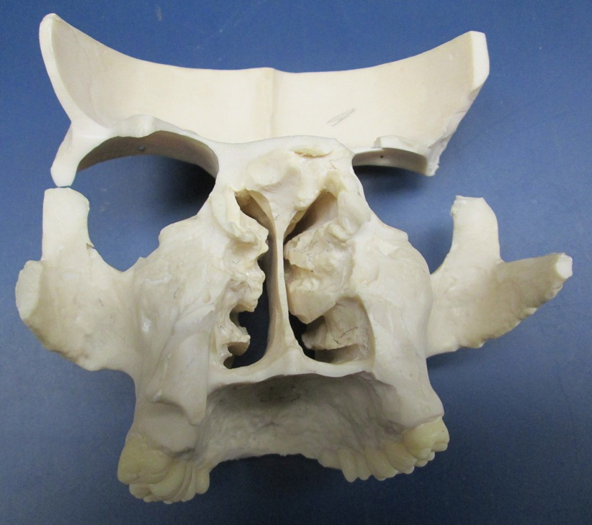
Ethmoid Bone (2 of 3)
Anterior View of the Nasal Cavity
Posterior View of the Nasal Cavity
1
2
3
1- Perpendicular Plate
2- Superior nasal concha
3- Middle nasal conchae

Slide 17
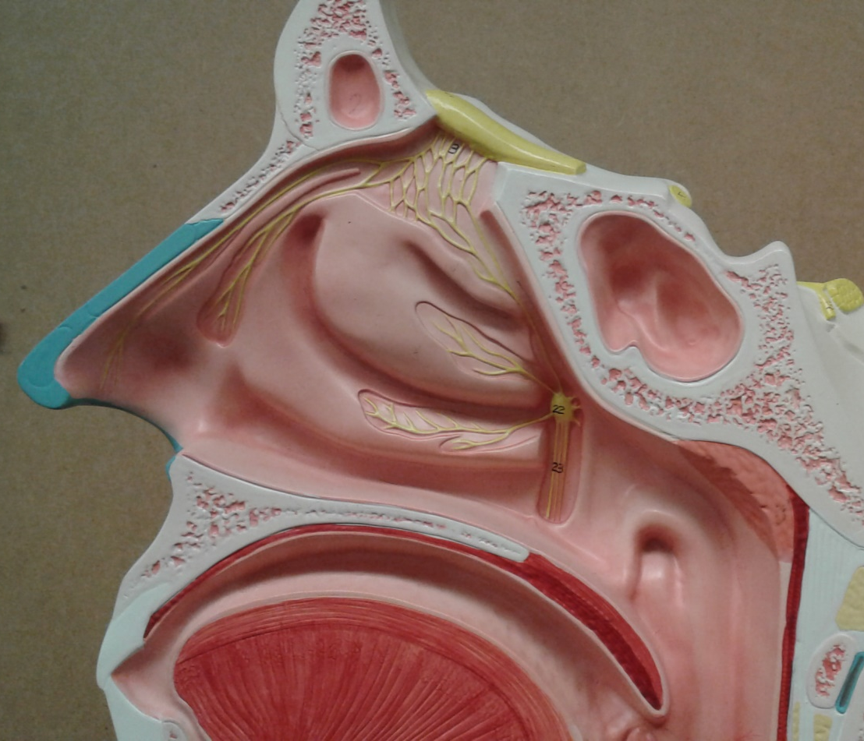
Ethmoid Bone (3 of 3)
Anterior View of the Nasal Cavity
Lateral Wall of the Nasal Cavity
1
2
3
1- Perpendicular Plate
2- Superior nasal concha
3- Middle nasal conchae

Slide 18
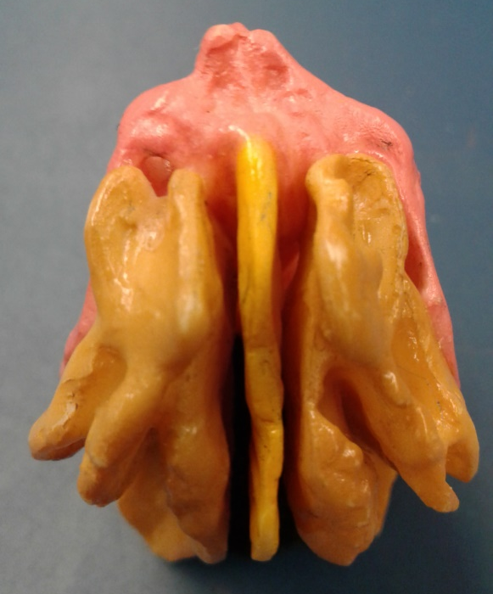
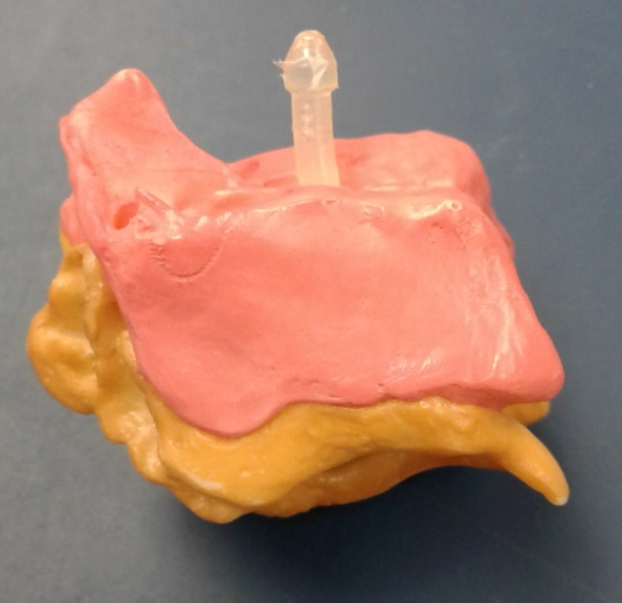
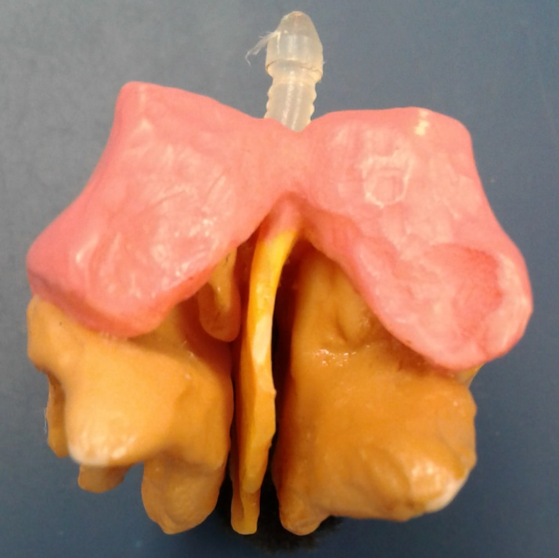
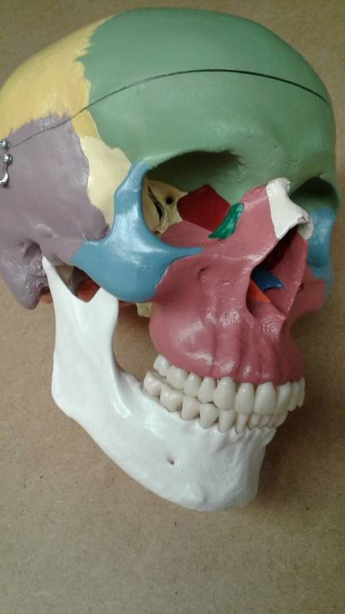
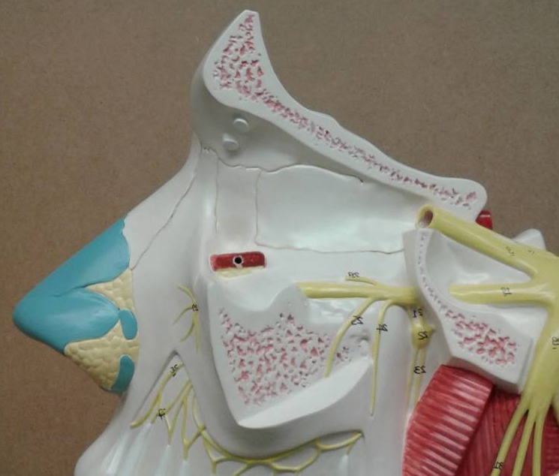
Ethmoidal Labyrinth of the Ethmoid Bone
Anterior view
Lateral view
Posterior view
Ethmoidal labyrinth in the medial wall of the orbit

Slide 19
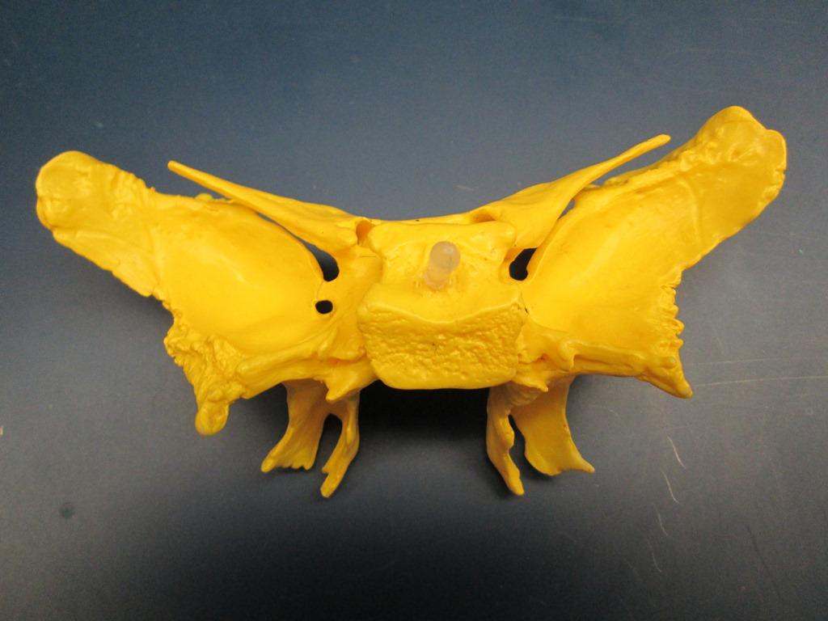
Sphenoid Bone (Anterior View) (1 of 4)
Greater wings
Lesser wings
Superior orbital fissures
Optic canals
Medial pterygoid plates
Lateral pterygoid plates

Slide 20
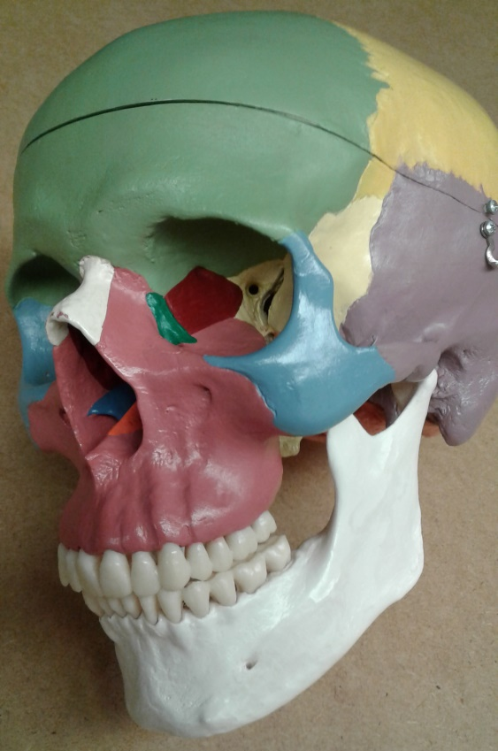
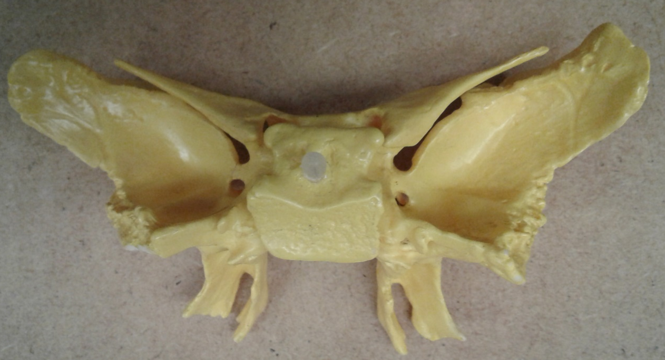
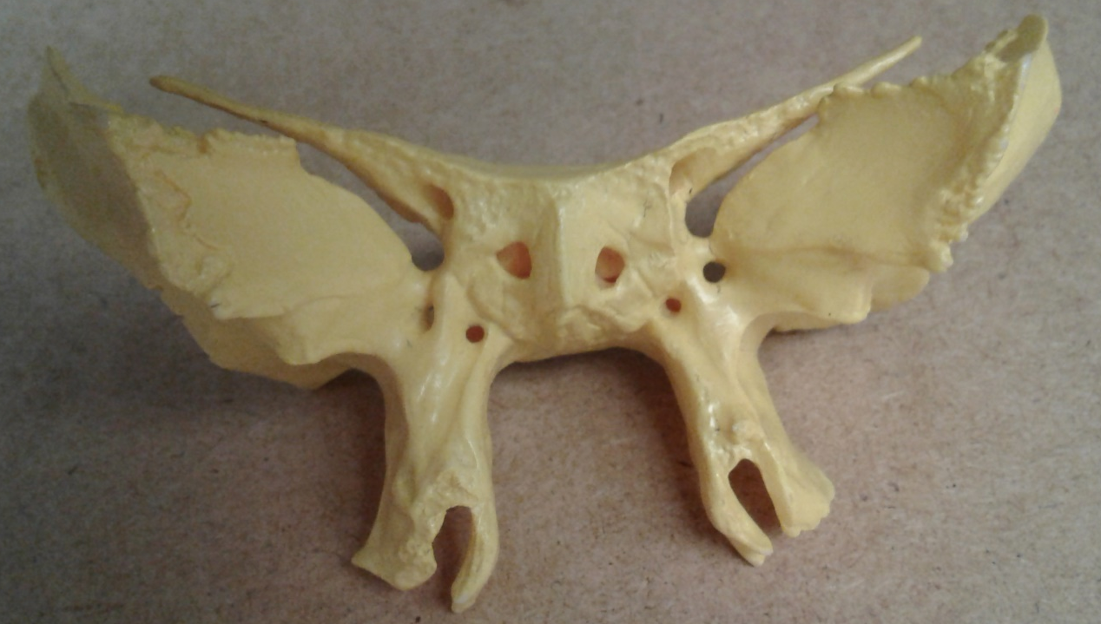
Sphenoid Bone (2 of 4)
Optic canals
Anterior view
Posterior view

Slide 21
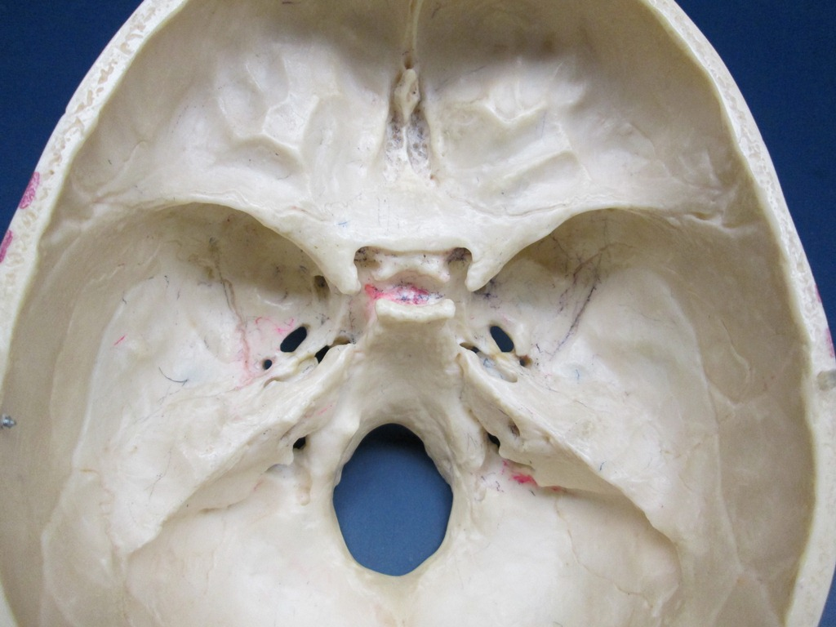
Sphenoid Bone (3 of 4)
Hypophyseal fossa of Sella turcica
Foramen rotundum
Foramen ovale
Foramen spinosum

Slide 22

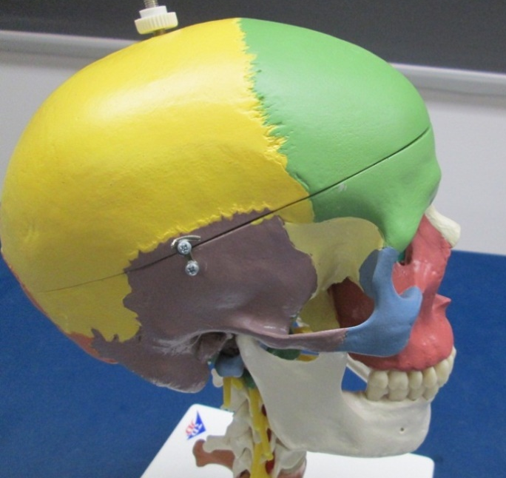
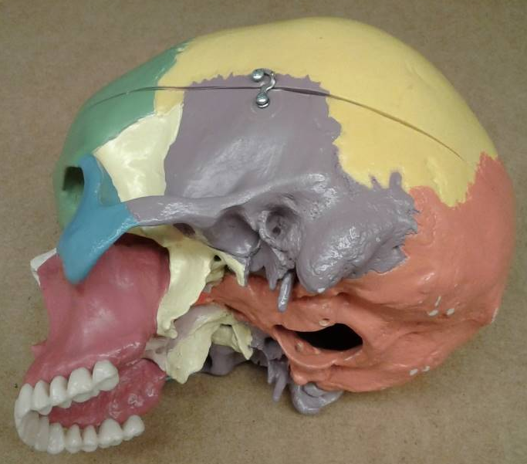
Sphenoid Bone* (4 of 4)
*
*
*
*
Lateral view
Inferior view
*
Superior view
*
*
Inferolateral view

Slide 23
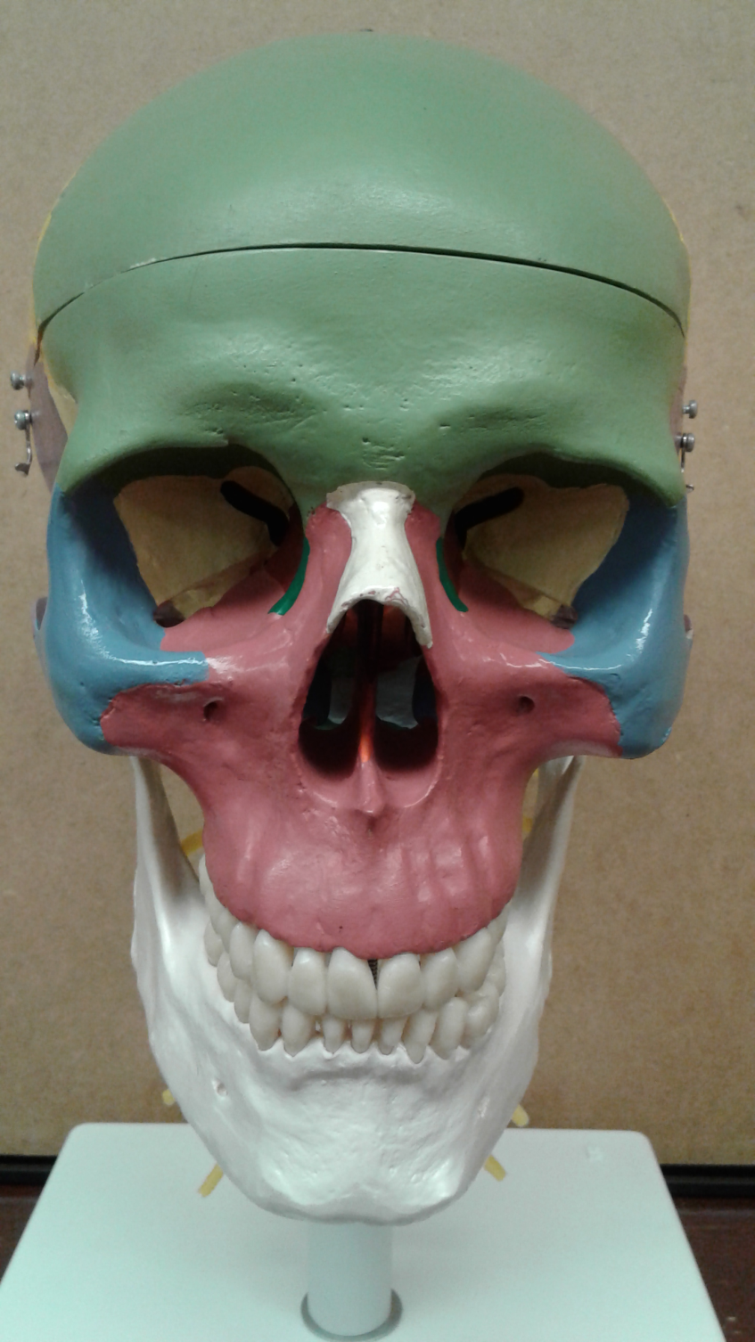
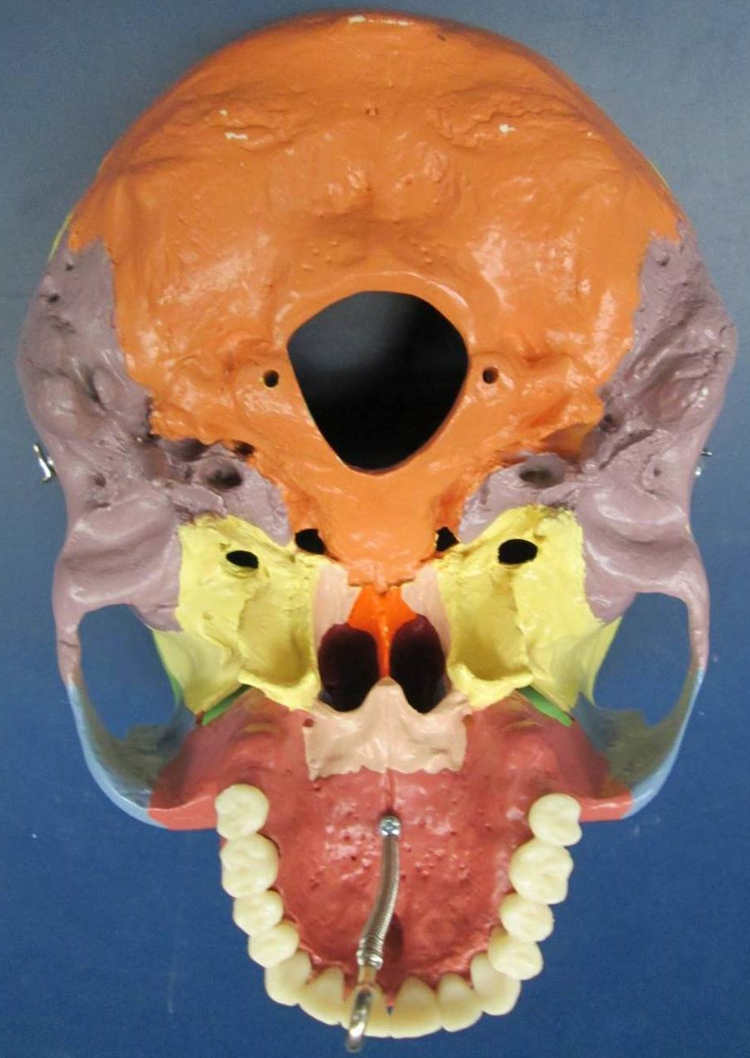
Maxillary Bones
Zygomatic process
Alveolar process
Palatine processes

Slide 24
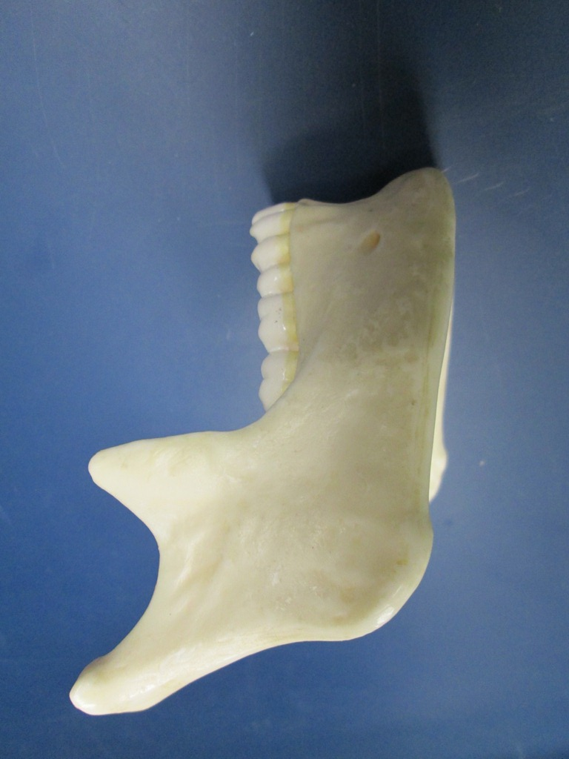
Mandible Bone
Condylar process
Mandibular notch
Coronoid process
Ramus
Alveolar process
Body
Mental foramen
Angle

Slide 25
Zygomatic Bones*
*
Temporal process

Slide 26
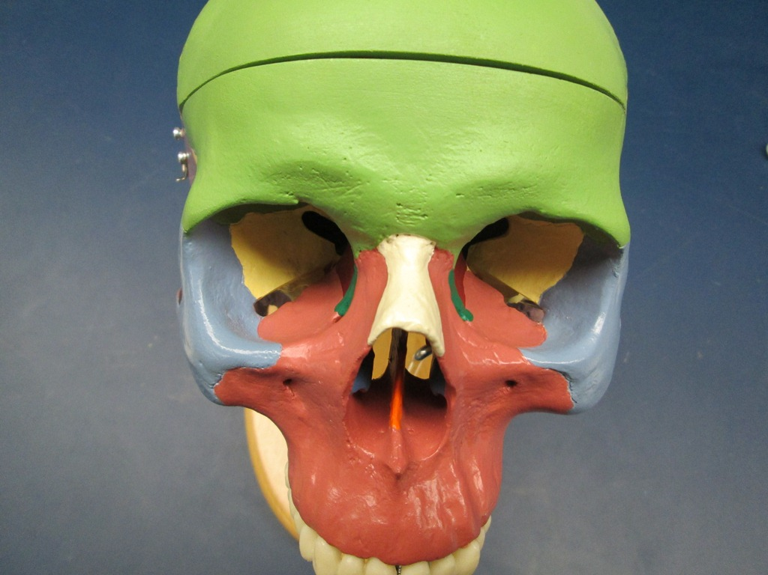
Nasal Bones

Slide 27
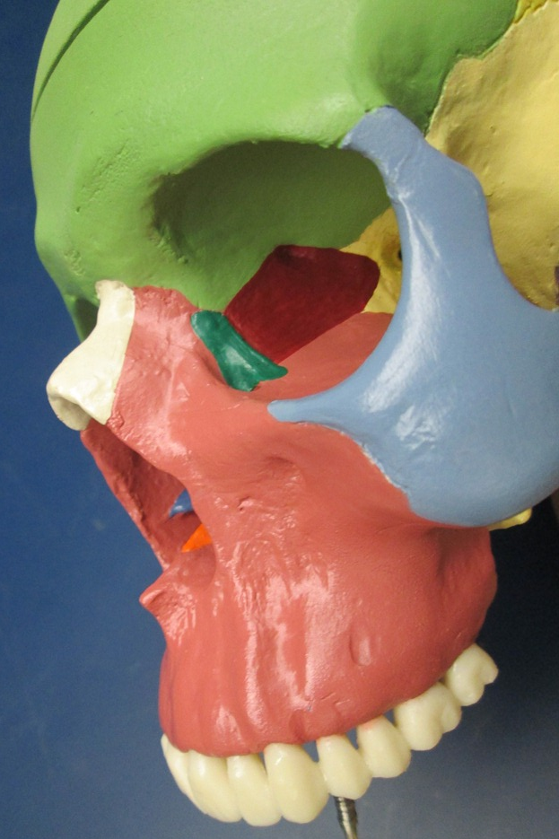
Lacrimal Bones
Lacrimal groove

Slide 28

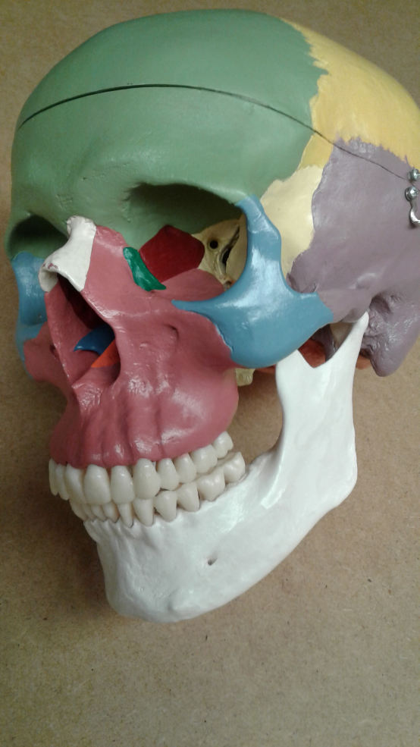
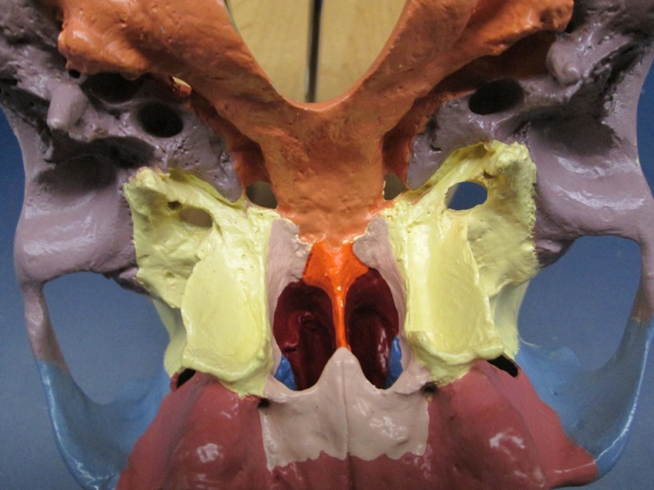
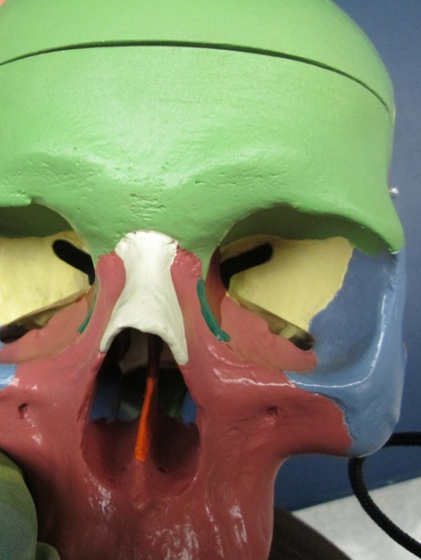
Vomer Bone
Anterior View of the
Nasal Cavity
Posterior View of the Nasal Cavity
Anterolateral View of the Nasal Cavity

Slide 29
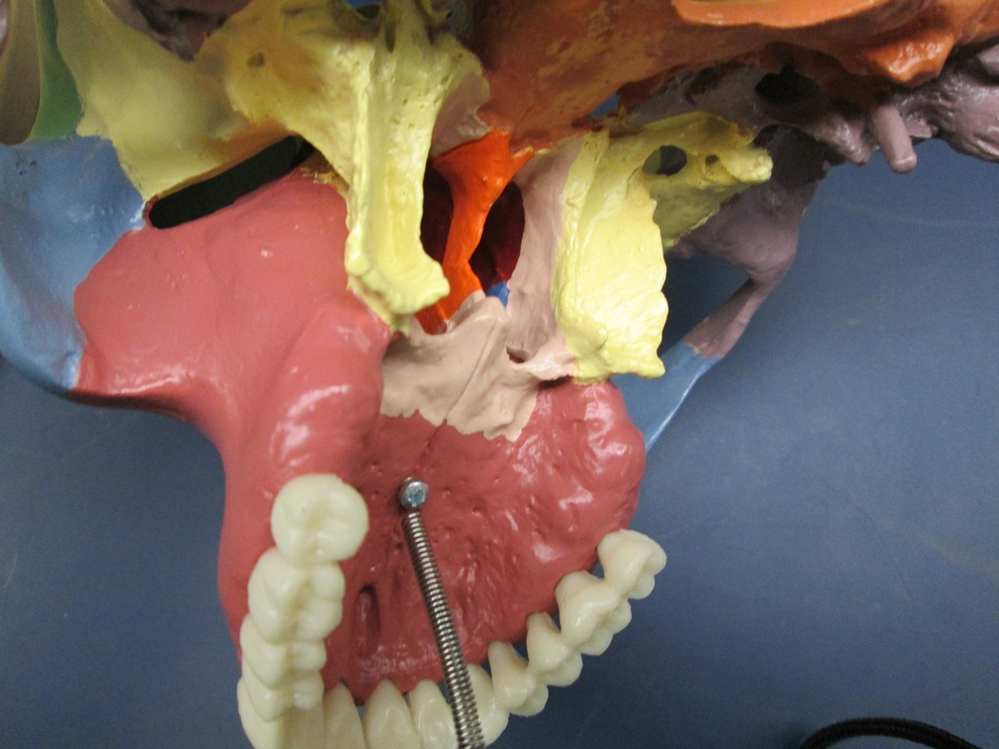
Palatine Bones*
*
*
*
*
*

Slide 30

Inferior Nasal Conchae

Slide 31
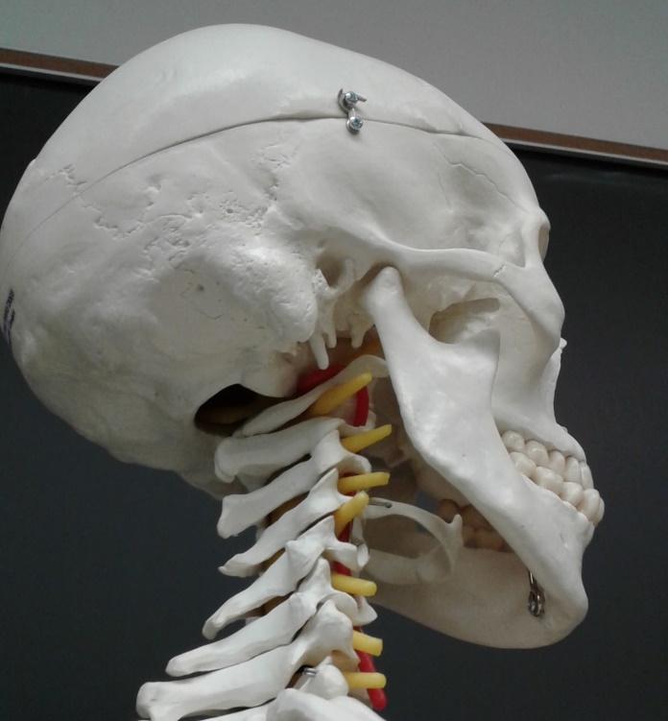





Hyoid Bone*
*
*
*

Slide 32

Auditory Ossicles (1 of 2)

Slide 33


Auditory Ossicles (2 of 2)
Stapes
Incus
Malleus

Slide 34



Fetal Skull (1 of 2)
Anterior fontanels
Frontal suture

Slide 35


Fetal Skull (2 of 2)
Posterior fontanel
Sphenoid fontanel
Mastoid fontanel

