Slide 1
The Skeletal System
The Appendicular Skeleton
The Pelvic Girdle and Lower Limb
Photographed by:
Dr. Syed Arif Humayun
Dr. Laila Nimri
Labeled and Made Accessible by:
Dr. Laila Nimri
Edited by:
Dr. Maya Byfield Mr. James Henry
Dist. Prof. Mary Dolnack Dr. Syed Arif Humayun
Dr. Essa Farah Dr. Laila Nimri

Slide 2
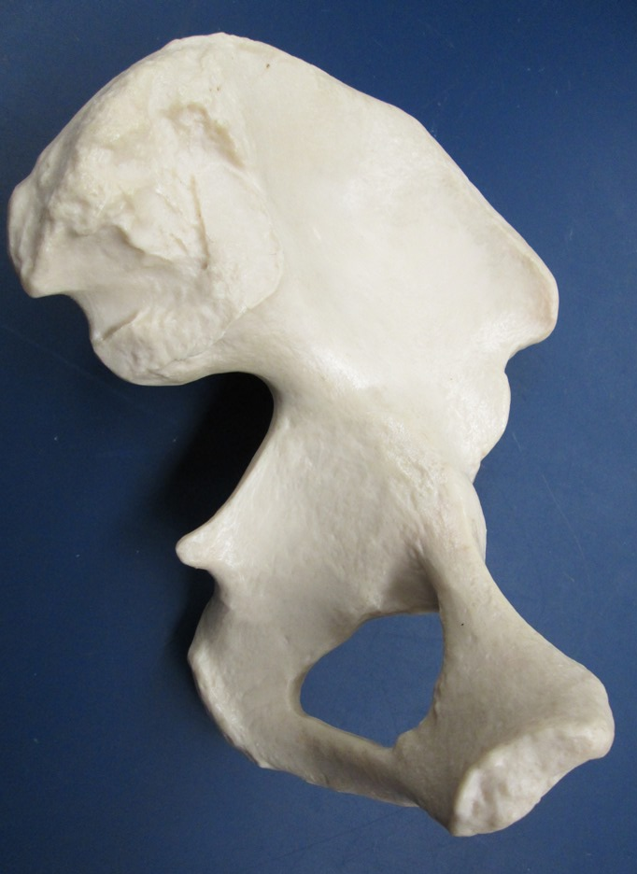
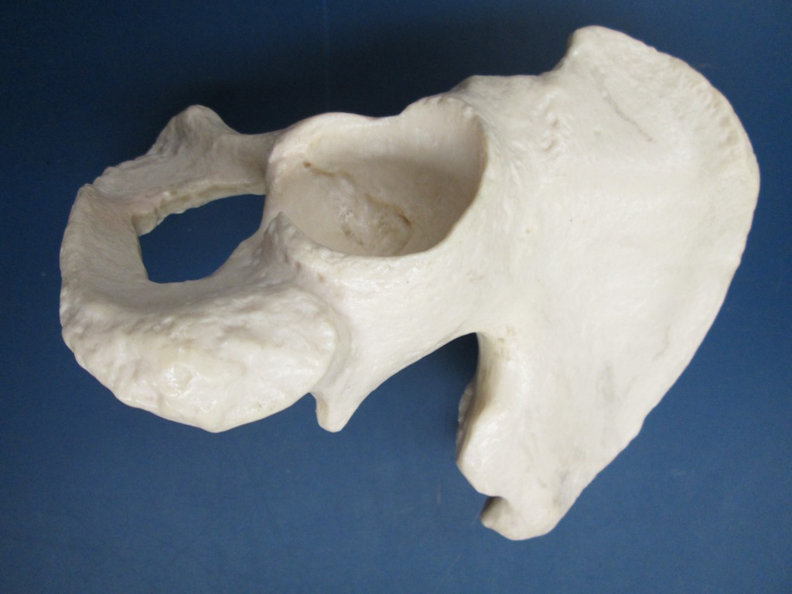
Pelvic Girdle / Coxal Bone (Os Coxae )
Ilium
Ilium
2
Ischium
Ischium
Pubis
1
1
Pubis
Medial View
Posterolateral View
1- Obturator foramen
2- Acetabulum

Slide 3
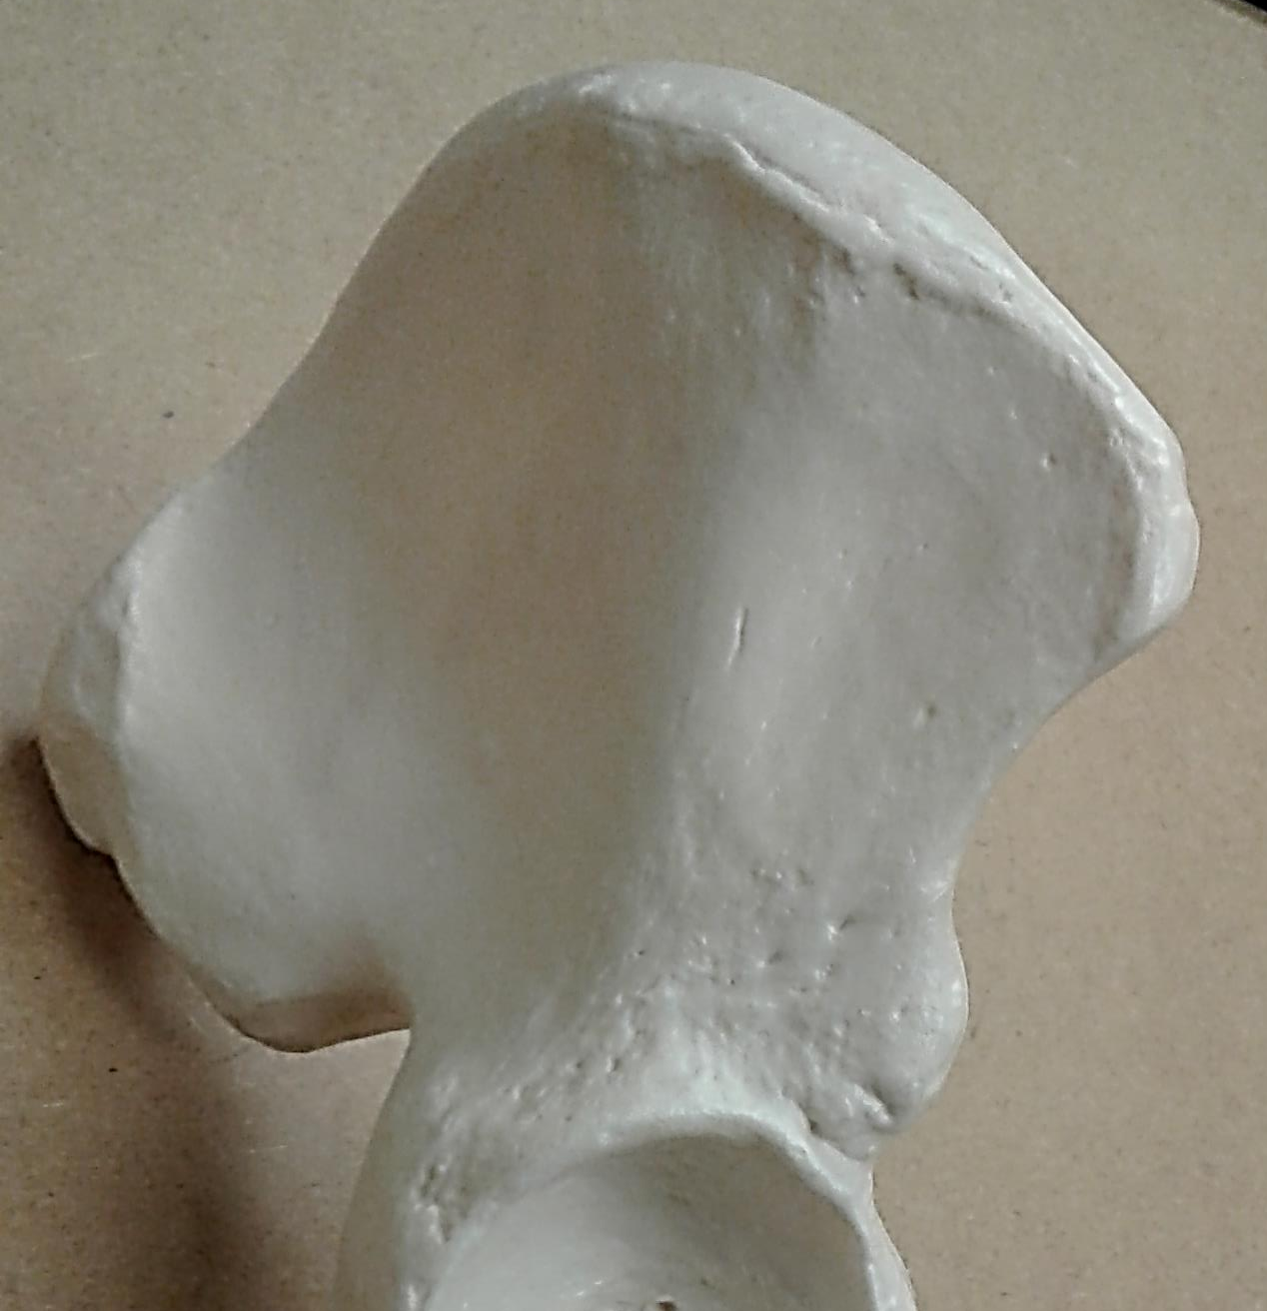
Pelvic Girdle / Ilium (1 of 2)
Iliac crest
Anterior superior iliac spine
Posterior superior iliac spine
Posterior inferior iliac spine
Anterior inferior iliac spine
Greater sciatic notch
Acetabulum
Lateral View

Slide 4
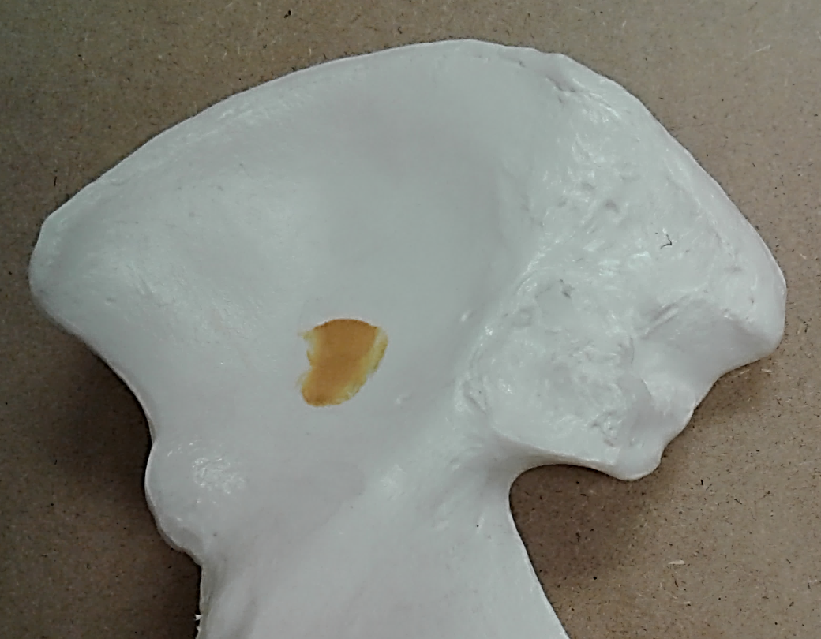
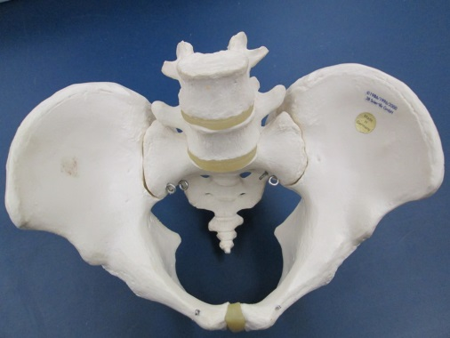
Pelvic Girdle / Ilium (2 of 2)
Auricular surface
Sacroiliac joint
Medial View

Slide 5
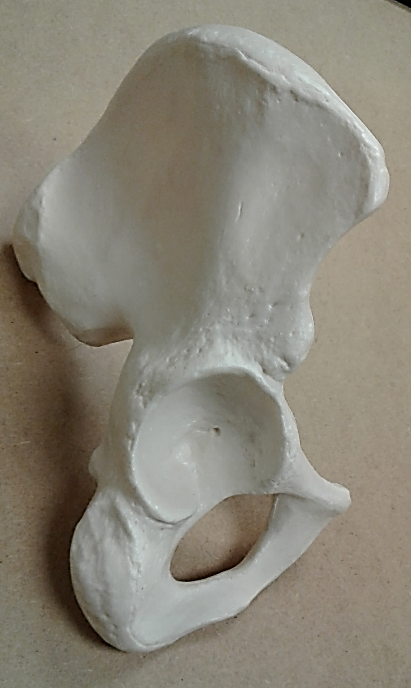
Pelvic Girdle / Ischium (Lateral View)
Ischial spine
Ischial tuberosity

Slide 6
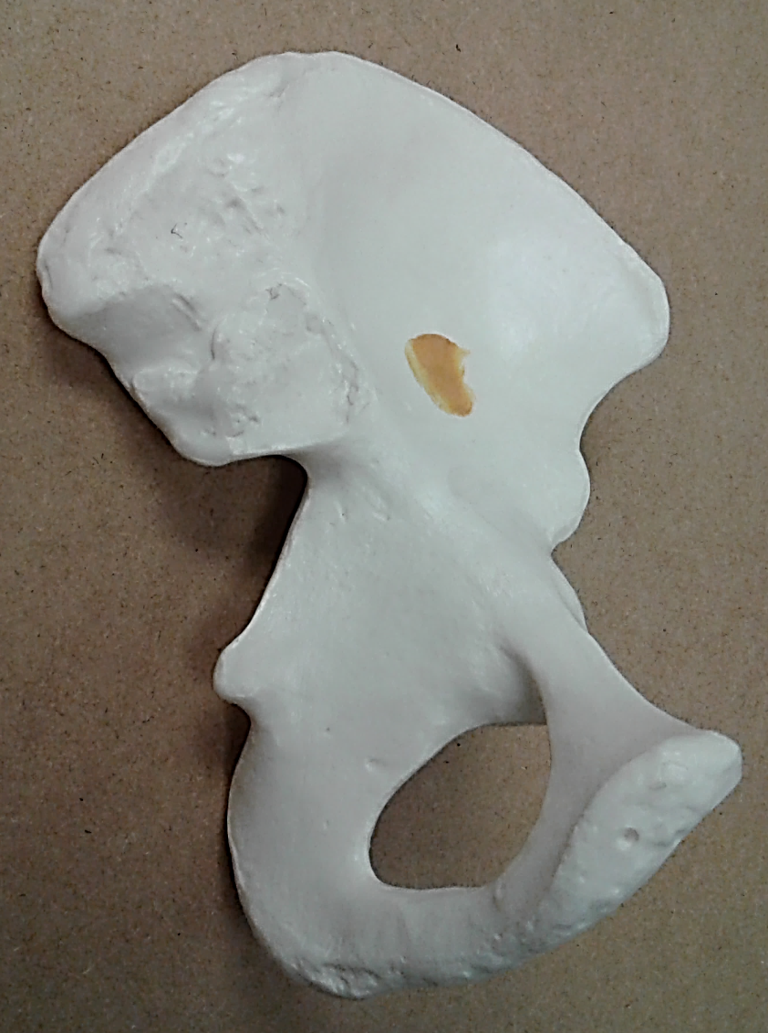
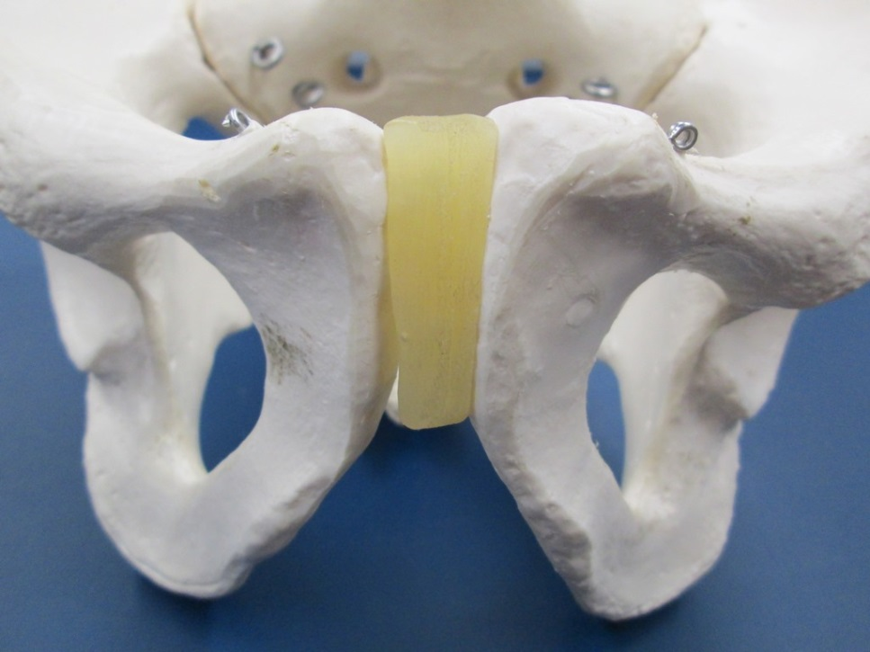
Pelvic Girdle / Pubis
Symphysial surface
Subpubic angle
Medial View
Pubic Symphysis

Slide 7

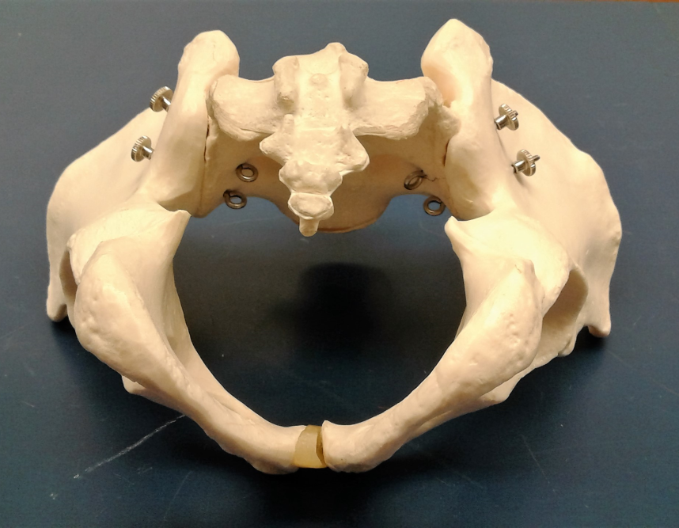
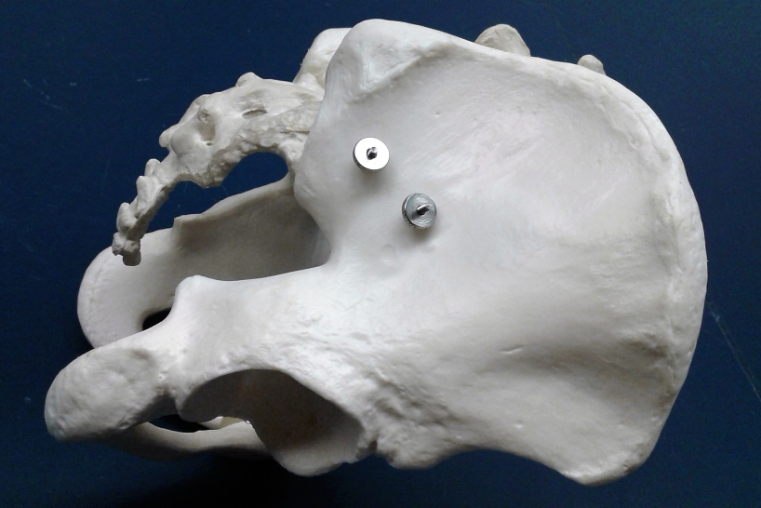
The Pelvis
Superior View
Inferior View
Pelvic brim
2
1
Lateral View
Space #1: Pelvic inlet (within pelvic brim)
Space #2: Pelvic outlet
False pelvis: region superior to pelvic brim
True pelvis: region inferior to pelvic brim

Slide 8
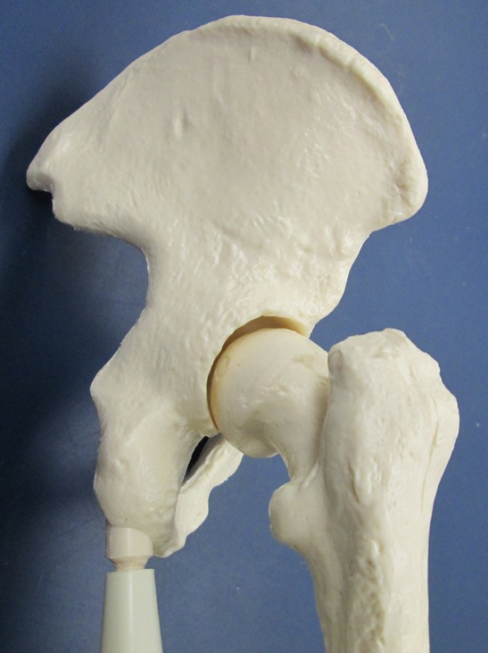
Articulation of the Femur with the Coxal Bone
Acetabulum of coxal bone
Head of femur

Slide 9
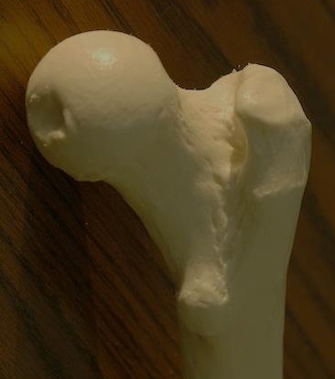
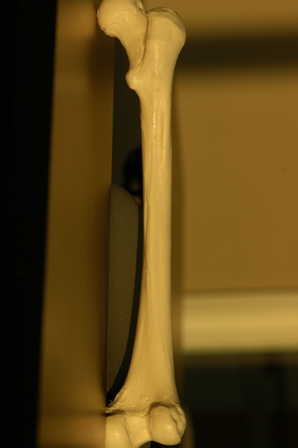
Posterior View of the Femur
Proximal end
h = head
n = neck
g.t. = greater trochanter
l.t. = lesser trochanter
p.s. = popliteal surface
m.c. = medial condyle
i.f. = intercondyler fossa
l.c. = lateral condyle
l.e. = lateral epicondyle
Proximal end
h
g.t.
n
l.t.
Linea aspera
p.s.
l.e.
Distal end
m.c.
i.f.
l.c.
Distal end

Slide 10
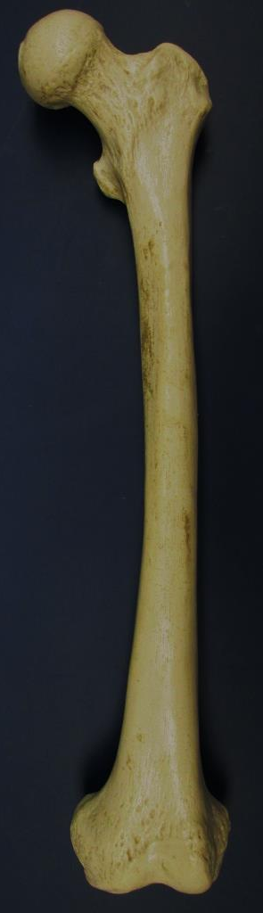
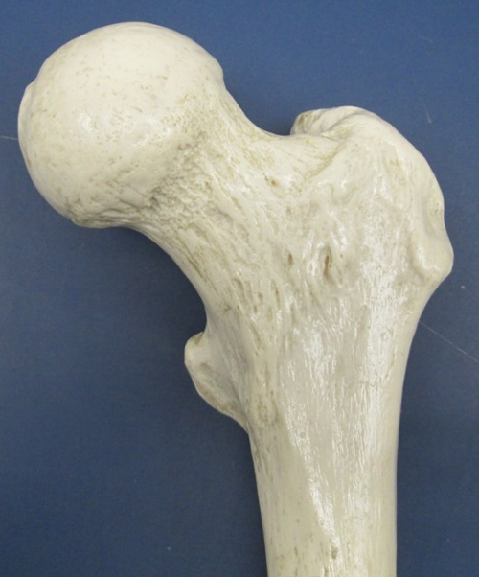
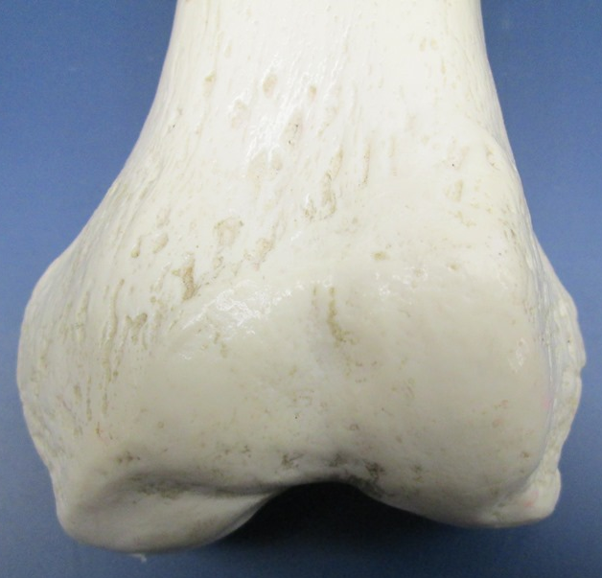
Anterior View of the Femur
Proximal end
h
h = head
n = neck
g.t. = greater trochanter
l.t. = lesser trochanter
pat.s. = patellar surface
m.e. = medial epicondyle
m.c. = medial condyle
l.c. = lateral condyle
l.e. = lateral epicondyle
n
g.t.
l.t.
m.e.
pat.s.
l.e.
m.c.
l.c.
Distal end

Slide 11
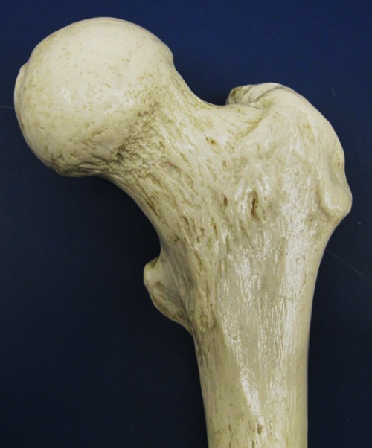
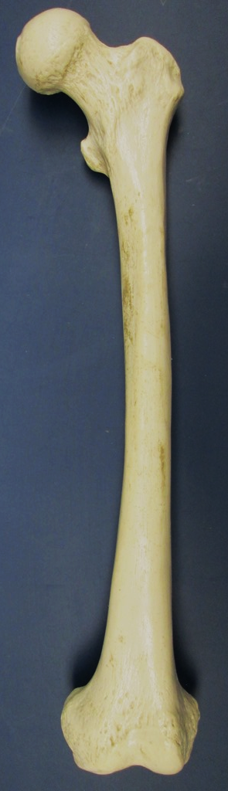
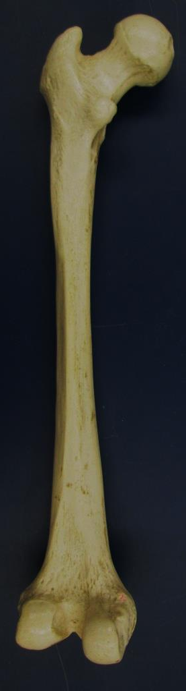
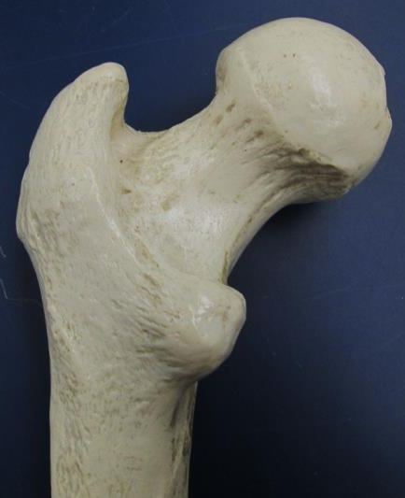
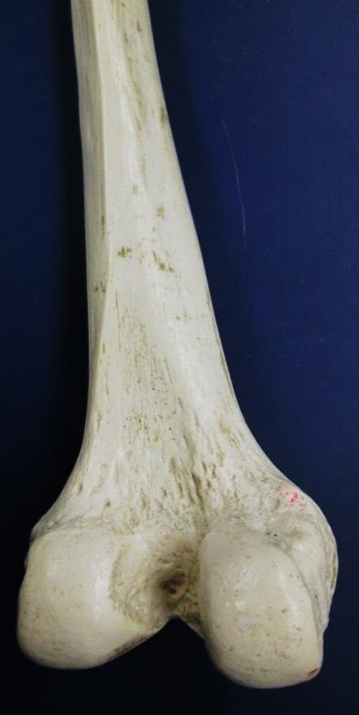
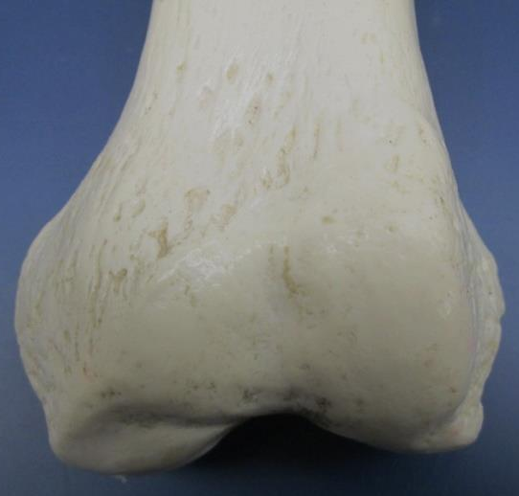
Anterior and Posterior View of the Femur
Anterior View
Posterior View
Test Your Knowledge of the Femur’s Bone Markings

Slide 12
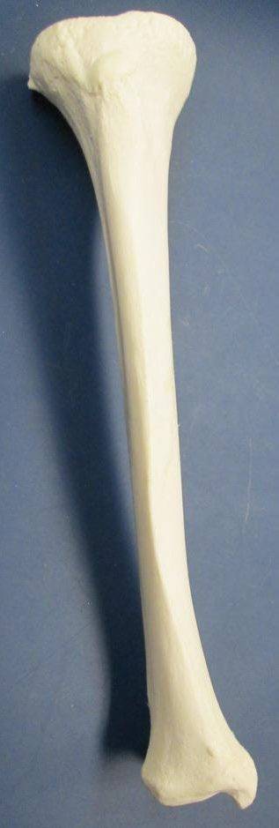
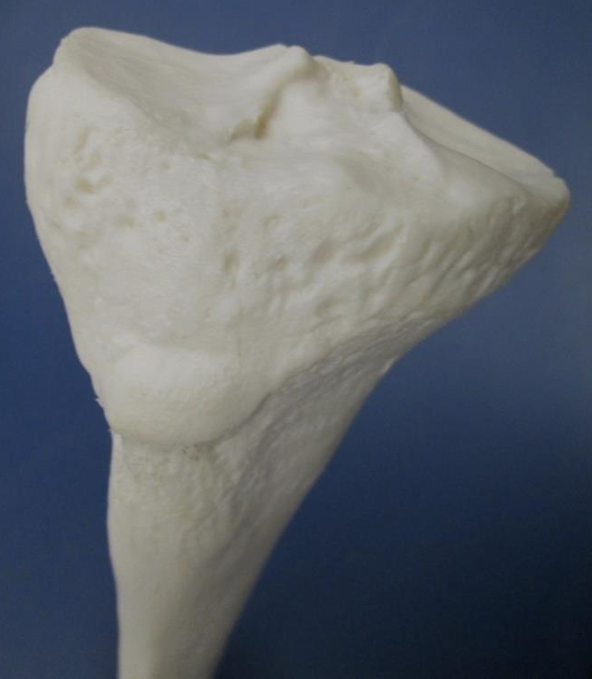
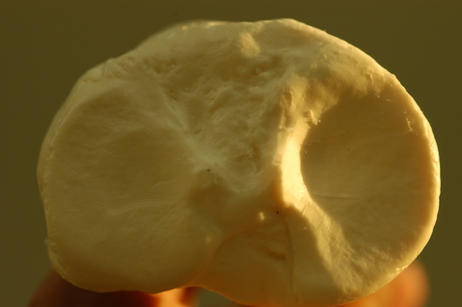
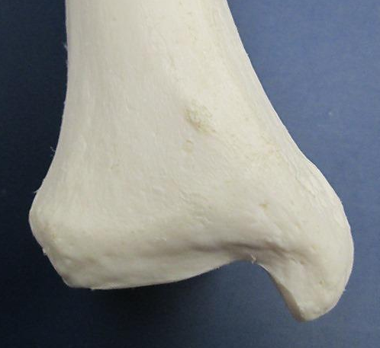
Tibia
Anterior View
Proximal end
l.c.
Proximal end,
articular surface
i.e.
m.c.
t.t.
i.e.
Anterior border
l.c. = lateral condyle
i.e. = intercondylar
eminence
m.c. = medial condyle
t.t. = tibial tuberosity
m.m. = medial malleolus
m.m.
Distal
end

Slide 13
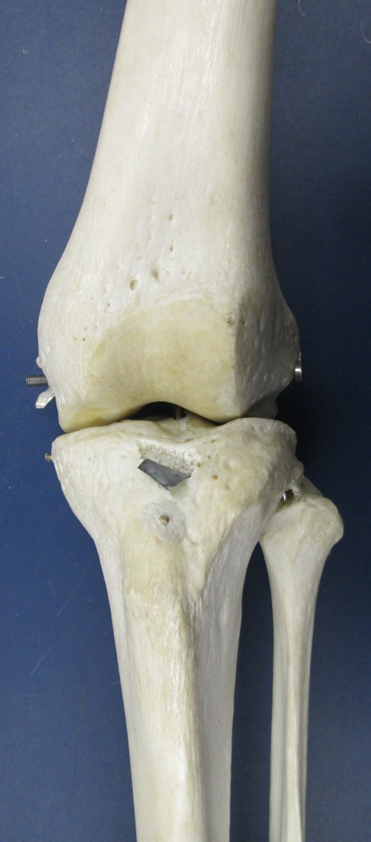
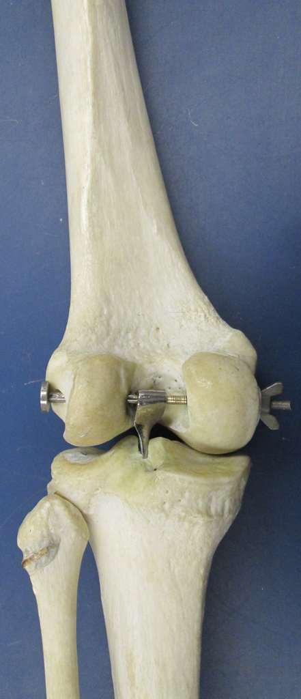
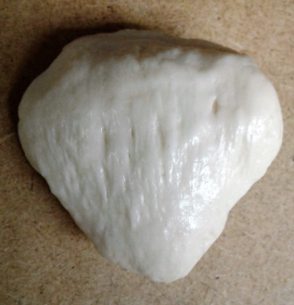
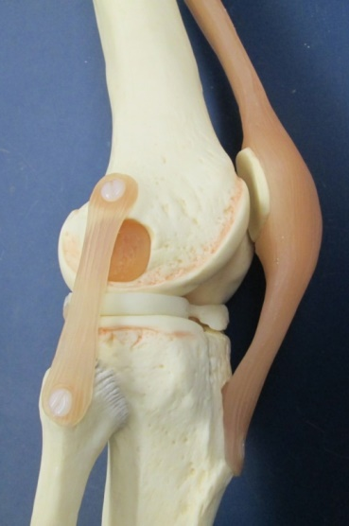
Articulation of the Femur with the Tibia and Fibula
femur
femur
Lateral
&
medial
condyles of femur
Patella
fibula
tibia
Lateral
&
medial
condyles of tibia
fibula
tibia
Anterior View
Posterior View

Slide 14
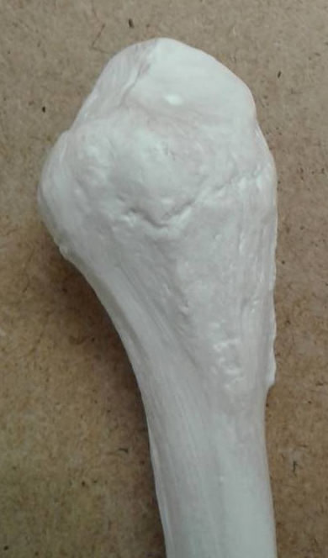
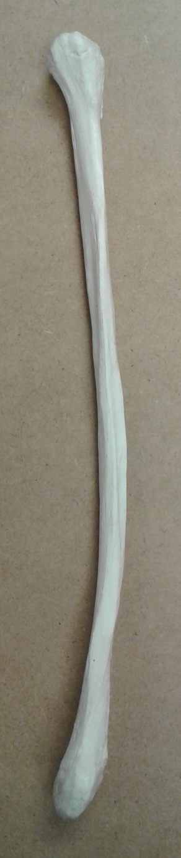
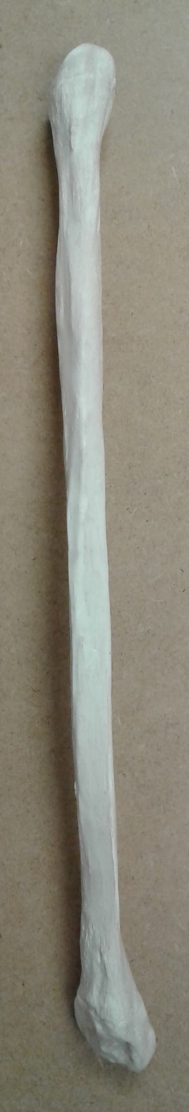
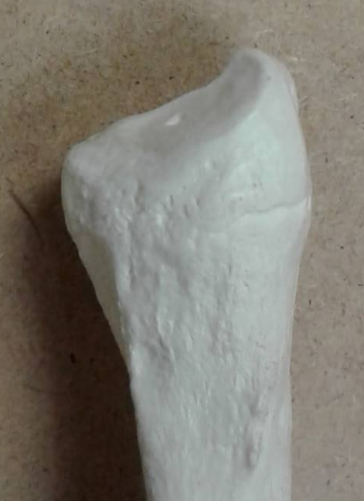
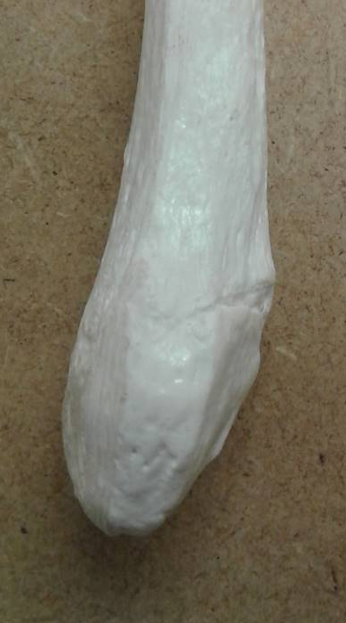
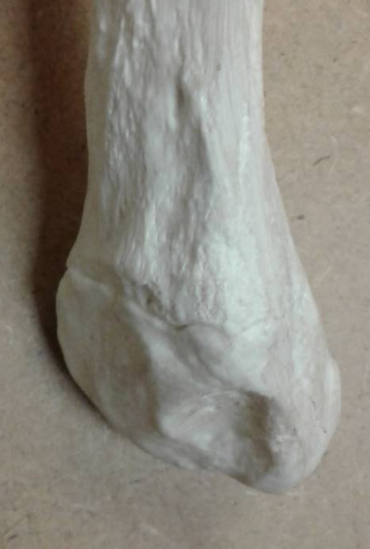
Fibula
Proximal end
Proximal end
H
H
H. = head
l.m. = lateral malleolus
l.m
l.m
Distal end
Distal end
Anterior View
Posterior View

Slide 15
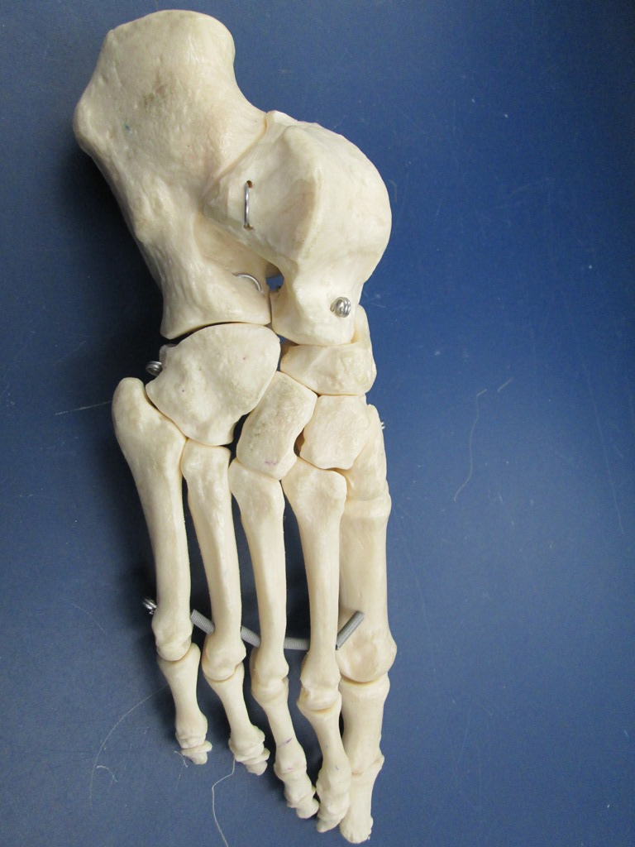
Tarsals, Metatarsals, and Phalanges
Talus
1st
p
d
d
2nd
p
m
d
d
m
d
3rd
p
m
d
p
4th
p
m
d
Calcaneus
5th
Tarsals
Metatarsals
Phalanges
P = proximal
m = middle
d = distal

Slide 16

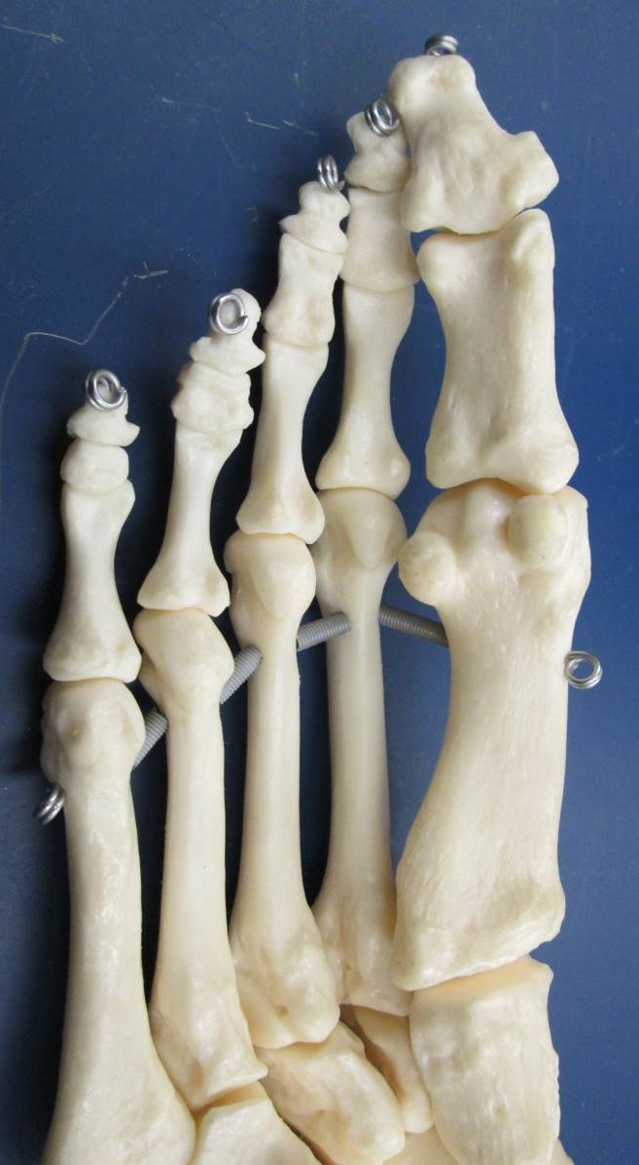
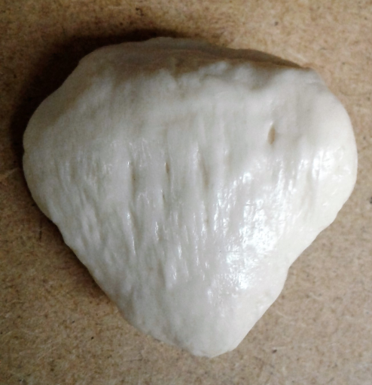
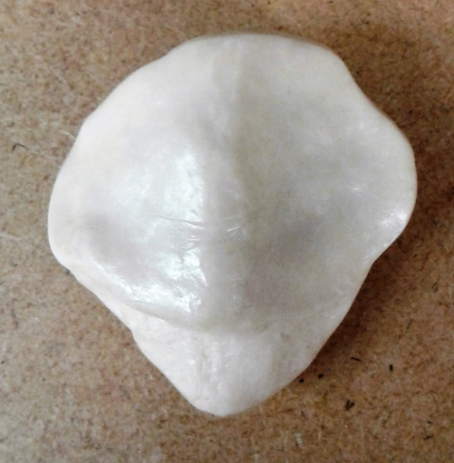
Sesamoid Bones
Patella
Sesamoid bones on the inferior (plantar) surface of foot
Anterior View
Posterior View

