Slide 1
The Skeletal System
The Appendicular Skeleton
The Pectoral Girdle and Upper Limb
Photographed by:
Dr. Syed Arif Humayun
Dr. Laila Nimri
Labeled and Made Accessible by:
Dr. Laila Nimri
Edited by:
Dr. Maya Byfield Mr. James Henry
Dist. Prof. Mary Dolnack Dr. Syed Arif Humayun
Dr. Essa Farah Dr. Laila Nimri

Slide 2
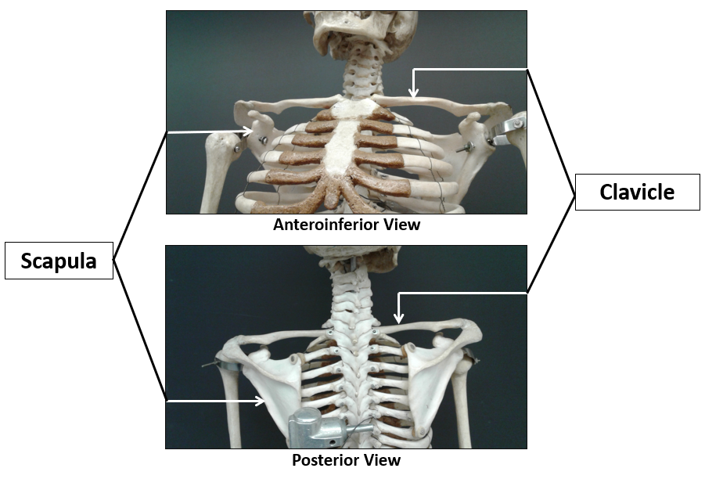
Pectoral Girdle (1 of 3)

Slide 3
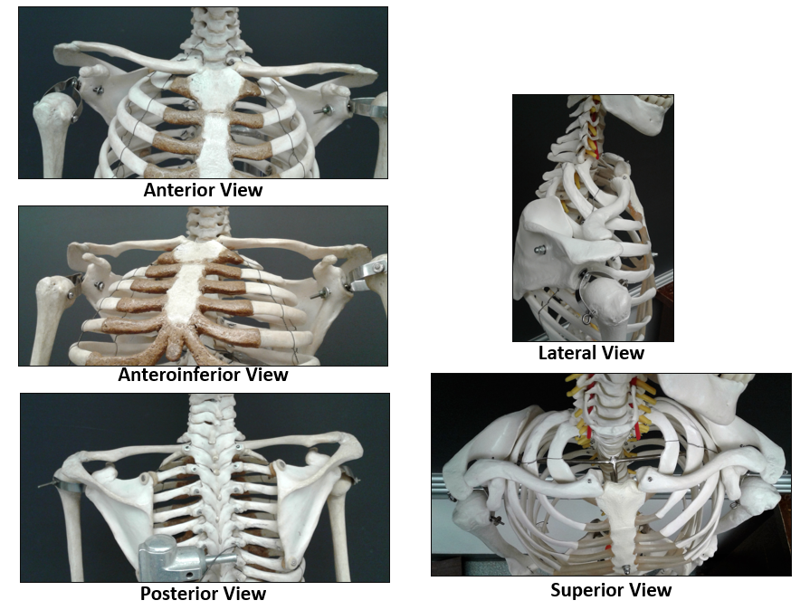
Pectoral Girdle (2 of 3)

Slide 4
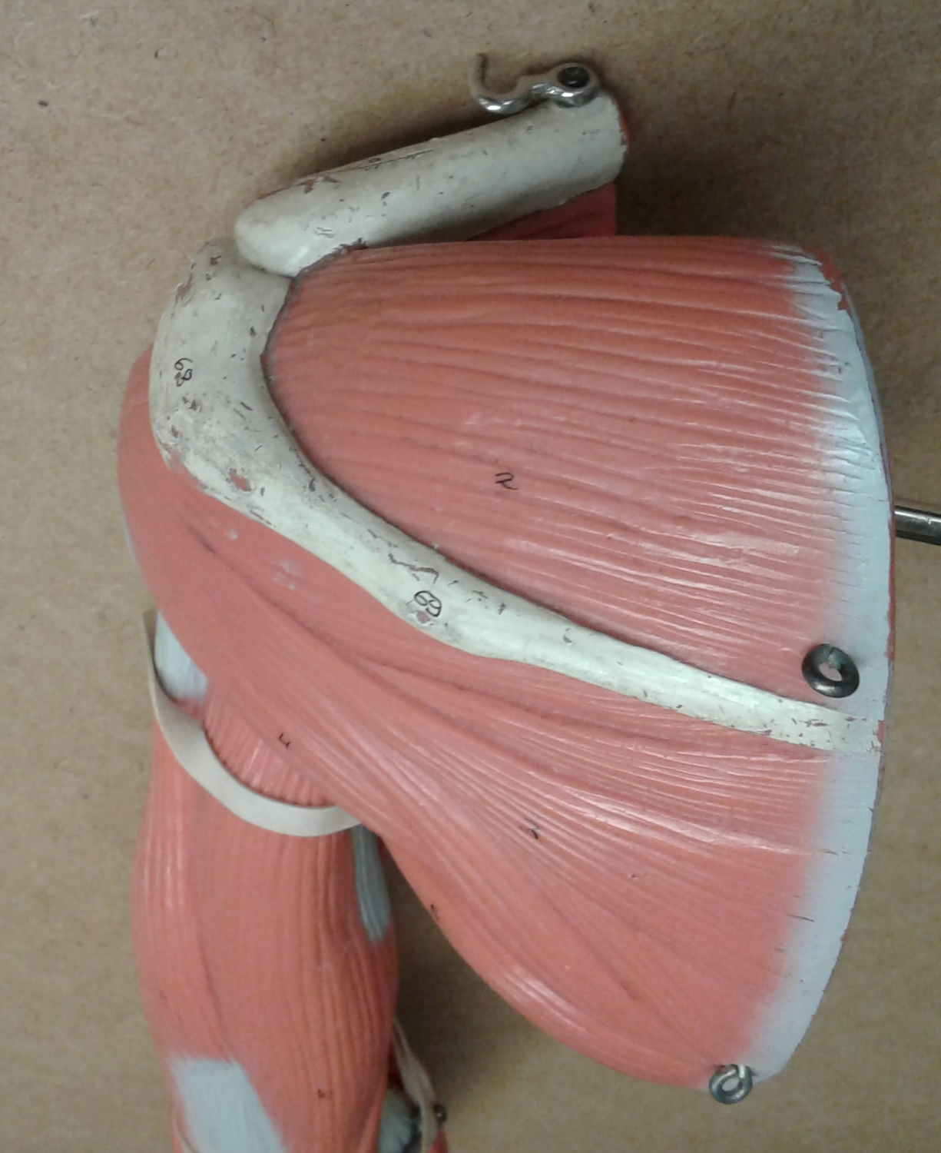
Pectoral Girdle (3 of 3)
Acromial end of clavicle
Acromion
Scapula
Spine

Slide 5
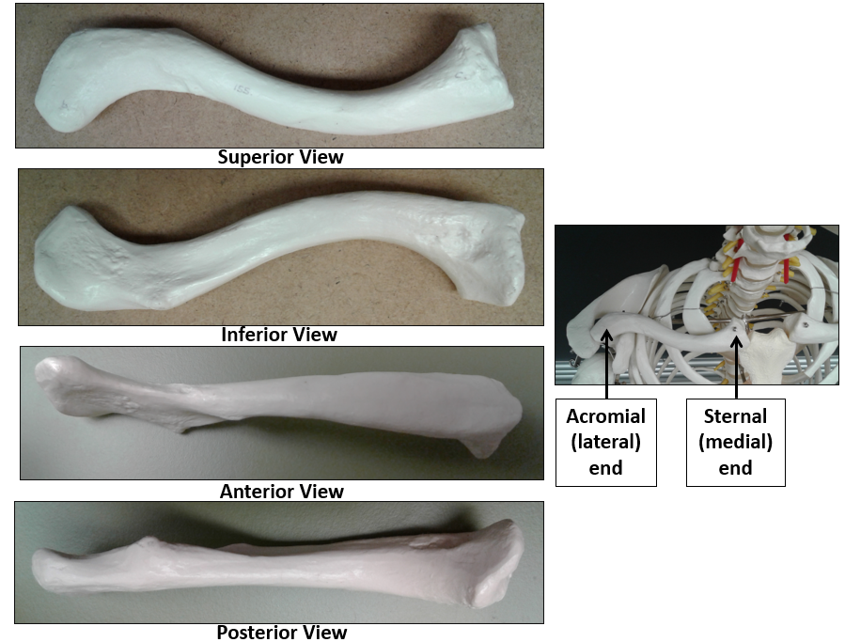
Pectoral Girdle / Clavicle

Slide 6
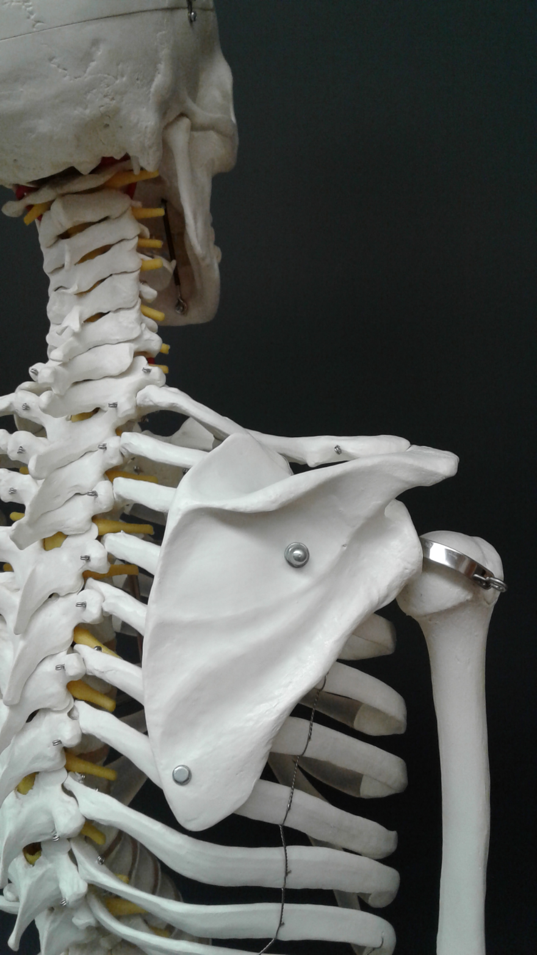
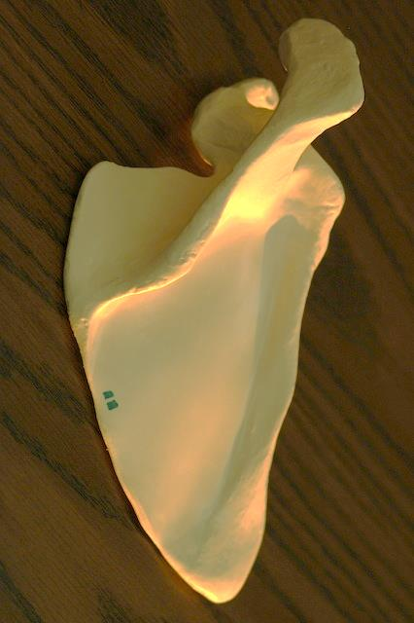
Pectoral Girdle / Scapula Borders (1 of 2)
s.b.
l.b.
m.b.
s.b. = superior border
m.b. = medial (vertebral) border
l.b. = lateral (axillary) border

Slide 7
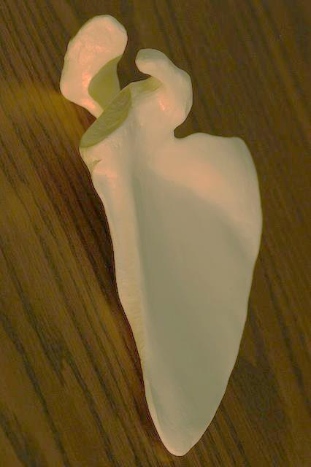
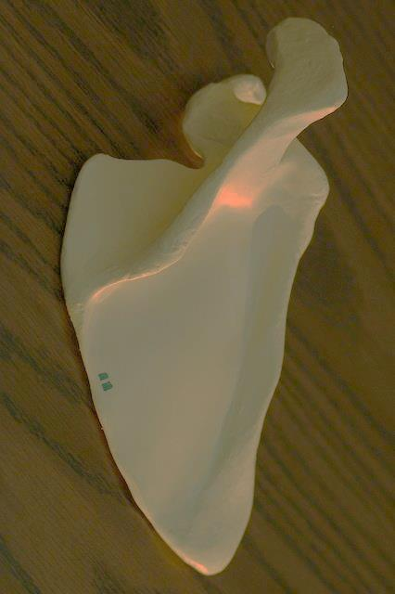
Pectoral Girdle / Scapula Borders (2 of 2)
s.b.
s.b.
l.b.
l.b.
m.b.
m.b.
Anterior View
Posterior View
s.b. = superior border
m.b. = medial (vertebral) border
l.b. = lateral (axillary) border

Slide 8
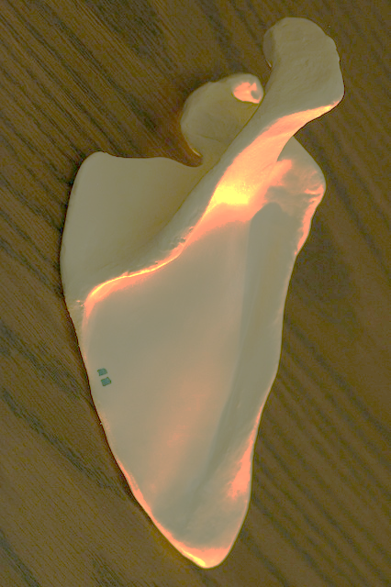
Pectoral Girdle / Scapula Angles
l.a.
s.a.
l.a.
s.a.
i.a.
i.a.
Anterior View
Posterior View
s.a. = superior angle
i.a. = inferior angle
l.a. = lateral angle

Slide 9
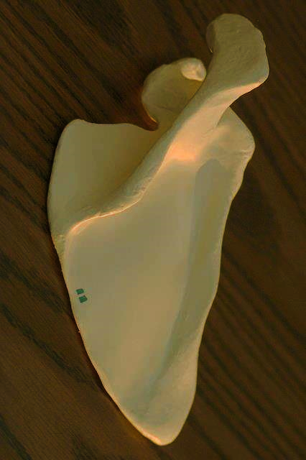
Pectoral Girdle / Scapula Fossae
Suprascapular notch
Supraspinous fossa
Glenoid cavity
Spine
Subscapular fossa
Infraspinous fossa
Anterior View
Posterior View

Slide 10
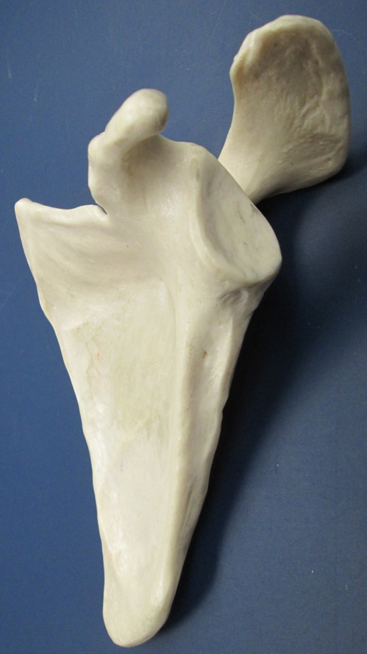
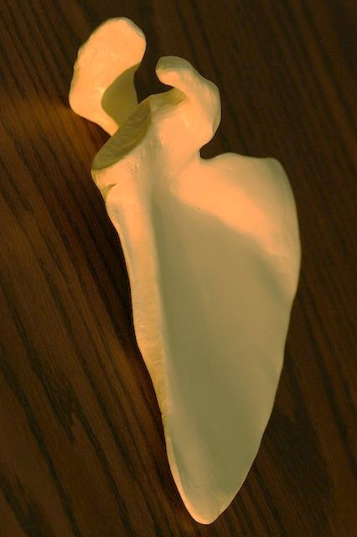
Pectoral Girdle / Scapula Tubercles
Supraglenoid tubercle
Glenoid cavity
Infraglenoid tubercle

Slide 11
Pectoral Girdle / Scapula Processes
Acromion process
Coracoid process
Anterior View
Posterior View

Slide 12
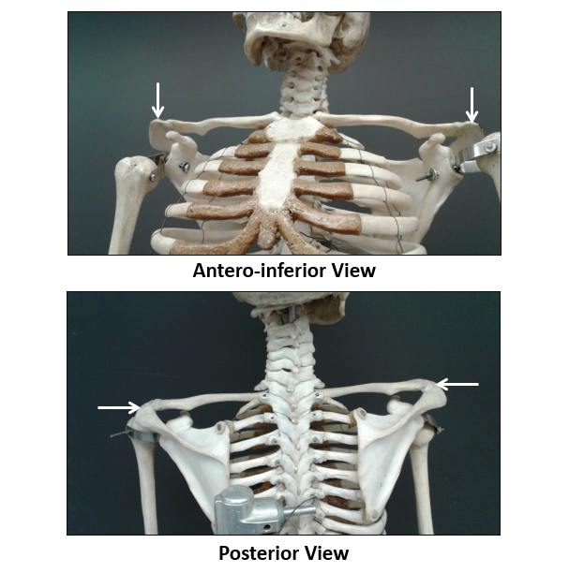
Pectoral Girdle / Scapula Acromion Process

Slide 13
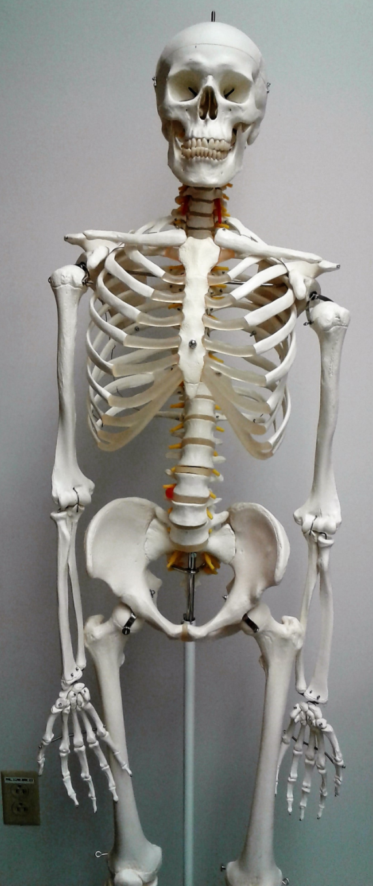
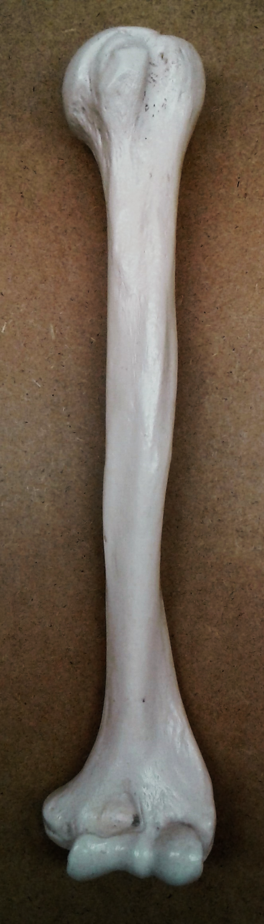
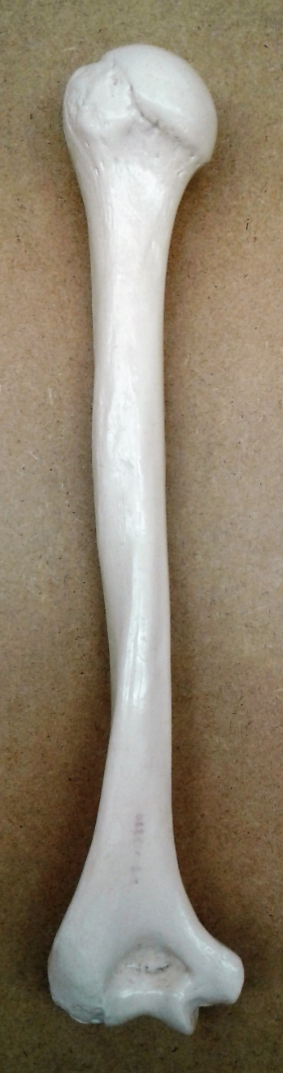
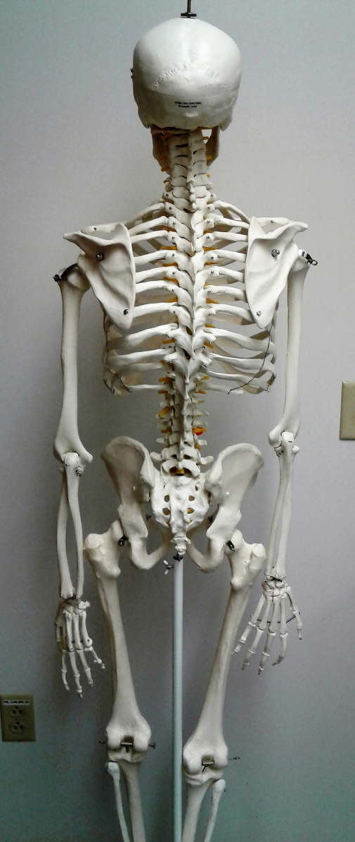
Humerus
Anterior View
Posterior View

Slide 14
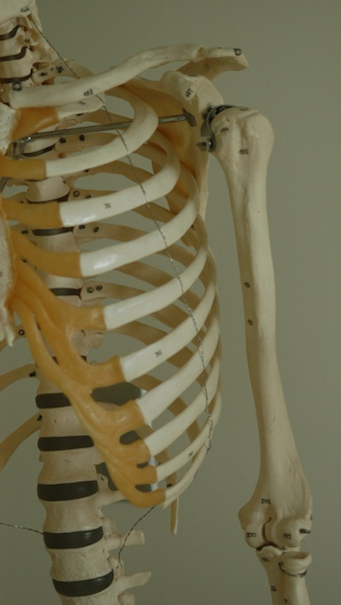
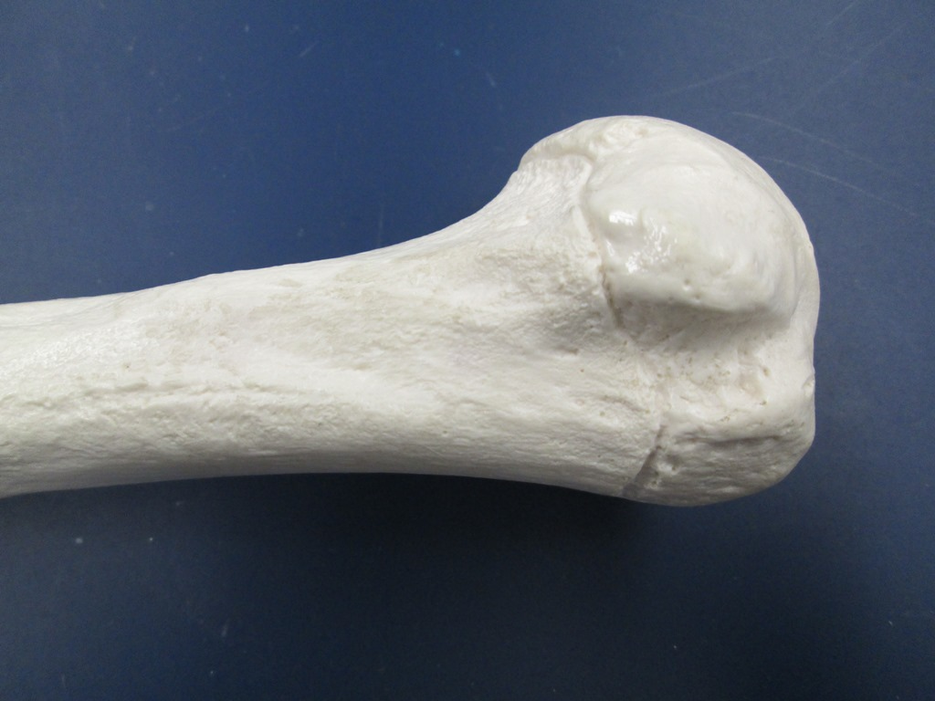
Anterior View of the Humerus
Head
Anatomical neck
Greater tubercle
Intertubercular sulcus
Lesser tubercle
Proximal End

Slide 15
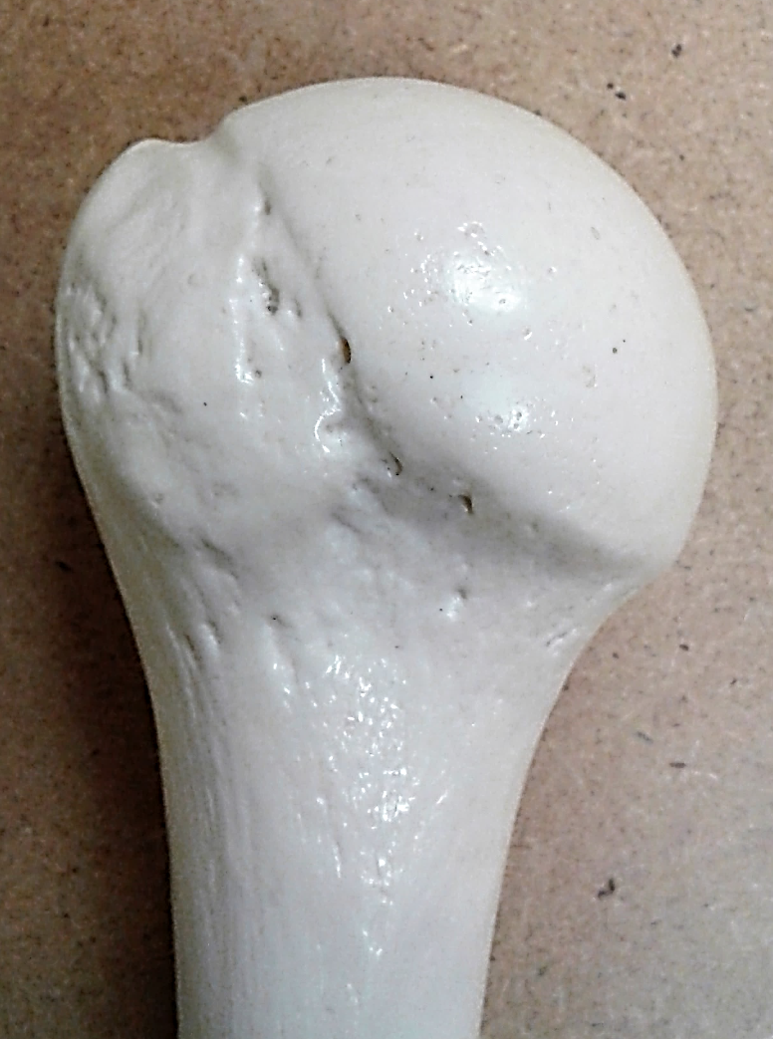
Posterior View of the Humerus
Head
Greater tubercle
Anatomical neck
Surgical neck
Proximal End

Slide 16
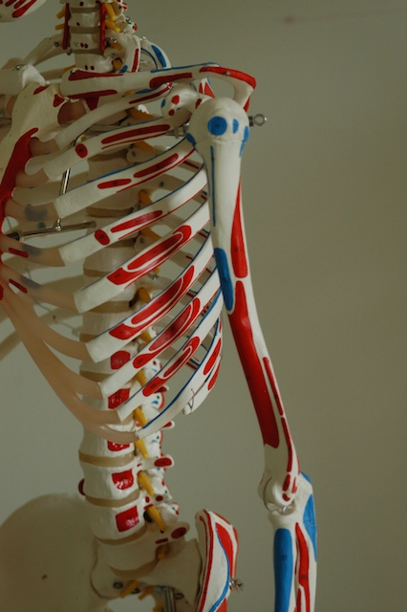
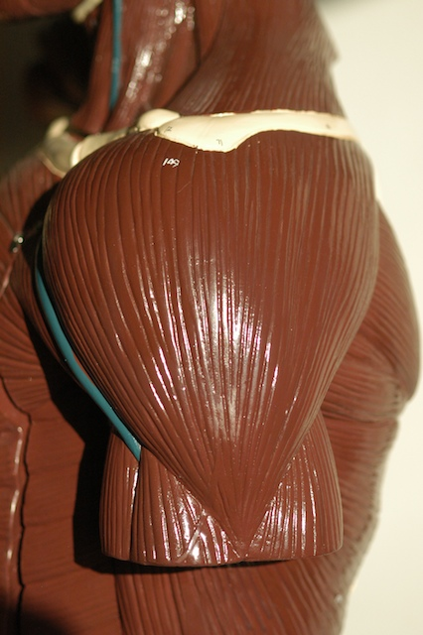
Humerus / Deltoid Tuberosity
Deltoid muscle
Deltoid tuberosity
Deltoid muscle inserts into the deltoid tuberosity

Slide 17

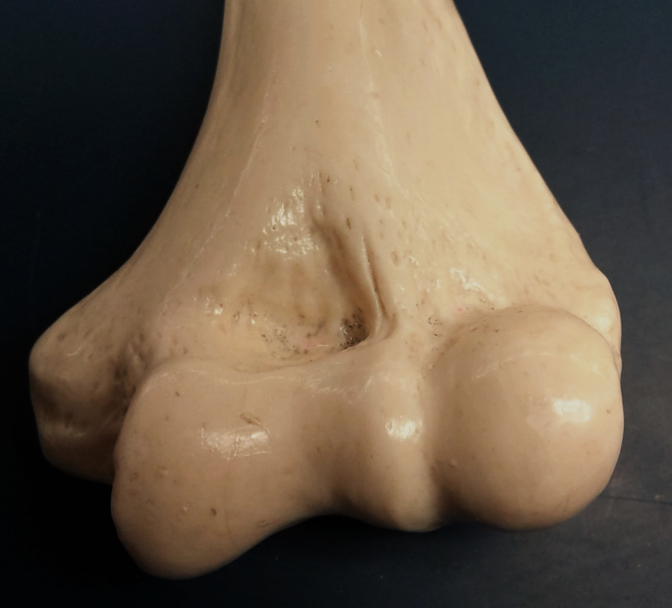
Anterior View of Humerus
Distal End
c.f.
r.f.
l.e.
m.e.
c
t
c = capitulum
t = trochlea
l.e. = lateral epicondyle
r.f. = radial fossa
c.f. = coronoid fossa
m.e. = medial epicondyle

Slide 18
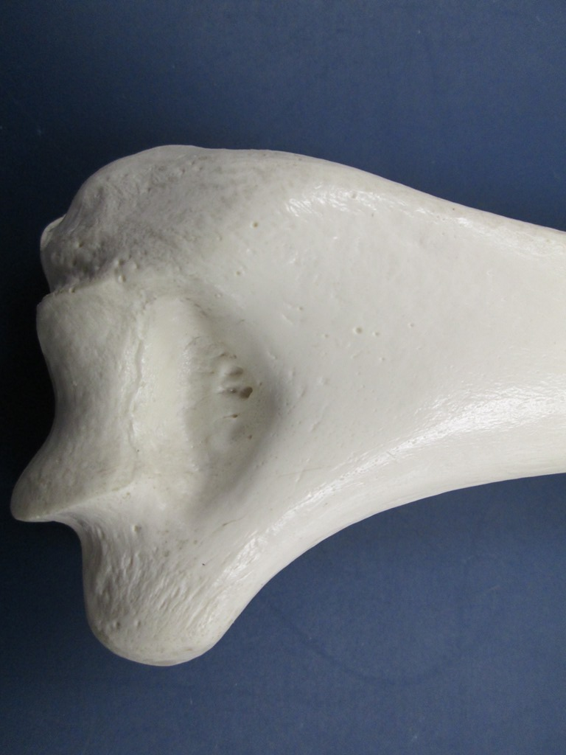
Posterior View of Humerus
Distal End
Olecranon fossa
Trochlea
Lateral epicondyle
Medial epicondyle

Slide 19
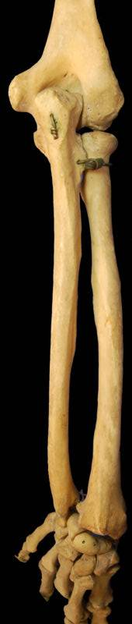
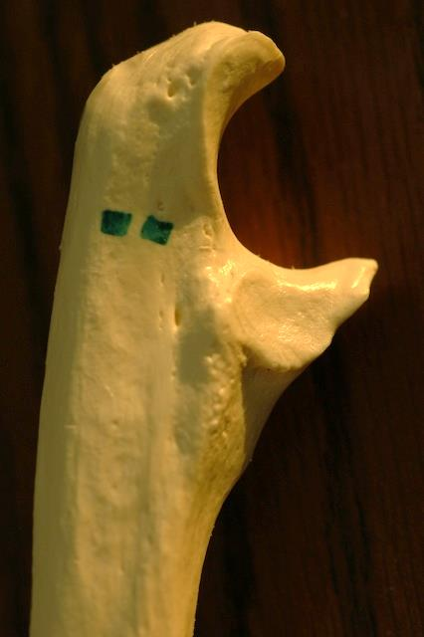
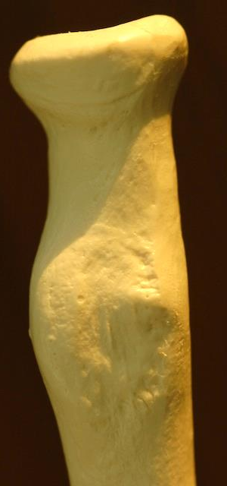
Ulna and Radius
o.p.
h.
t.n.
c.p.
r.n.
r.t.
Ulna
Radius
o.p. = olecranon process r.n. = radial notch
t.n. = trochlear notch h. = head
c.p. = coronoid process r.t. = radial tuberosity
Posterior View

Slide 20
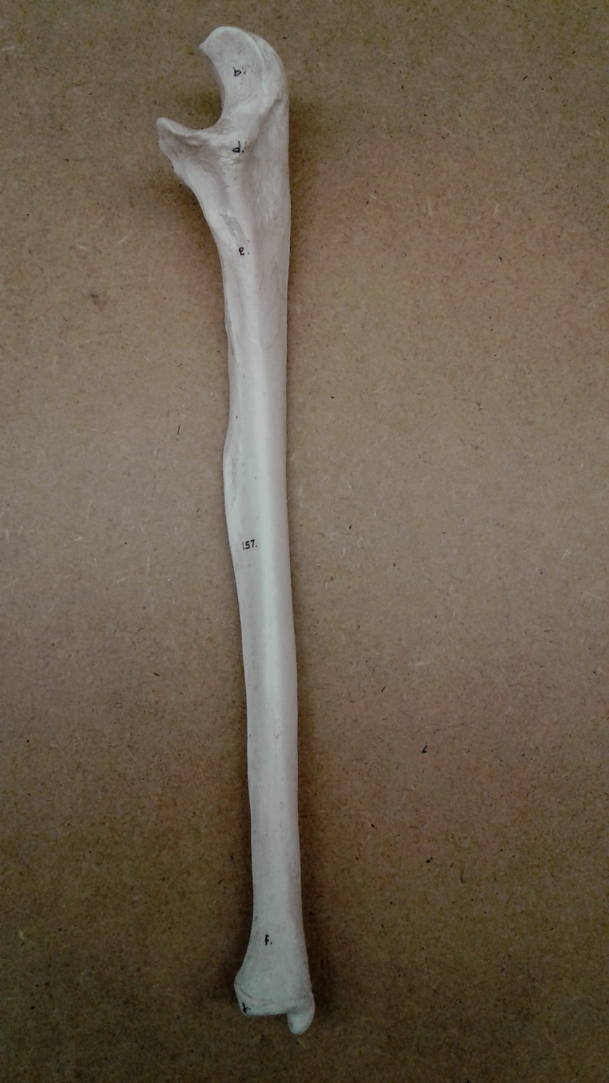
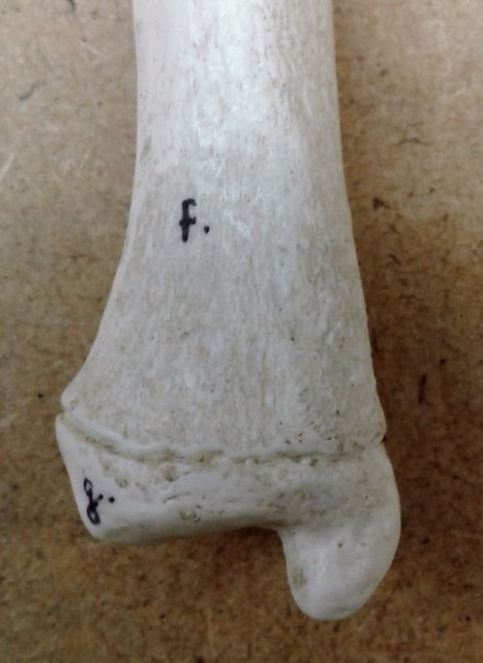
Ulna
Proximal End
Olecranon process
Trochlear notch
Coronoid process
Styloid process of ulna
Proximal End
Head of ulna
Distal End
Distal End

Slide 21
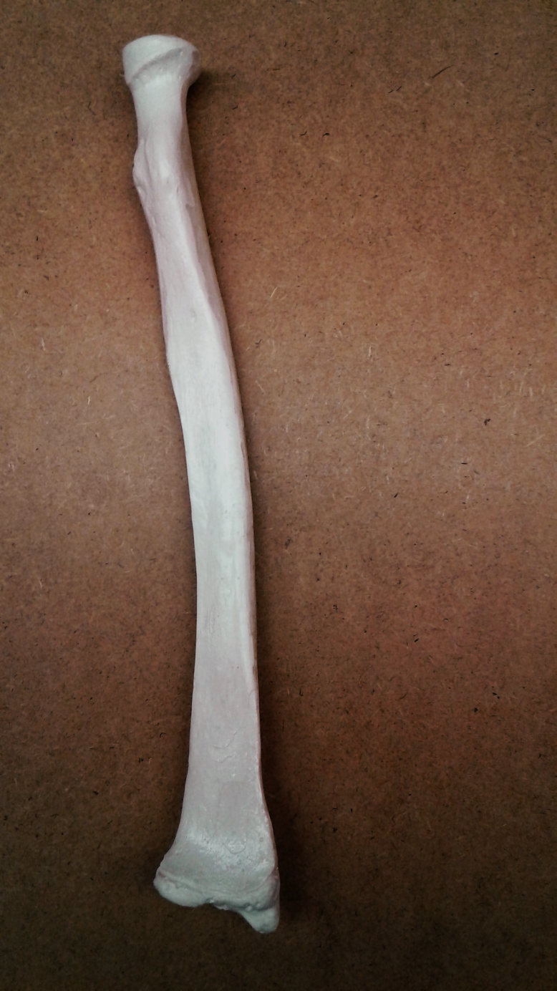

Radius
Proximal End
Head
Radial tuberosity
Proximal End
Styloid process of radius
Distal End
Distal End

Slide 22
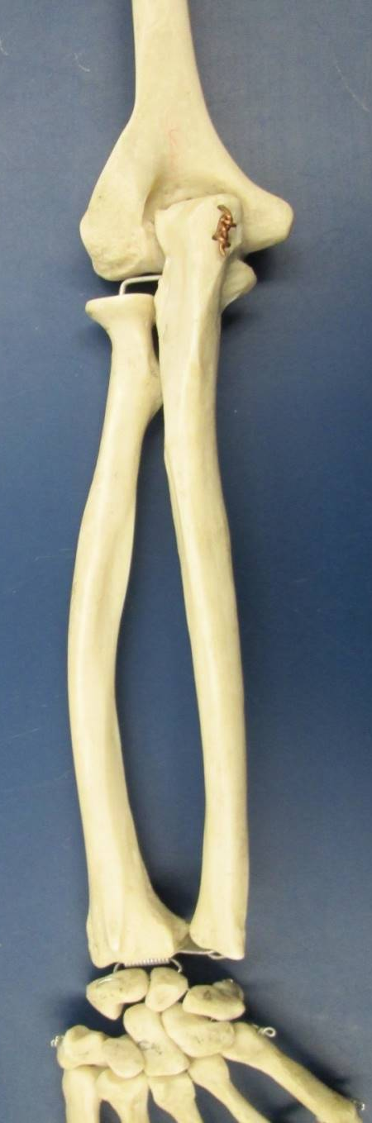
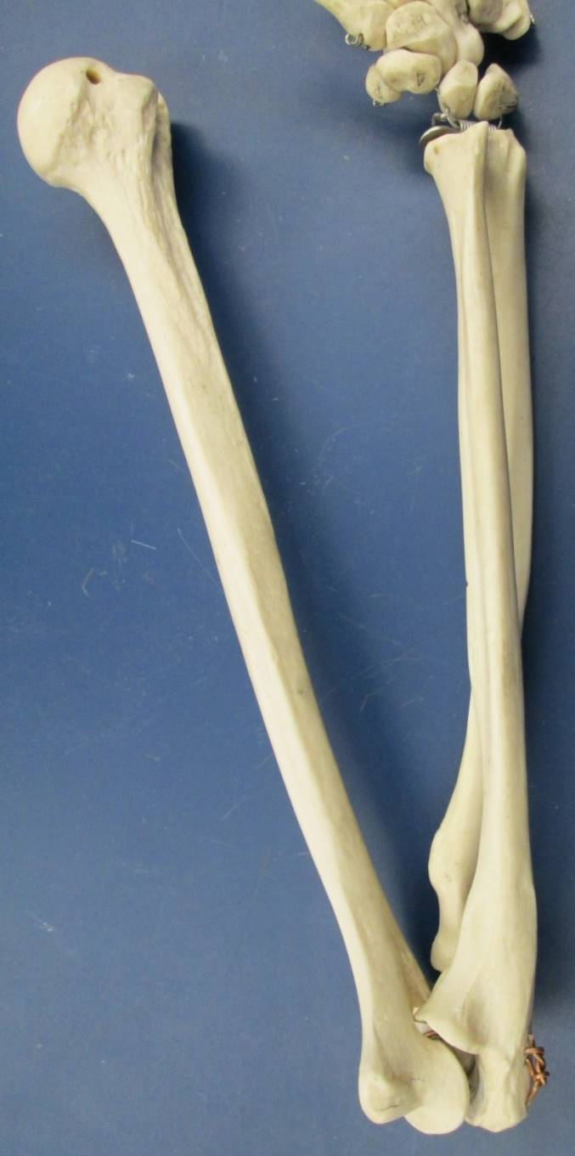
Articulation of Humerus with Ulna and Radius at the Elbow Joint
h.
h.
r.
u.
h. = humerus
r. = radius
u. = ulna
r.
u.
Elbow Extension
Elbow Flexion

Slide 23
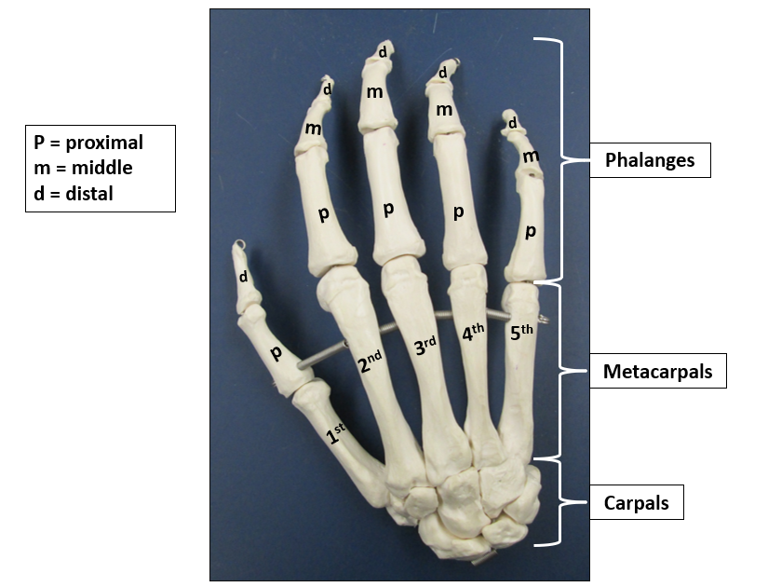
Carpals, Metacarpals, and Phalanges

