Slide 1
Rat Dissection
Photographed by:
Mr. James Henry
Dr. Laila Nimri
Labeled and Made Accessible by:
Dr. Laila Nimri
Edited by:
Dr. Maya Byfield Mr. James Henry
Dist. Prof. Mary Dolnack Dr. Syed Arif Humayun
Dr. Essa Farah Dr. Laila Nimri

Slide 2
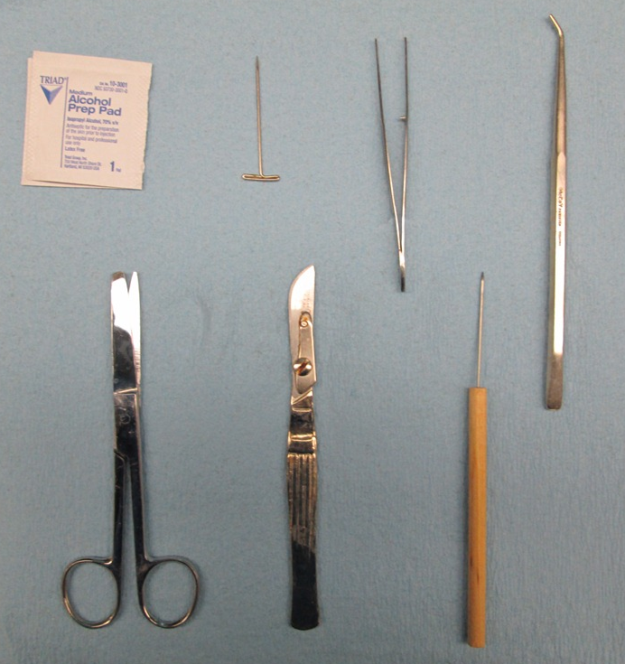
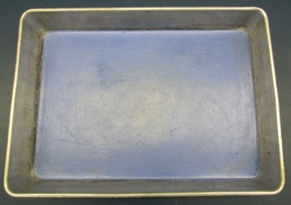
Common Dissecting Tools
1- Dissecting pin
2- Forceps
3- Blunt probe
4- Scissors
5- Scalpel
5a- Scalpel
blade
5b- Scalpel
handle
6- Dissecting needle
7- Dissecting tray
1
2
3
5a
7
5
4
5b
6
Notes:
Common Dissecting Tools:
1- Dissecting pin,
2- Forceps, 3- Blunt probe, 4- Scissors, 5- Scalpel, 5a- Scalpel blade, 5b- Scalpel handle, 6- Dissecting needle, 7- Dissecting tray

Slide 3
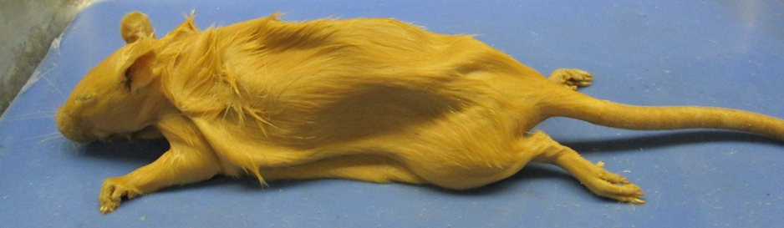
External Features of a Rat
(Lateral View)
Rostrum (snout)
Auricles
Hindlimb
Tail
whiskers
Directional Terms in Humans
Forelimb
Superior (cranial)
Dorsal
Anterior (ventral)
Posterior (dorsal)
Anterior (cranial)
Posterior (caudal)
Ventral
Inferior (caudal)
Notes:
External Features of a Rat (Lateral View).

Slide 4
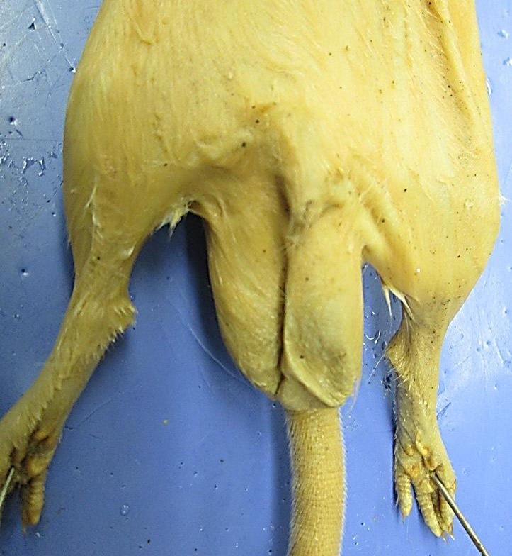
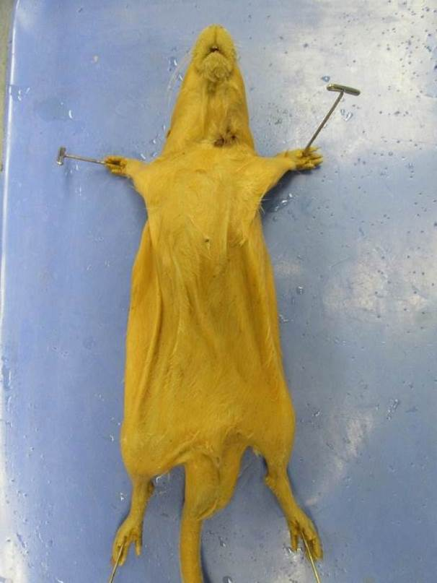
Male Rat
(Ventral View)
Mammary papilla
Urogenital orifice
Scrotum
Notes:
Male Rat (Ventral View)

Slide 5
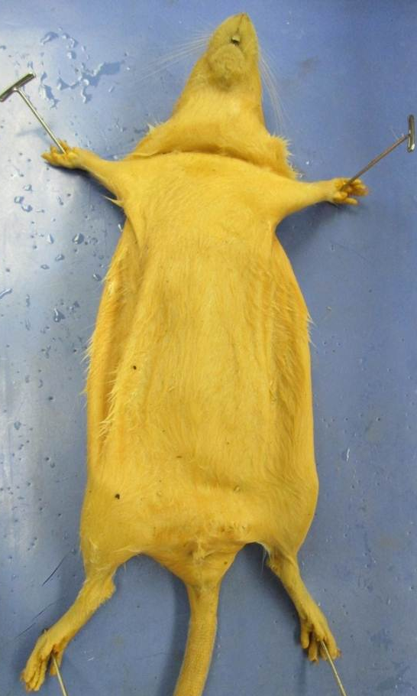
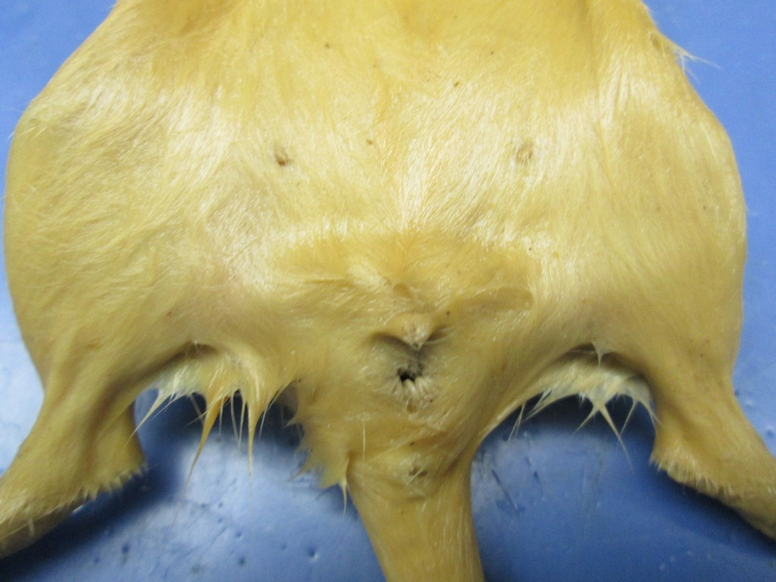
Female Rat
(Ventral View)
Mammary papillae
External urethral orifice
Vaginal orifice
Anus
Notes:
Female Rat (Ventral View)

Slide 6
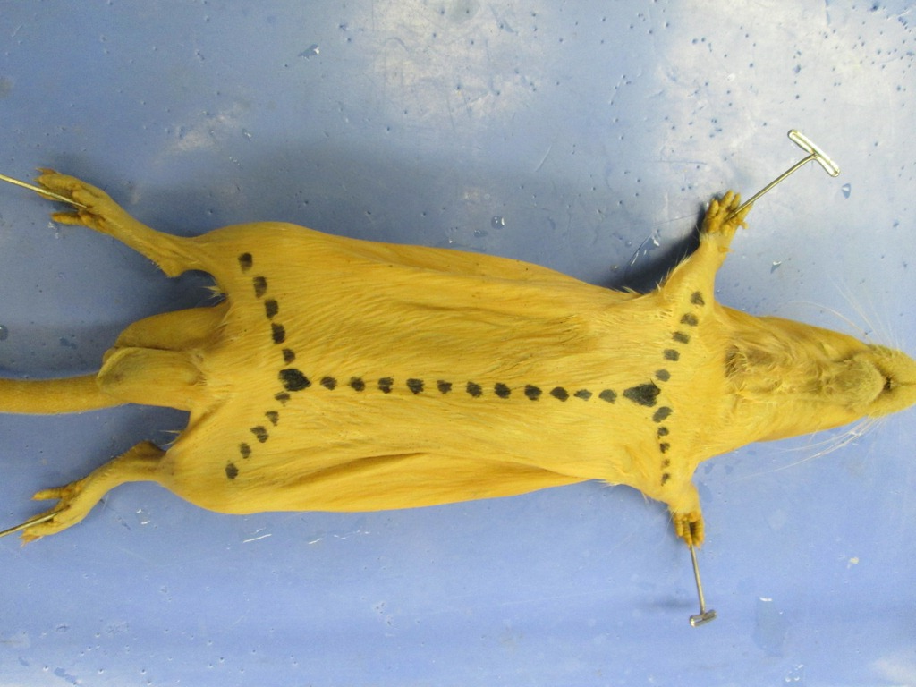
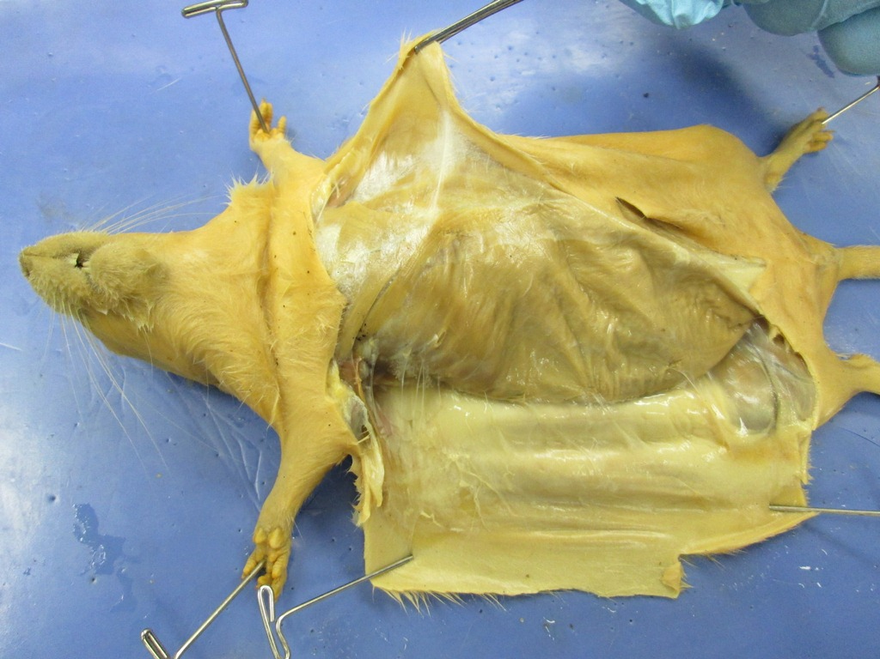
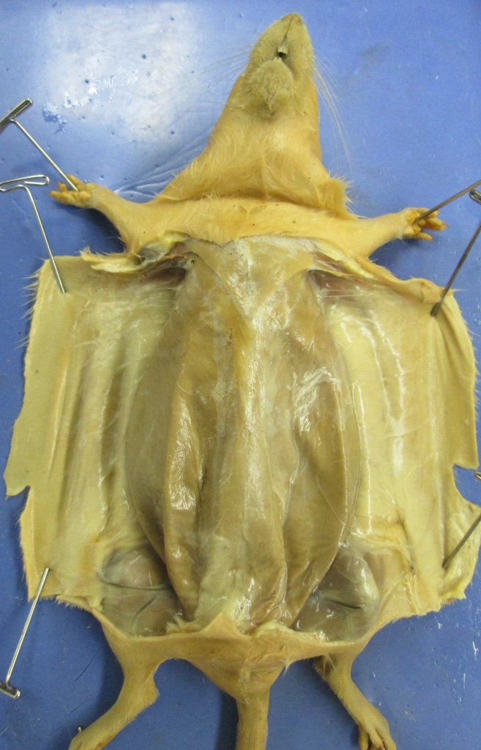
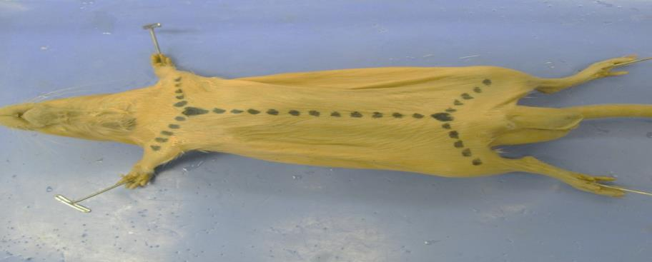
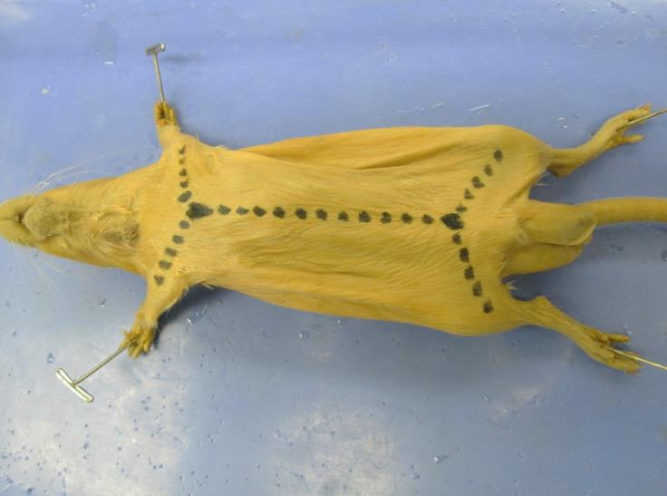
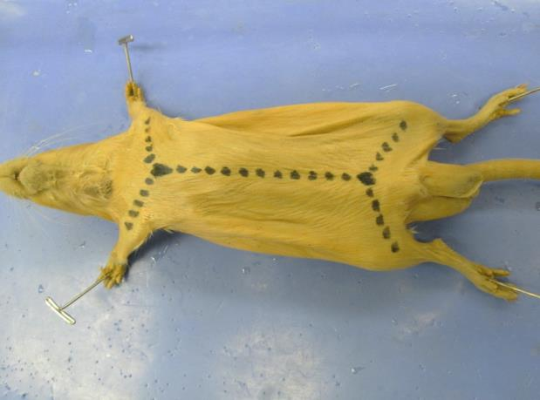
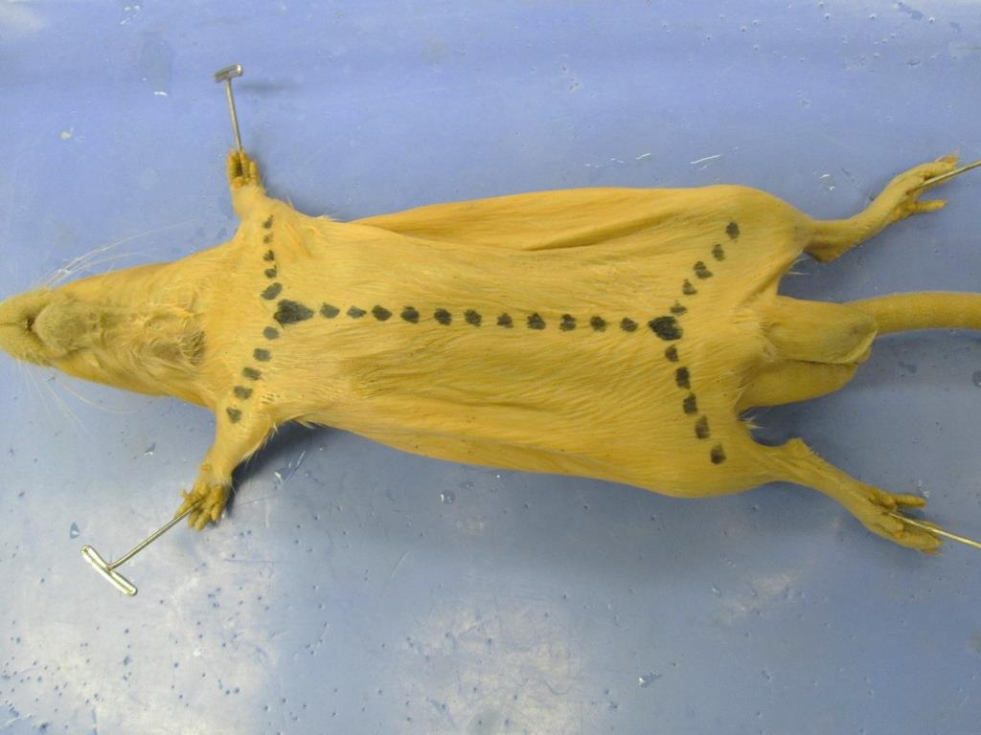
Skinning of Rat
2
3
1
Notes:
Skinning of Rat

Slide 7
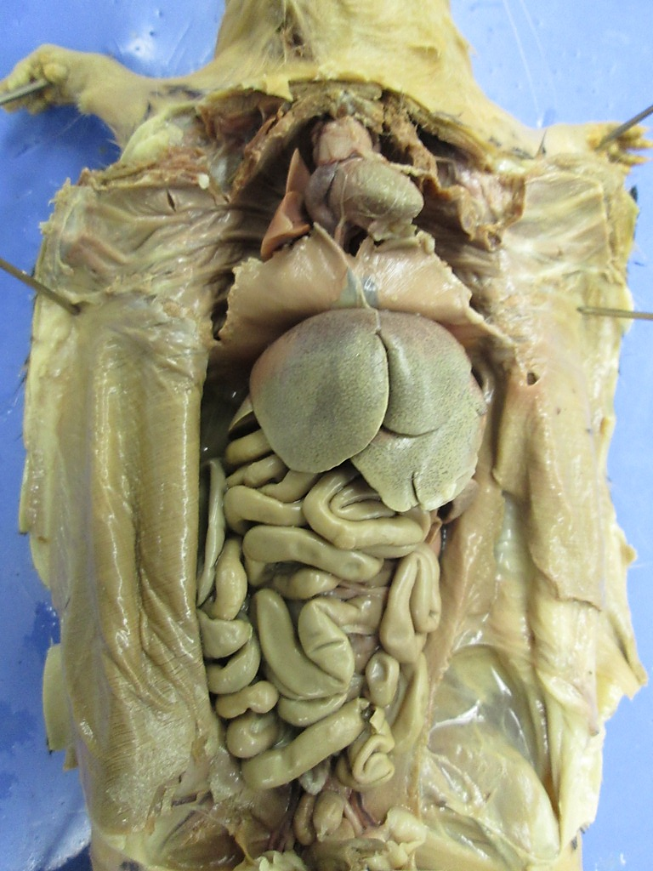
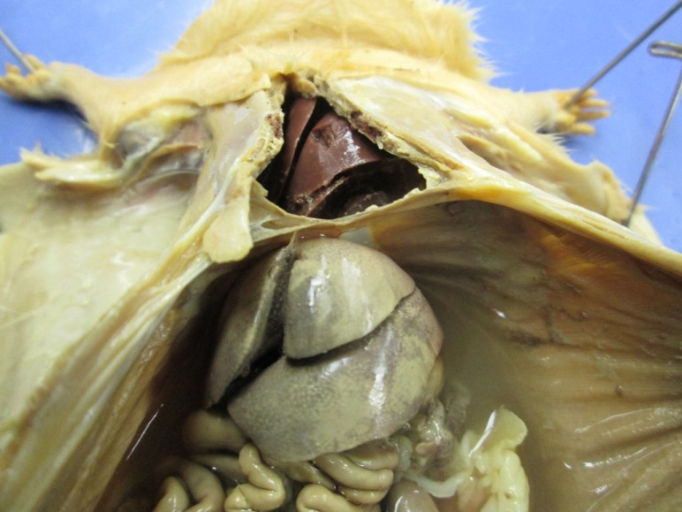
Body Cavities
Thoracic cavity
Diaphragm
Abdominopelvic cavity
Notes:
Body Cavities

Slide 8
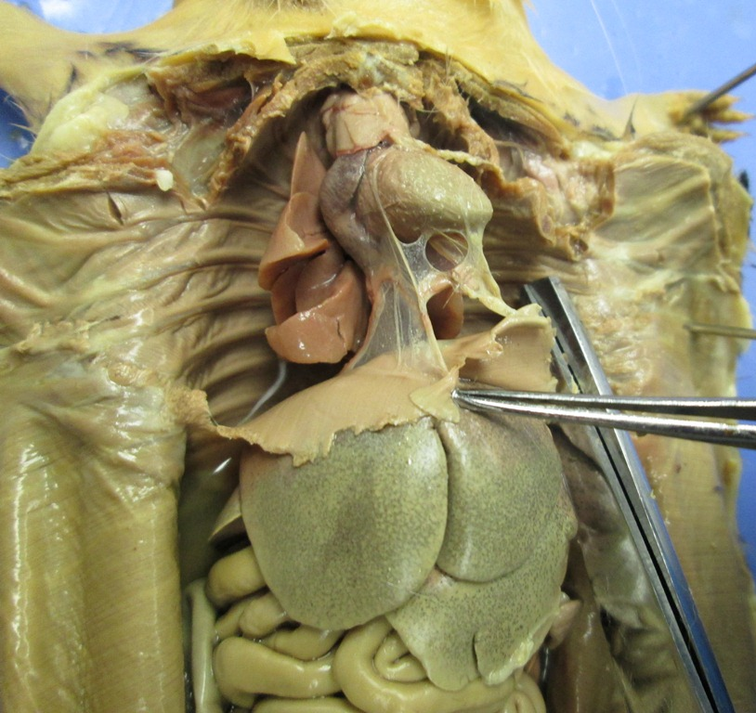
Serous Membranes of the Thoracic Cavity
Visceral pericardium (epicardium)
Pleural cavity
Parietal pleura
(Lines cavity wall)
Pericardial cavity
Visceral pleura
(Covers lungs)
Parietal pericardium
Notes:
Serous Membranes of the Thoracic Cavity

Slide 9
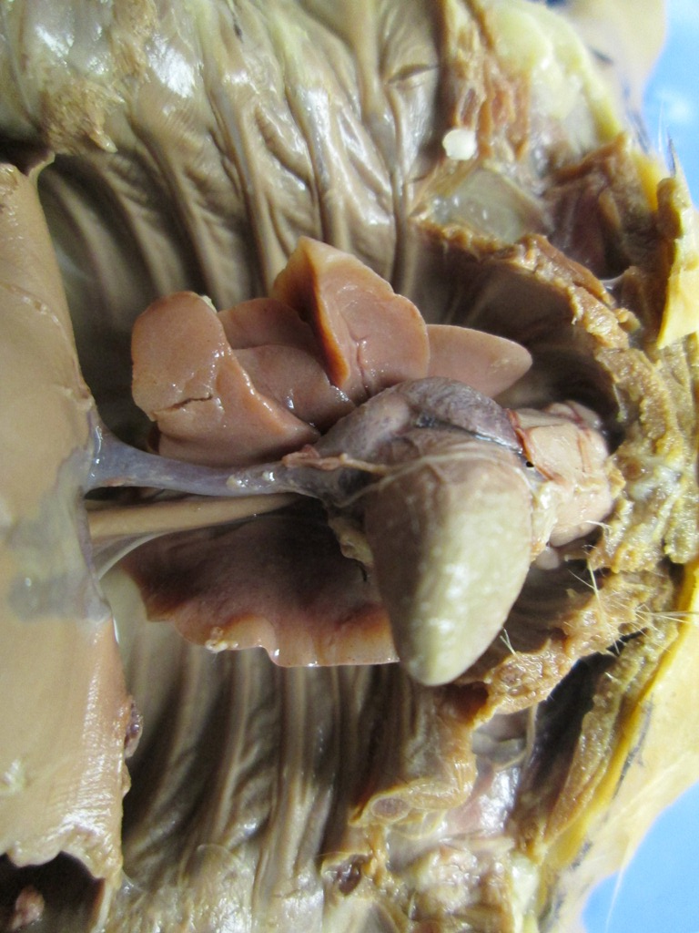
Organs of the Thoracic Cavity (1 of 2)
Thymus gland
Lungs
Heart
Posterior (caudal)
vena cava
Esophagus
Notes:
Organs of the Thoracic Cavity

Slide 10
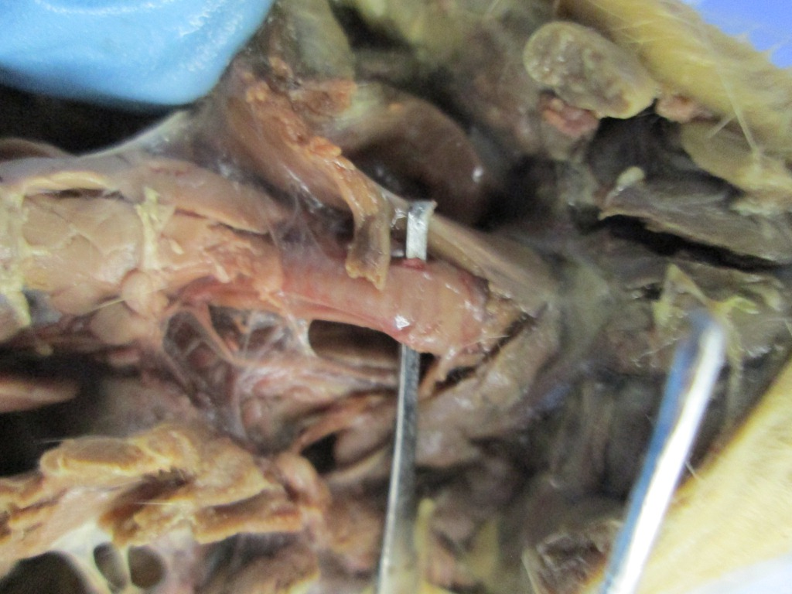
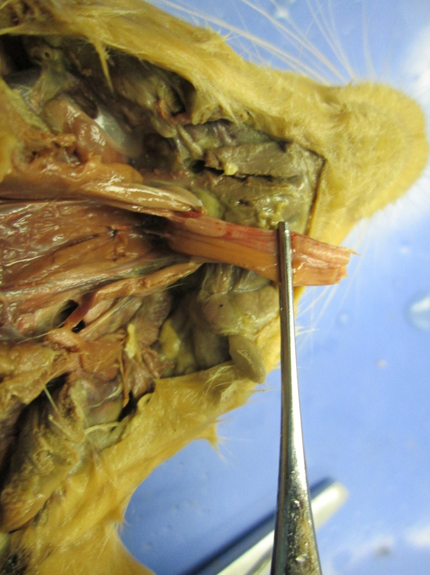
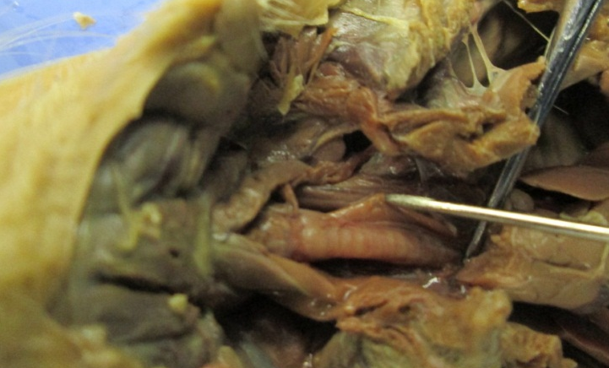
Organs of the Thoracic Cavity (2 of 2)
Trachea
Esophagus
Notes:
Organs of the Thoracic Cavity

Slide 11
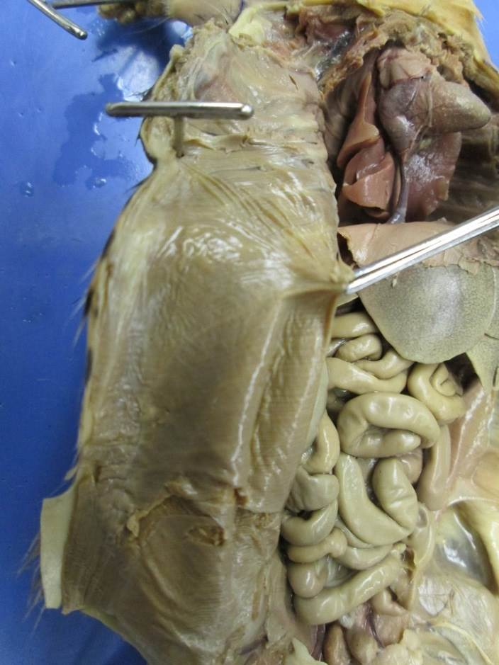
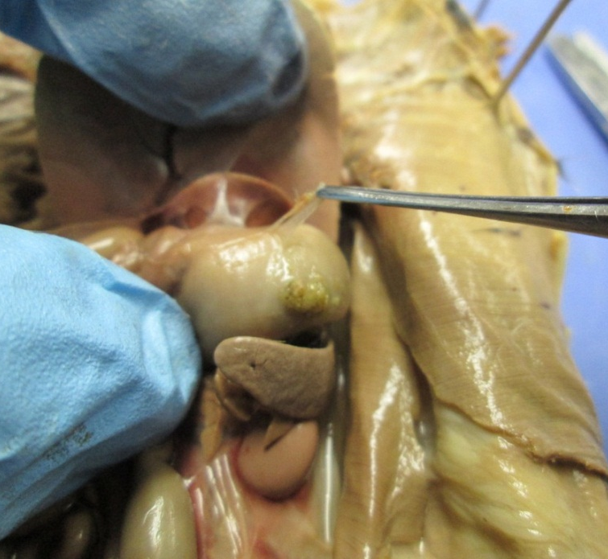
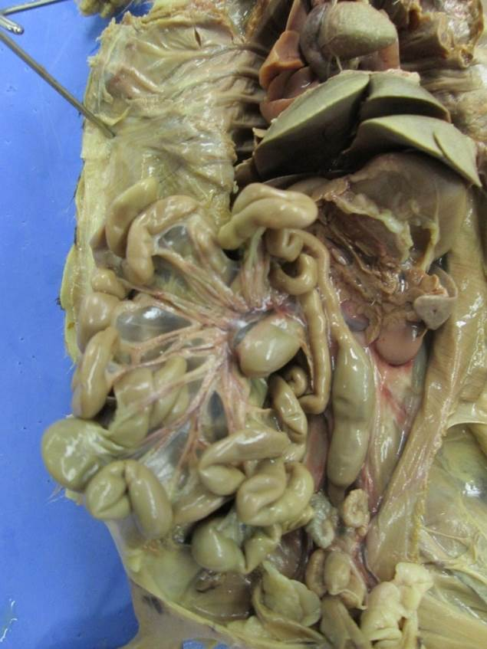

Serous Membranes of the Abdominopelvic Cavity
Visceral peritoneum
(pulled away from the stomach’s outer wall)
Parietal peritoneum
(Lines cavity wall)
Mesentery
Notes:
Serous Membranes of the Abdominopelvic Cavity

Slide 12
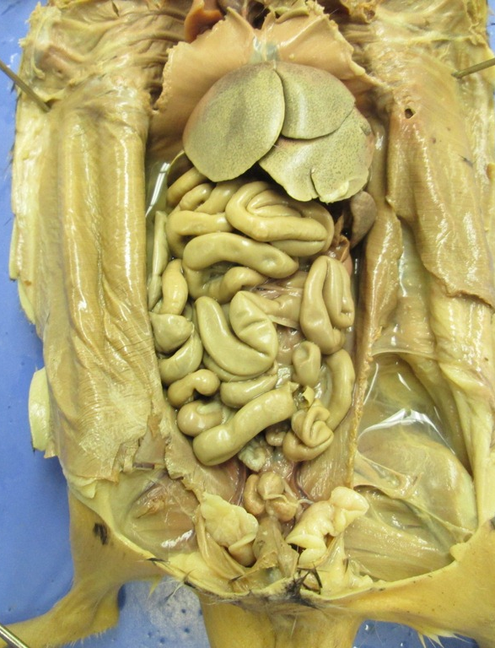
Organs of the Abdominopelvic Cavity (1 of 4)
Liver
Spleen
Urinary bladder
Notes:
Organs of the Abdominopelvic Cavity

Slide 13
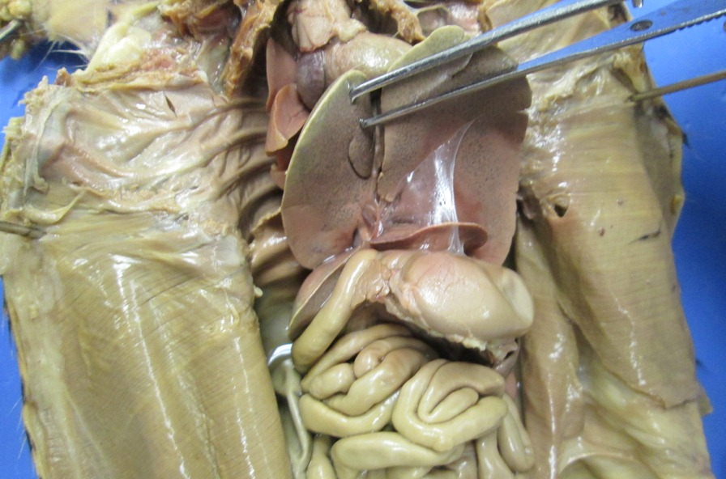
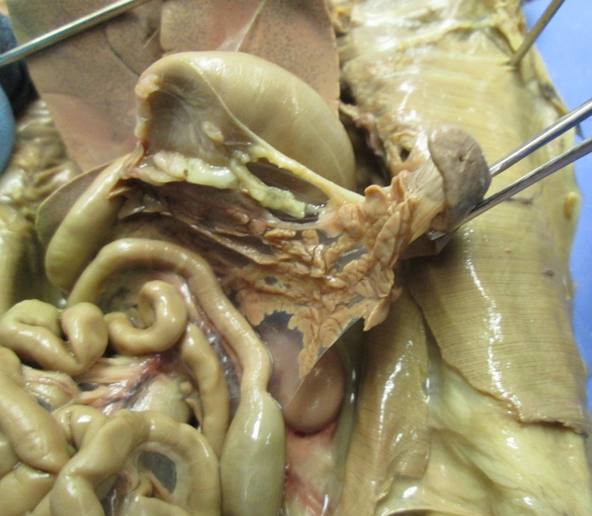
Organs of the Abdominopelvic Cavity (2 of 4)
Liver
Stomach
Small intestine
Spleen
Pancreas
Kidney
Notes:
Organs of the Abdominopelvic Cavity

Slide 14
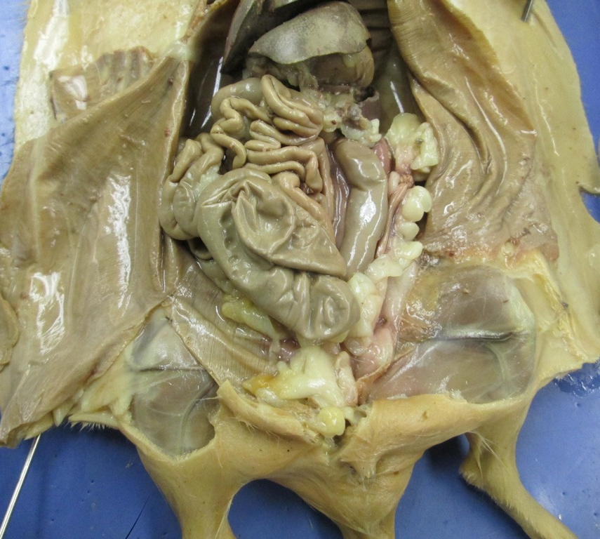
Organs of the Abdominopelvic Cavity (3 of 4)
Small intestine
Colon
Large intestine
Cecum
Notes:
Organs of the Abdominopelvic Cavity.

Slide 15
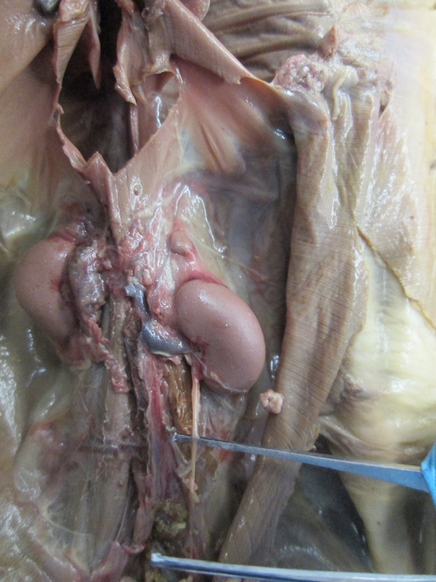
Organs of the Abdominopelvic Cavity (4 of 4)
Kidney
(Retroperitoneal organ)
Parietal peritoneum
Ureter
Notes:
Organs of the Abdominopelvic Cavity

Slide 16
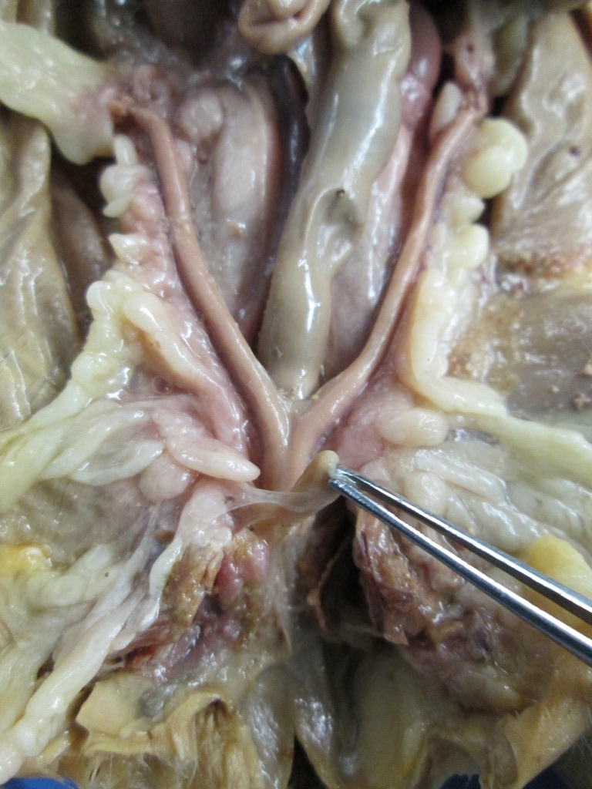
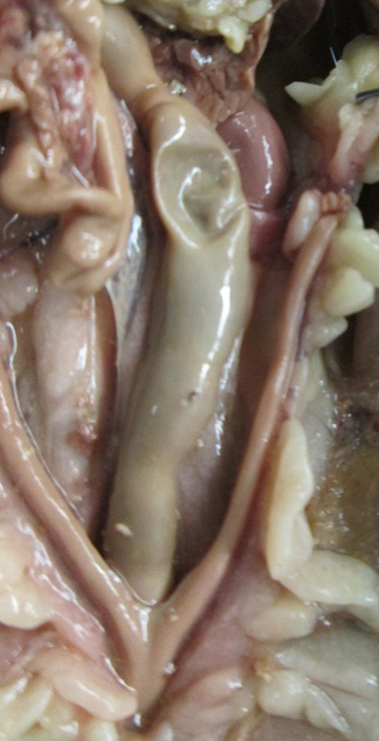
Reproductive System of a Female Rat
Ovaries
Uterine horns
Uterine body
Notes:
Reproductive System of a Female Rat.

Slide 17
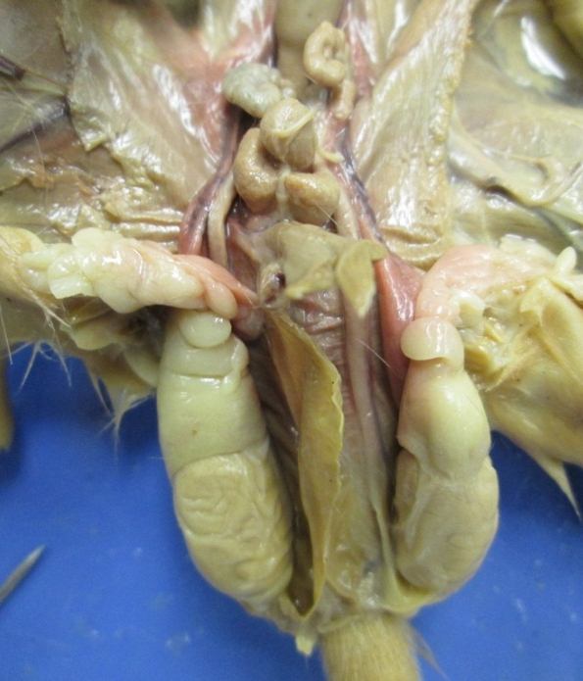
Reproductive System of a Male Rat
Testis
Ductus deferens

