Slide 1
Microscopy & Cytology
Photographed by:
Mr. James Henry
Dr. Laila Nimri
Labeled and Made Accessible by:
Dr. Laila Nimri
Edited by:
Dr. Maya Byfield Mr. James Henry
Dist. Prof. Mary Dolnack Dr. Syed Arif Humayun
Dr. Essa Farah Dr. Laila Nimri

Slide 2
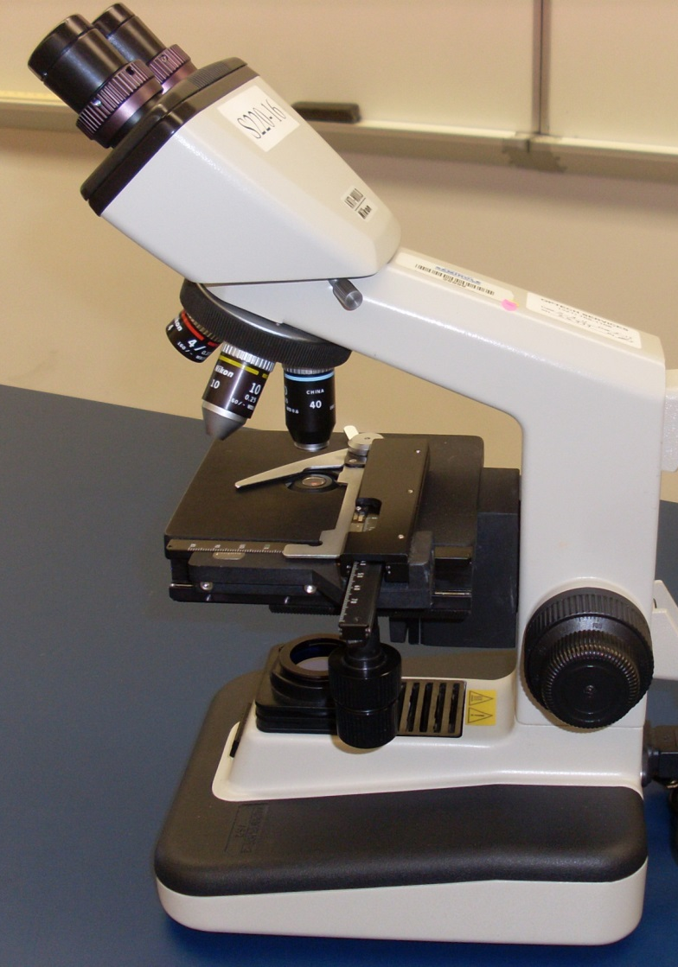
The Compound Microscope
Ocular Lens (Eyepiece)
Binocular Eyepiece Tube
Revolving Nosepiece
Arm
Objective Lens
Mechanical Stage
Stage
Coarse Adjustment Focus Knob
Illuminator
Mechanical Stage Adjustment Knob
Fine Adjustment Focus Knob
Not Shown under the stage: condenser with iris diaphragm
Base
Notes:
The Compound Microscope

Slide 3
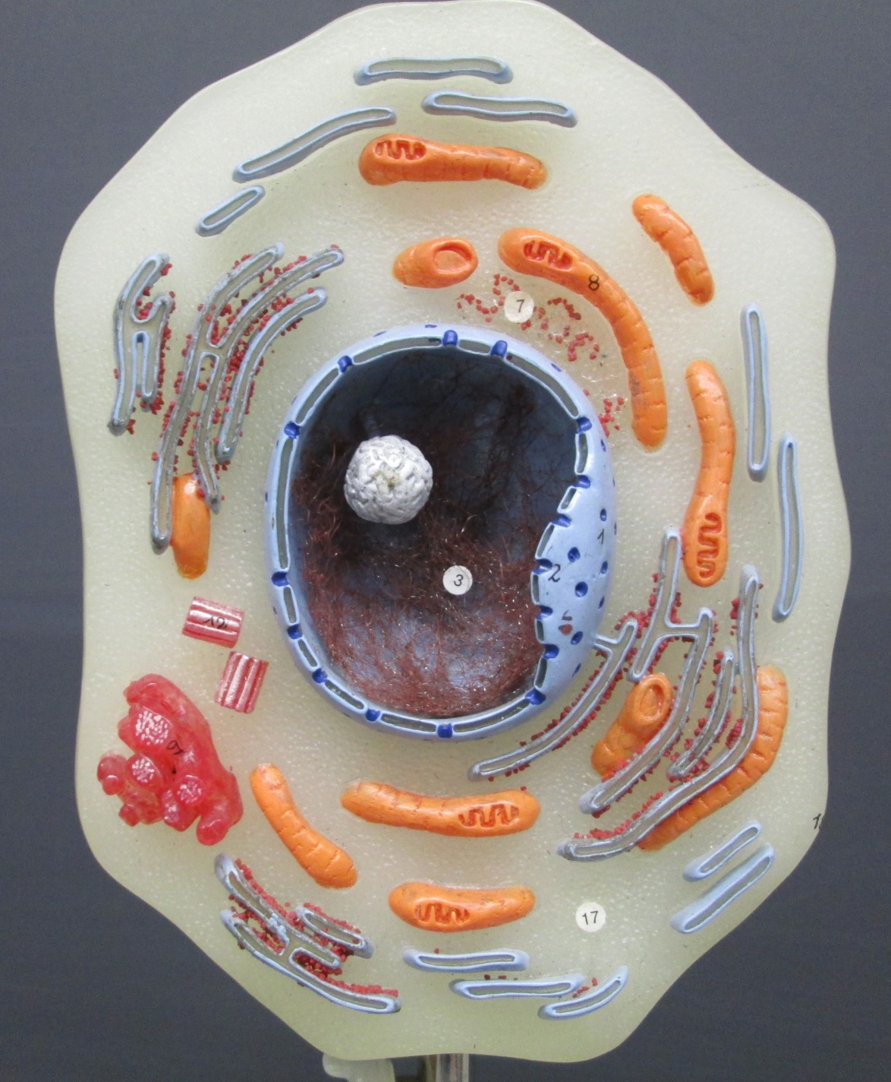
Animal Cell Model – 1 of 2
Plasma membrane
Smooth Endoplasmic Reticulum
Cytosol
Cytoplasm
Organelles
Free Ribosomes
Nuclear Envelope
Nucleus
Nucleolus
Chromatin
Bound Ribosomes
Centrioles
Rough Endoplasmic Reticulum
Golgi Apparatus
Mitochondrion
Notes:
Animal Cell Model - 1

Slide 4
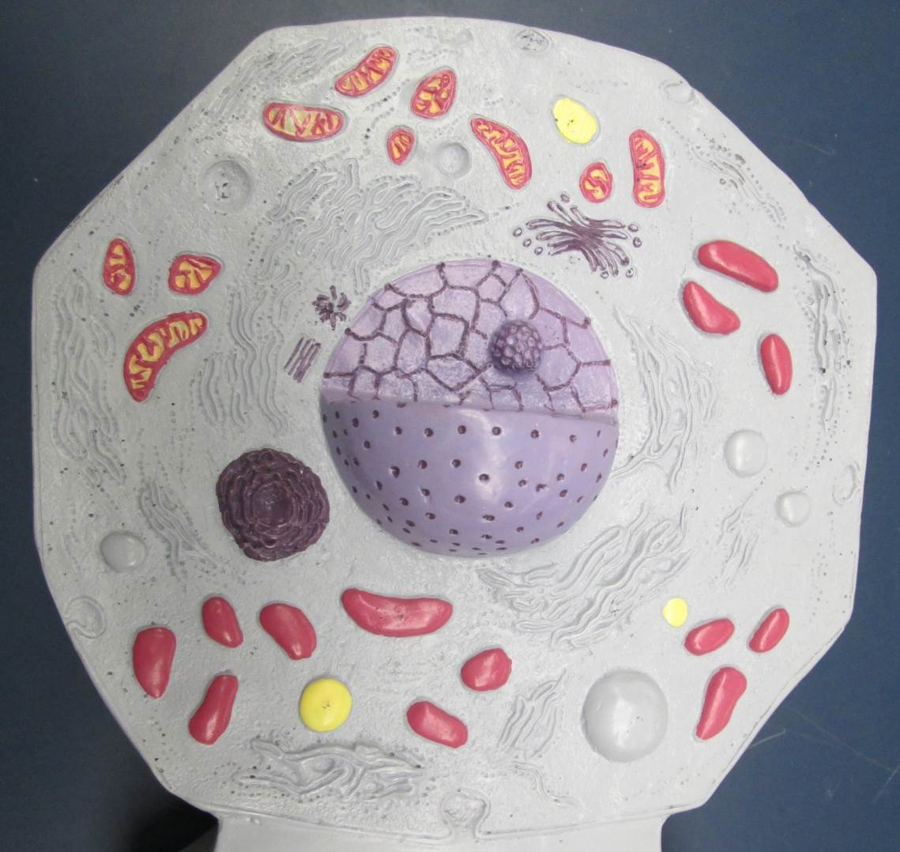
Animal Cell Model – 2 of 2
Notes:
Animal Cell Model – 2 of 2

Slide 5
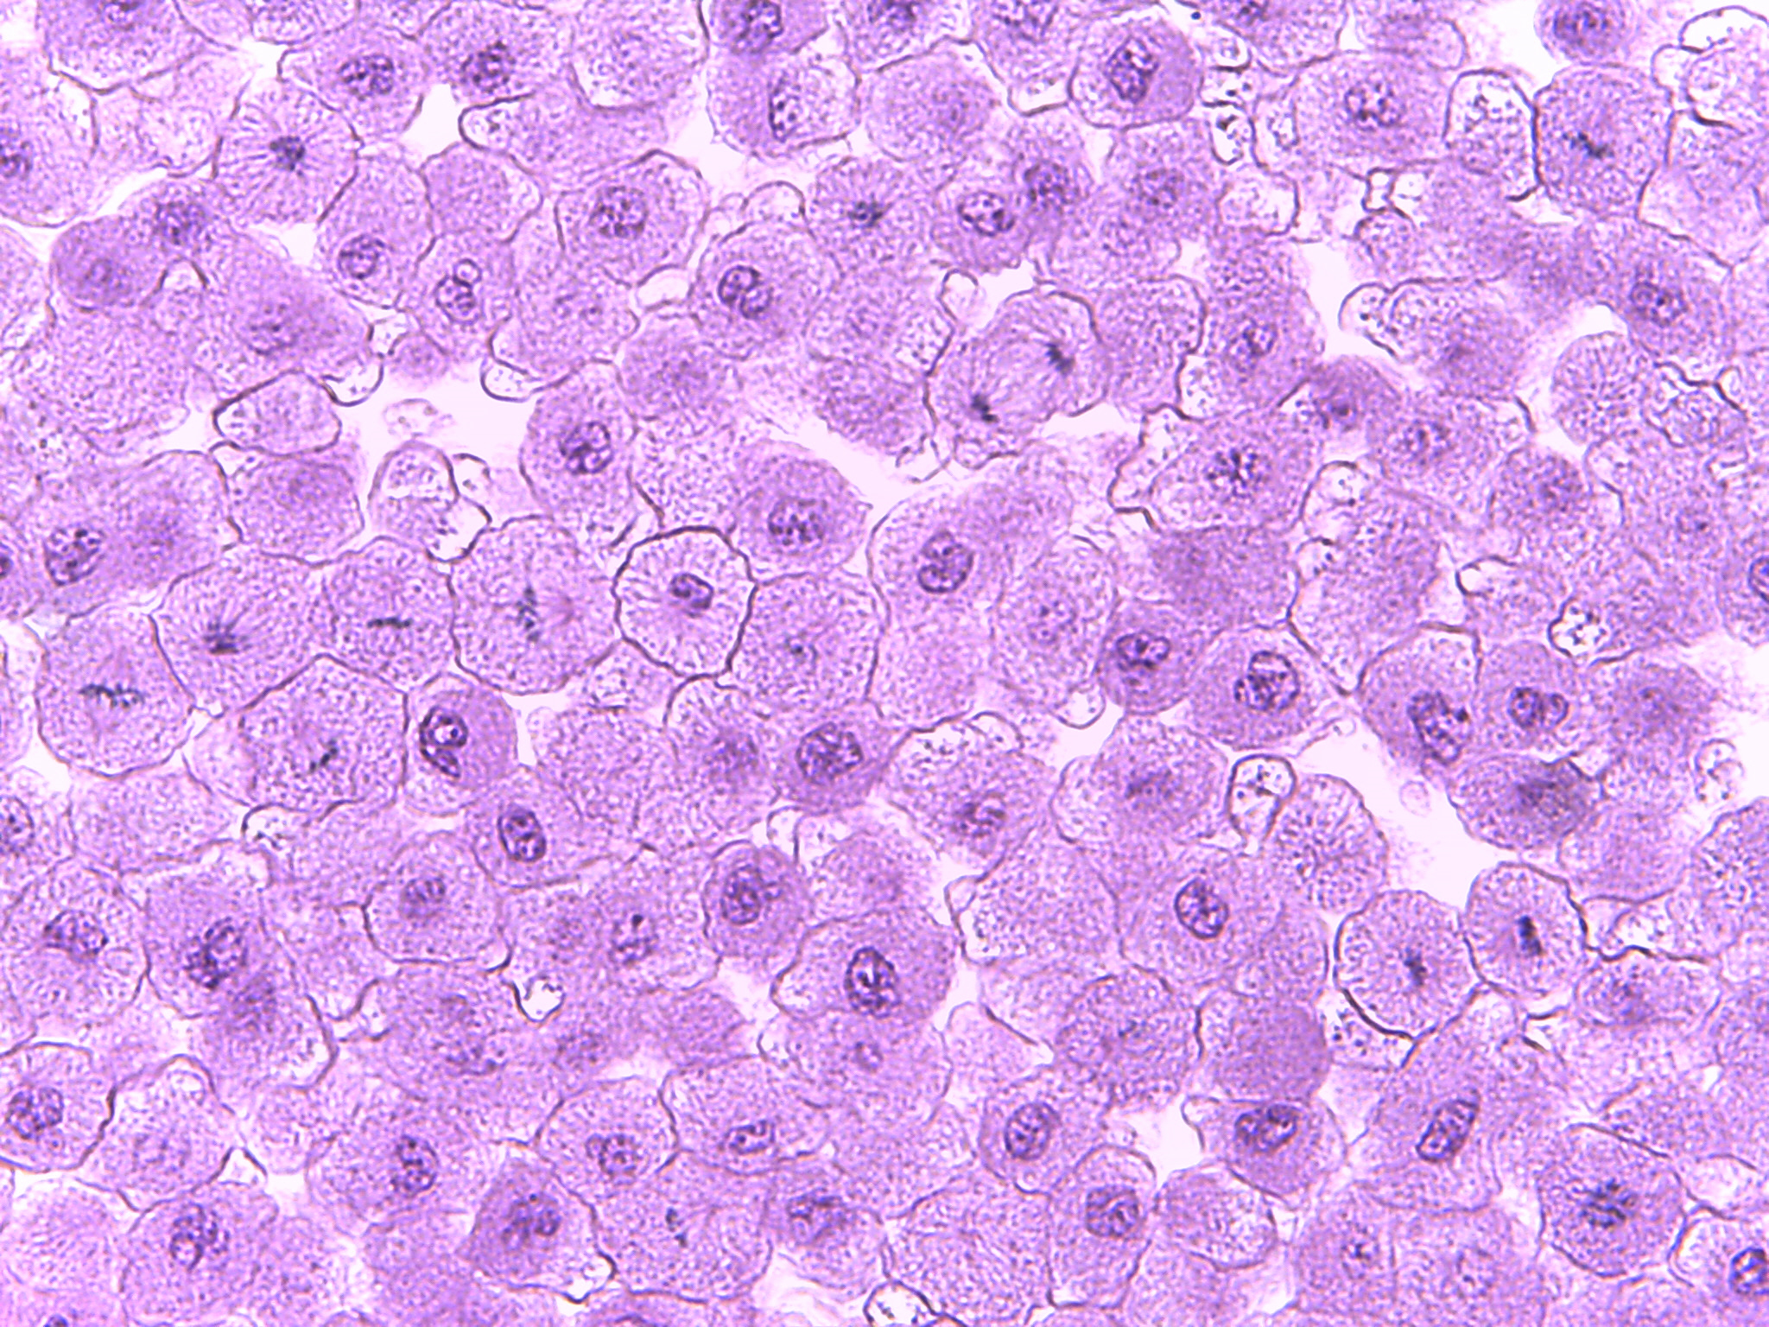
Different Phases of the Cell Cycle in Whitefish Blastula
400X
Notes:
Different Phases of the Cell Cycle in Whitefish Blastula 400X

Slide 6
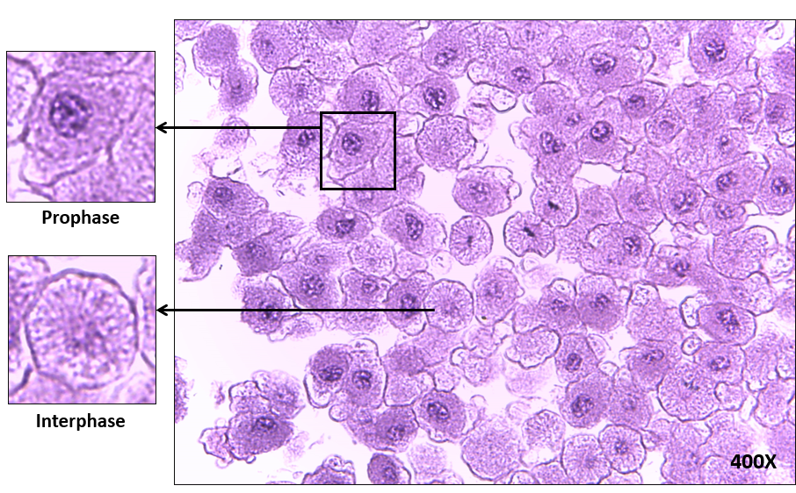
Interphase & Prophase of Mitosis
Notes:
Interphase & Prophase of Mitosis – 400X

Slide 7
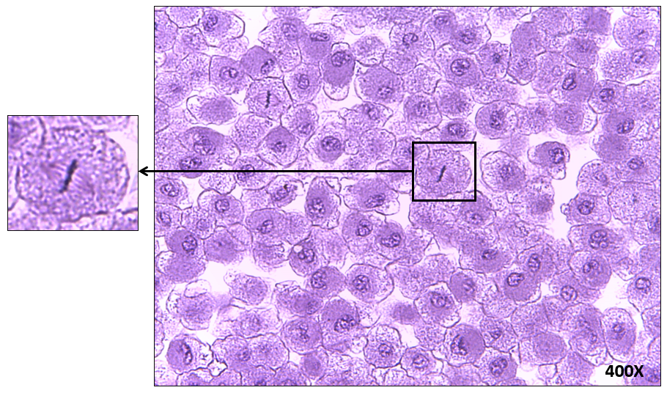
Metaphase of Mitosis
400X
Notes:
Metaphase of Mitosis – 400X

Slide 8
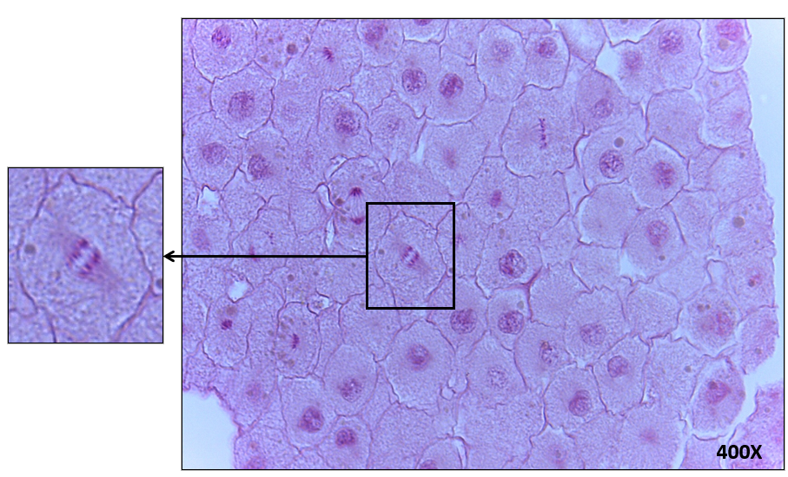
Anaphase of Mitosis
Notes:
Anaphase of Mitosis – 400X

Slide 9
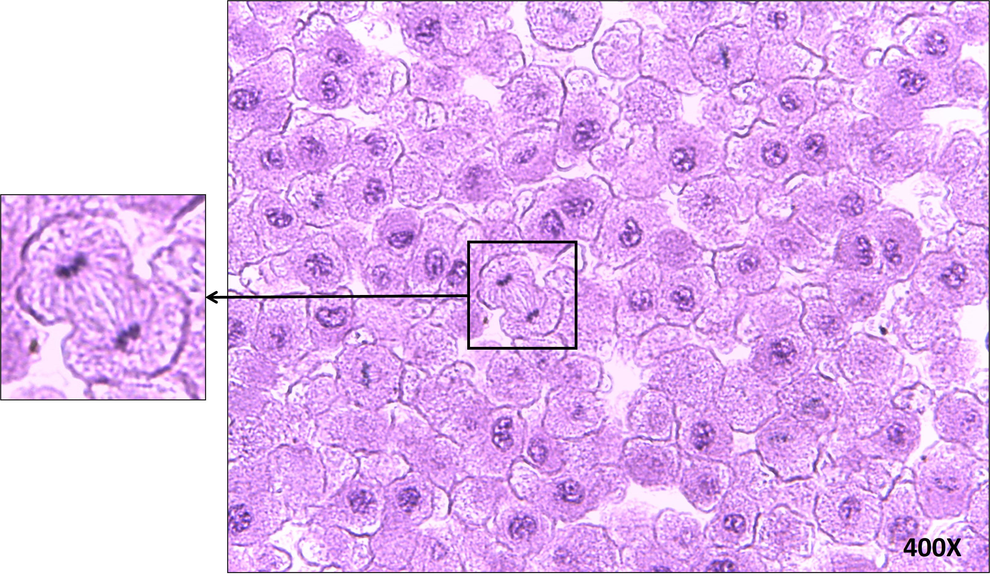
Telophase of Mitosis and Cytokinesis
Notes:
Telophase of Mitosis and Cytokinesis–400X

Slide 10
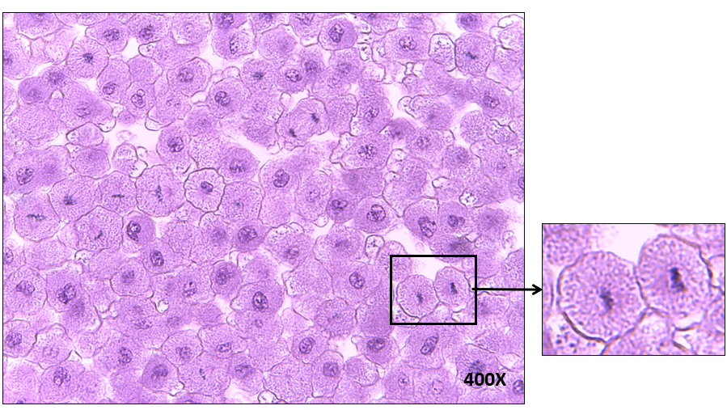
End Result of Mitosis and Cytokinesis (Two Daughter Cells)
Notes:
End Result of Mitosis and Cytokinesis (Two Daughter Cells)-400X

Slide 11
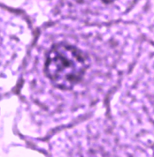
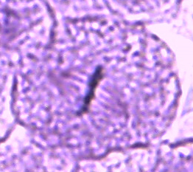

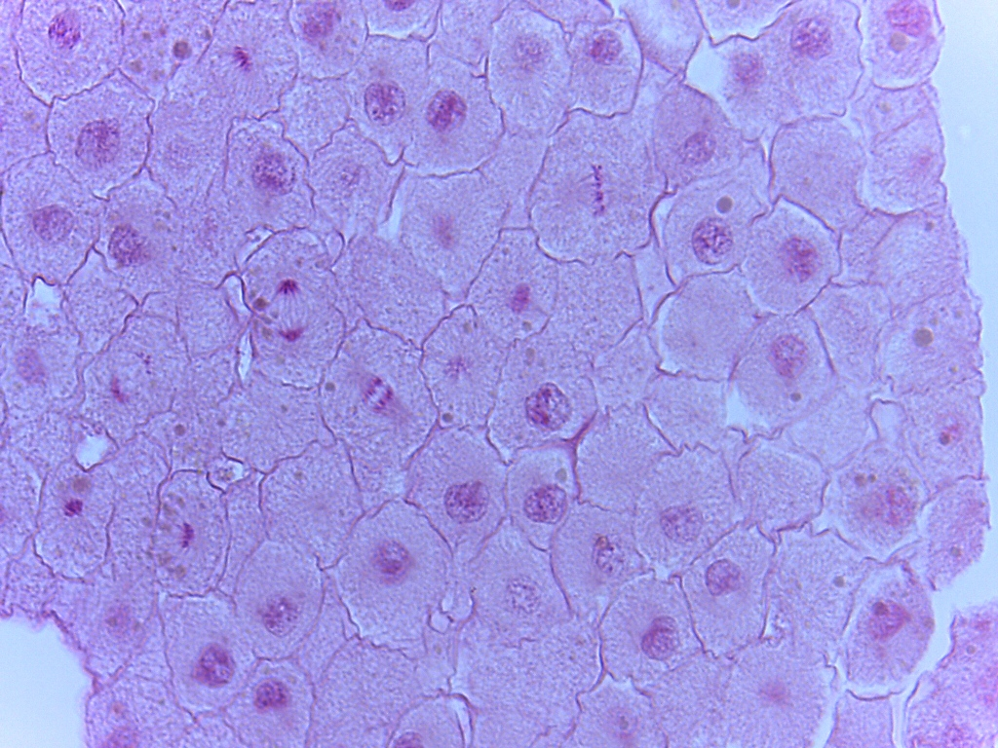
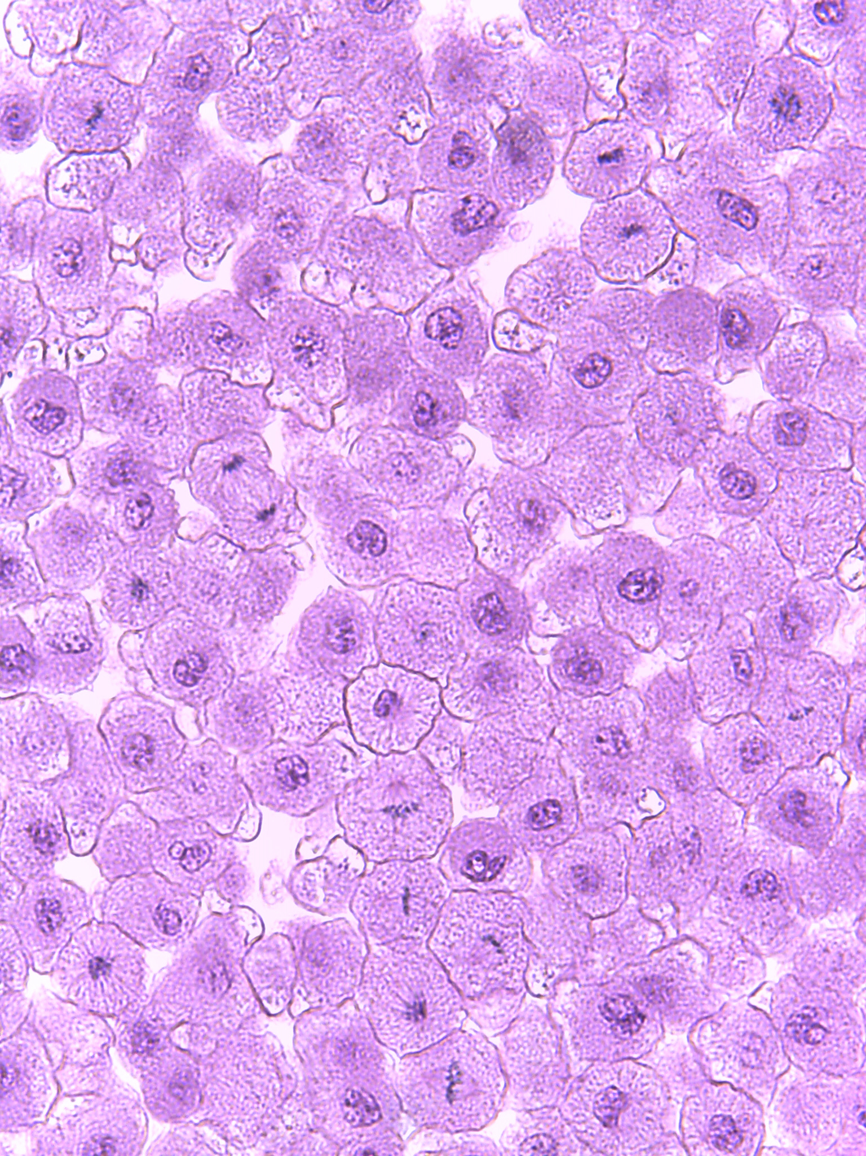
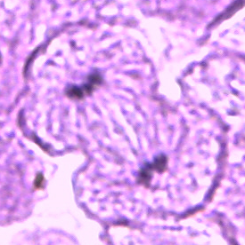
The Cell Cycle
Prophase
Metaphase
Interphase
Anaphase
Two Daughter Cells
Telophase & Cytokinesis
Notes:
The Cell Cycle

Slide 12
Test Your Knowledge
of the Phases of the Cell Cycle
400X
Notes:
Test Your Knowledge of the Phases of the Cell Cycle

