Slide 1
Integumentary System
Photographed by:
Mr. James Henry
Dr. Laila Nimri
Labeled and Made Accessible by:
Dr. Laila Nimri
Edited by:
Dr. Maya Byfield Mr. James Henry
Dist. Prof. Mary Dolnack Dr. Syed Arif Humayun
Dr. Essa Farah Dr. Laila Nimri

Slide 2
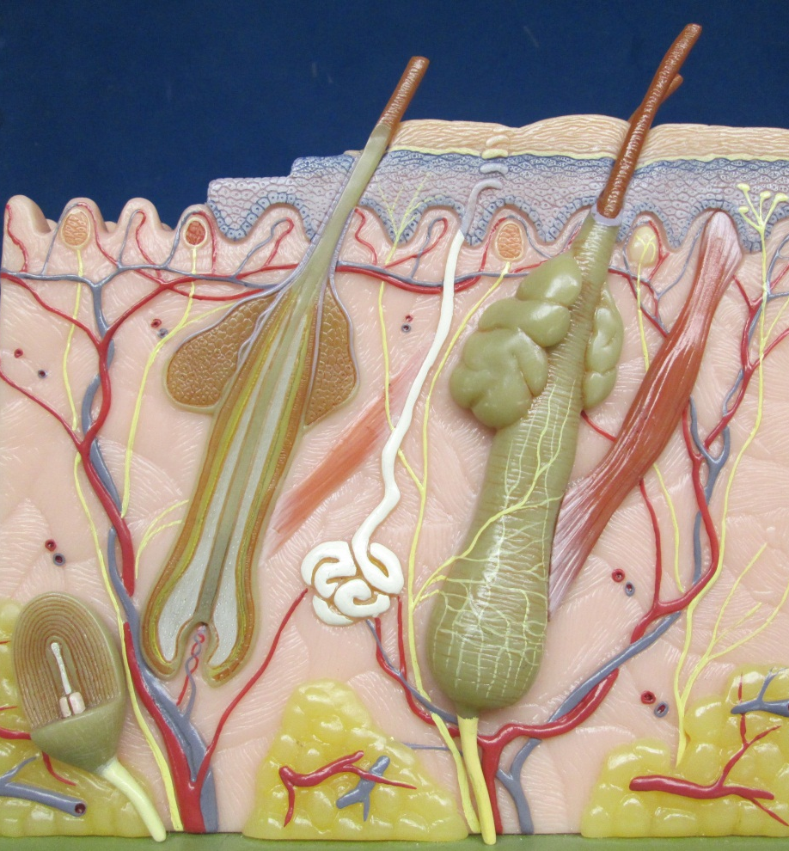
Integument and the Underlying Hypodermis– Model 1 (1 of 2)
Dermal Papillae
Epidermis
Integument
Tactile (Sensory) Receptors
Dermis
Vein
Hypodermis
Artery
Notes:
The Integument and the Underlying Hypodermis

Slide 3
Integument and the Underlying Hypodermis– Model 1 (2 of 2)
Sebaceous glands
Arrector pili muscle
Sweat gland duct
Eccrine sweat gland
Hair follicles
Notes:
The Integument and the Underlying Hypodermis

Slide 4
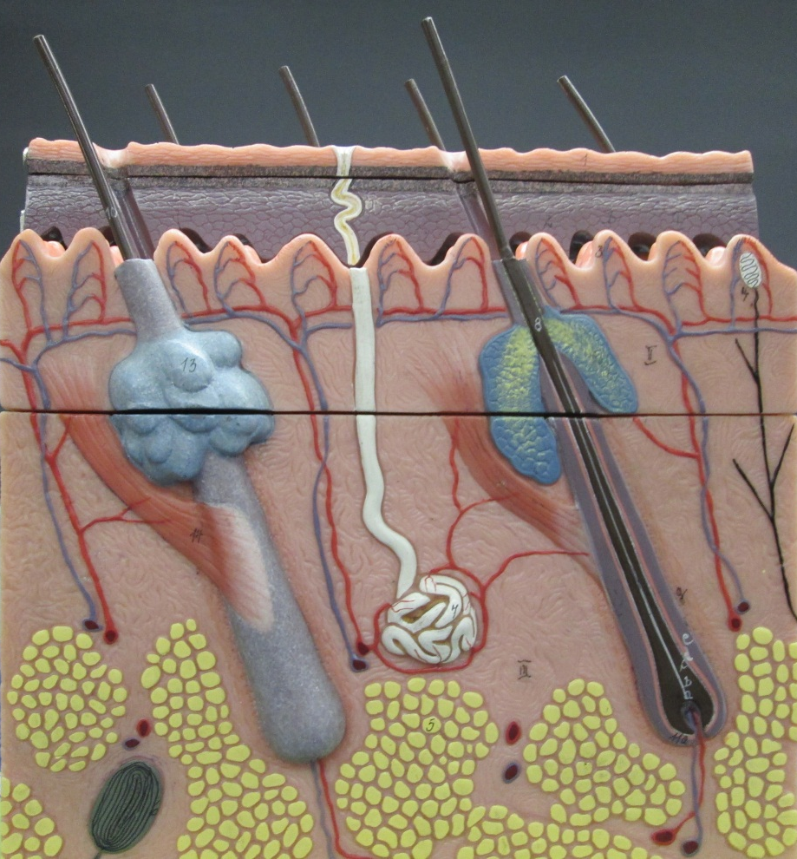
Integument and the Underlying Hypodermis– Model 2
Notes:
The Integument and the Underlying Hypodermis

Slide 5
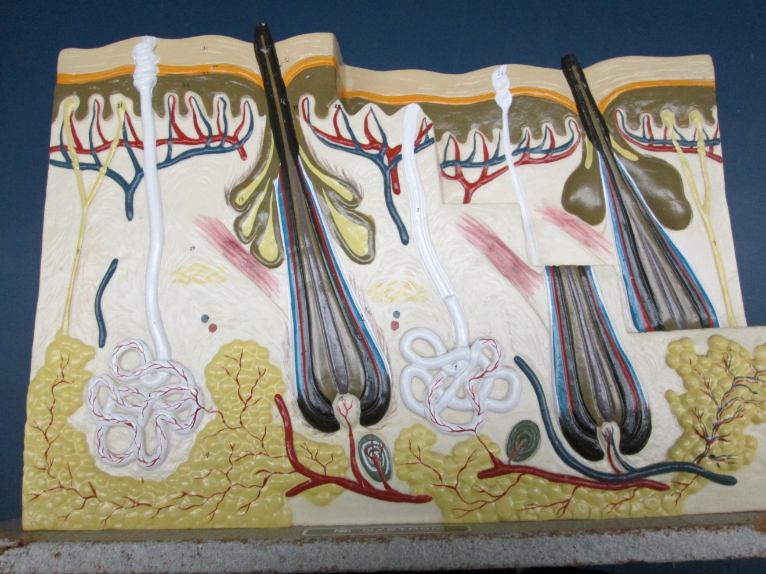
Integument and the Underlying Hypodermis– Model 3
Notes:
The Integument and the Underlying Hypodermis

Slide 6
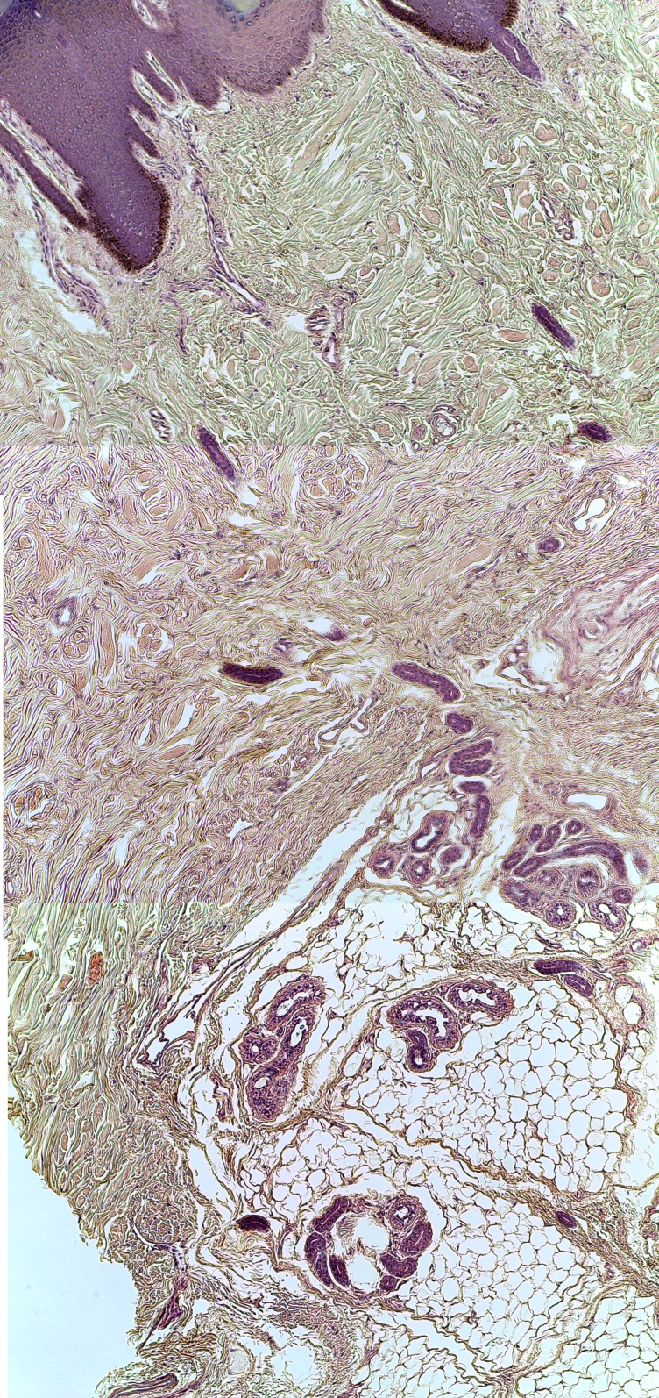
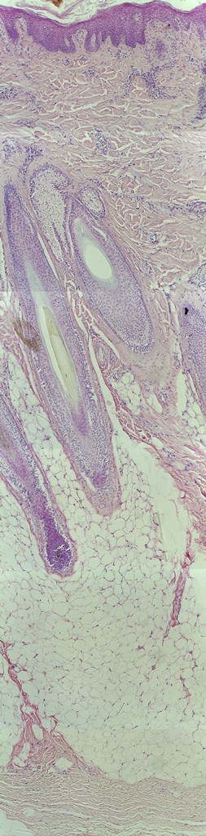
Integument and the Underlying Hypodermis
Epidermis
Papillary layer
Dermis
Reticular layer
Hairs in hair follicles
Hypodermis
100X
100X
Notes:
Integument and the underlying hypodermis as seen under the microscope magnified 100X

Slide 7
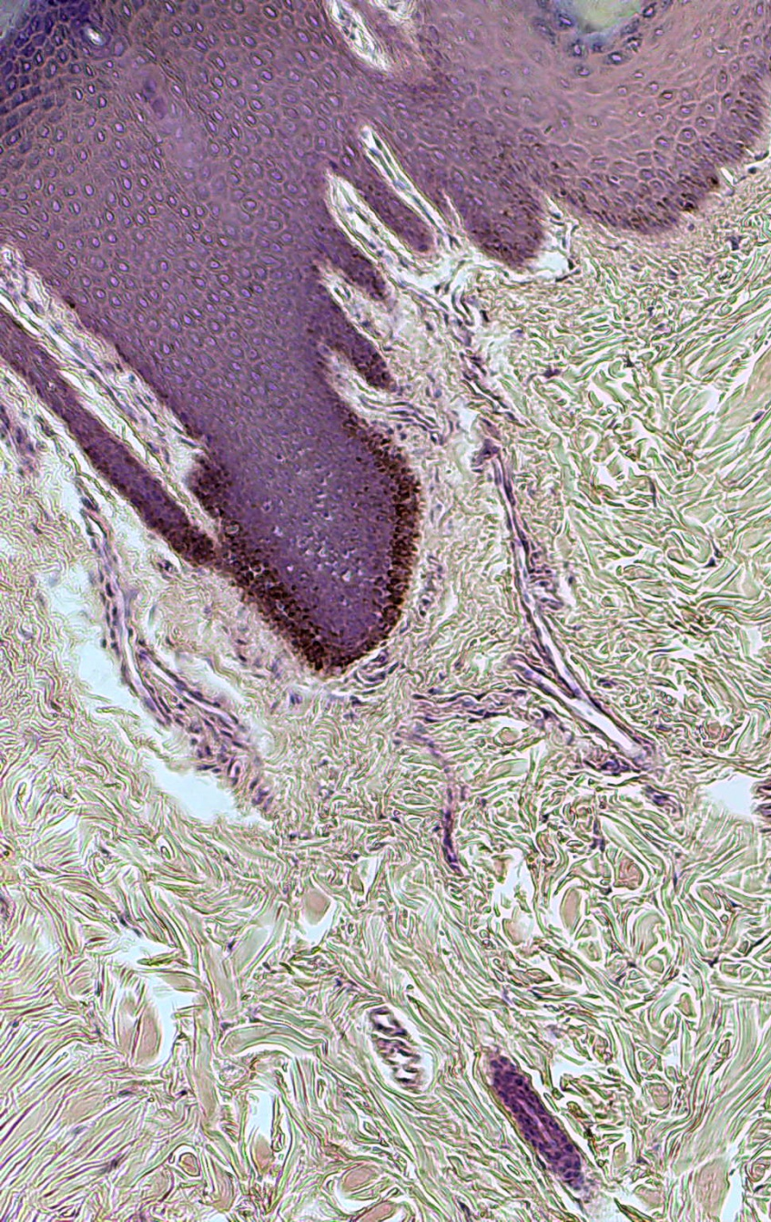
Integument Layers (1 of 3)
Epidermis
Papillary layer
Dermis
Reticular layer
400X
100X
Notes:
Integument layers as seen under the microscope magnified 400X and 100X

Slide 8
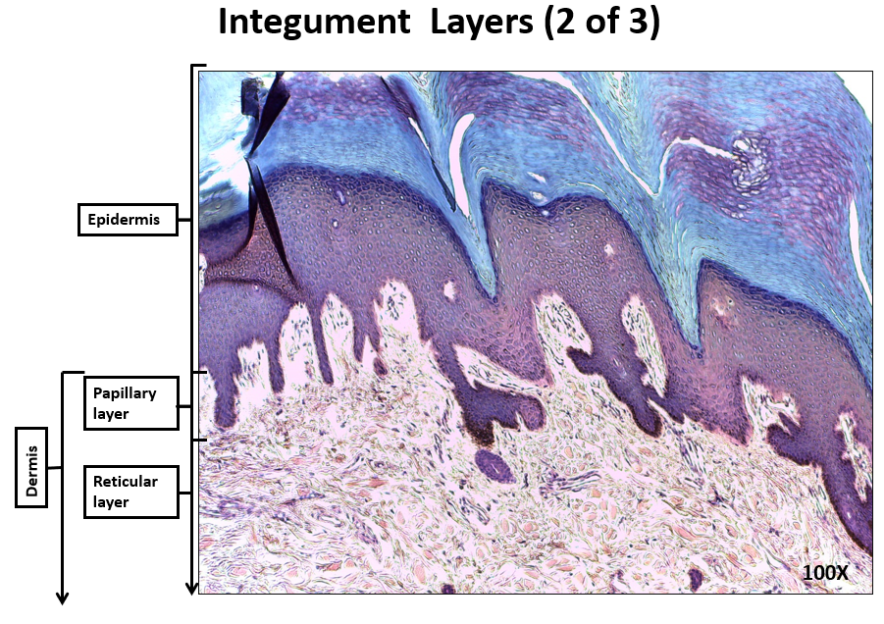
Integument Layers (2 of 3)
Notes:
Integument layers as seen under the microscope magnified 100X

Slide 9
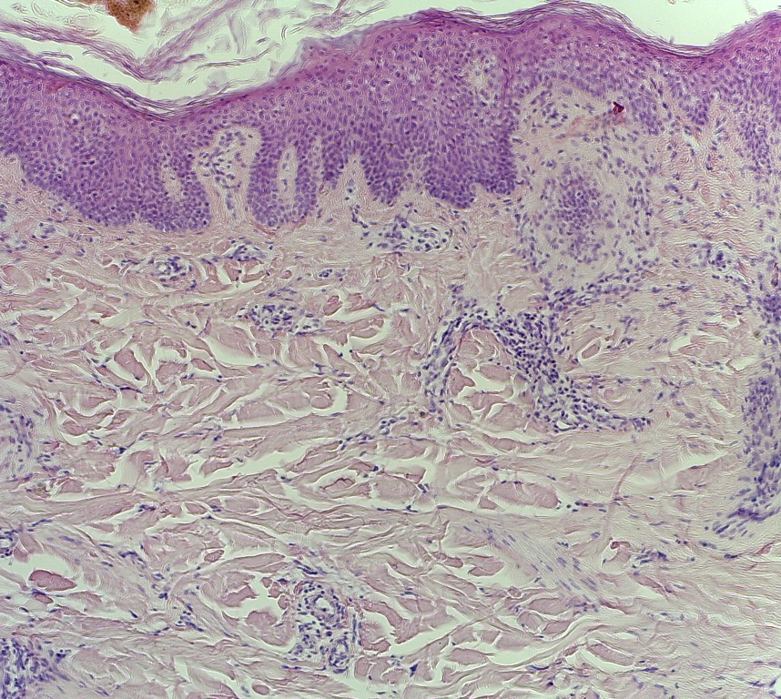
Integument Layers (3 of 3)
Epidermis
Papillary layer
Dermis
Reticular layer
100X
Notes:
Integument layers as seen under the microscope magnified 100X

Slide 10
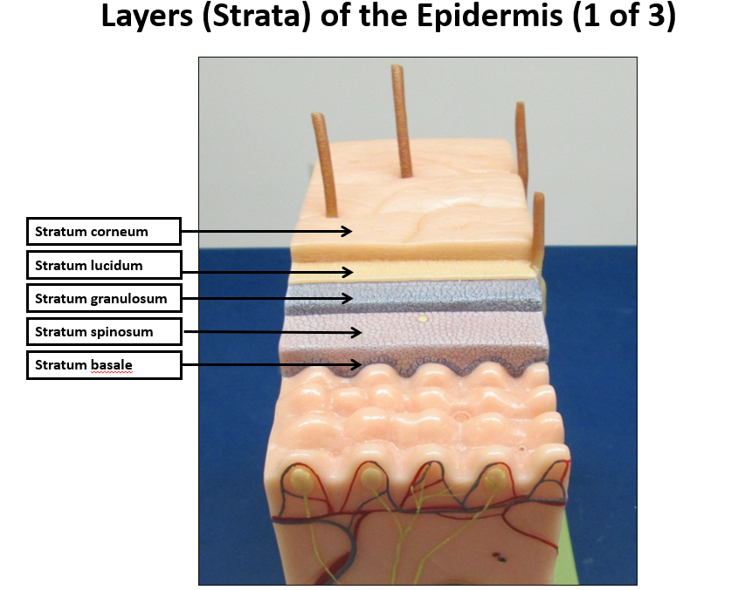
Layers (Strata) of the Epidermis (1 of 2)
Notes:
Model of the layers (strata) of the epidermis

Slide 11
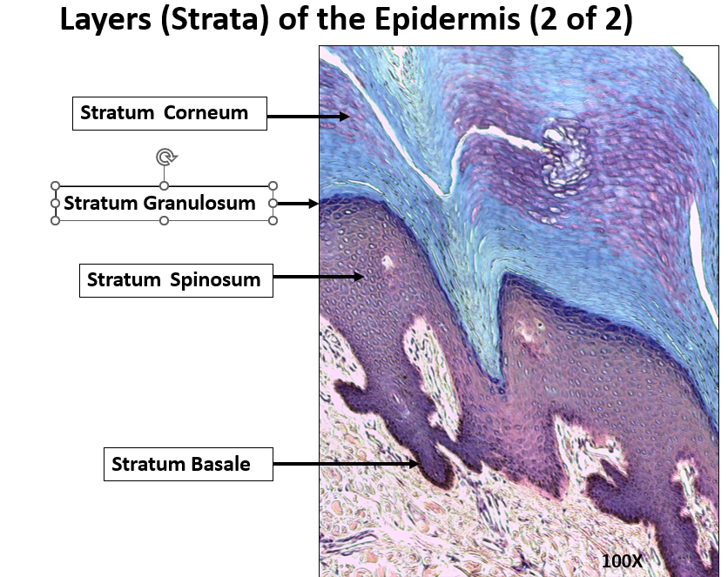
Layers (Strata) of the Epidermis (2 of 2)
Notes:
Layers (Strata) of the Epidermis 100X

Slide 12
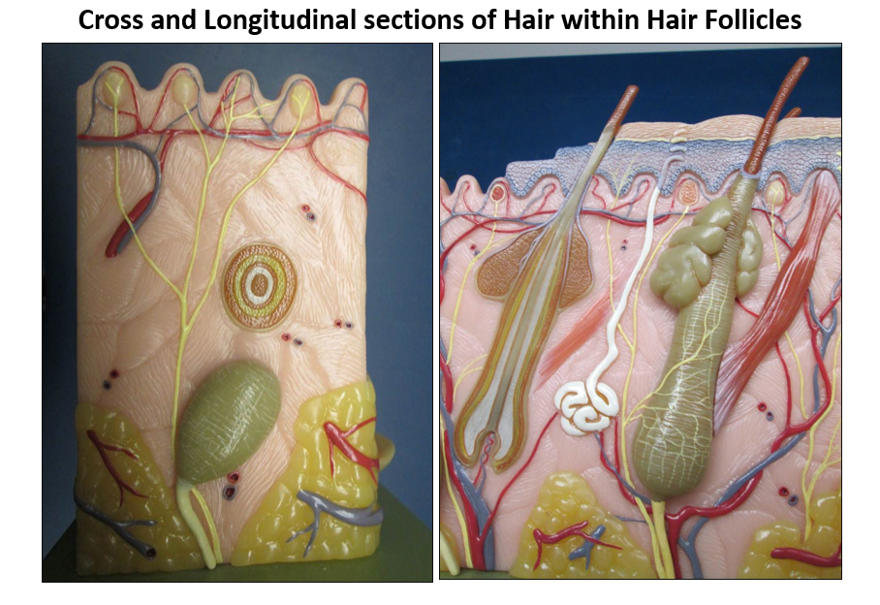
Cross and Longitudinal sections of Hair within Hair Follicles
Notes:
Models show hair within hair follicles

Slide 13
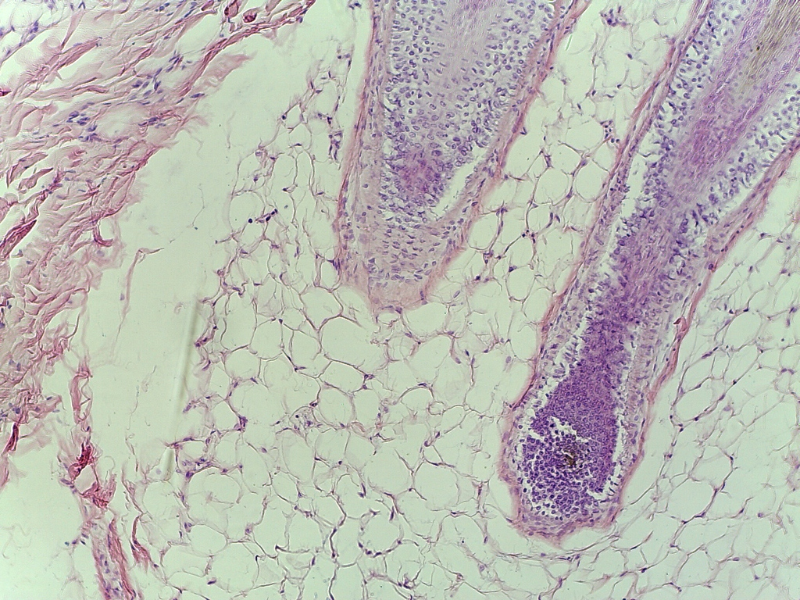
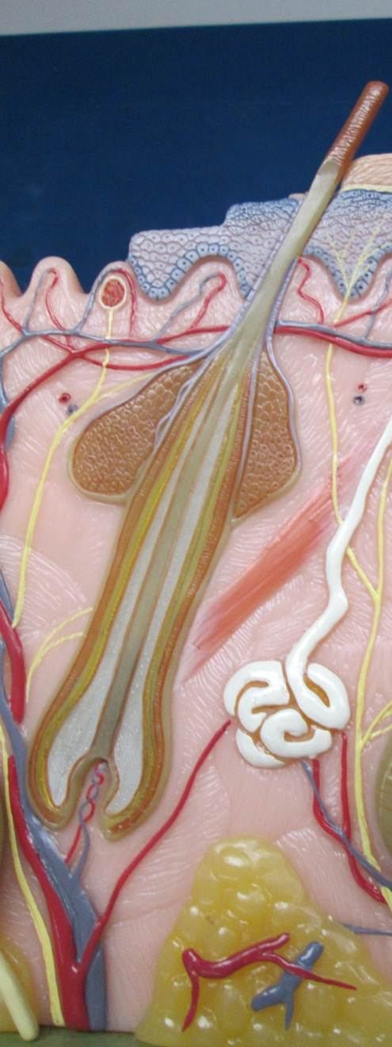
Longitudinal Section of a Hair Within Its Follicle
100x
Notes:
Hair within its follicle

Slide 14
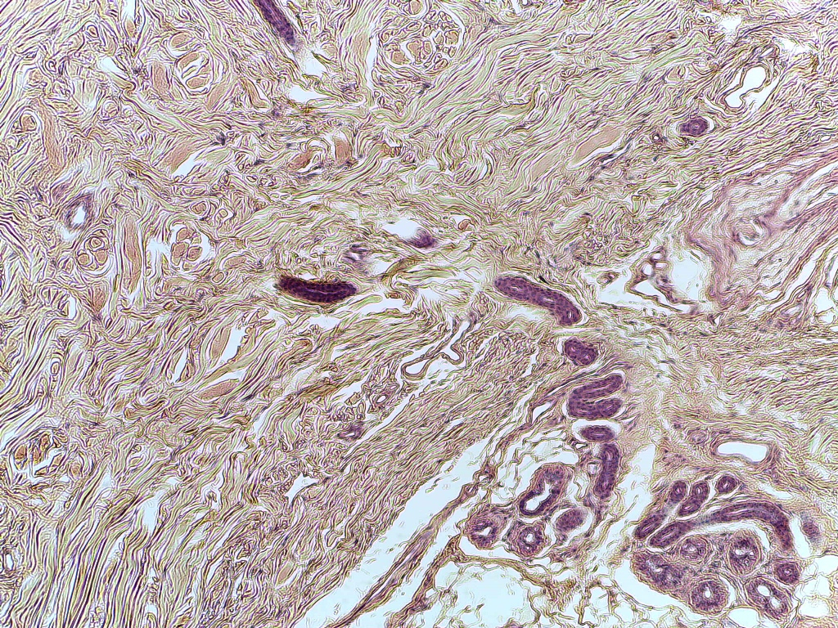
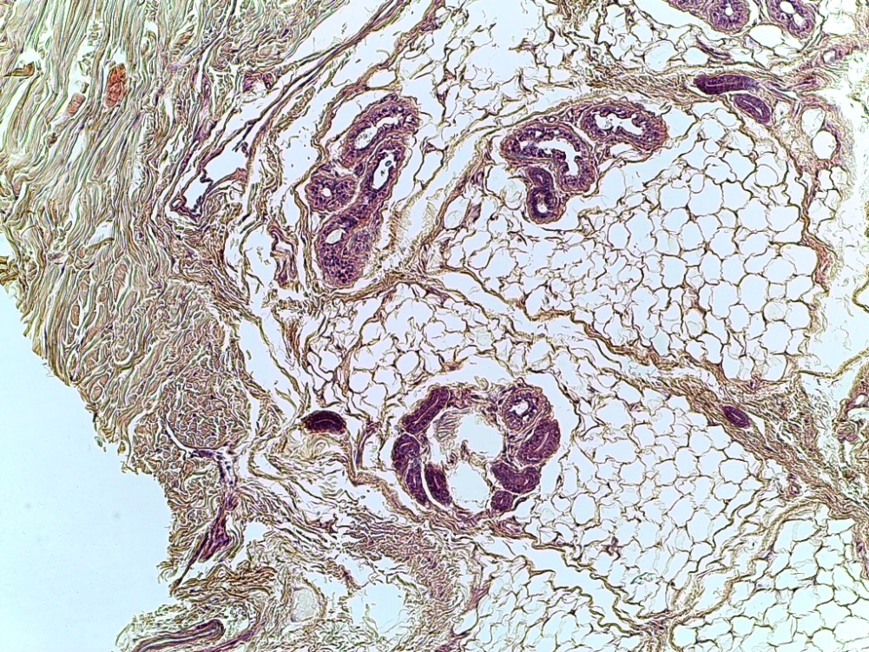
Sweat Glands
100x
100x

Slide 15
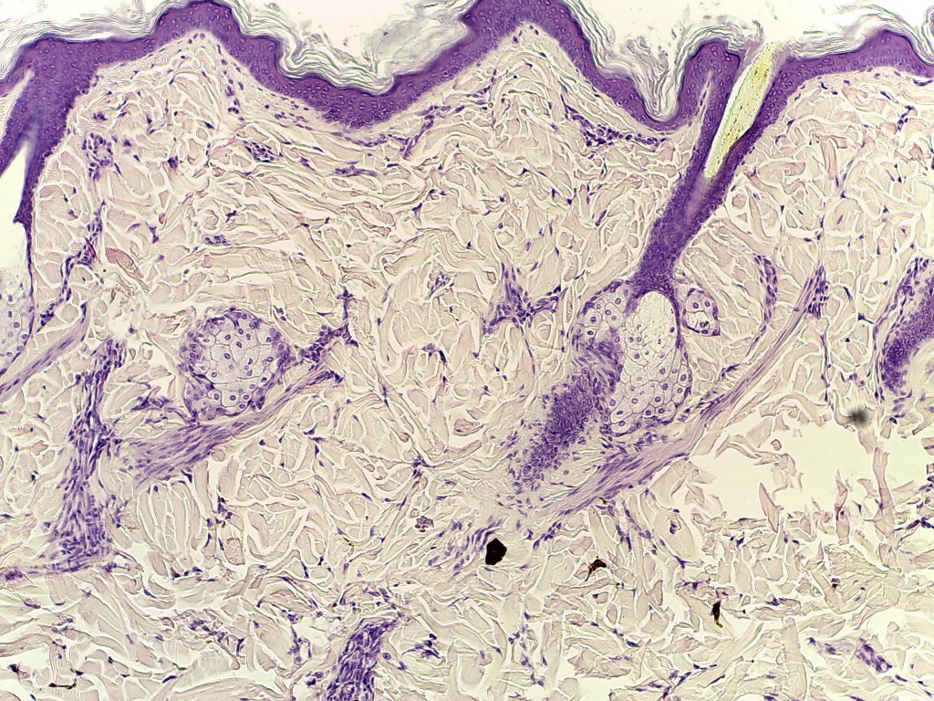
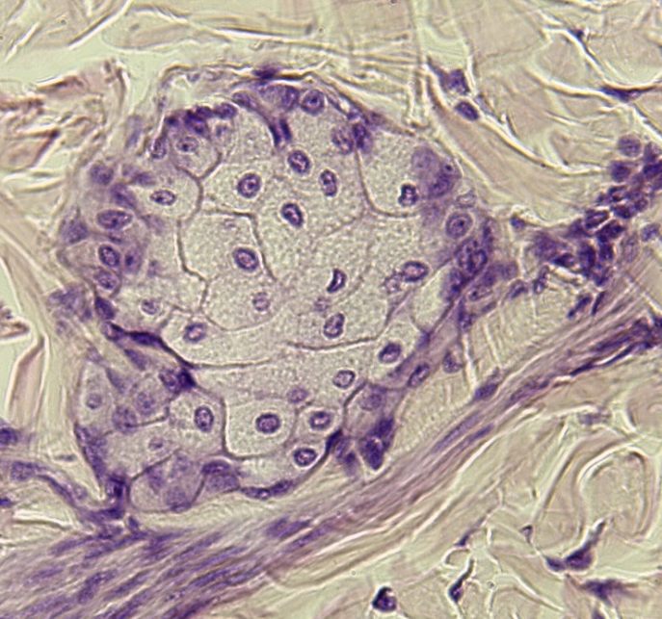
Sebaceous Glands
400X
100X

