Slide 1
Special Senses
The Eye
Photographed, Labeled, and Made Accessible by:
Dr. Laila Nimri
Edited by:
Dr. Maya Byfield Mr. James Henry
Dist. Prof. Mary Dolnack Dr. Syed Arif Humayun
Dr. Essa Farah Dr. Laila Nimri

Slide 2
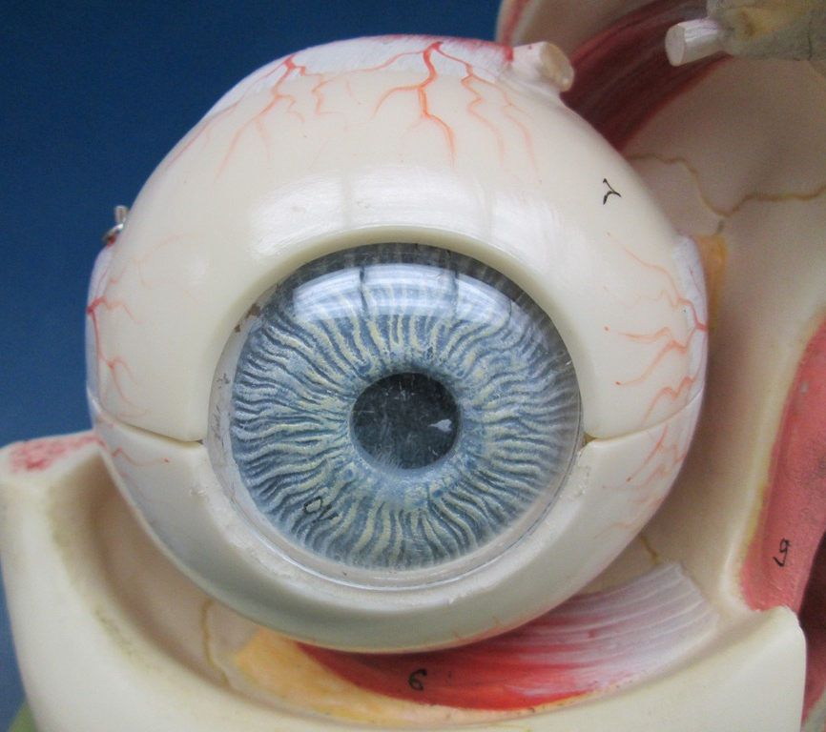
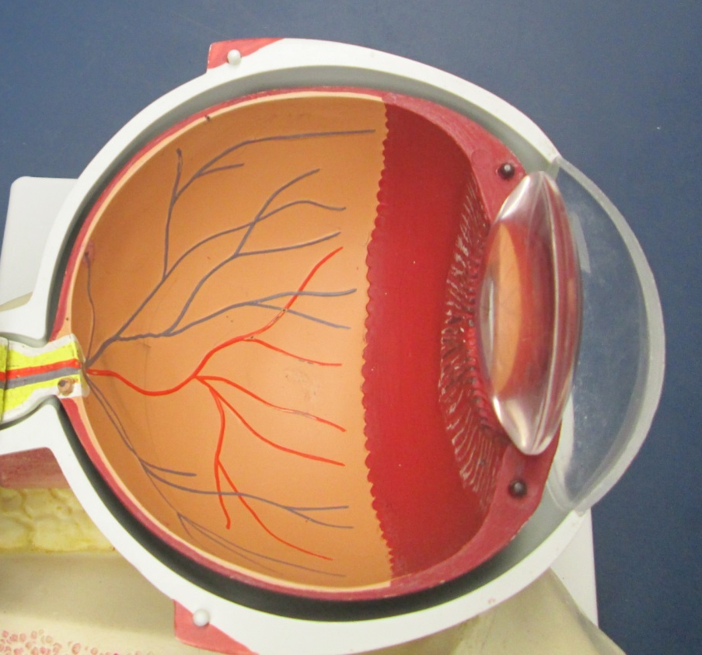
Layers of the Eyeball / Fibrous Layer (External)
Sclera
Cornea
Anterior View of Eyeball
Transverse Section of Eyeball

Slide 3
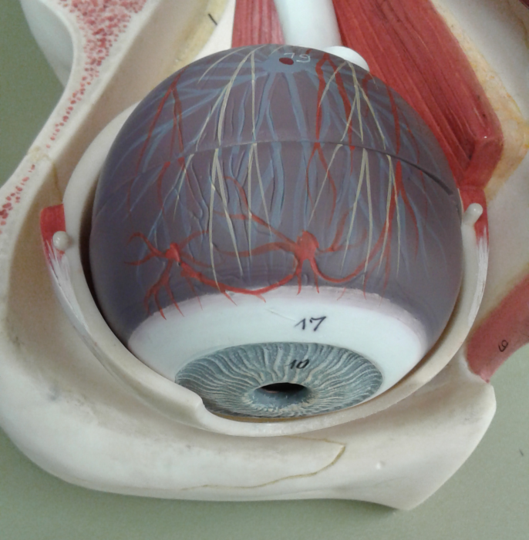
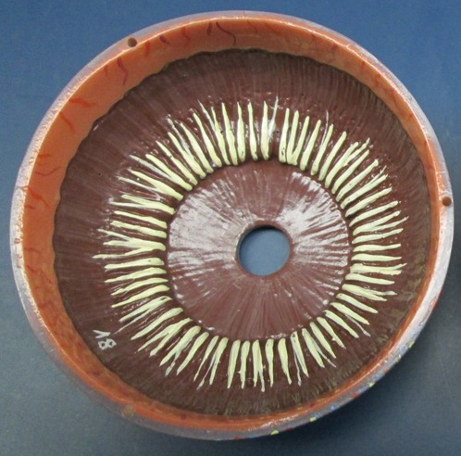
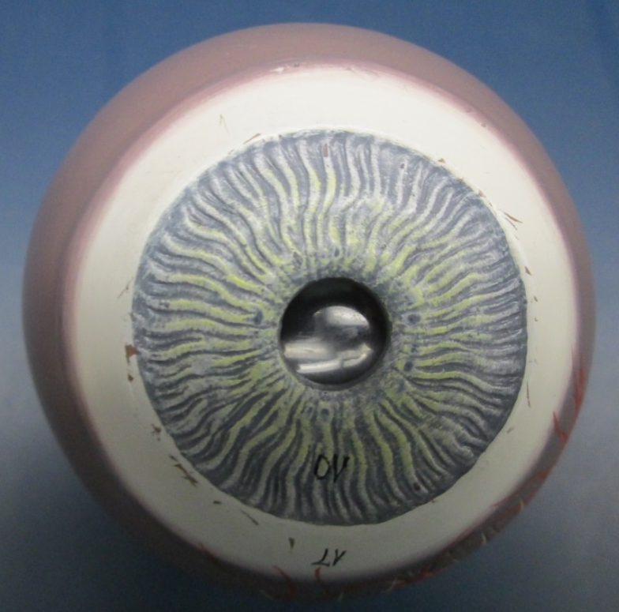
Layers of the Eyeball / Vascular Layer (Middle)
Choroid
Posterior View
Anterior View
Ciliary body
Iris
Pupil

Slide 4
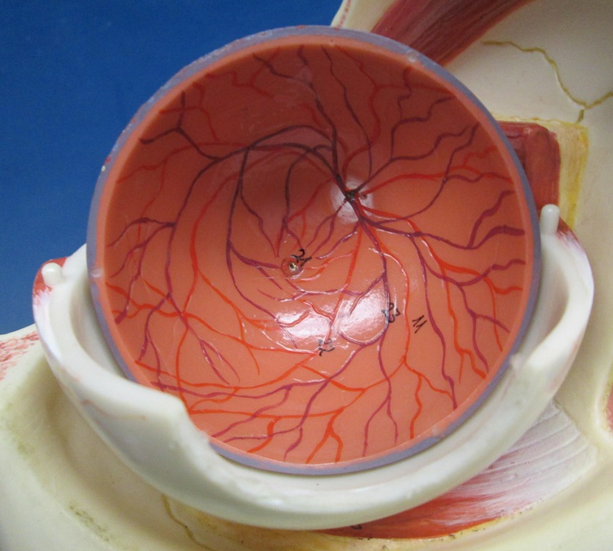
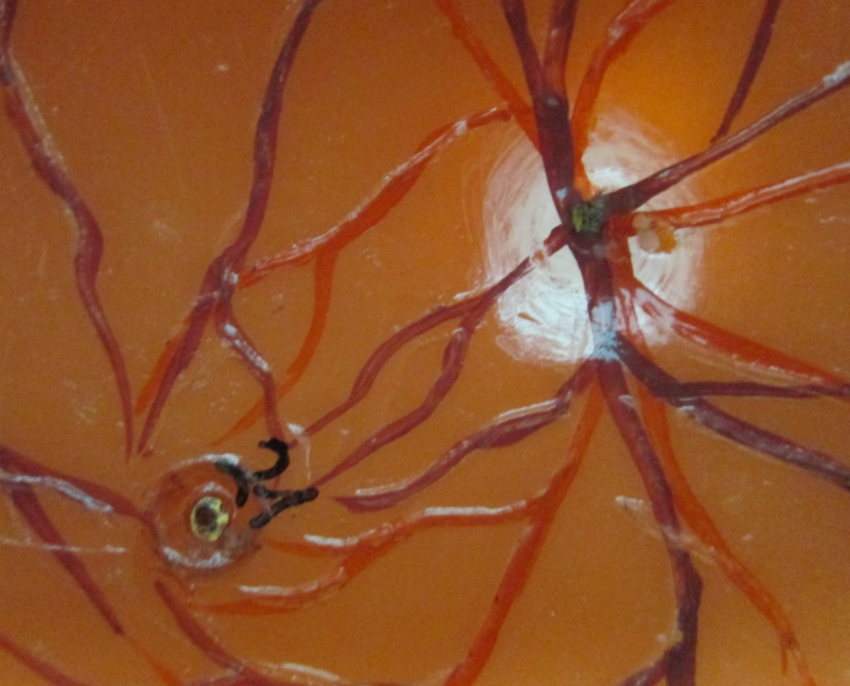
Layers of the Eyeball / Neural Layer (Internal)
Retina
Optic disc
Fovea centralis
Macula lutea

Slide 5

The Eyeball (Transverse Section)
Retina
Ora serrata
Optic disc
Suspensory ligaments

Slide 6
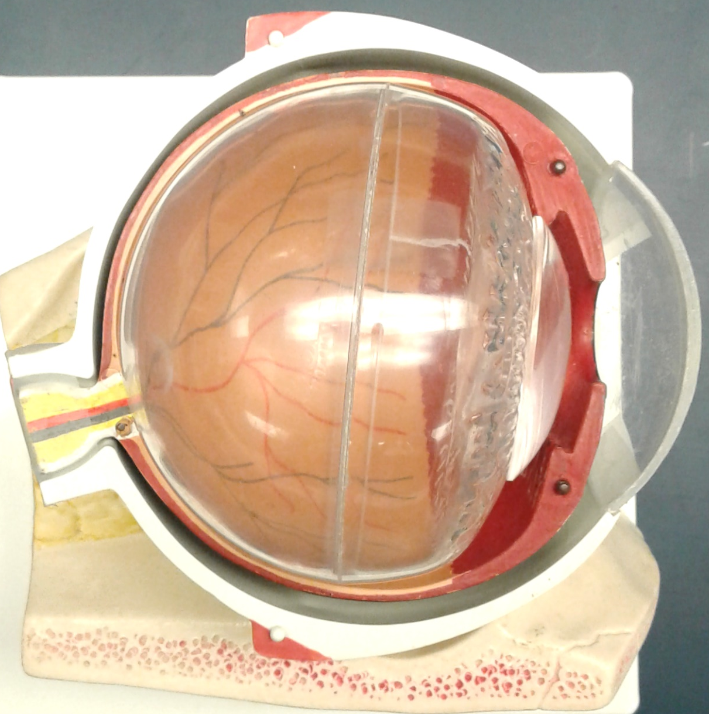
Eyeball Cavities (Transverse Section)
Lens
Anterior cavity
Posterior cavity
Optic nerve
(CN II)
Cornea

Slide 7
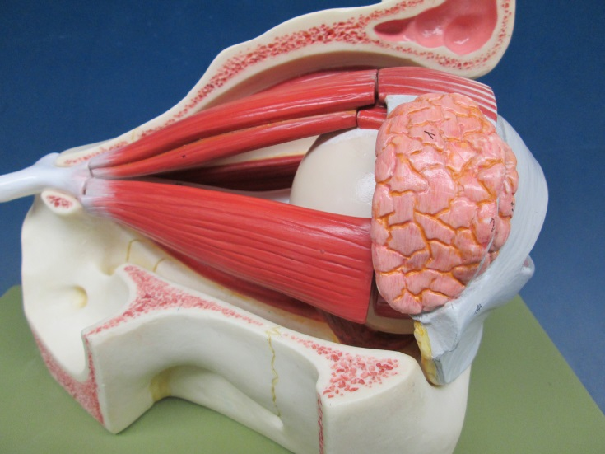
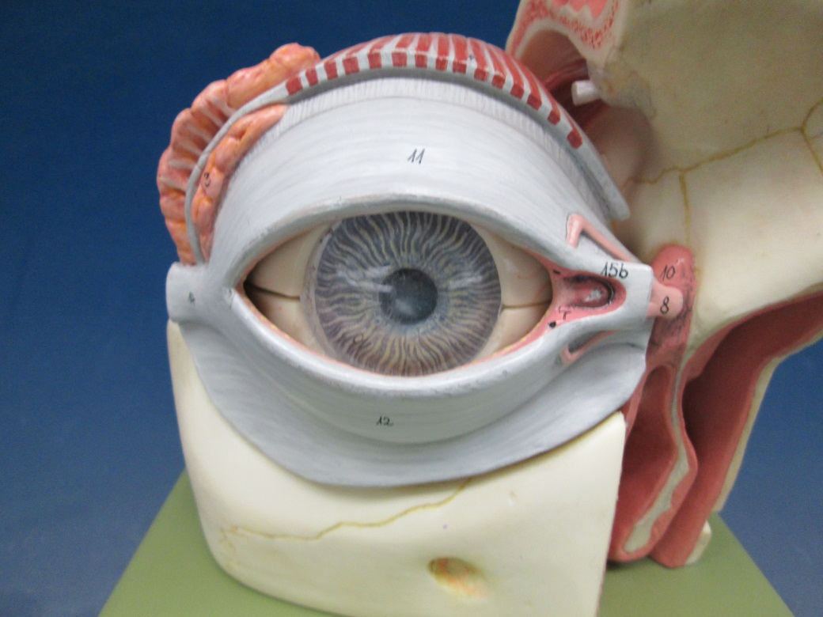
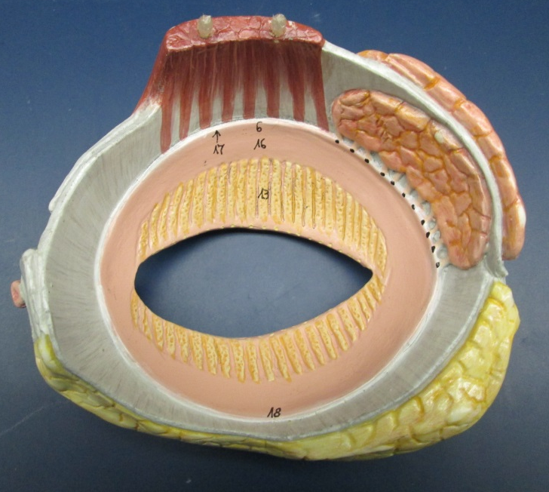
Palpebrae (Eyelids)
Levator Palpebrae Superioris Muscle
Superior palpebra
Lateral View
Anterior View
Posterior View

Slide 8
Palpebrae (Eyelids)
Lateral palpebral commissure
Medial palpebral commissure
Lacrimal caruncle

Slide 9
Lacrimal Apparatus (1 of 2)
Lacrimal canaliculi
Lacrimal gland
Lacrimal sac
Nasolacrimal duct
Superior & inferior lacrimal puncta

Slide 10

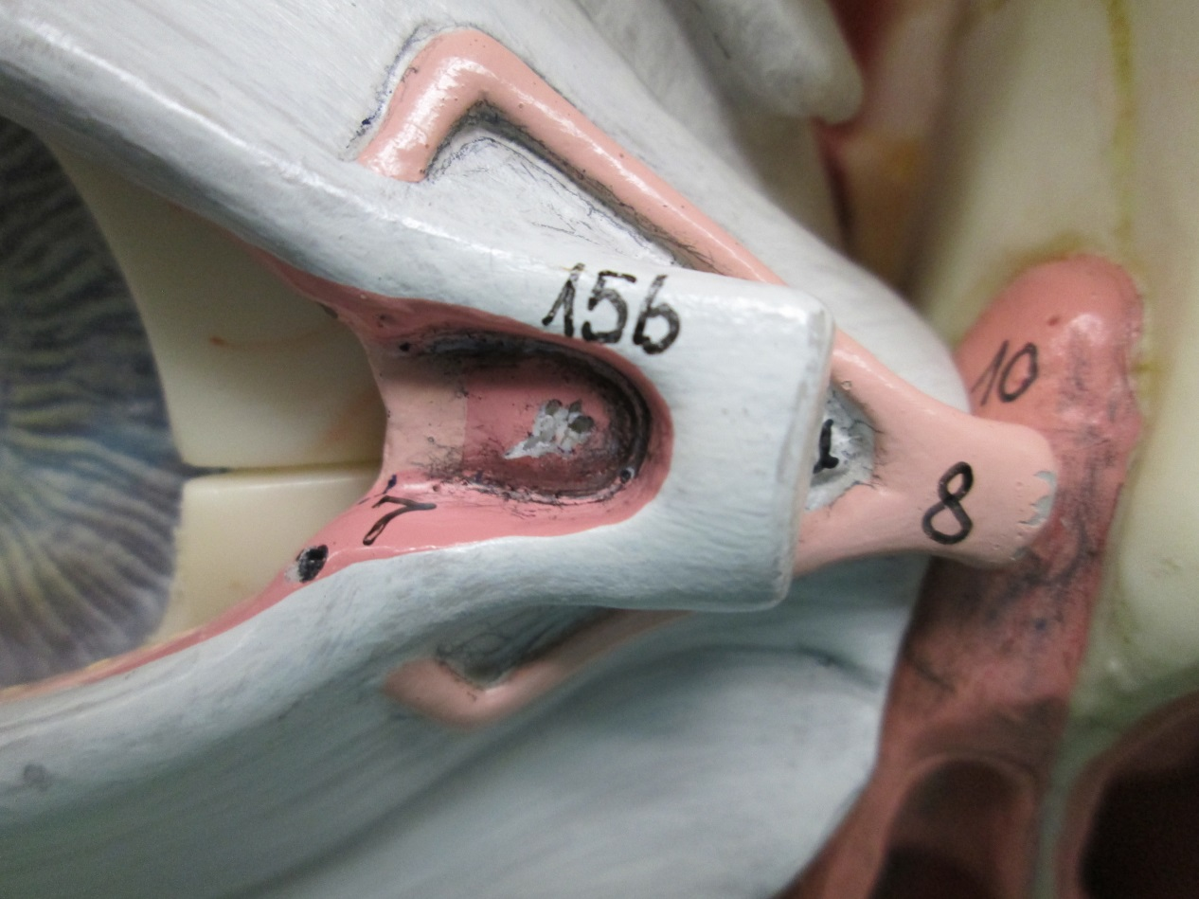
Lacrimal Apparatus (2 of 2)
Lacrimal canaliculi
Lacrimal sac
inferior lacrimal punctum
Nasolacrimal duct

Slide 11
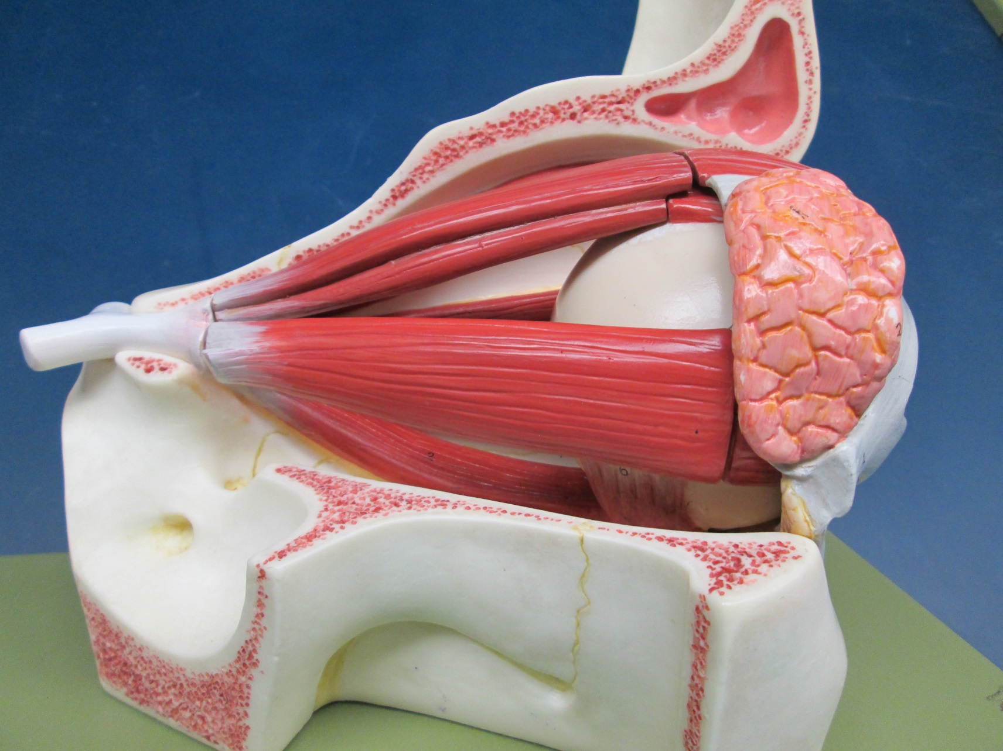
Extrinsic Eye Muscles (Lateral View)
Superior rectus
Medial rectus
Lateral rectus
Inferior oblique
Inferior rectus

Slide 12
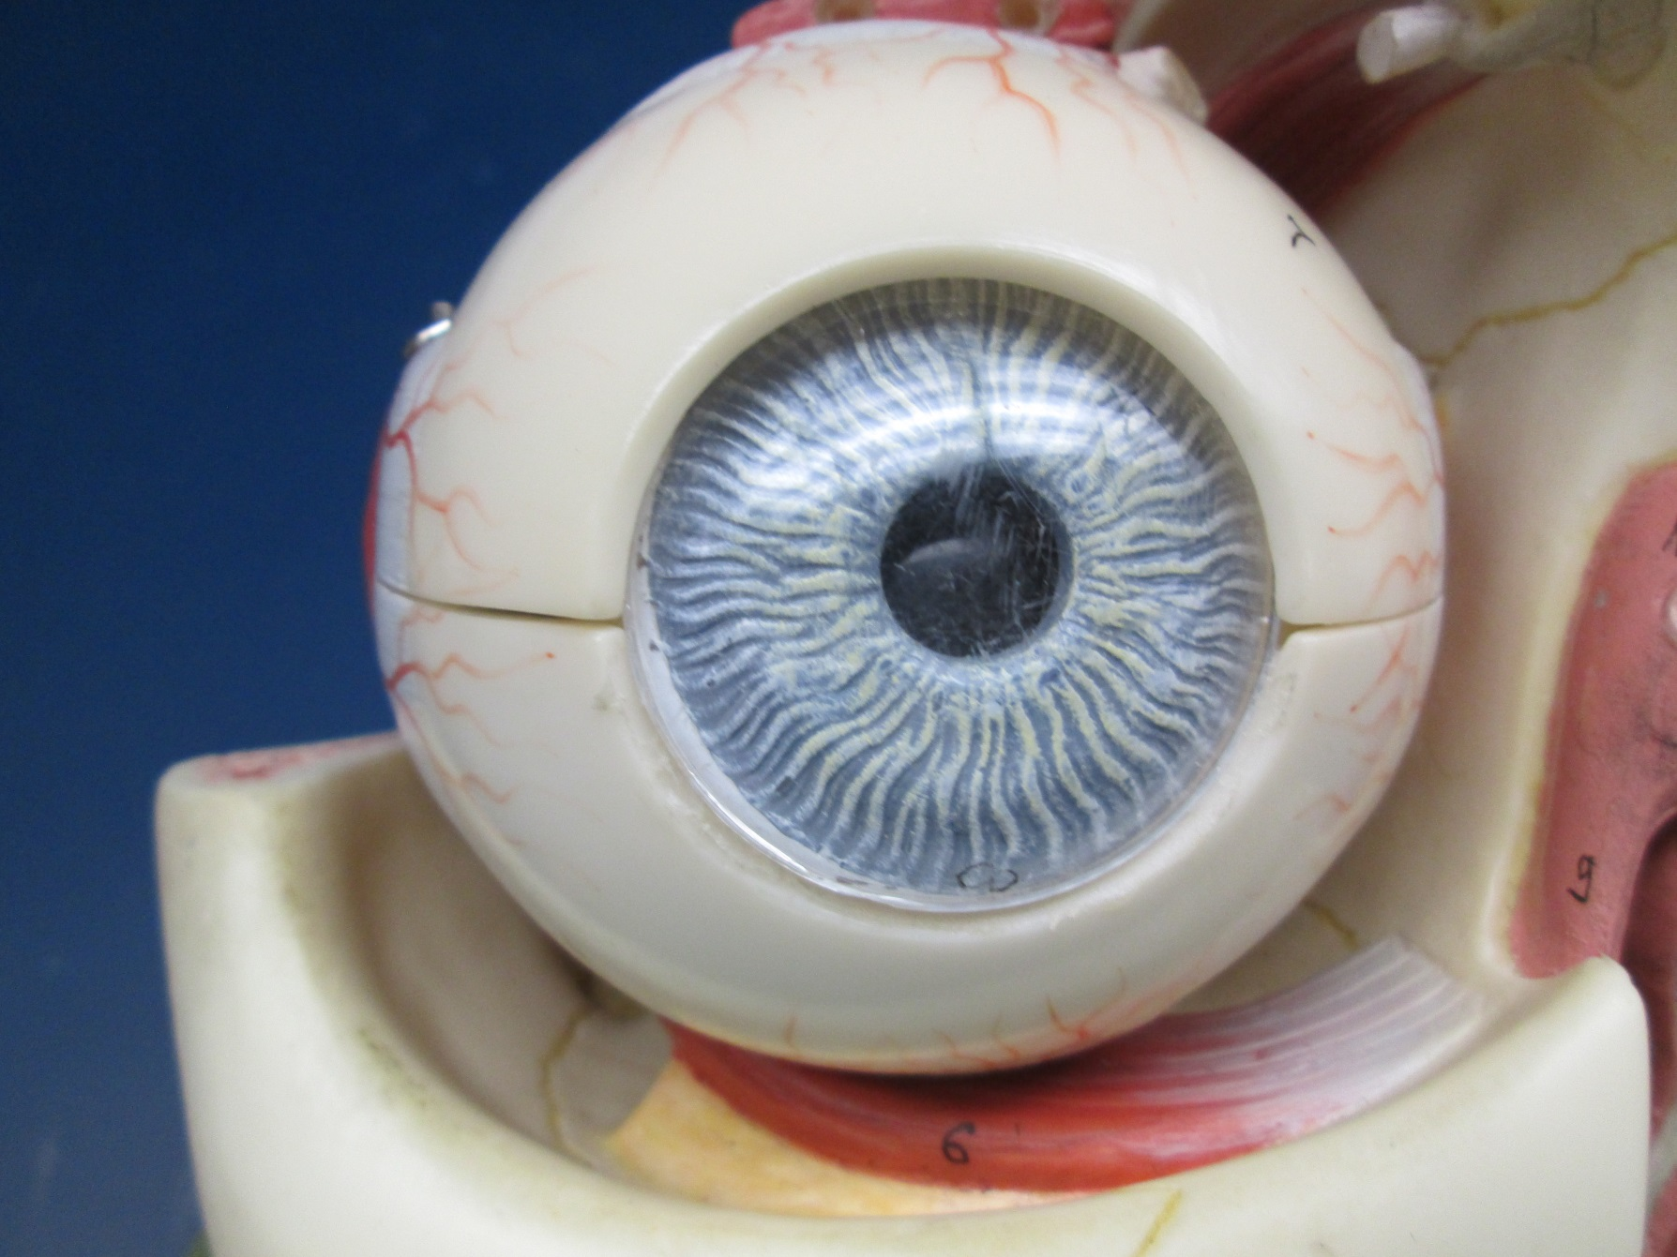
Extrinsic Eye Muscles / Inferior oblique*
*

Slide 13
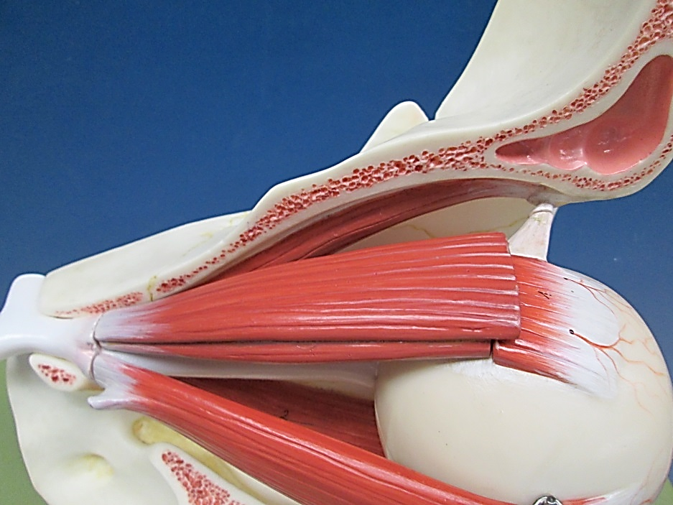
Extrinsic Eye Muscles / Superior Oblique
1
2
1- Superior oblique muscle 2- Superior oblique tendon

