Slide 1
Special Senses The Eye
Special Senses
The Ear
Photographed, Labeled, and Made Accessible by:
Dr. Laila Nimri
Edited by:
Dr. Maya Byfield Mr. James Henry
Dist. Prof. Mary Dolnack Dr. Syed Arif Humayun
Dr. Essa Farah Dr. Laila Nimri

Slide 2
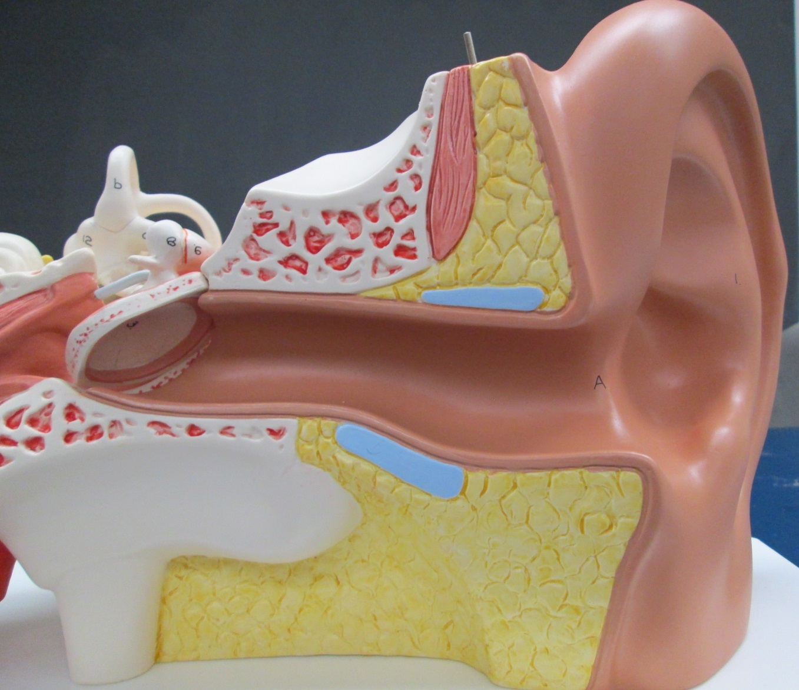
External (Outer) Ear
Auricle
Tympanic membrane
External auditory canal

Slide 3
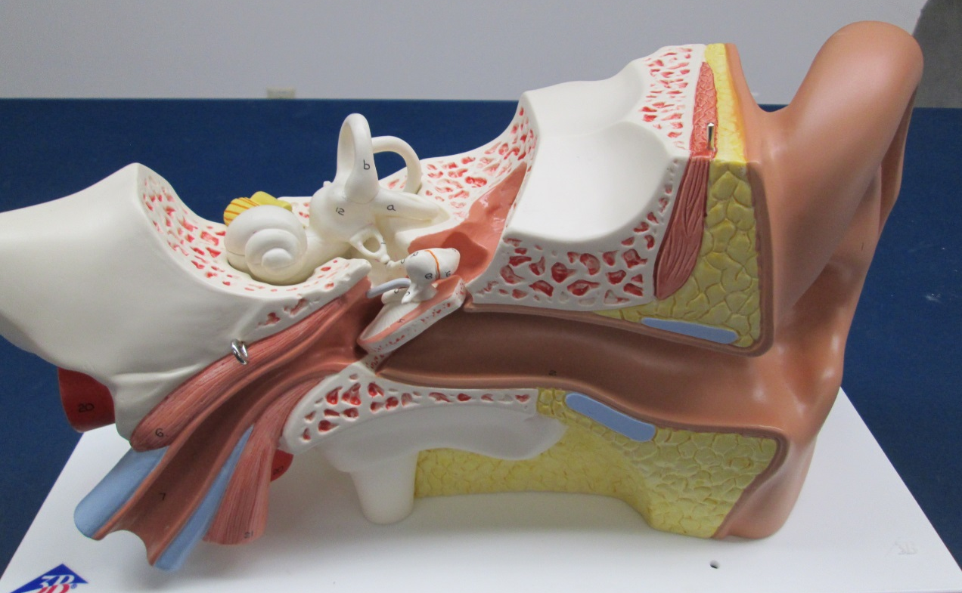
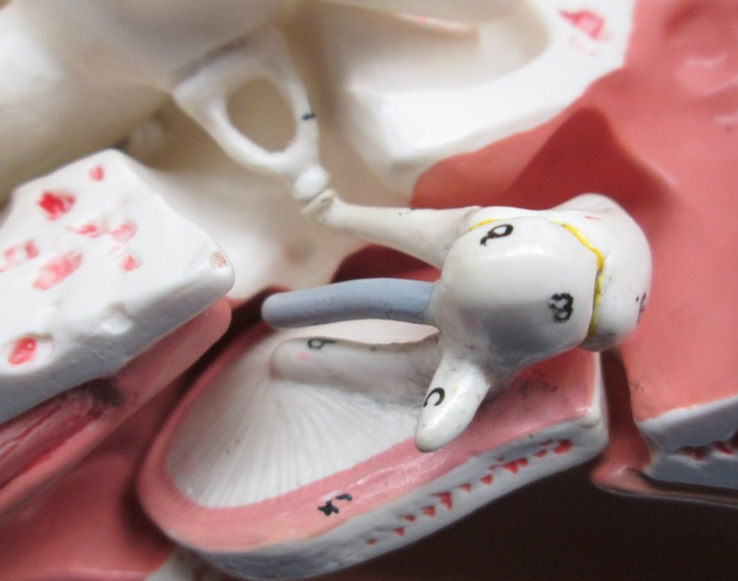
Middle Ear
Pharyngotympanic tube
Stapes
Incus
Malleus

Slide 4
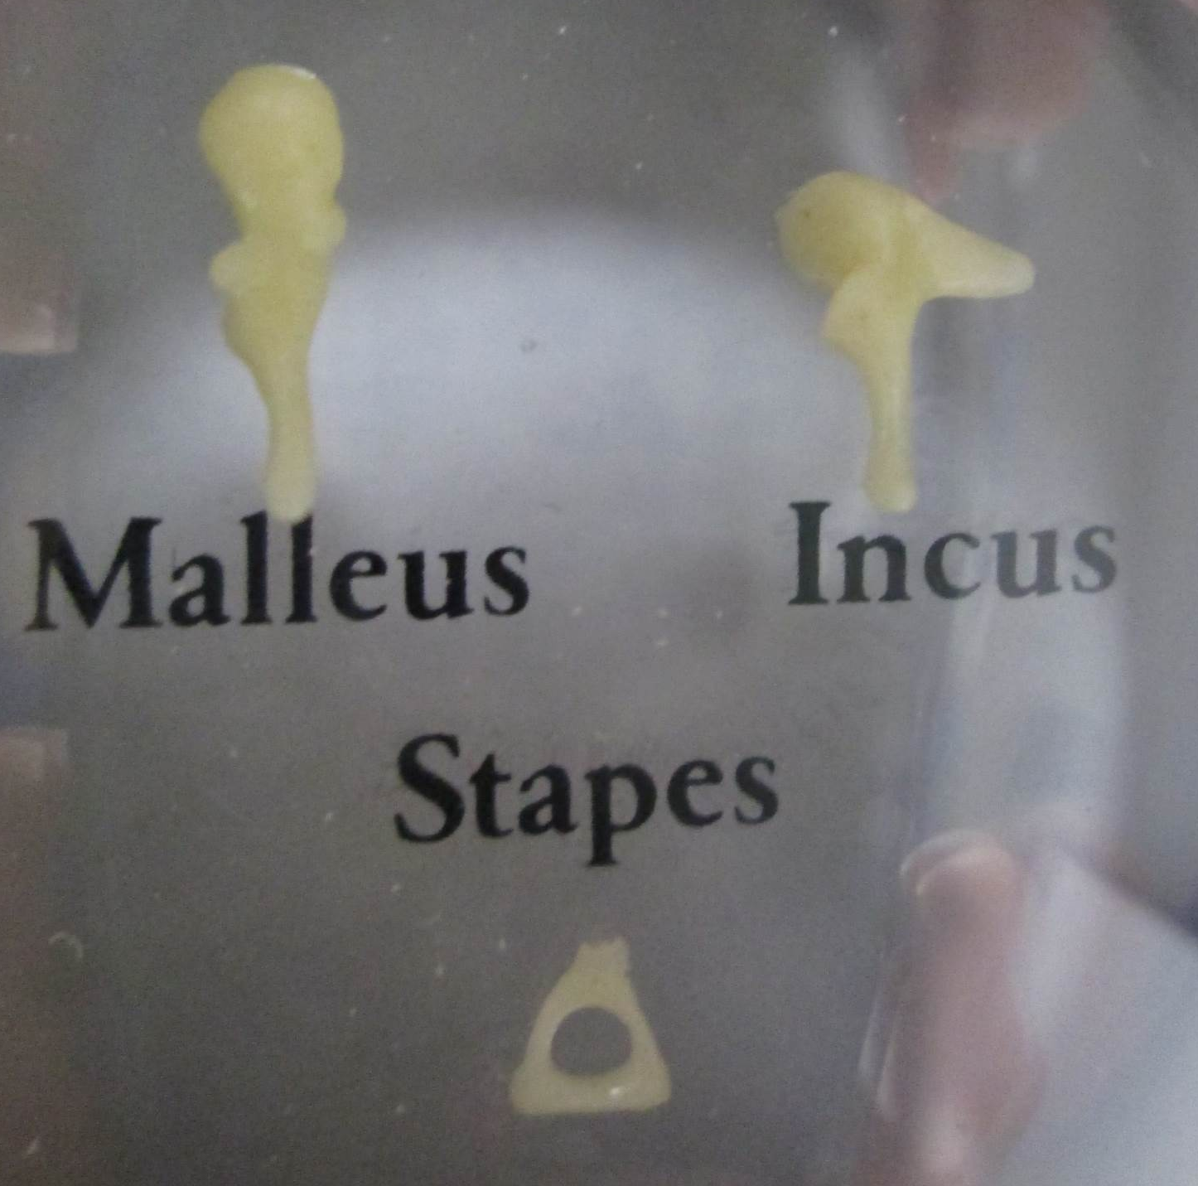
Middle Ear / Auditory Ossicles

Slide 5
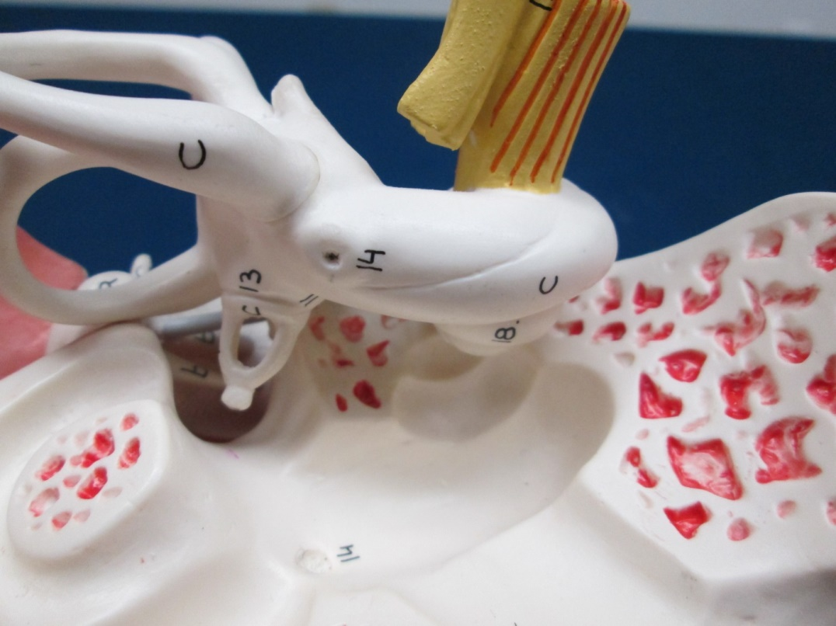
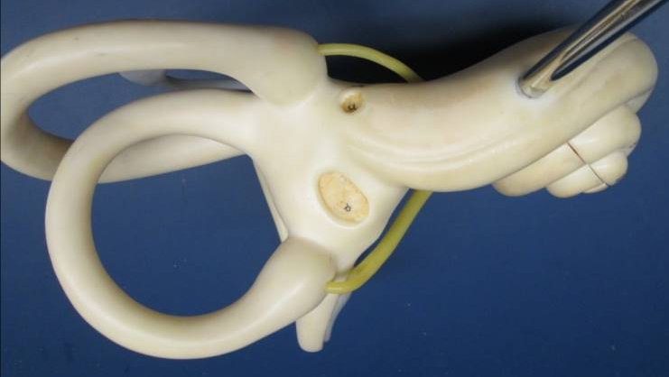
Membrane-Covered Openings between Middle and Inner Ear
Round window
Oval window

Slide 6
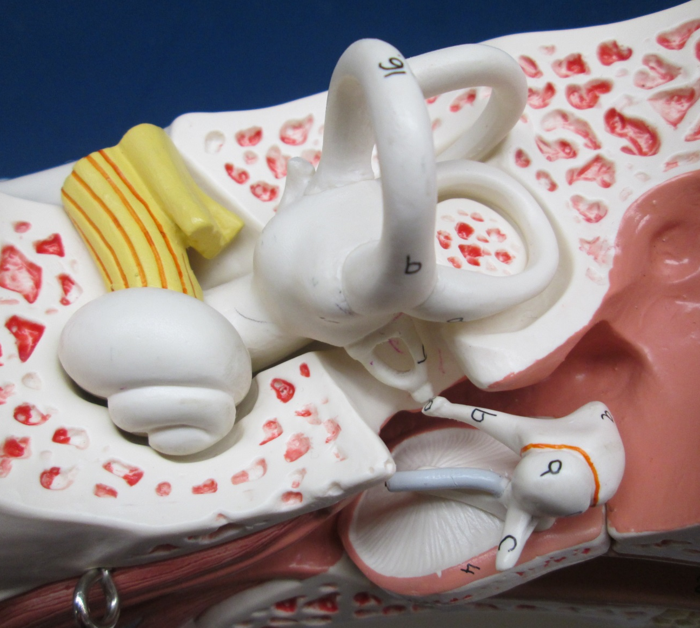
Inner Ear (1 of 2)
Semicircular canals
Vestibule
Cochlea

Slide 7
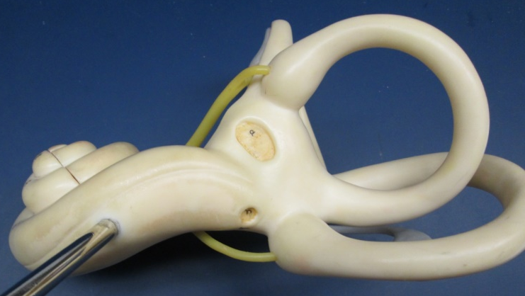
Inner Ear (2 of 2)
3
3
2
1
3
1- Cochlea
2- Vestibule
3- Semicircular canals

Slide 8
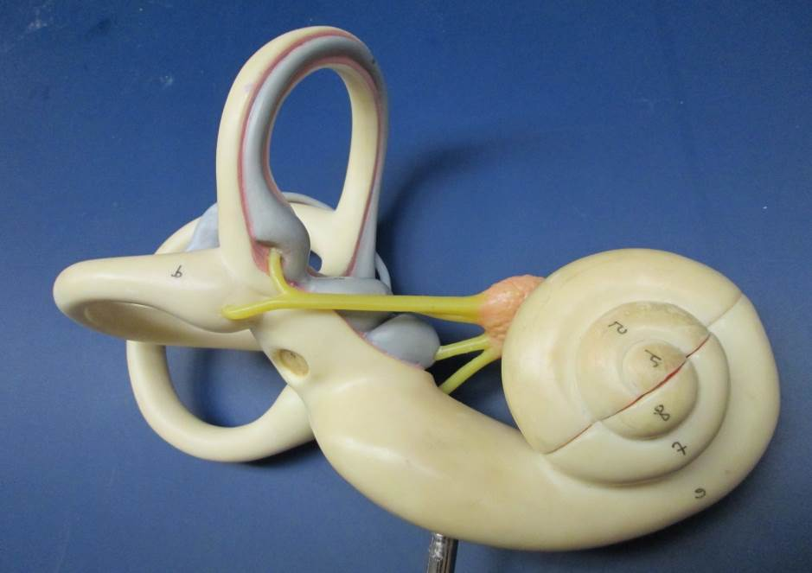
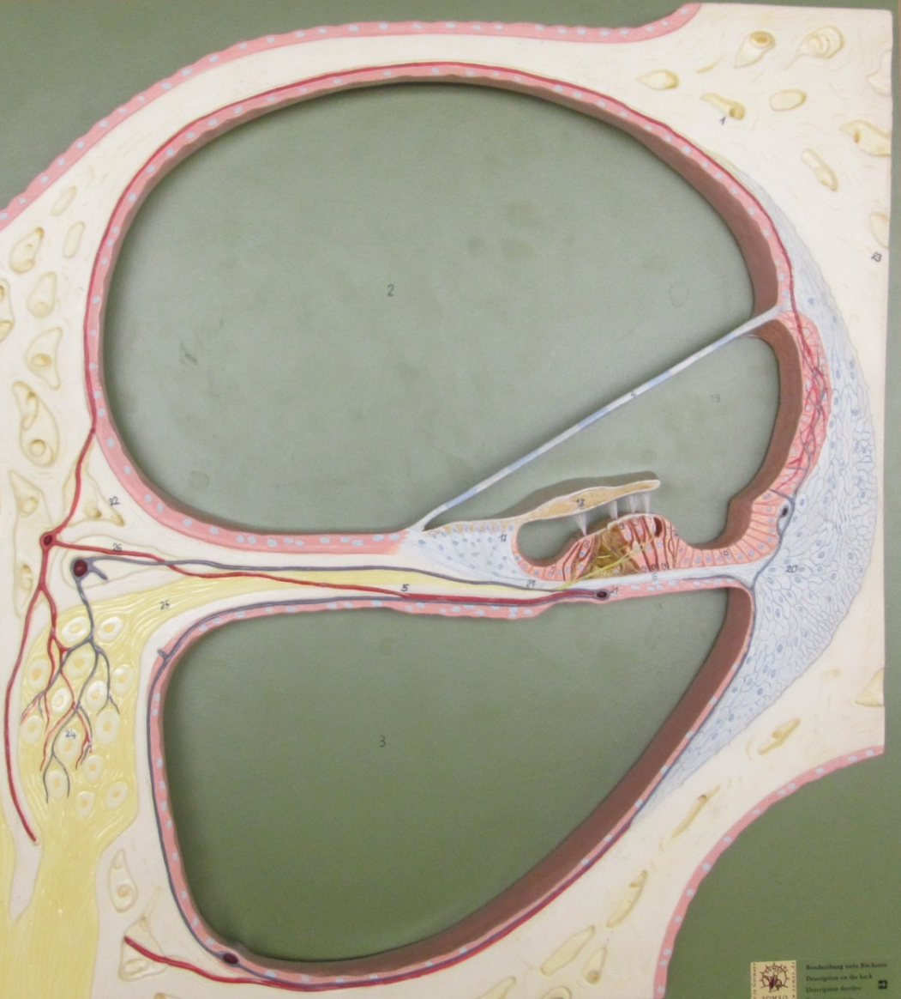
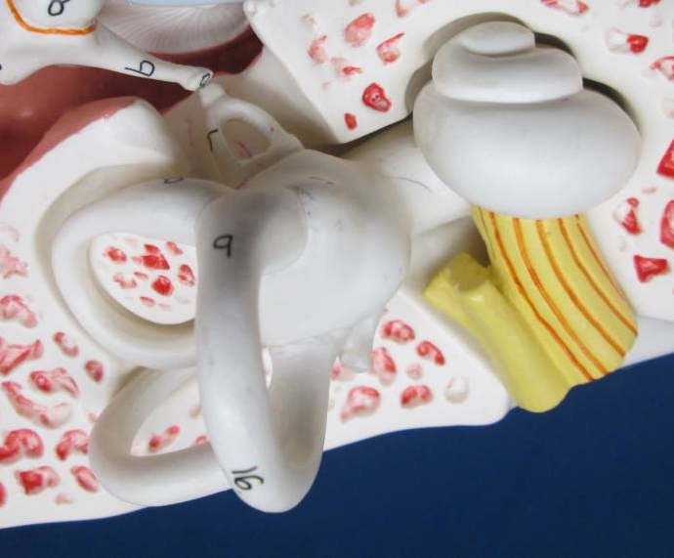
Inner Ear / Cochlea
Scala vestibuli
(contains perilymph)
Helicotrema
Scala tympani (contains perilymph)
Transverse section of one turn of cochlea

Slide 9
Transverse Section of One Turn of Cochlea
Scala vestibuli
(contains perilymph)
Membranous labyrinth
Cochlear duct
(Scala media contains endolymph)
Bony labyrinth
Scala tympani (contains perilymph)

Slide 10

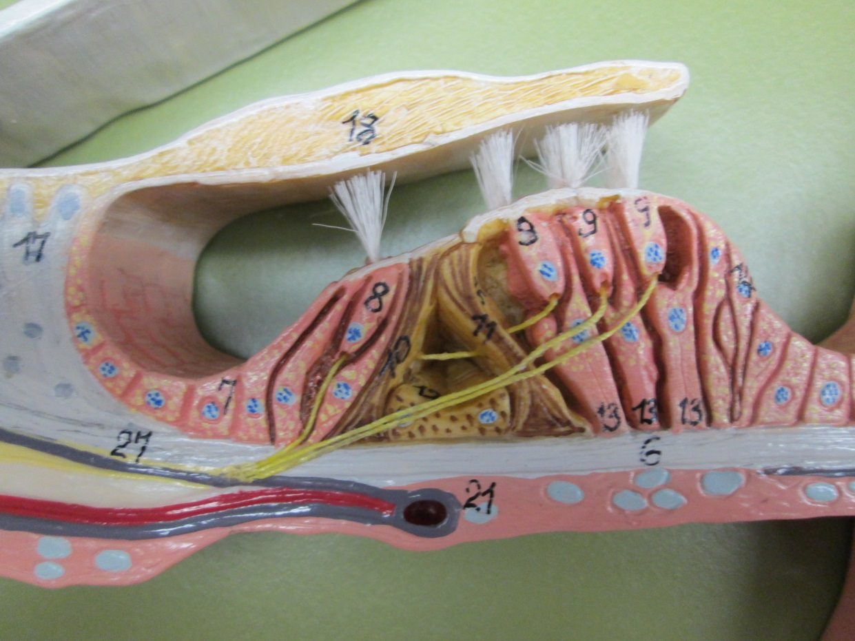
Membranous Part of Cochlea / Cochlear Duct Containing Spiral Organs
Vestibular membrane
Tectorial membrane
Inner hair cell
Hair cells
Transverse section of one turn of cochlea
Outer hair cells
Basilar membrane
Spiral Organ

Slide 11

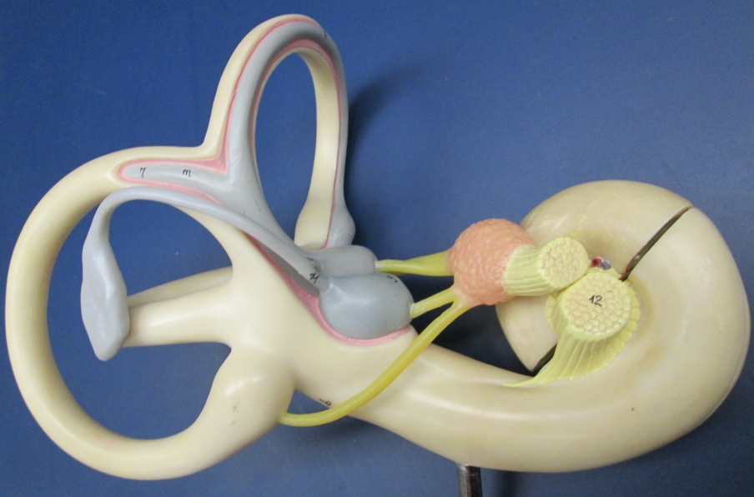
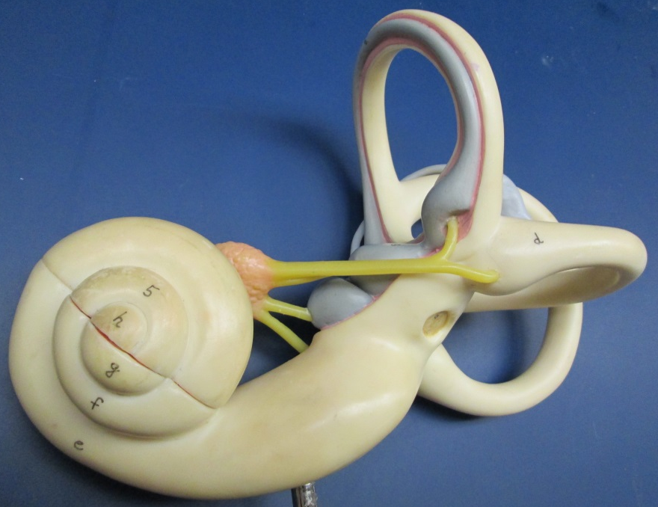
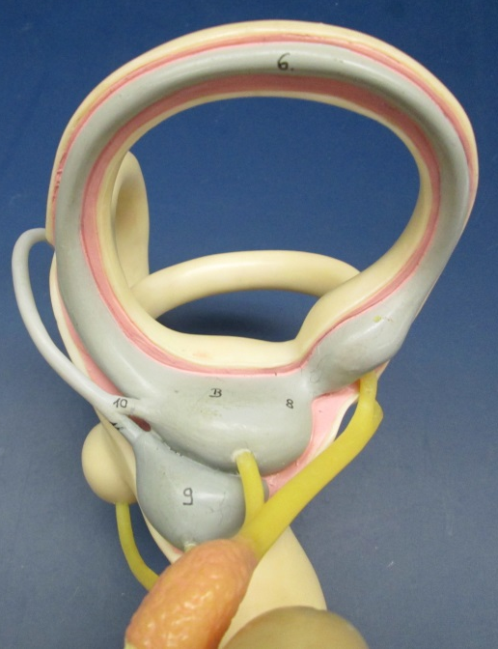
Membranous Part of Vestibule / Utricle and Saccule
Posterior View
U
S
Anterior View
Superior View
Utricle
Saccule

Slide 12


Membranous Part of Semicircular Canals / Semicircular Ducts
Semicircular canal
Semicircular duct
Perilymph
Ampulla

Slide 13
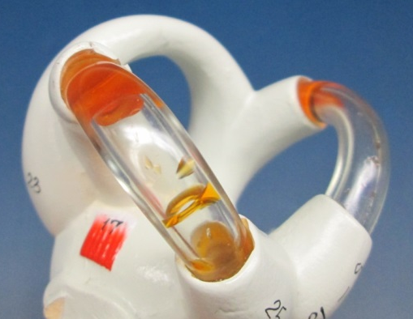

Inner Ear
3
Endolymph
Perilymph
3
3
3a
3a
3a
2a
3
3
1
2b
2
3
3
1a
Bony labyrinth
1- Cochlea
2- Vestibule
3- Semicircular canals
Membranous labyrinth
1a- Cochlear duct (scala media) contains endolymph
2a- Utricle
2b- Saccule
3a- Semicircular ducts
Transverse section of one turn of cochlea

Slide 14

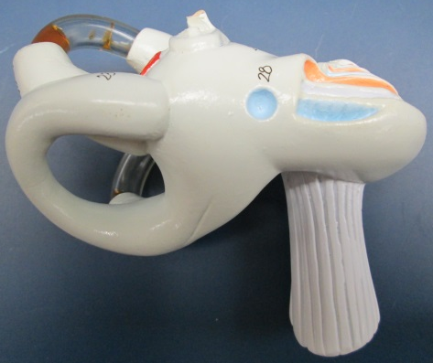
Vestibulocochlear Nerve (CN VIII)
Vestibular branch of CN VIII
Cochlear branch of CN VIII
CN VIII

