Slide 1
Histology Slides Part 3 Muscle and Nervous Tissues
Photographed by:
Mr. James Henry
Labeled and Made Accessible by:
Dr. Laila Nimri
Edited by:
Dr. Maya Byfield Mr. James Henry
Dist. Prof. Mary Dolnack Dr. Syed Arif Humayun
Dr. Essa Farah Dr. Laila Nimri

Slide 2
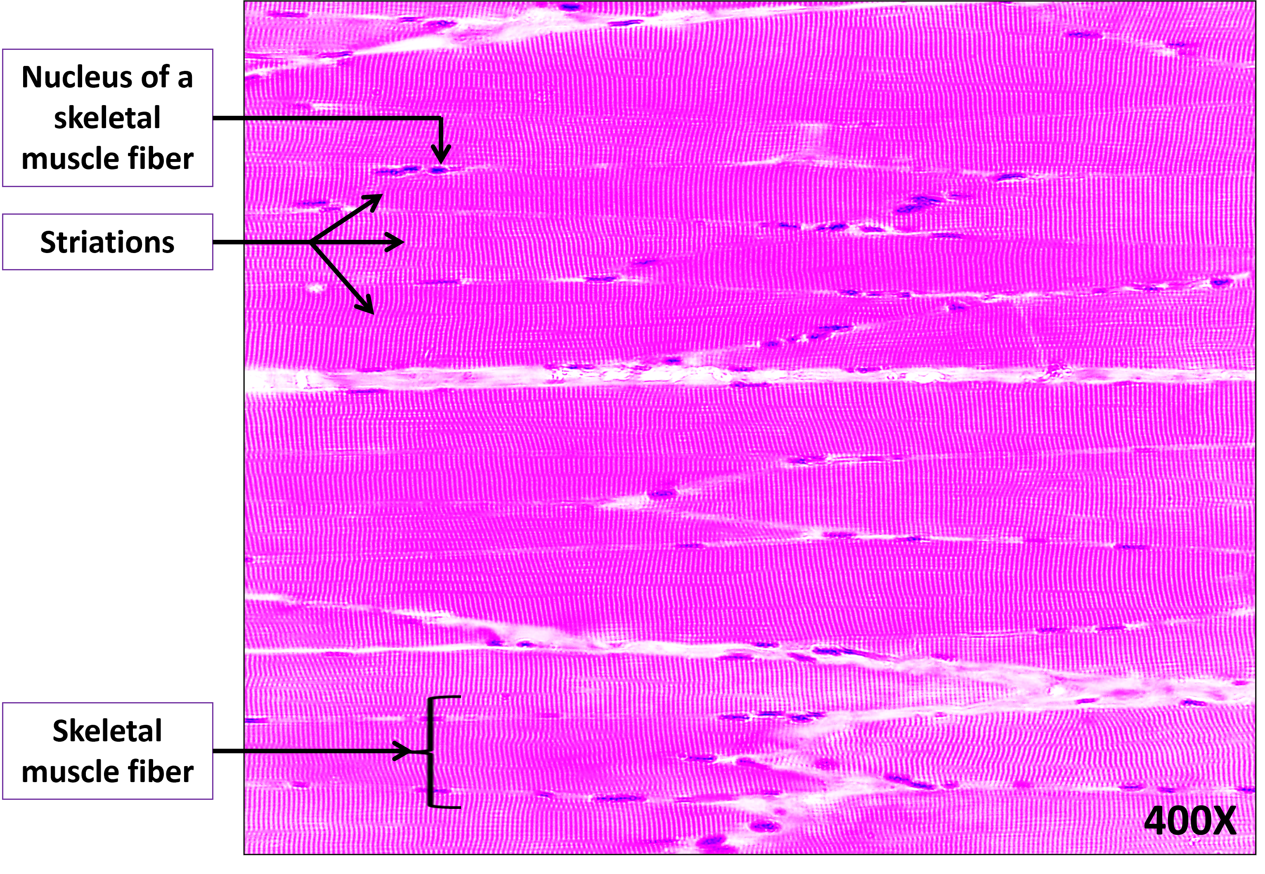
Skeletal Muscle Tissue (1 of 2)

Slide 3


Skeletal Muscle Tissue (2 of 2)
Striations
Nucleus of a skeletal muscle fiber
Skeletal muscle fiber
400X
Notes:
Skeletal Muscle Tissue 400X

Slide 4
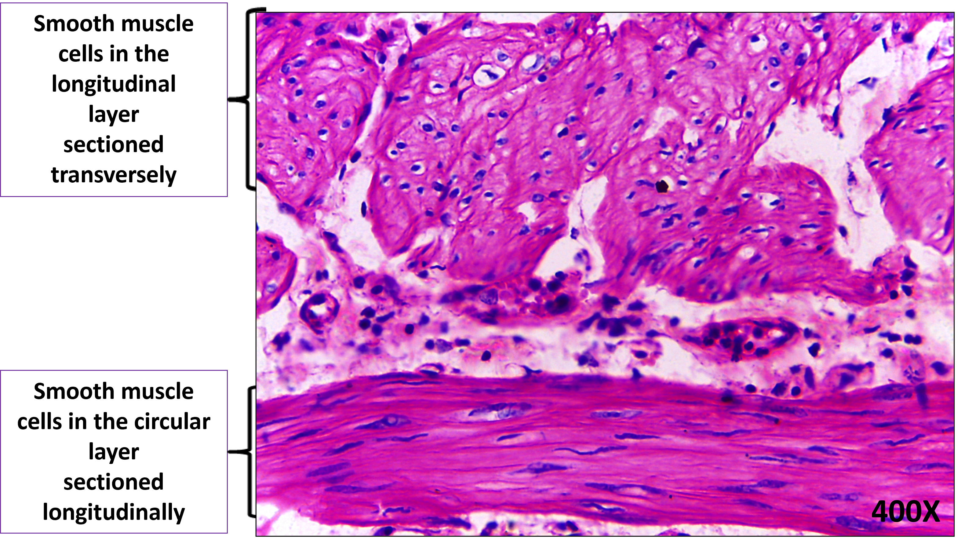
Smooth Muscle Tissue (1 of 2) (A Transverse Section of the Muscularis Bilayer of Small Intestine)

Slide 5
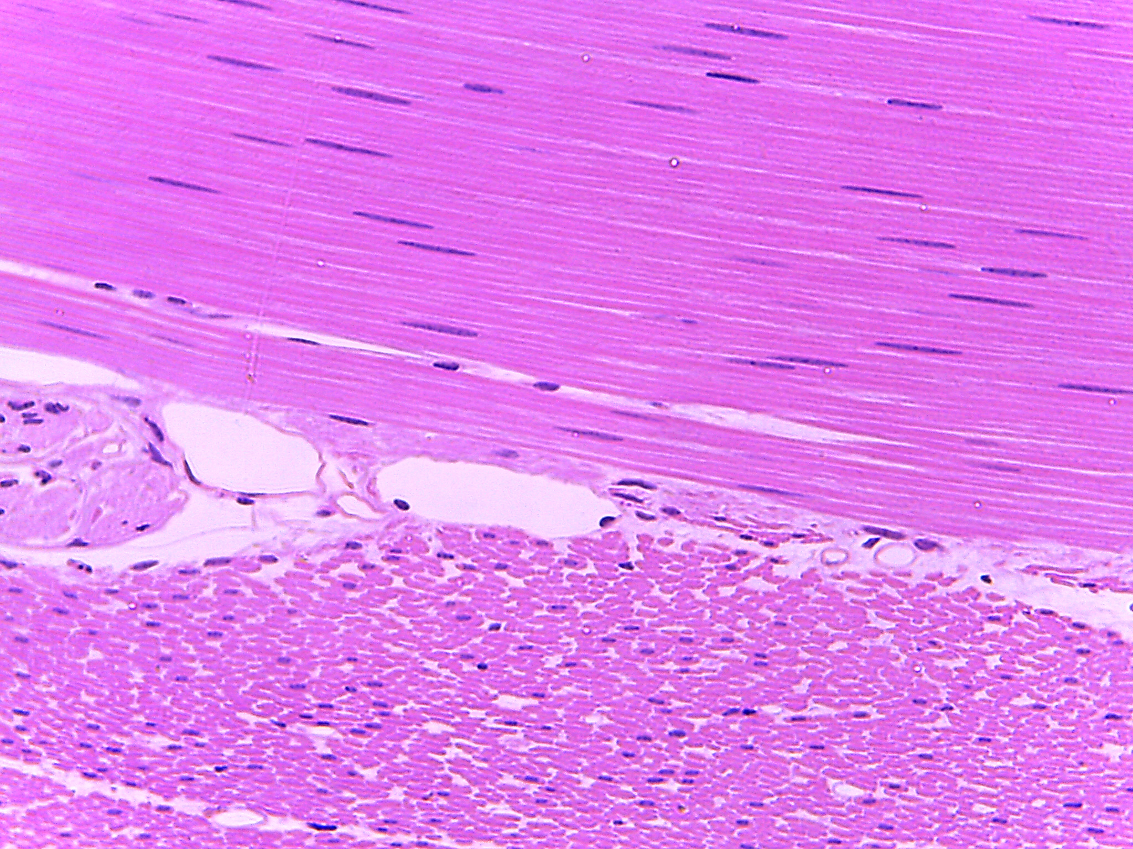
Smooth Muscle Tissue (2 of 2)
400X
Notes:
Smooth Muscle Tissue 400X

Slide 6
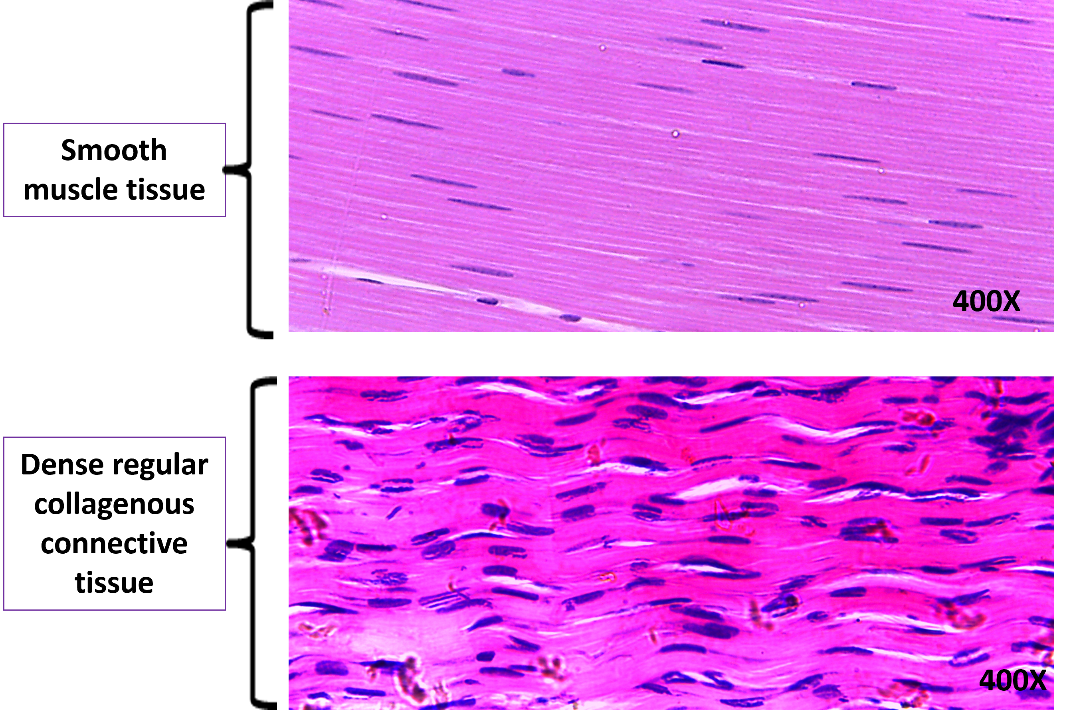
A Comparison Between Smooth Muscle and Dense Regular Collagenous Connective Tissues

Slide 7
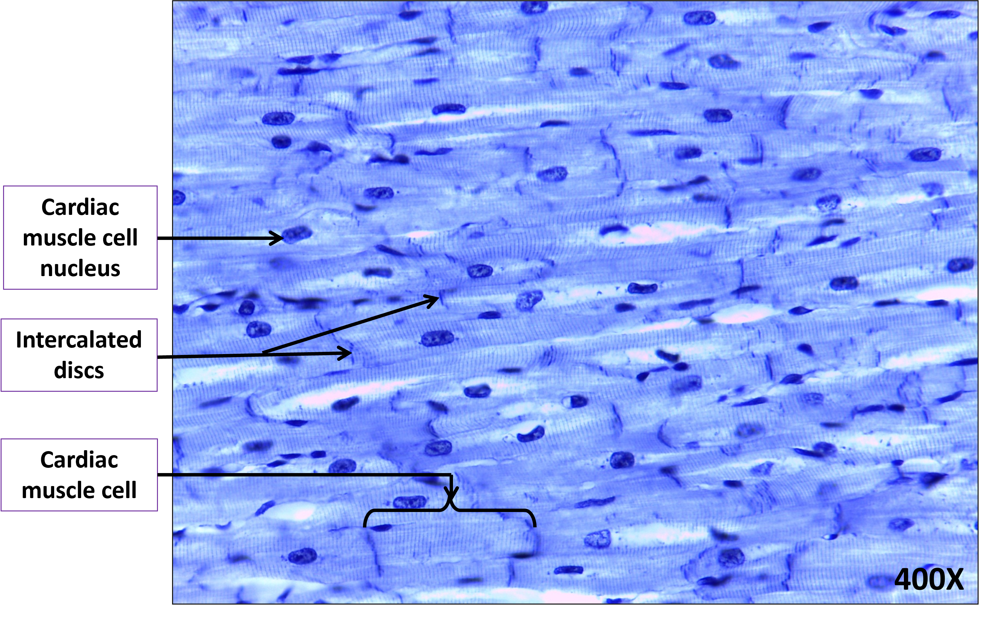
Cardiac Muscle Tissue (1 of 2)

Slide 8
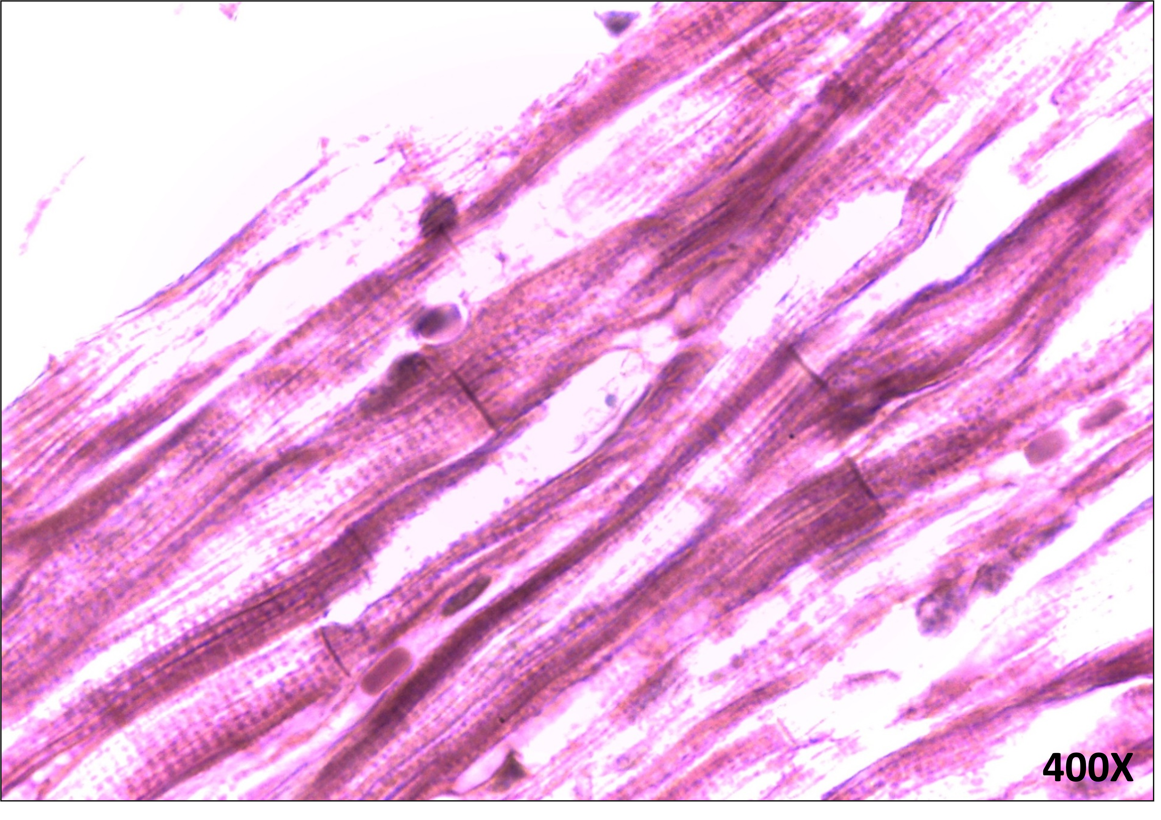
Cardiac Muscle Tissue (2 of 2)

Slide 9
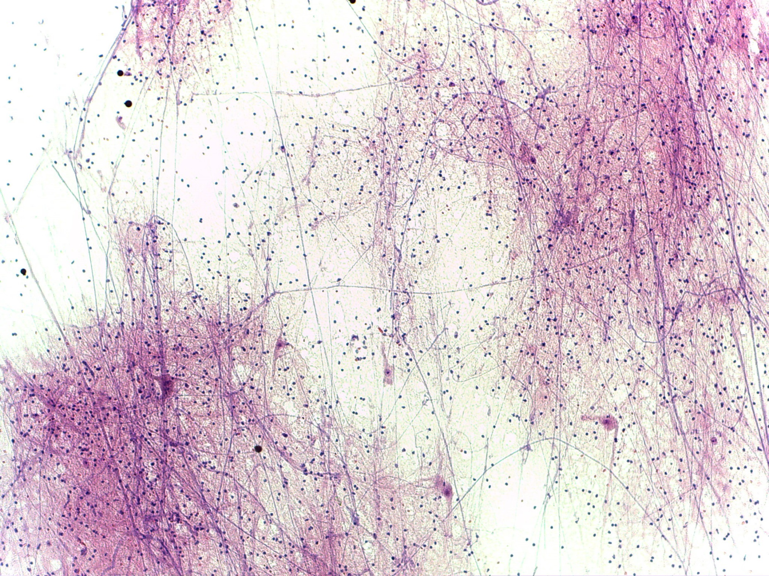
Nervous Tissue (1 of 3)
100X
Notes:
Nervous Tissue 100X

Slide 10
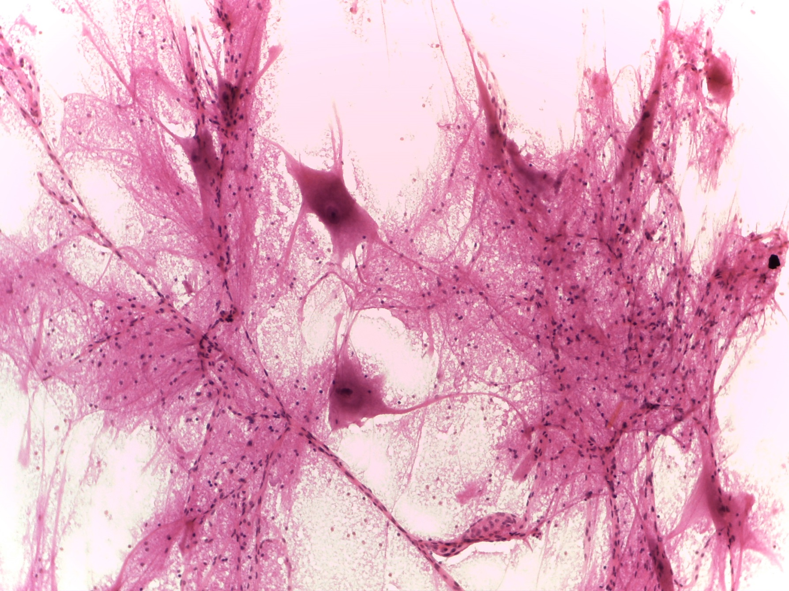
Nervous Tissue (2 of 3)
Nuclei of glial cells
Dendrites
Cell body of a neuron
Axon
400X
Notes:
Nervous Tissue 400X

Slide 11
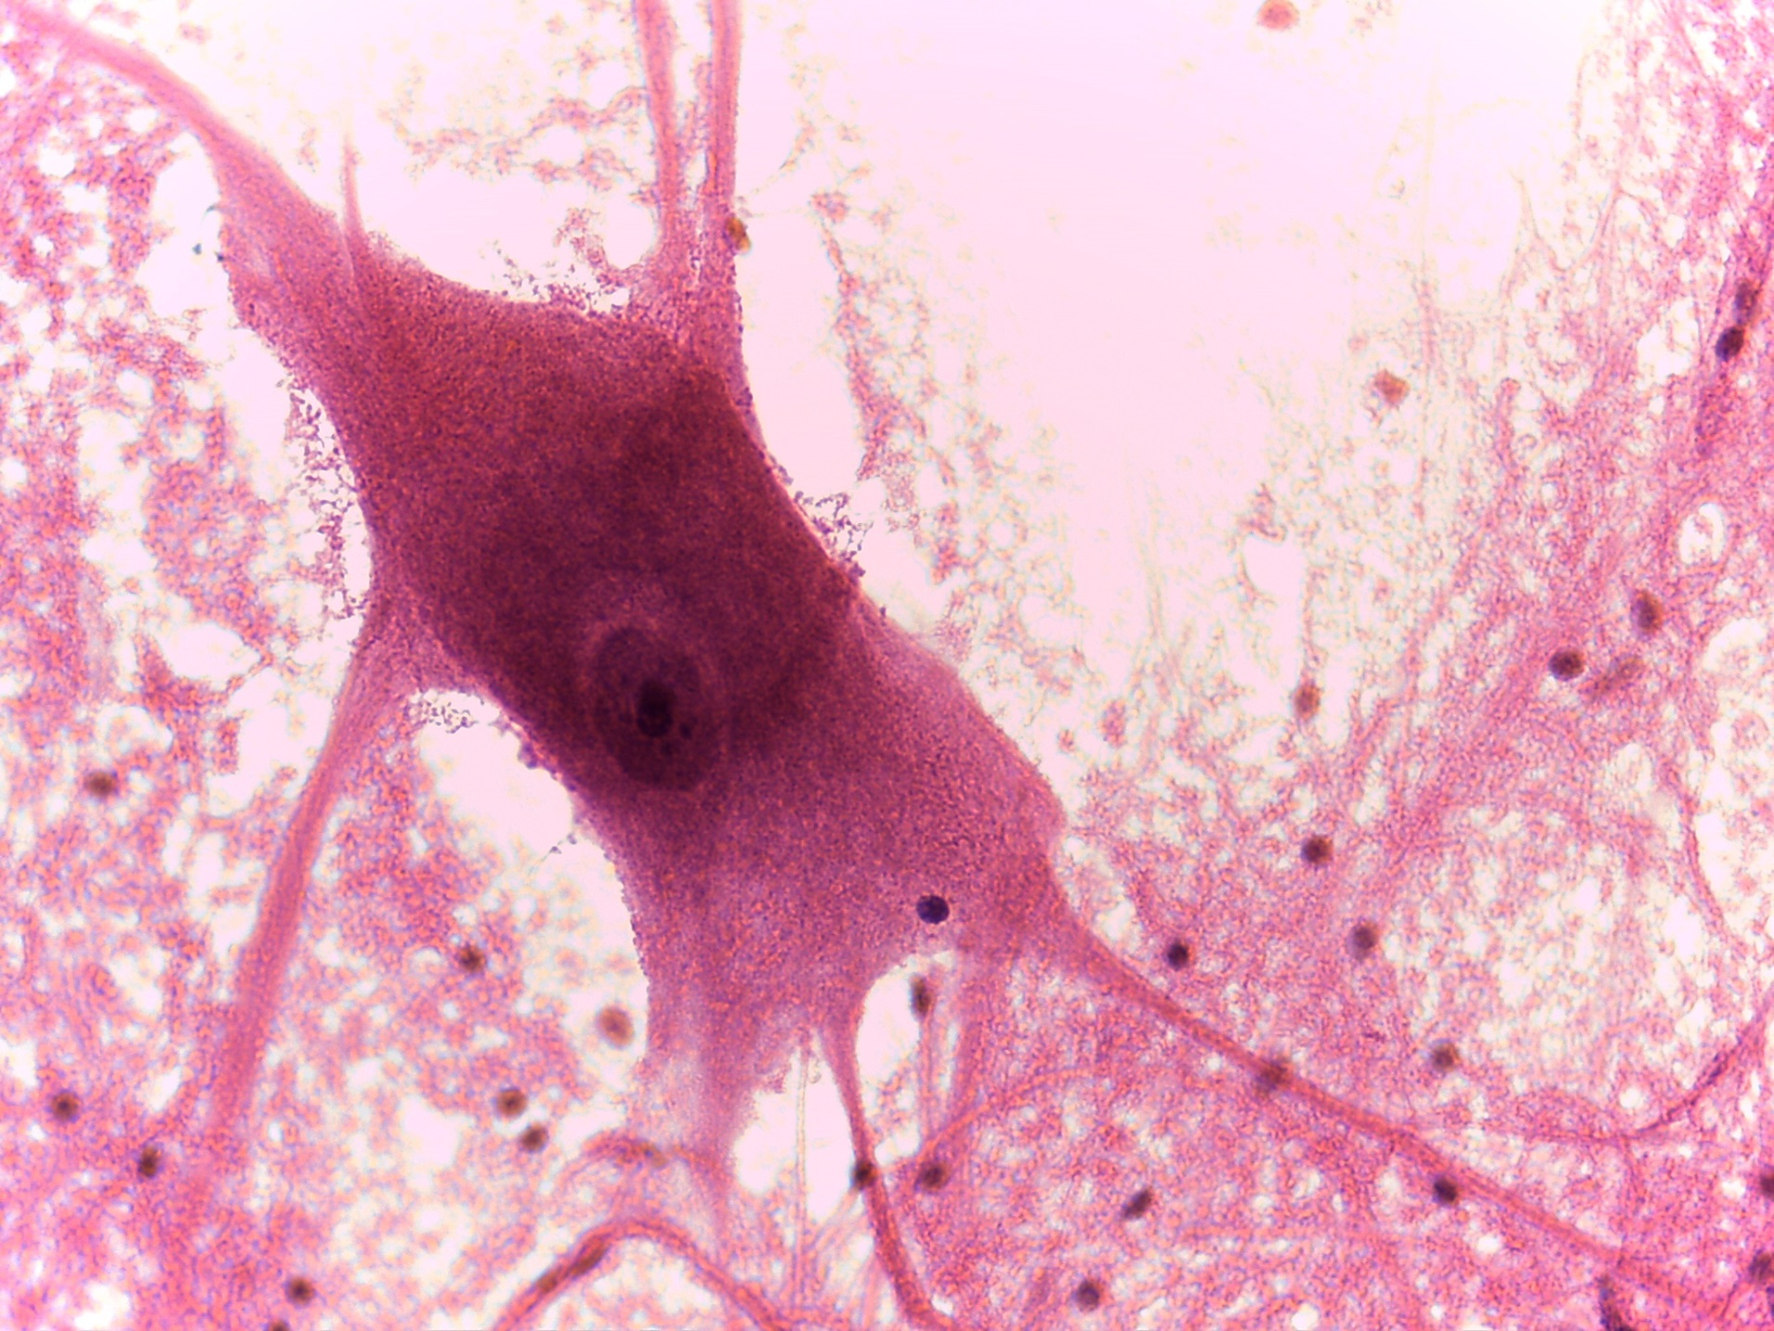
Nervous Tissue (3 of 3)
1000X
Notes:
Nervous Tissue 1000X

