Slide 1
Histology Slides
Part 1
Epithelial Tissues (Epithelia)
Photographed by:
Mr. James Henry
Labeled and Made Accessible by:
Dr. Laila Nimri
Edited by:
Dr. Maya Byfield Mr. James Henry
Dist. Prof. Mary Dolnack Dr. Syed Arif Humayun
Dr. Essa Farah Dr. Laila Nimri

Slide 2
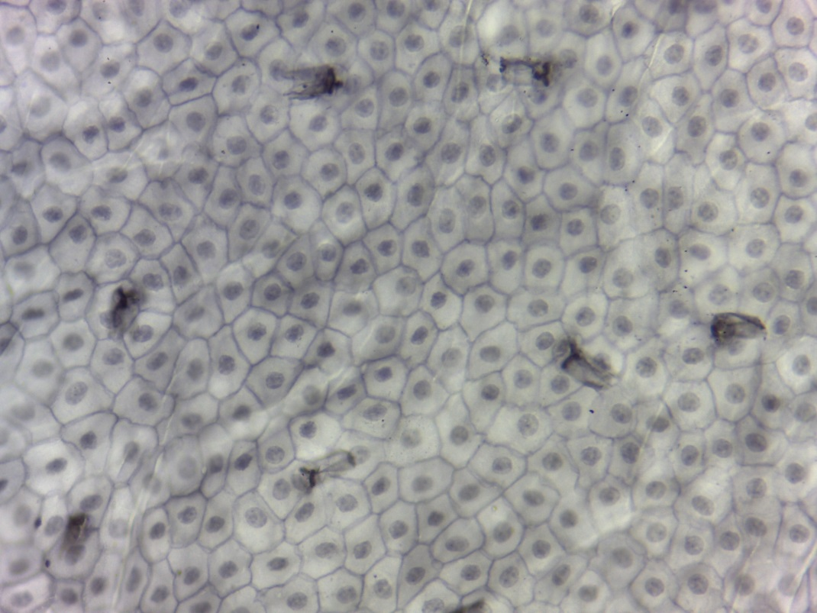
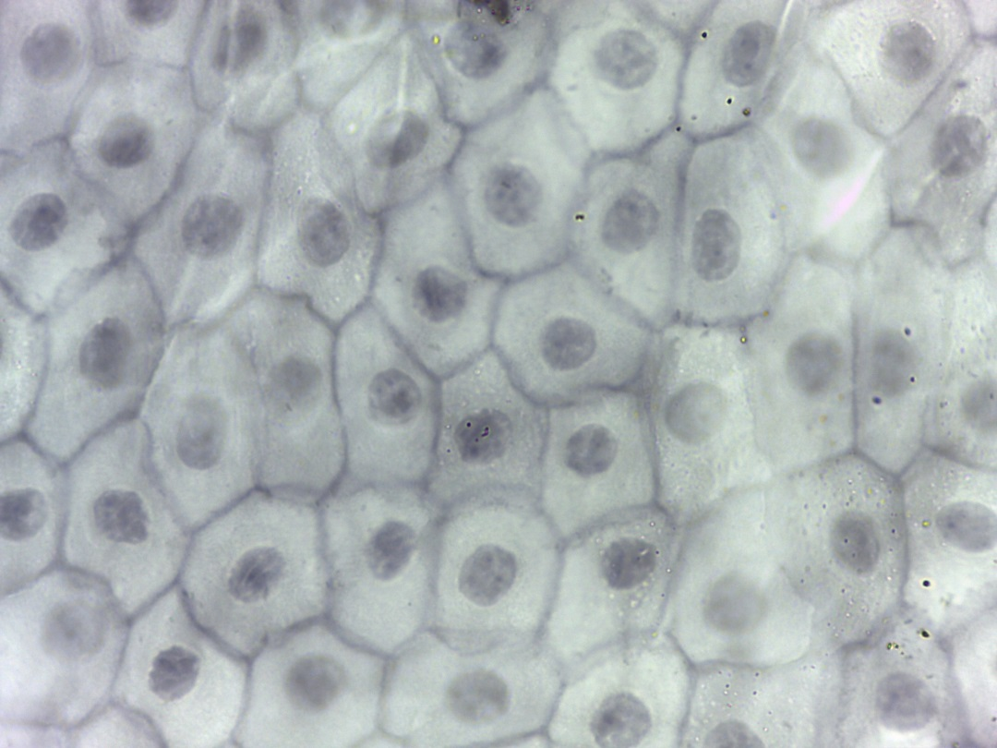
Simple Squamous Epithelium (Surface View) (1 of 2)
400X
1000X
Notes:
Simple Squamous Epithelium (Surface View) 400X and 1000X

Slide 3
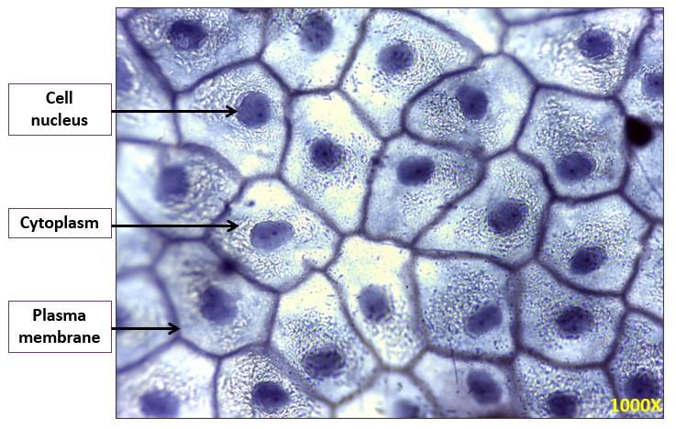
Simple Squamous Epithelium (Surface View) (2 of 2)
Notes:
Simple Squamous Epithelium (Surface View) 1000X

Slide 4
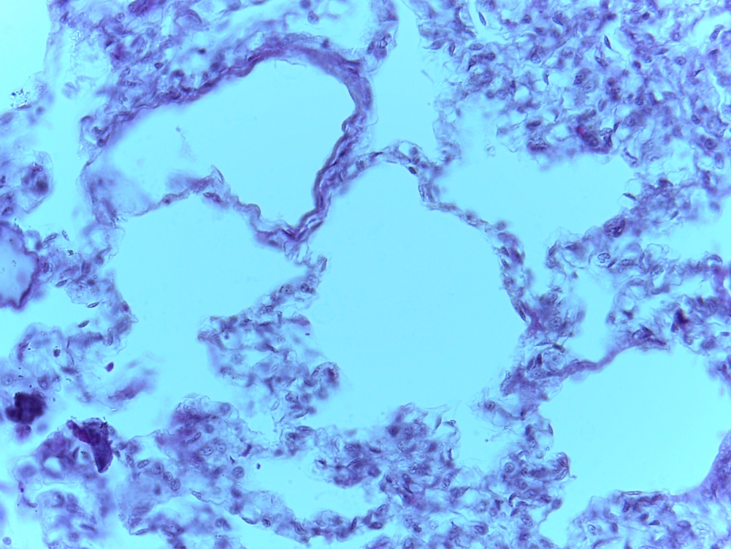
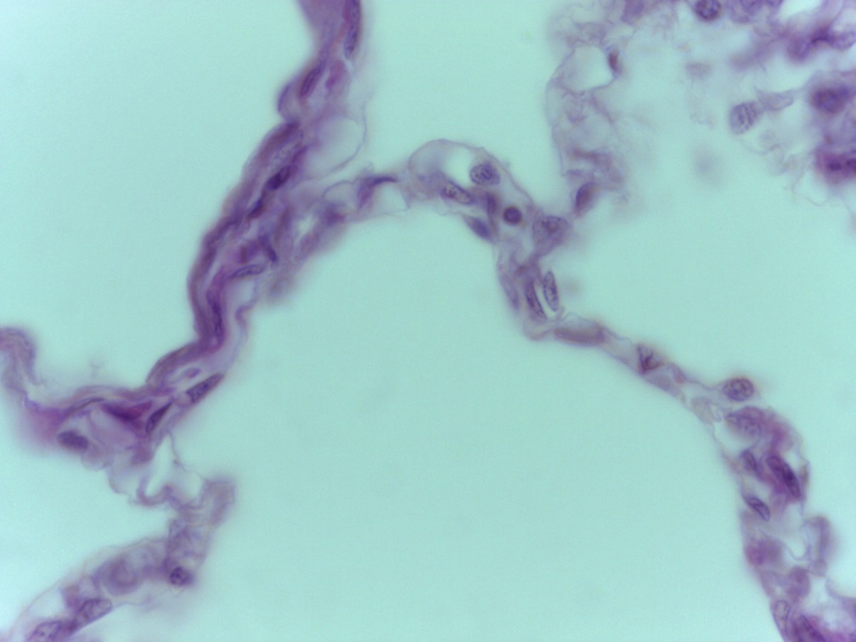
Simple Squamous Epithelium
(Walls of the Alveoli of the Lungs)
400X
1000X
Notes:
Simple Squamous Epithelium (Walls of the Alveoli of the Lungs) 400X and 1000X

Slide 5
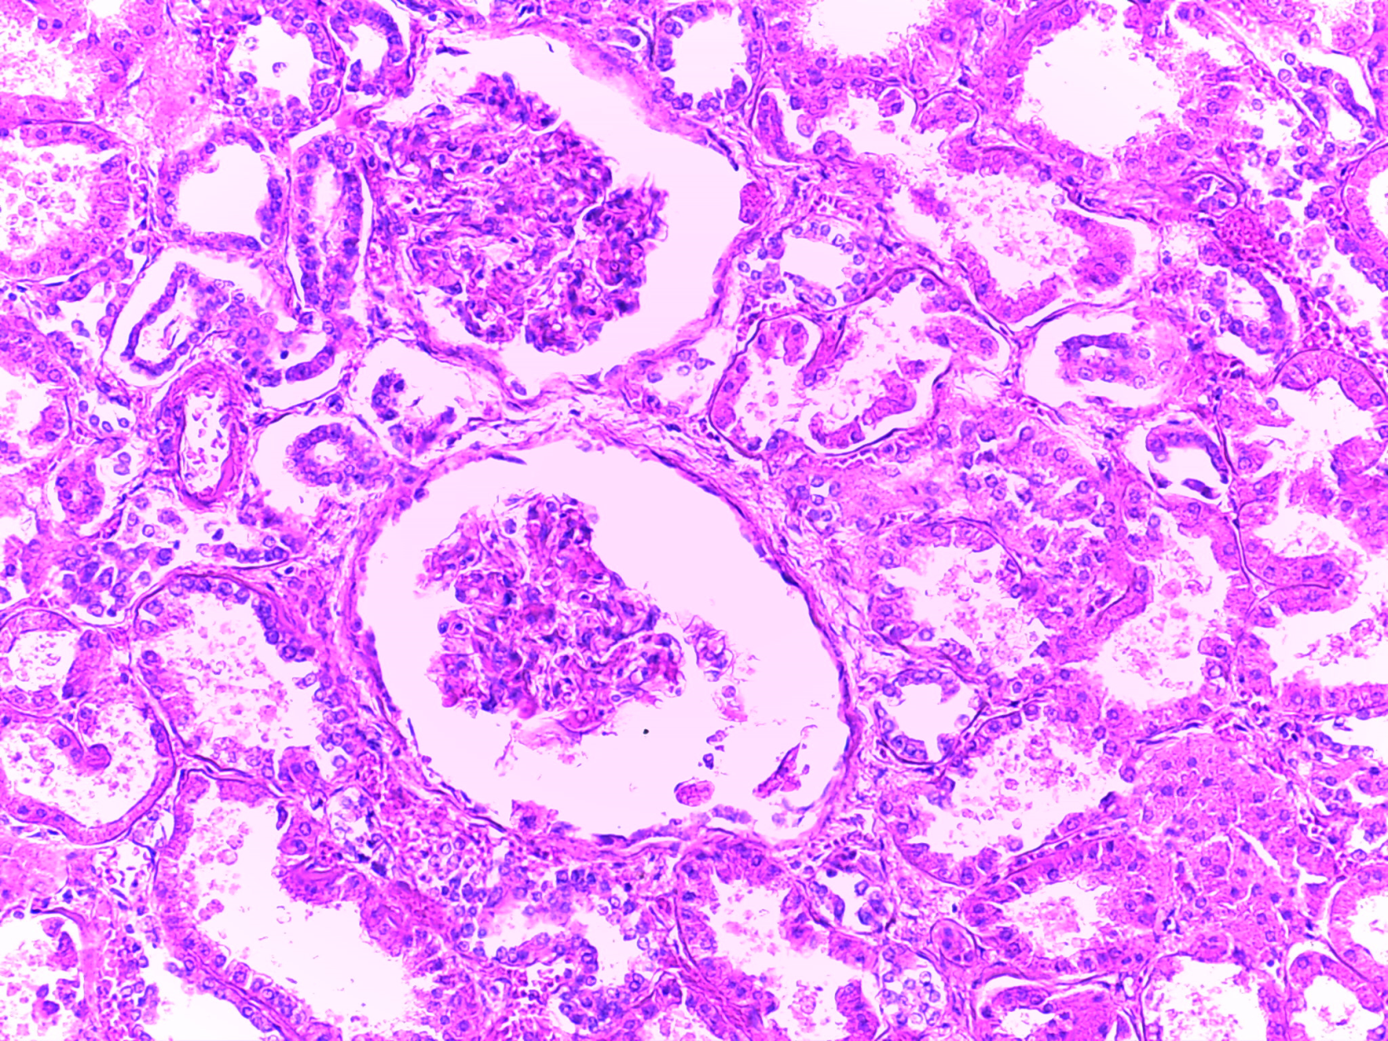
Simple Squamous Epithelium
(Parietal Layer of Glomerular Capsule of the Kidneys)
Notes:
Simple Squamous Epithelium (Parietal Layer of Glomerular Capsule of the Kidneys)

Slide 6
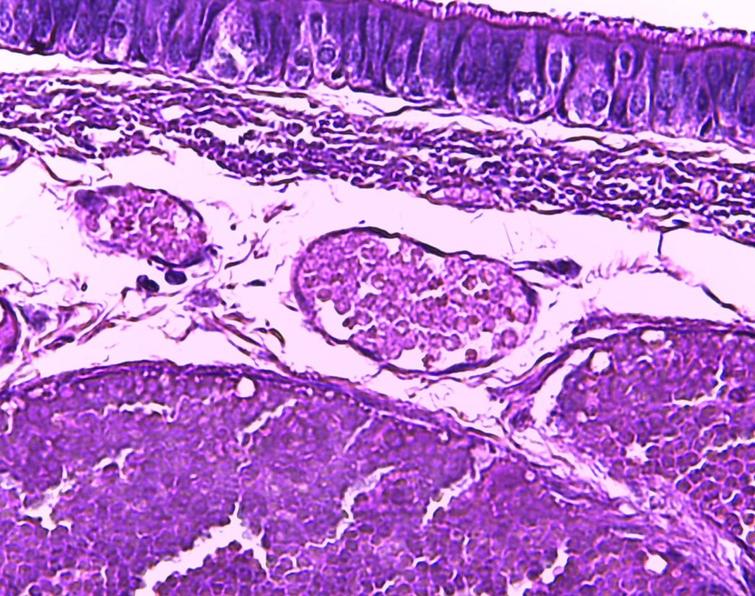
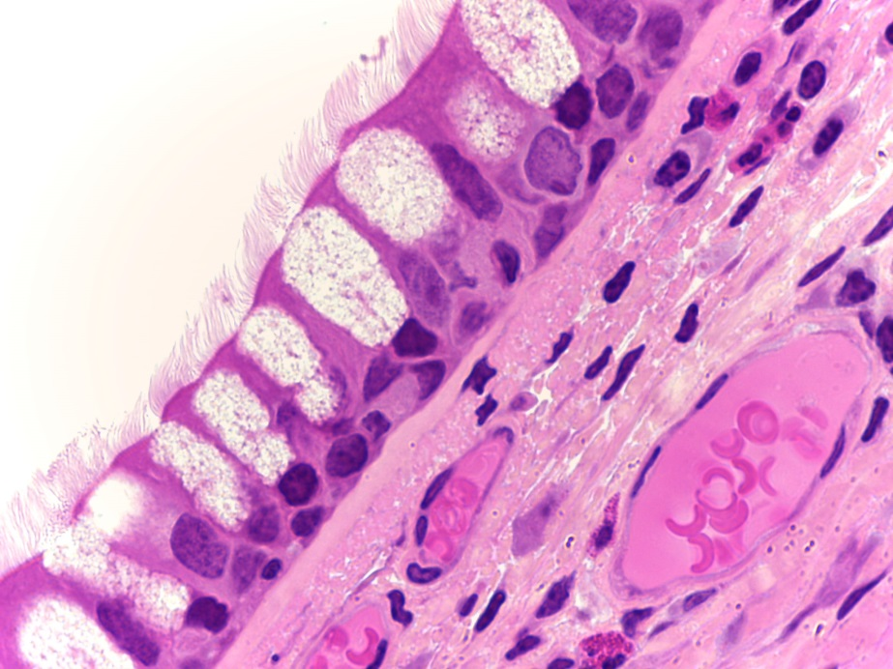
Simple Squamous Epithelium
(Walls of Capillaries)
Notes:
Simple Squamous Epithelium (Walls of Capillaries)

Slide 7
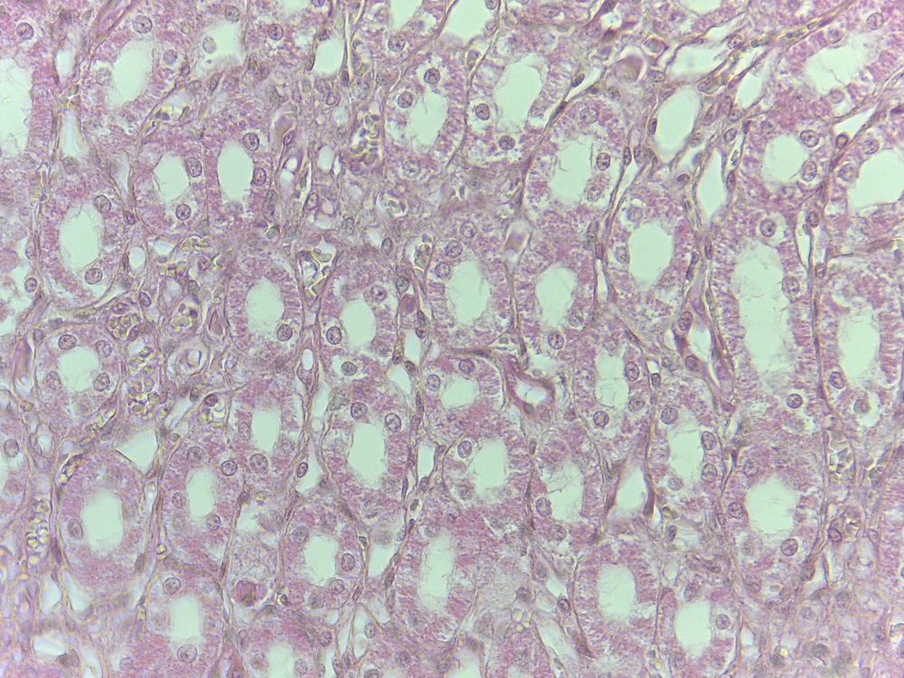
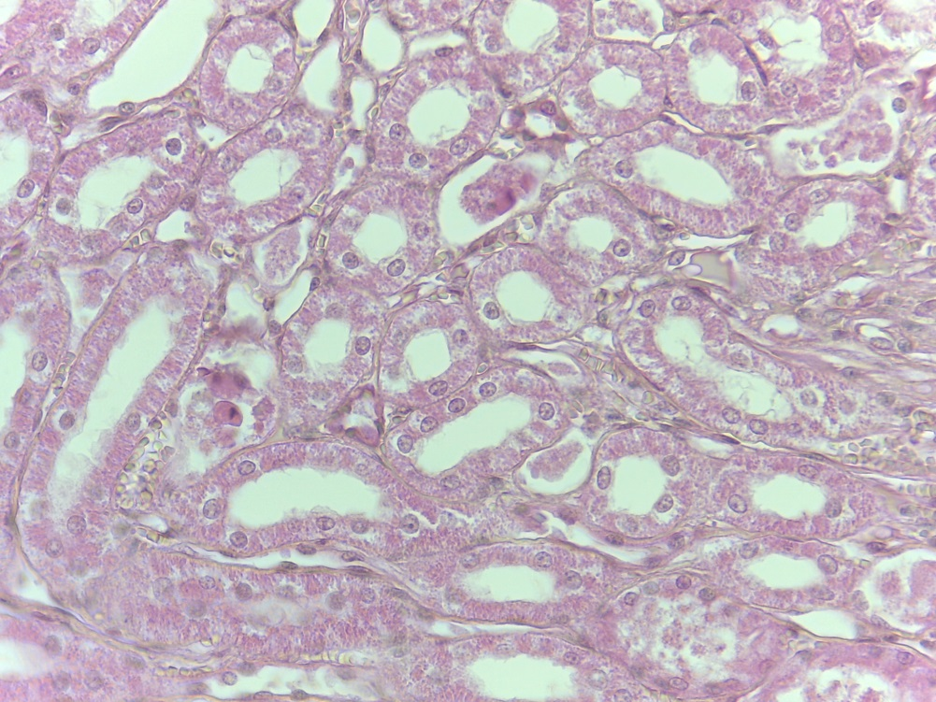
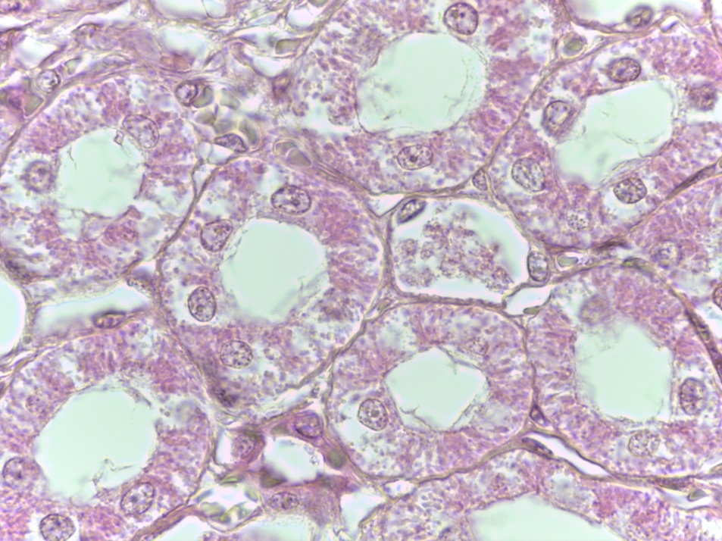
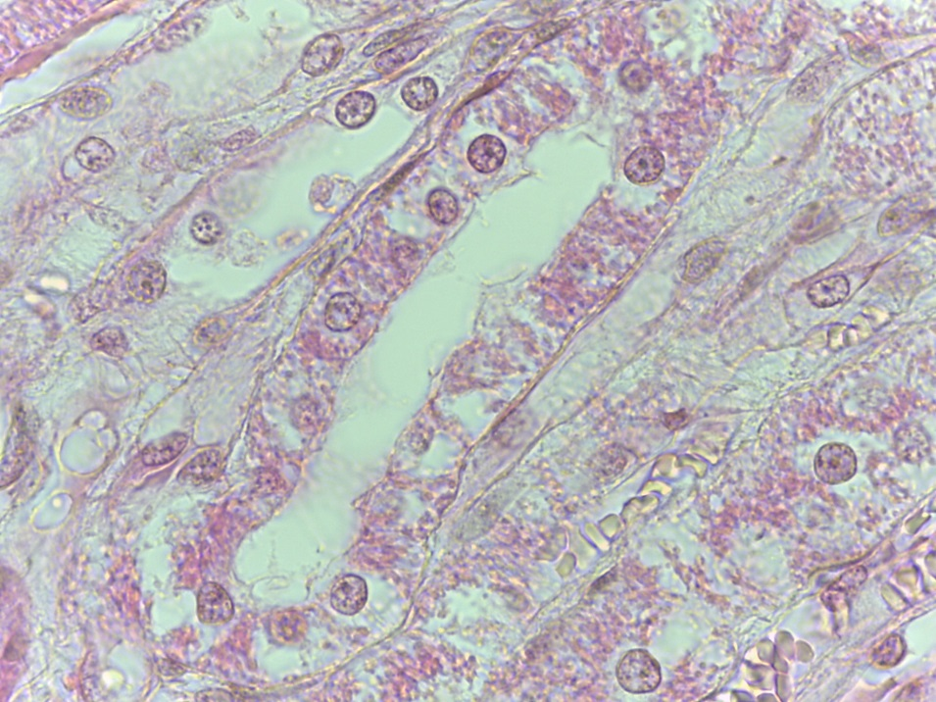
Simple Cuboidal Epithelium (1 of 2)
(400X)
(400X)
(1000X)
(1000X)
Notes:
Simple Cuboidal Epithelium 400X and 1000X

Slide 8
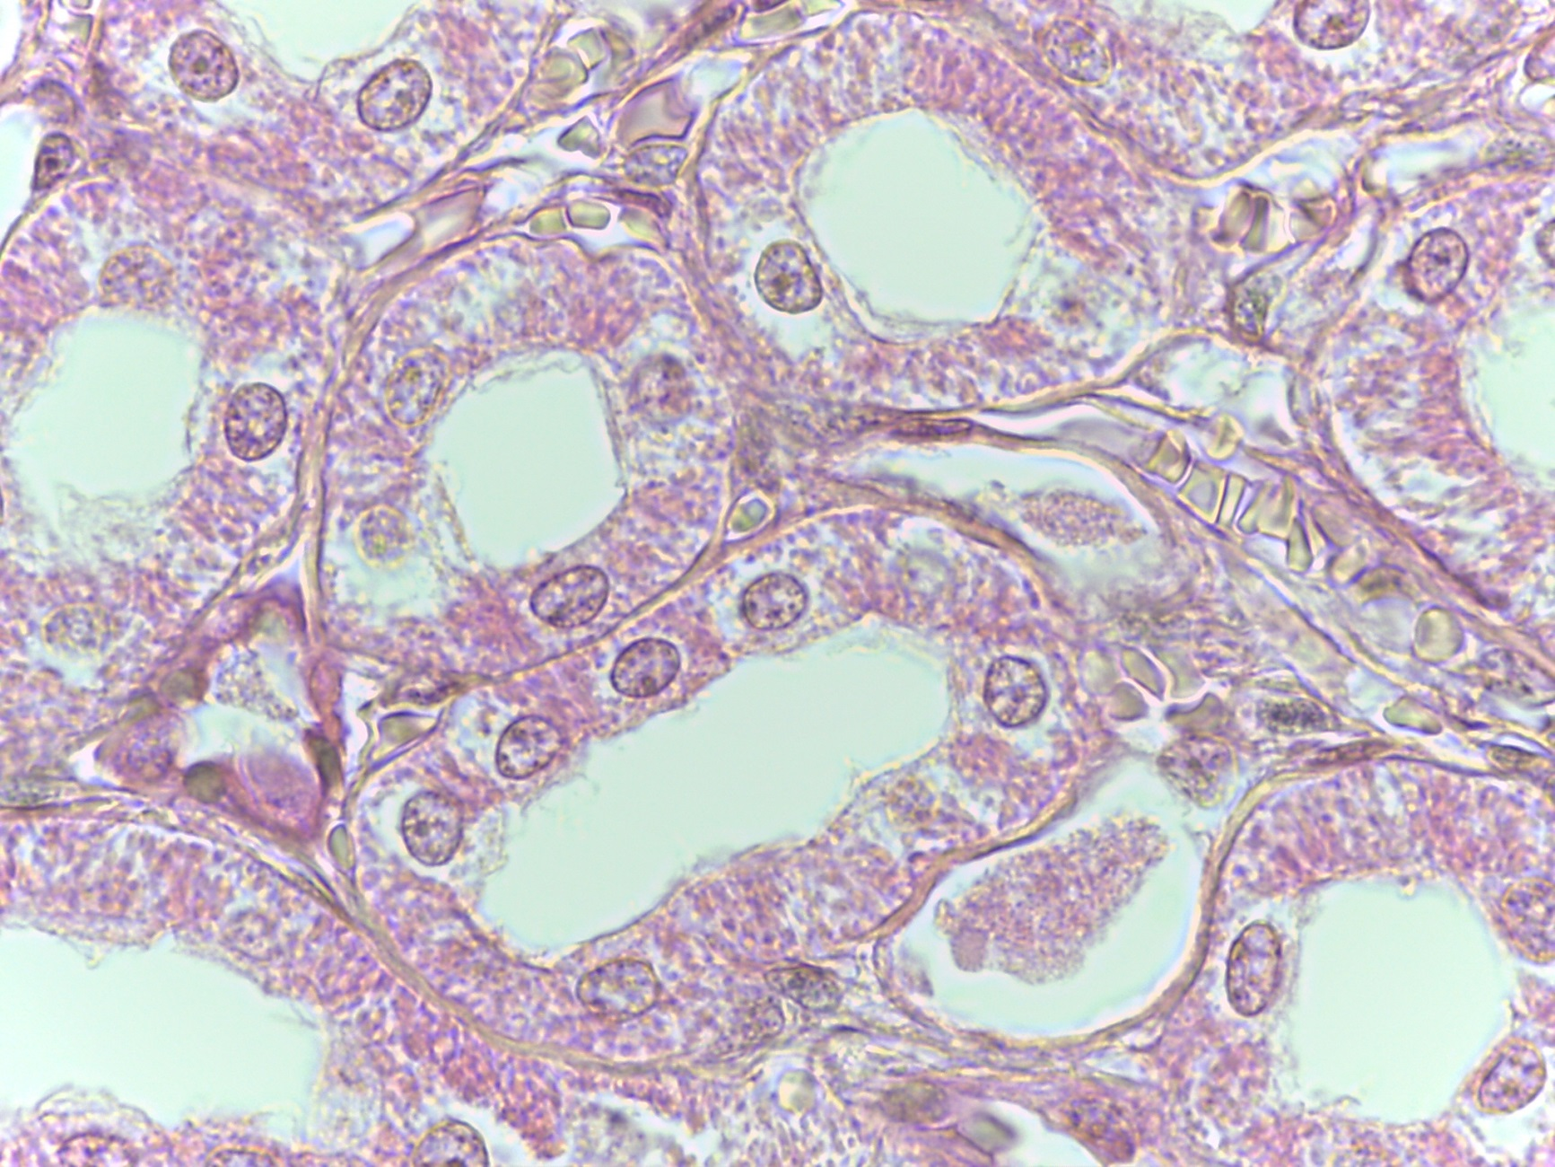
Simple Cuboidal Epithelium (2 of 2)
Nucleus
Simple cuboidal cell
Basement membrane
1000X
Notes:
Simple Cuboidal Epithelium 1000X

Slide 9
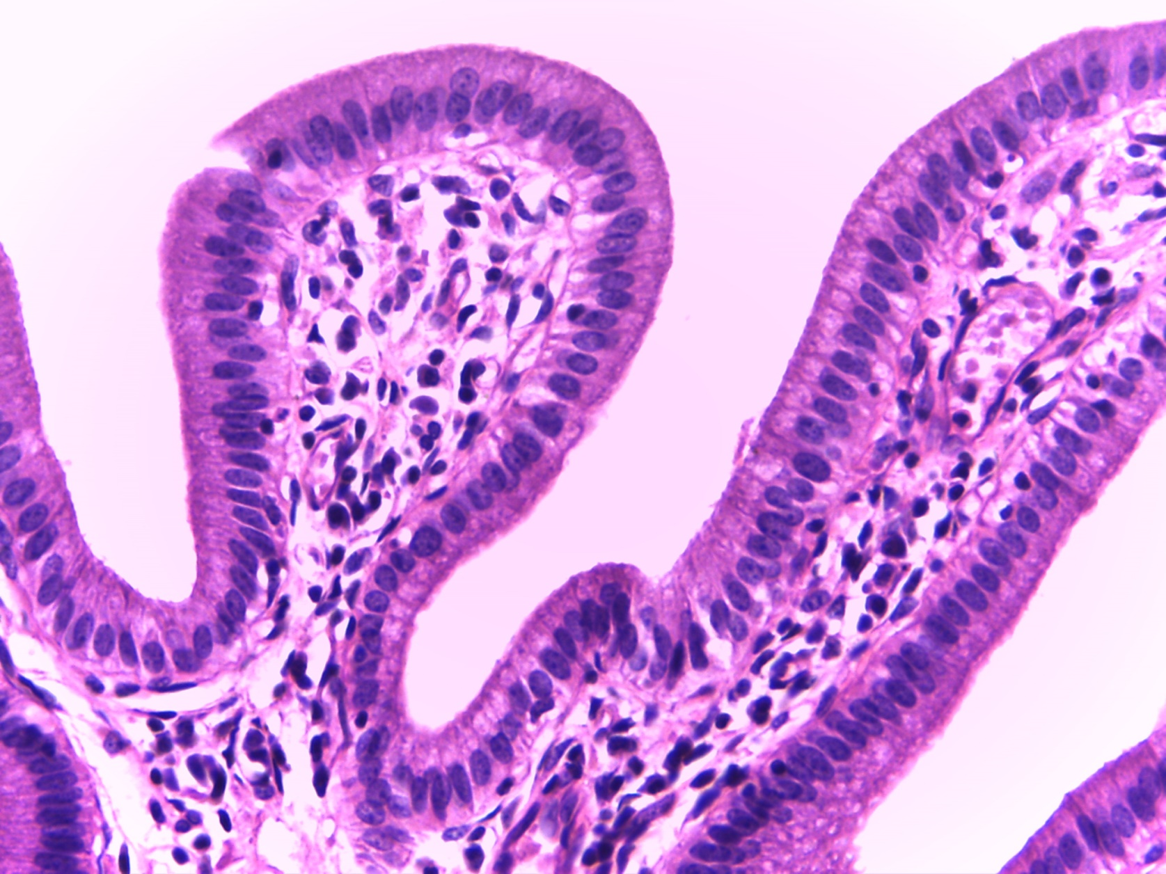
Nonciliated Simple Columnar Epithelium
(Small Intestine)
Basement membrane
Brush border
400X
Notes:
Nonciliated Simple Columnar Epithelium (Small Intestine) 400X

Slide 10
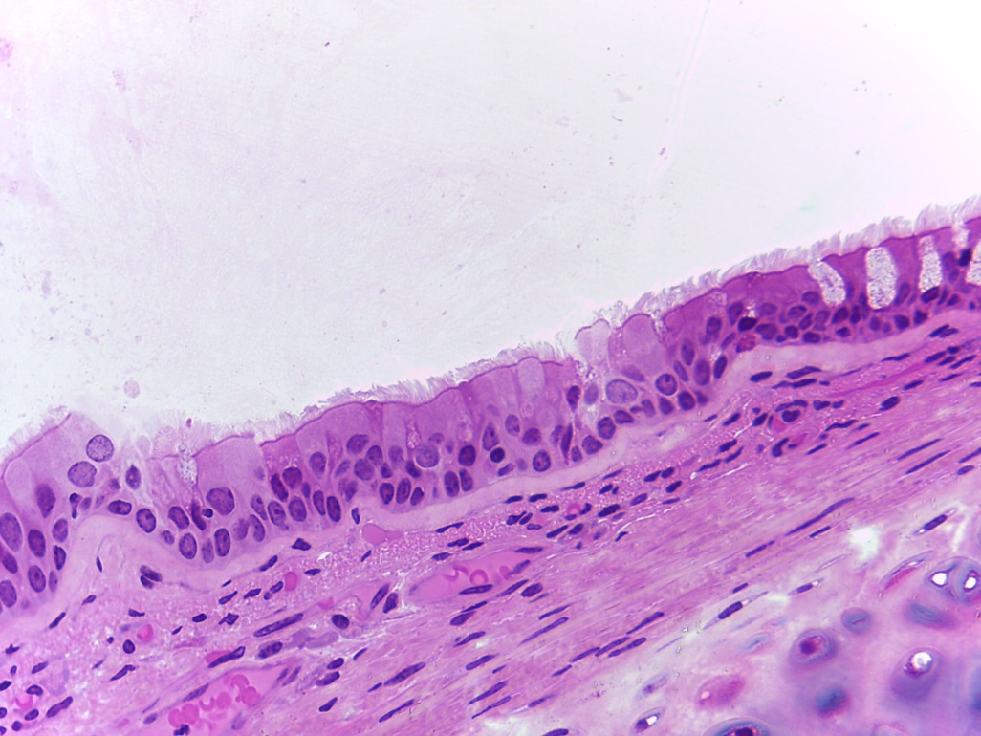
Ciliated Pseudostratified Columnar Epithelium (Trachea) (1 of 3)
(400X)
(1000X)
Notes:
Ciliated Pseudostratified Columnar Epithelium (Trachea) (1 out of 3) 400X and 1000X

Slide 11
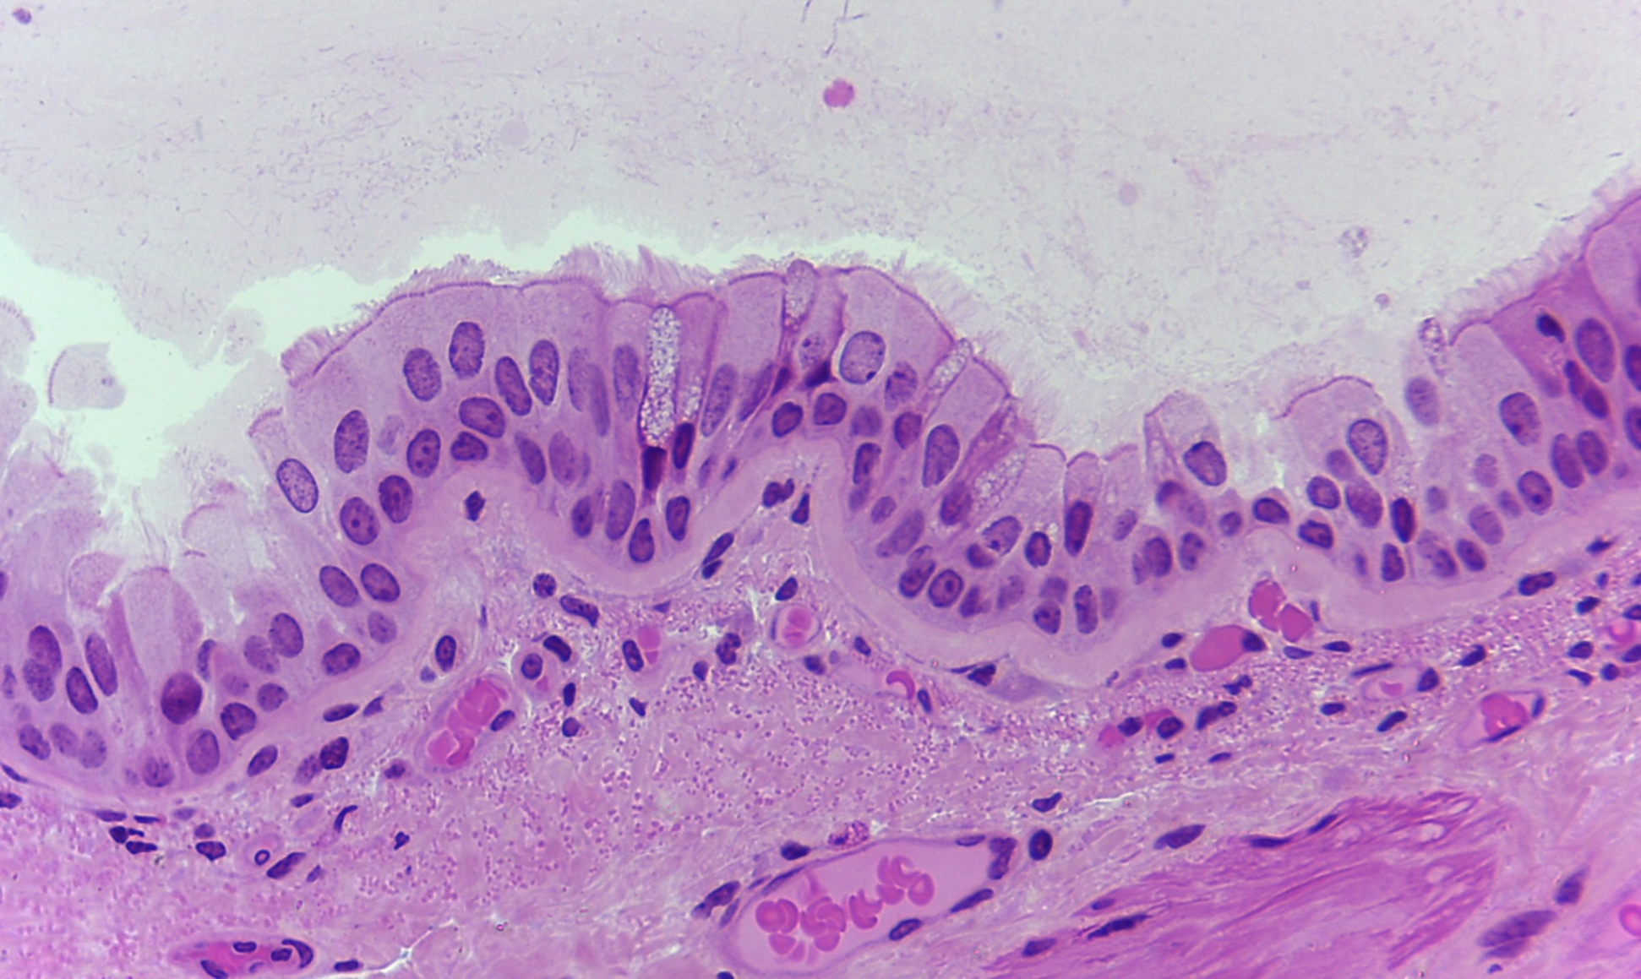
Ciliated Pseudostratified Columnar Epithelium
(Trachea) (2 of 3)
400X
Notes:
Ciliated Pseudostratified Columnar Epithelium (Trachea) 400X

Slide 12
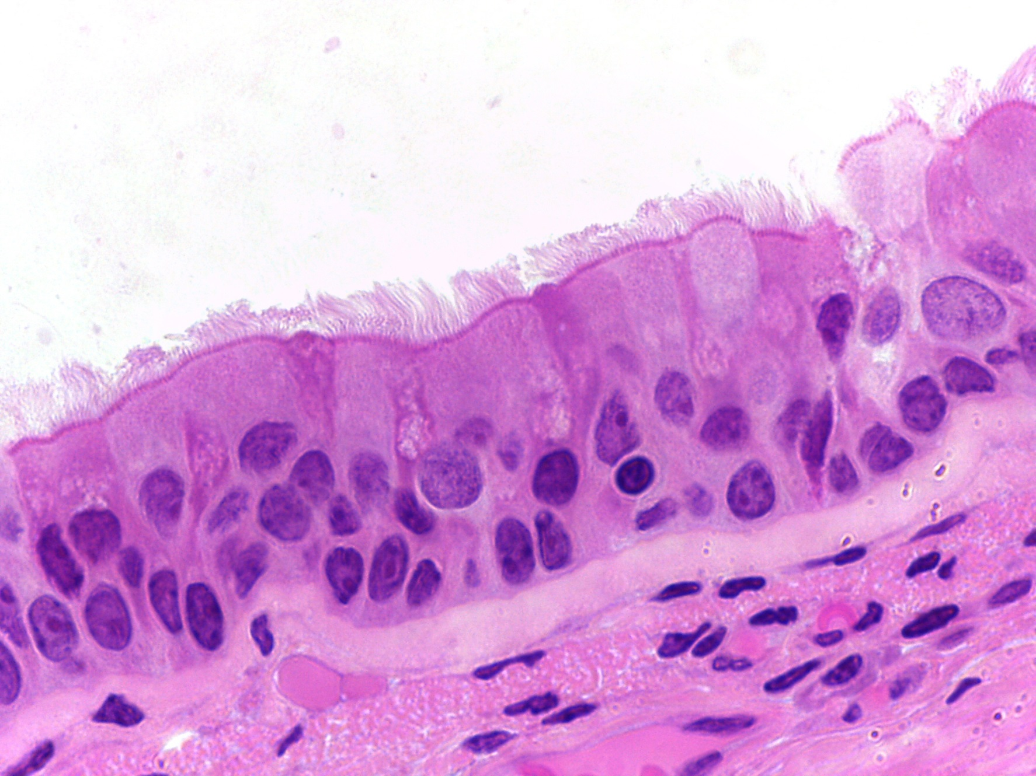
Ciliated Pseudostratified Columnar Epithelium
(Trachea) (3 of 3)
Goblet cell
Cilia
Basement membrane
1000X
Notes:
Ciliated Pseudostratified Columnar Epithelium (Trachea) 1000X

Slide 13
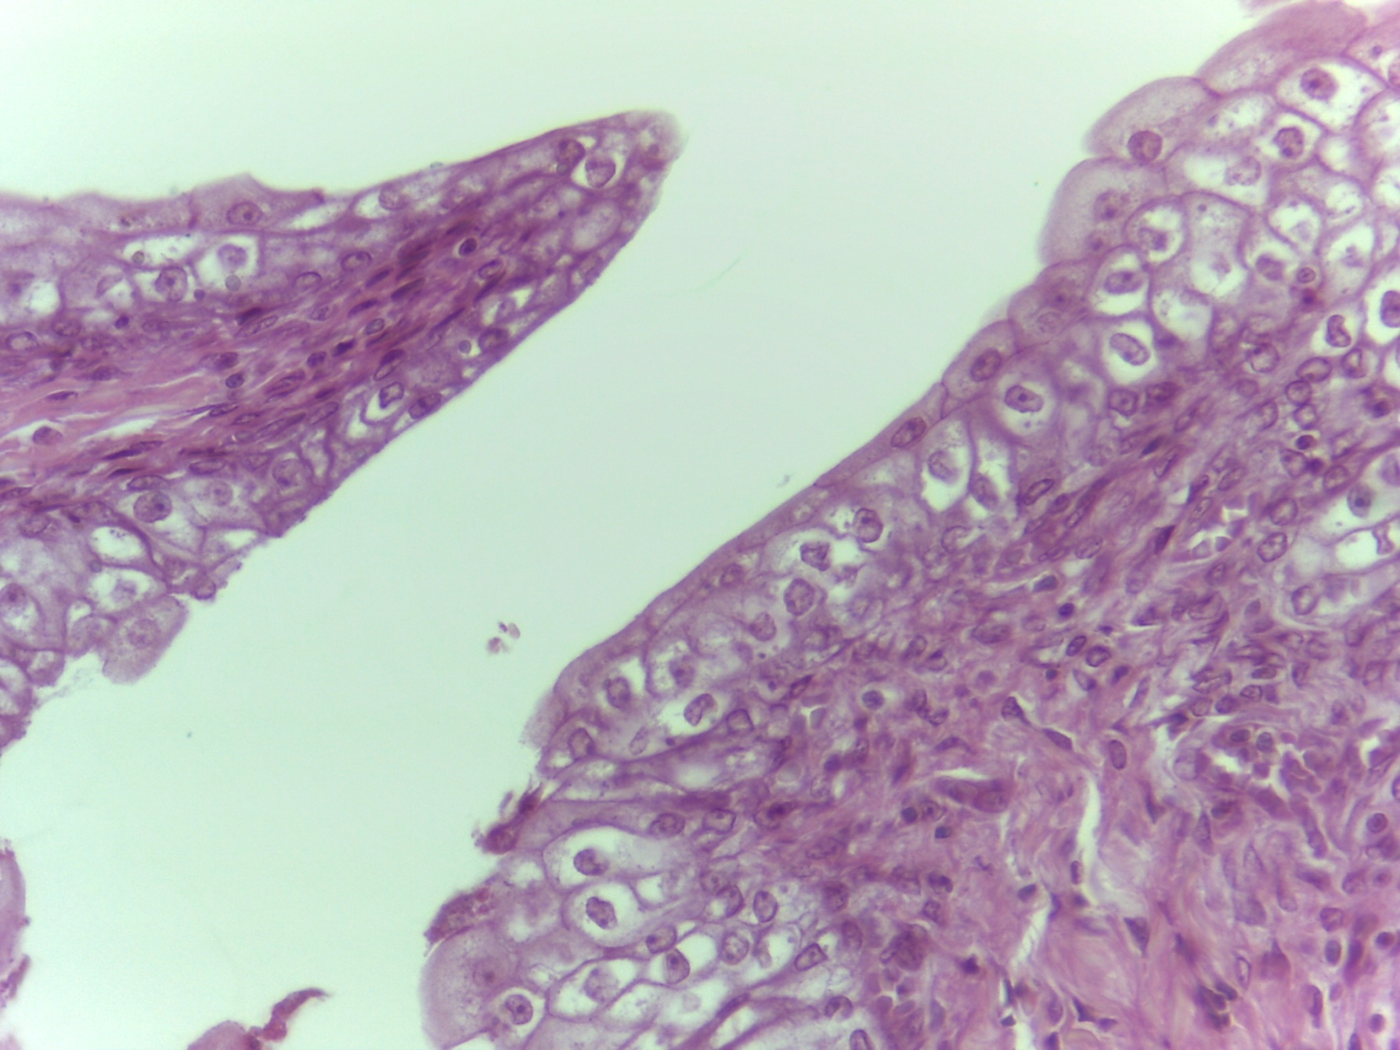
Transitional Epithelium (1 of 3)
Basement membrane
400X
Notes:
Transitional Epithelium 400X

Slide 14
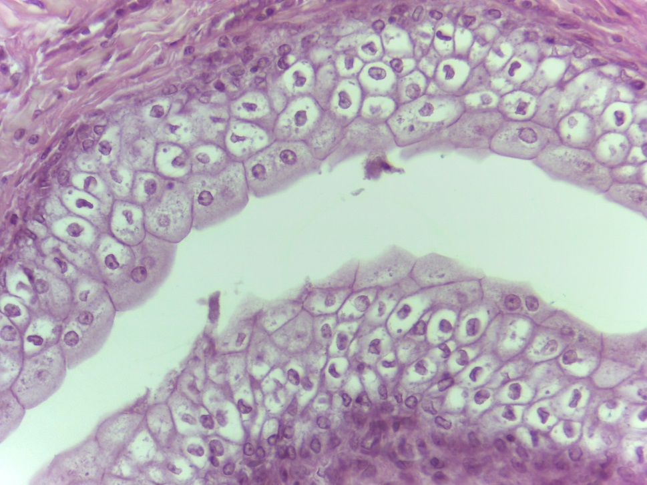
Transitional Epithelium (2 of 3)
400X
Notes:
Transitional Epithelium 400X

Slide 15
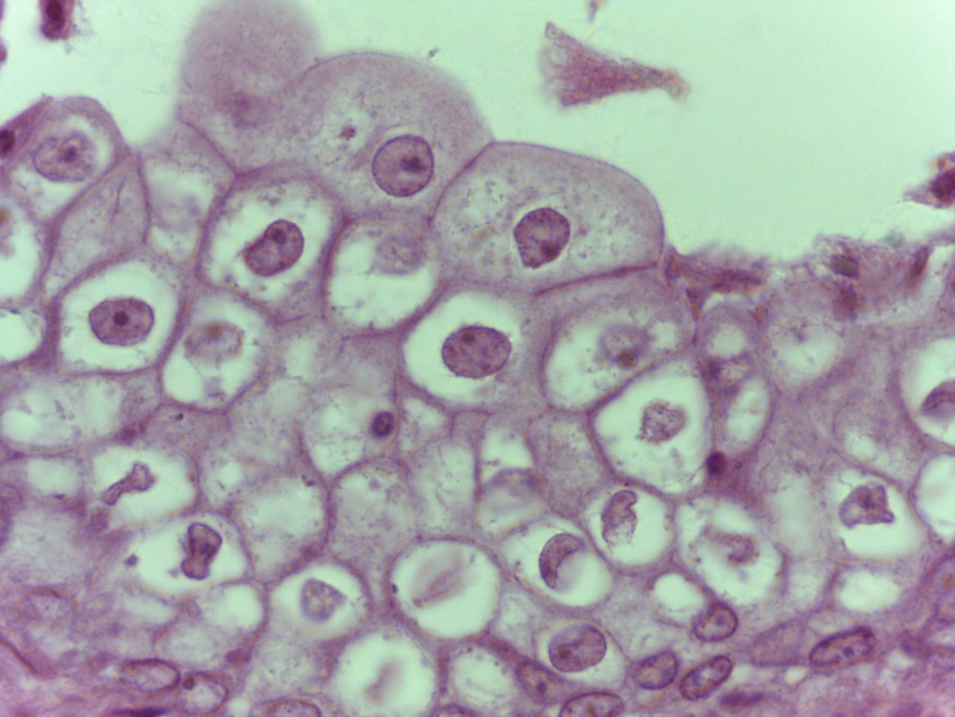
Transitional Epithelium (3 of 3)
1000X
Notes:
Transitional Epithelium 1000X

Slide 16
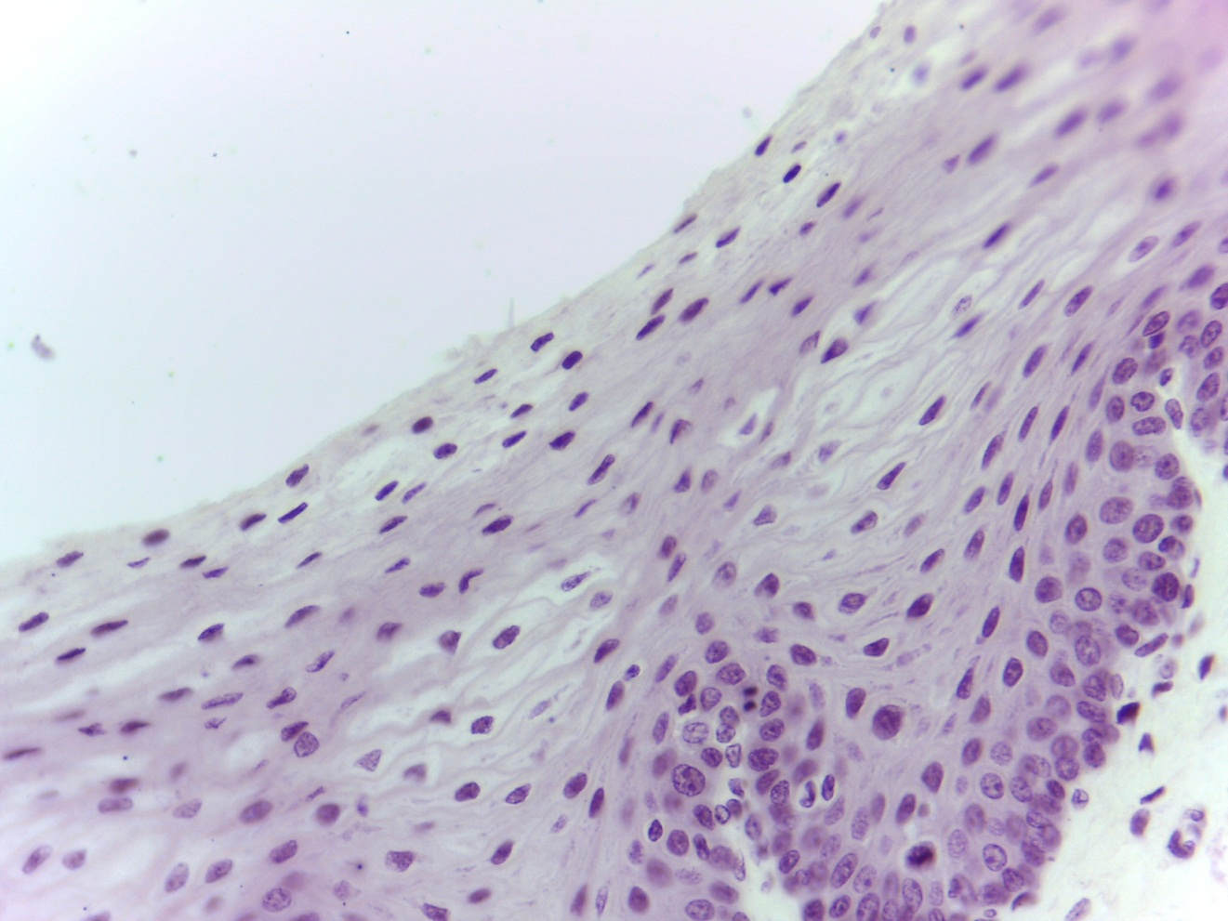
Nonkeratinized Stratified Squamous Epithelium
400X
Notes:
Nonkeratinized Stratified Squamous Epithelium 400X

Slide 17
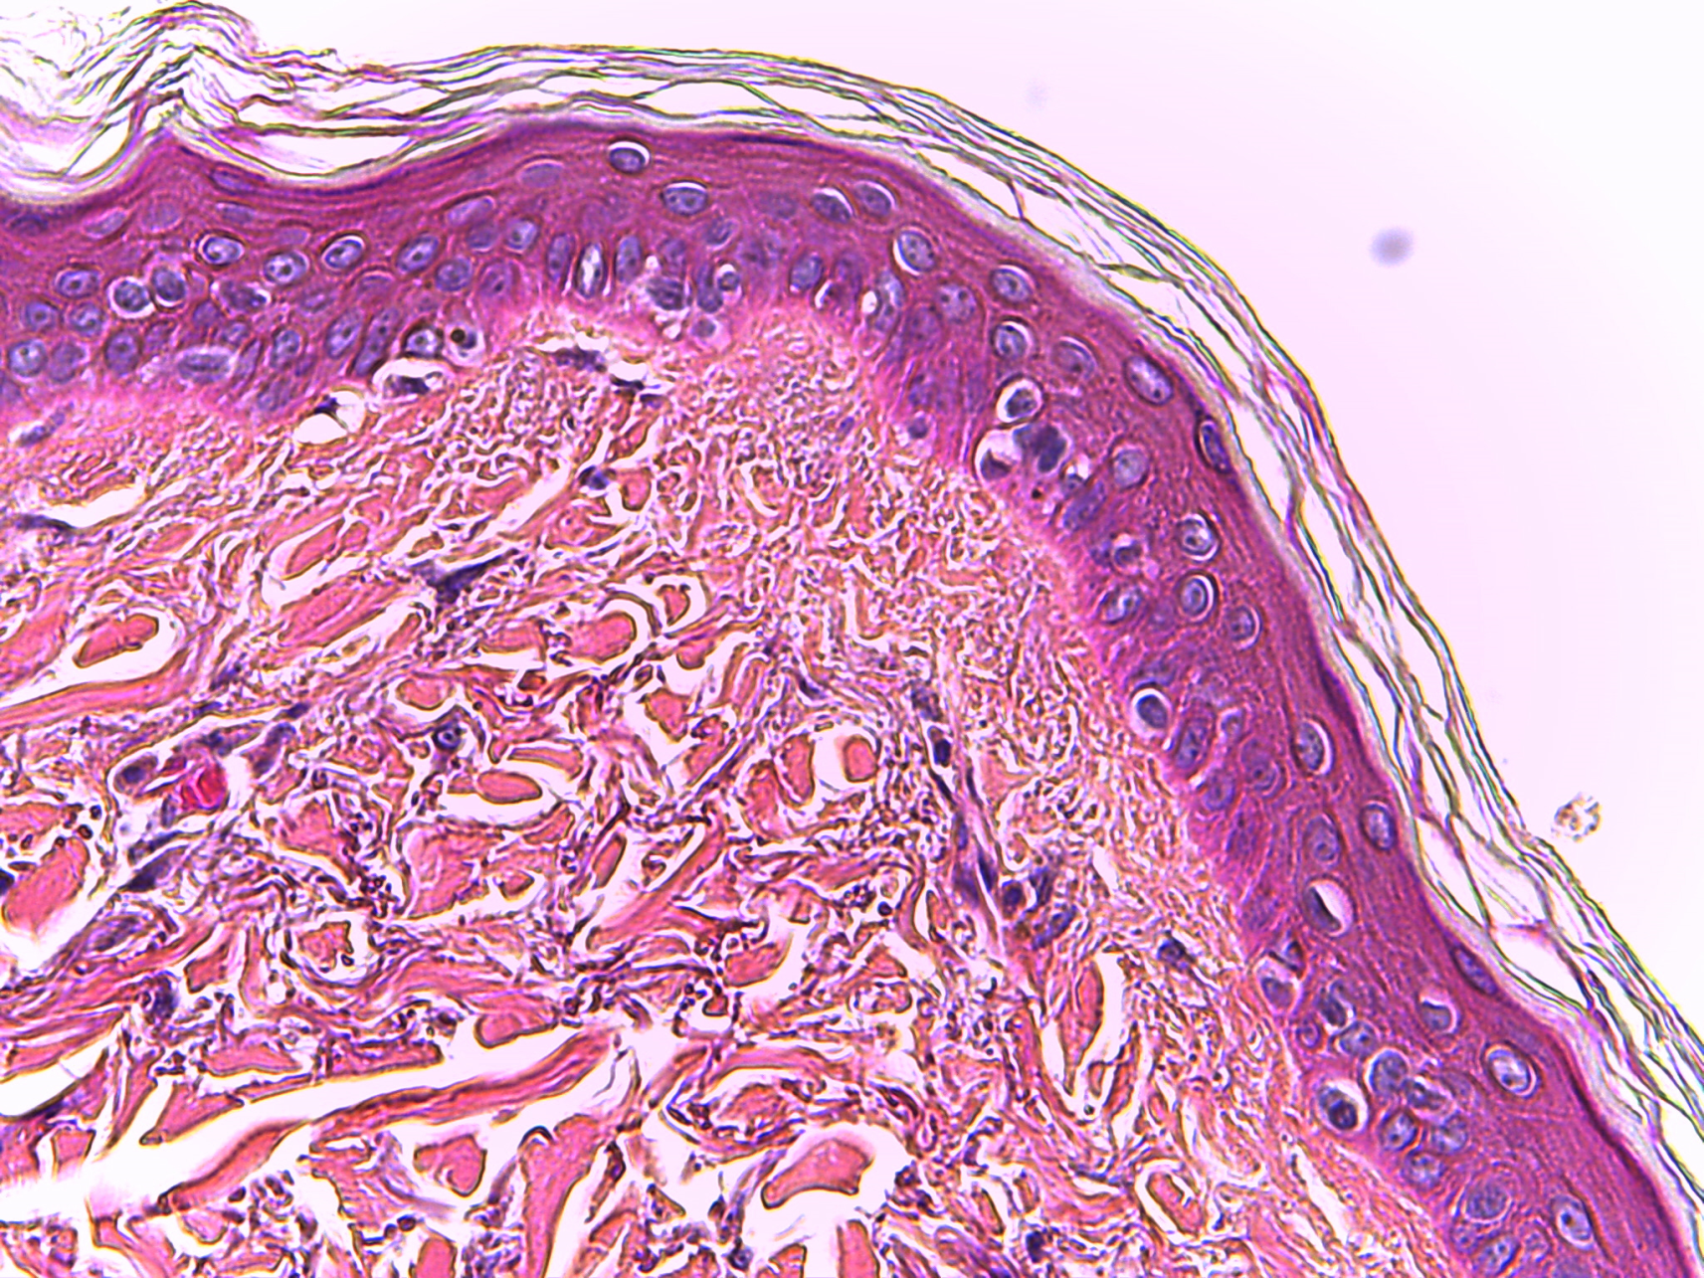
Keratinized Stratified Squamous Epithelium
Notes:
Keratinized Stratified Squamous Epithelium

Slide 18
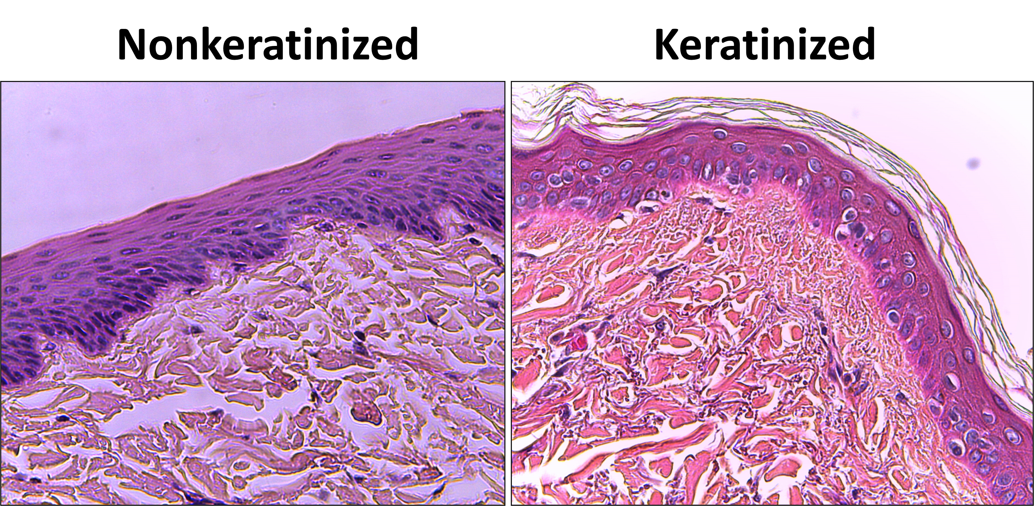
Stratified Squamous Epithelium
Notes:
Stratified Squamous Epithelium Nonkeratinized and Keratinized

