Slide 1
Histology Slides Part 2 Connective Tissues
Photographed by:
Mr. James Henry
Labeled and Made Accessible by:
Dr. Laila Nimri
Edited by:
Dr. Maya Byfield Mr. James Henry
Dist. Prof. Mary Dolnack Dr. Syed Arif Humayun
Dr. Essa Farah Dr. Laila Nimri

Slide 2
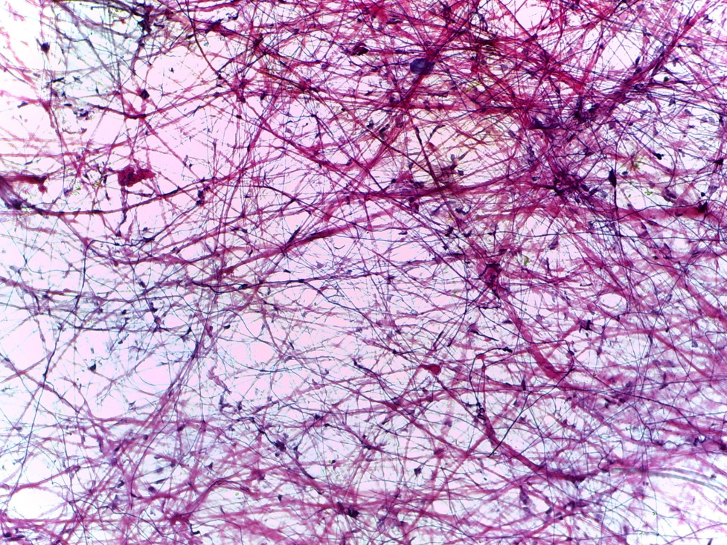
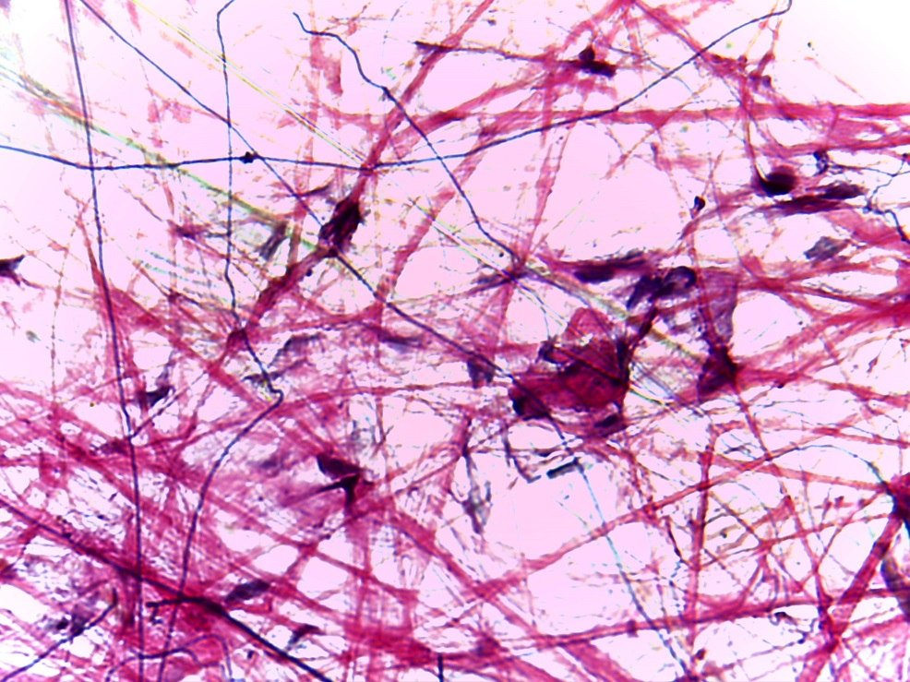
Loose (Areolar) Connective Tissue (1 of 2)
(200X)
(400X)
Notes:
Loose (Areolar) Connective Tissue 200X and 400X

Slide 3
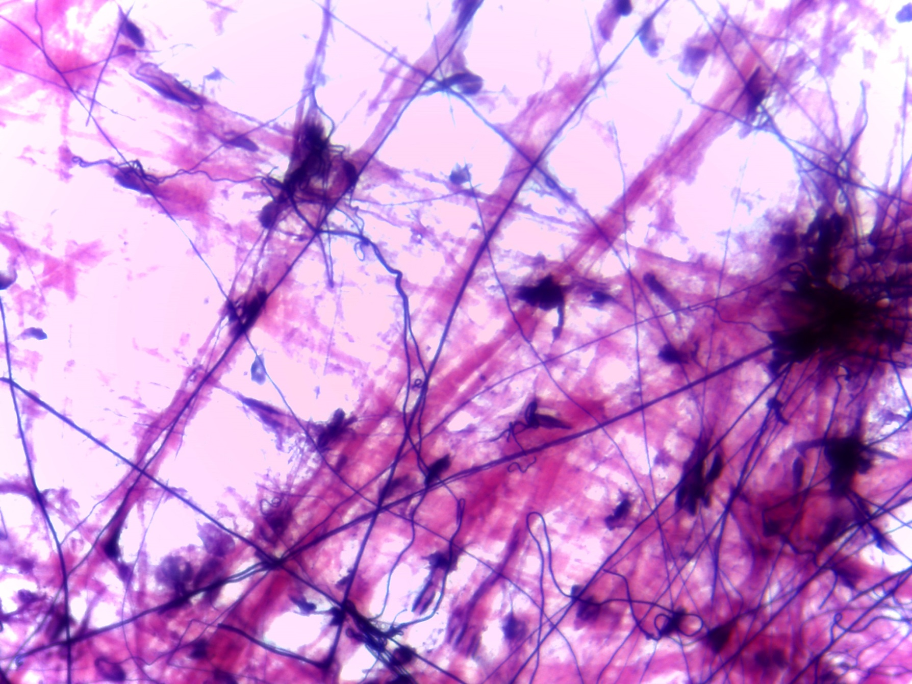
Loose (Areolar) Connective Tissue (2 of 2)
Fibroblast nucleus
Collagen fiber
Elastic fiber
Ground substance
400X
Notes:
Loose (Areolar) Connective Tissue 400X

Slide 4
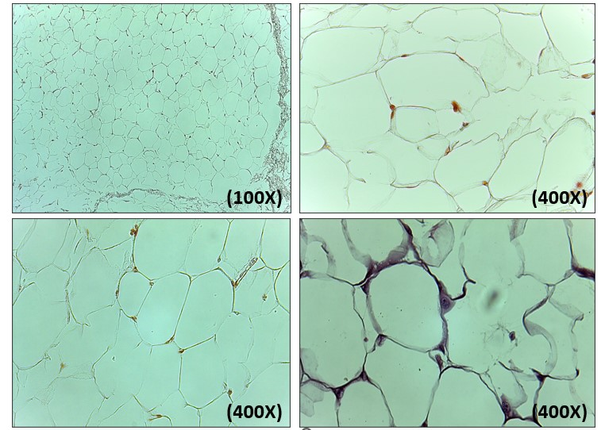
Adipose Connective Tissue (1 of 3)

Slide 5
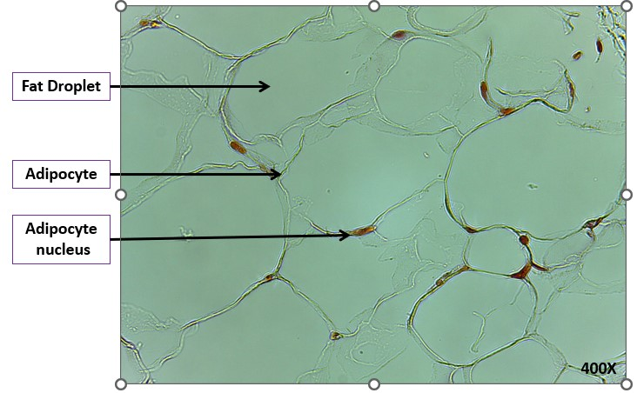
Adipose Connective Tissue (2 of 3)

Slide 6
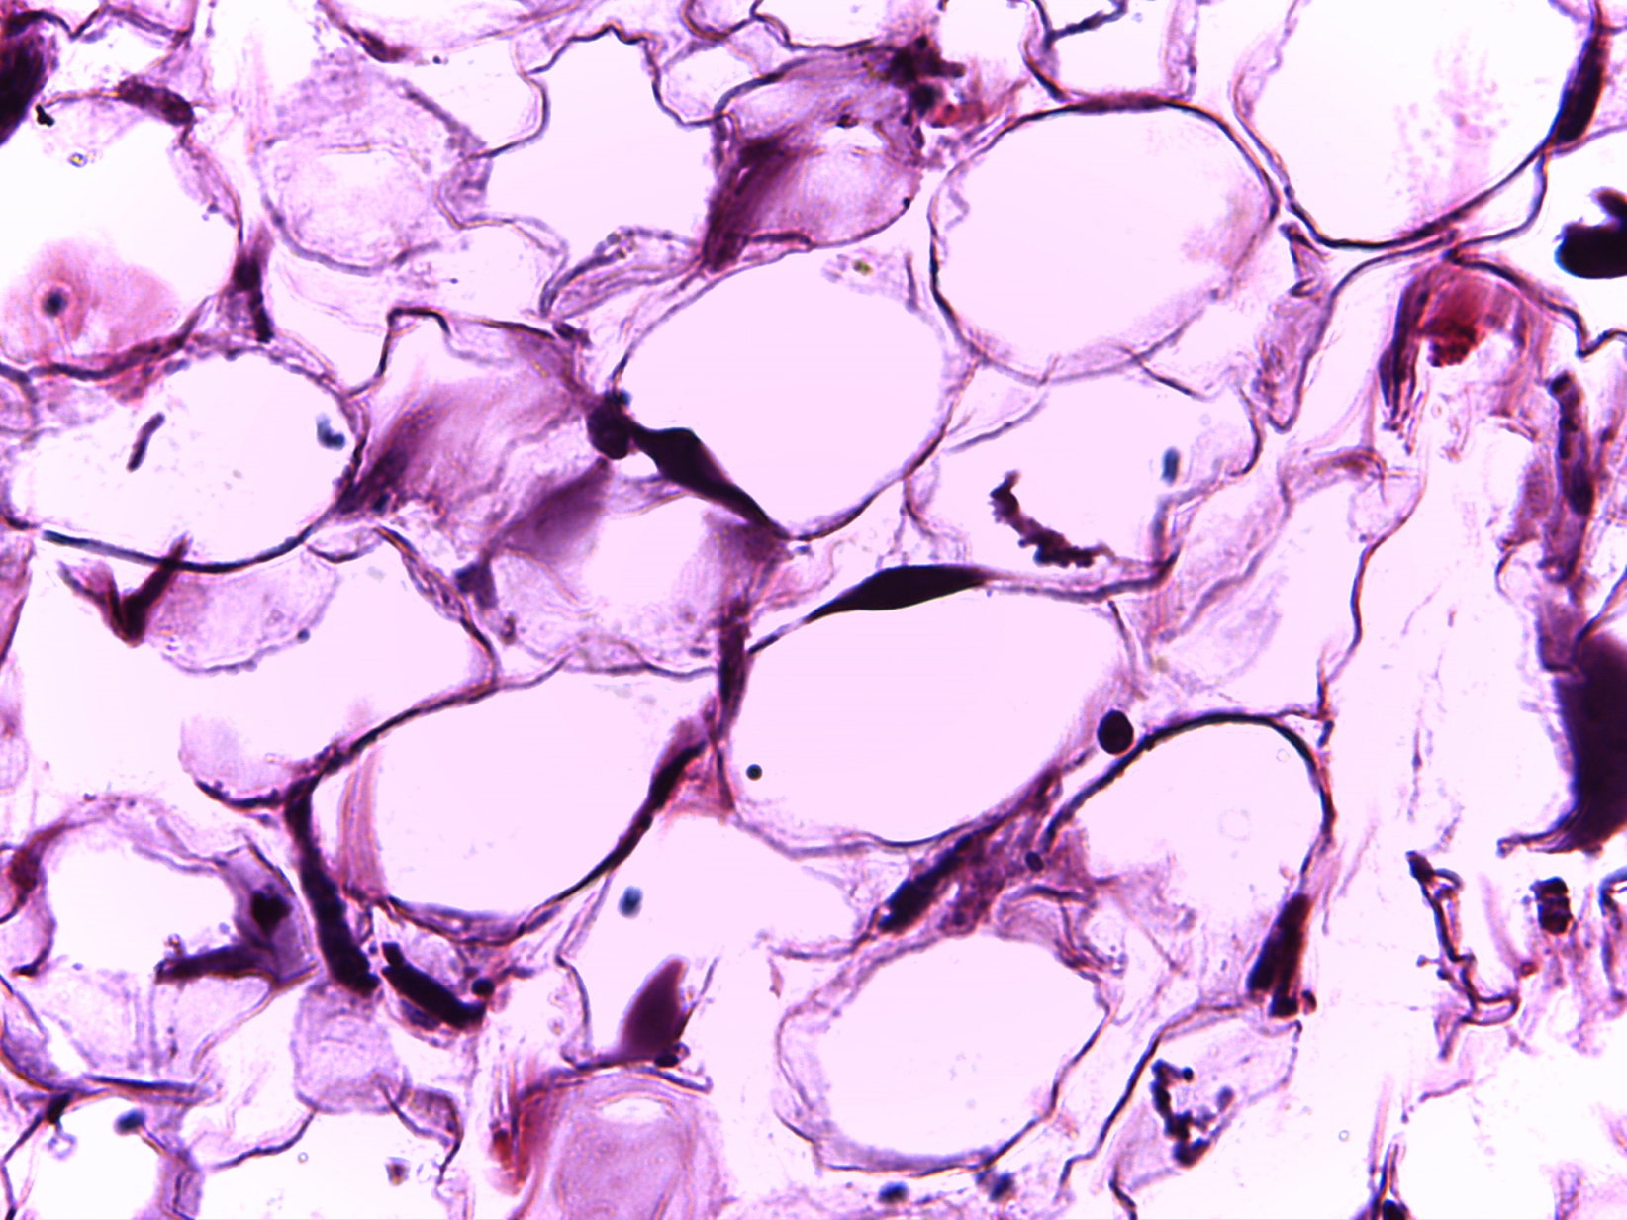
Adipose Connective Tissue (3 of 3)
Adipocyte
Adipocyte
nucleus
Fat Droplet
400X
Notes:
Adipose Connective Tissue 400X

Slide 7
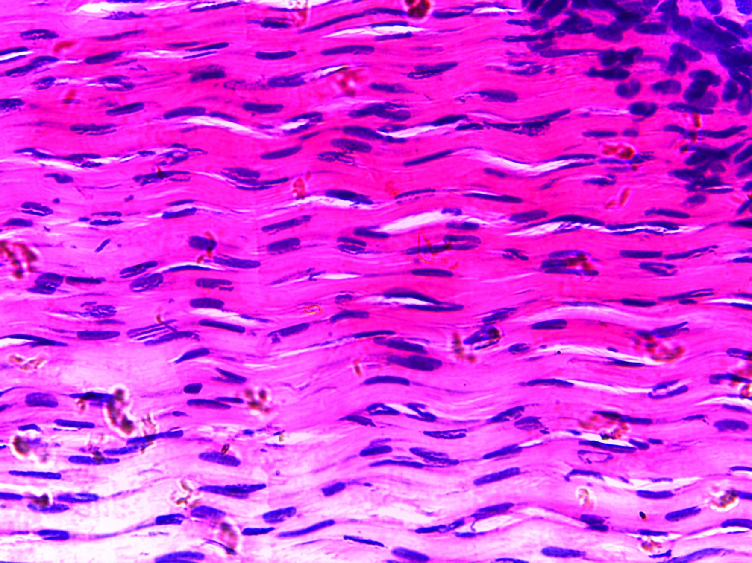
Dense Regular Connective Tissue
Ground substance
Collagen fiber bundles
Fibroblast nucleus
400X
Notes:
Dense Regular Connective Tissue 400X

Slide 8
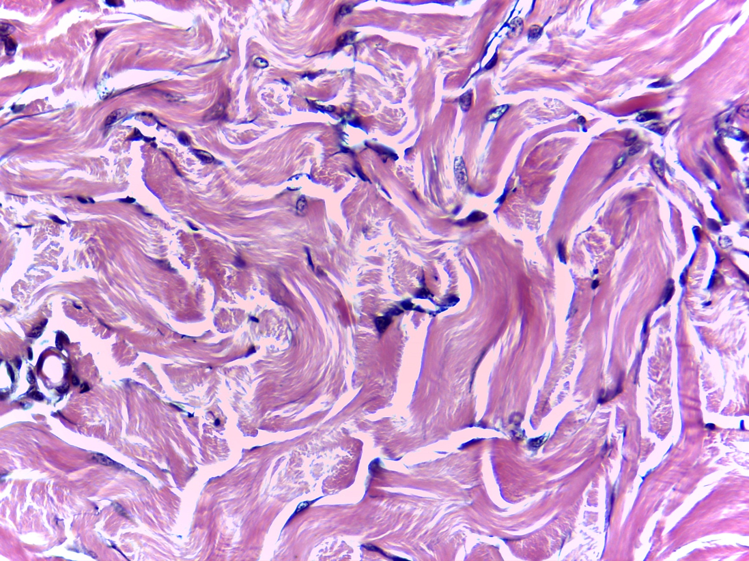
Dense Irregular Connective Tissue
Fibroblast nucleus
Collagen fiber bundles
Ground substance
400X
Notes:
Dense Irregular Connective Tissue 400X

Slide 9
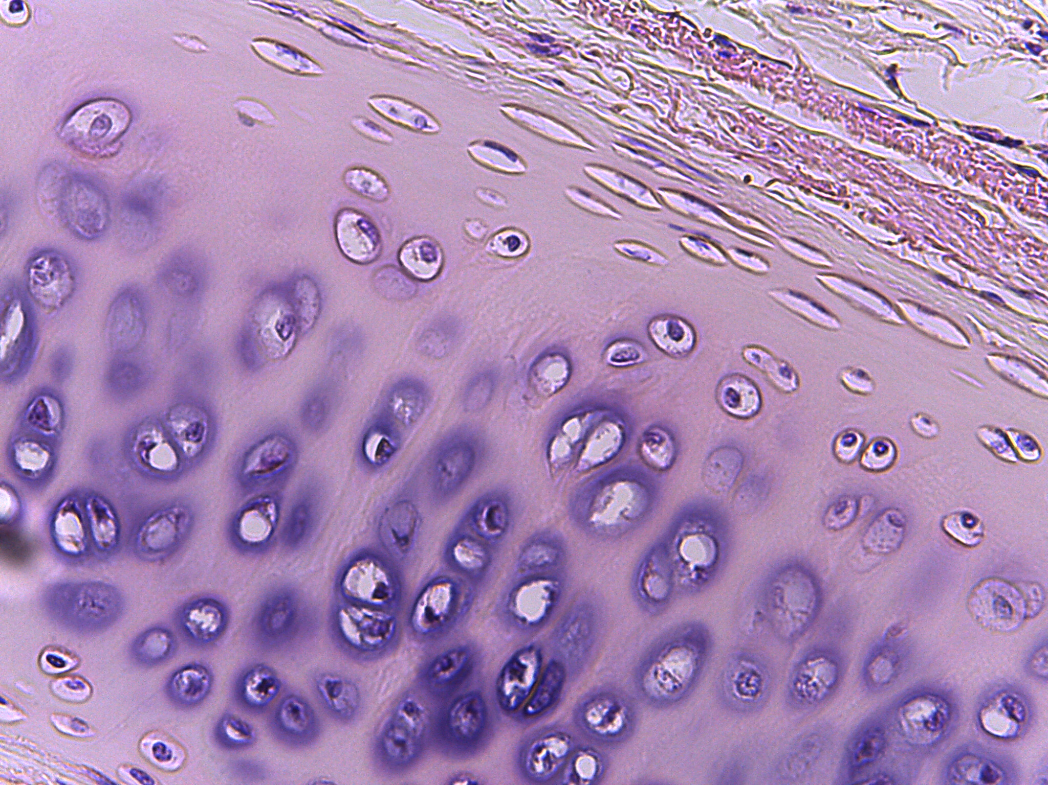
Hyaline Cartilage Connective Tissue (1 of 2)
400X
Notes:
Hyaline Cartilage Connective Tissue 400X

Slide 10
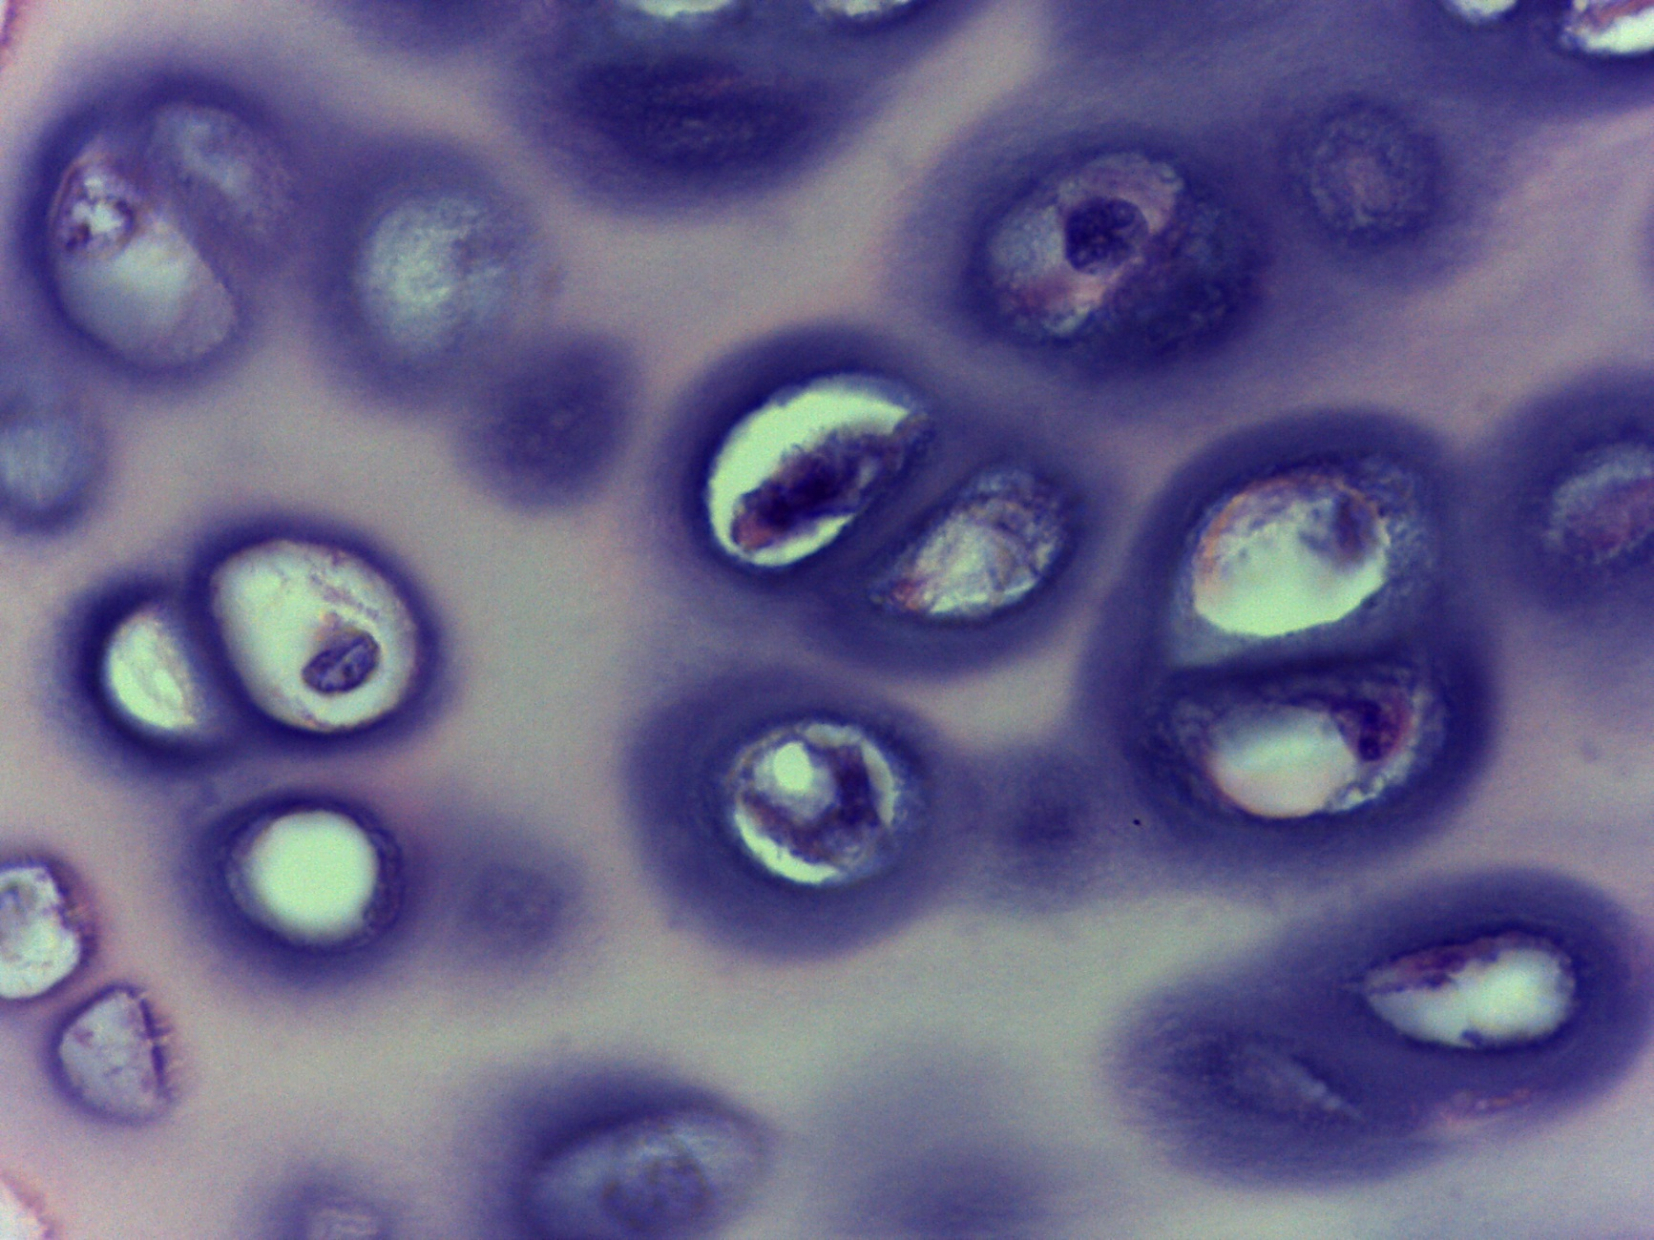
Hyaline Cartilage Connective Tissue (2 of 2)
Chondrocyte in a lacuna
Ground substance
1000X
Notes:
Hyaline Cartilage Connective Tissue 1000X

Slide 11
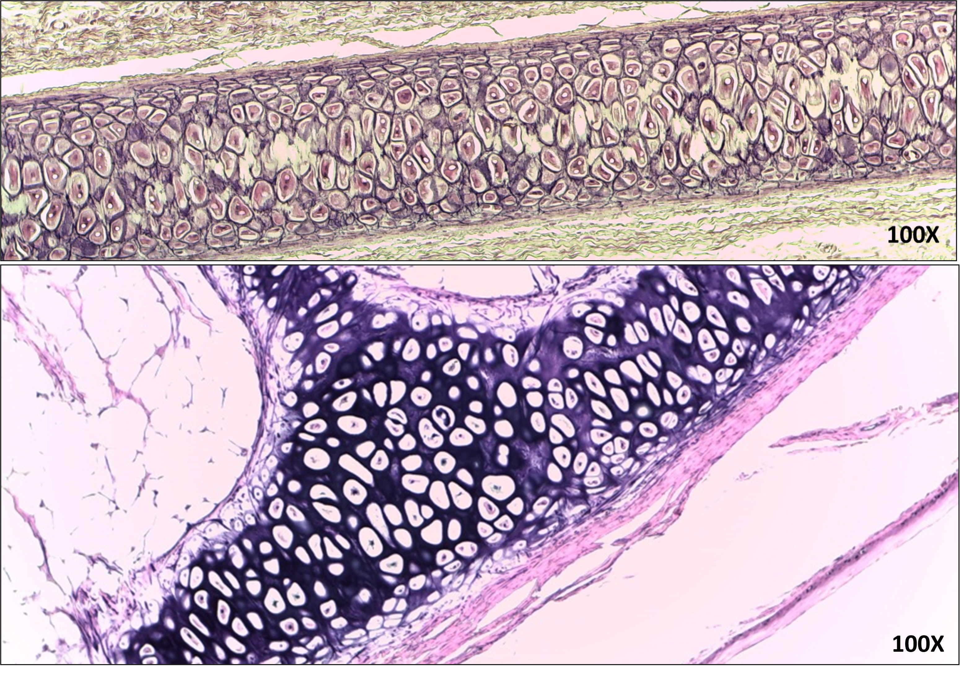
Elastic Cartilage Connective Tissue (1 of 2)

Slide 12
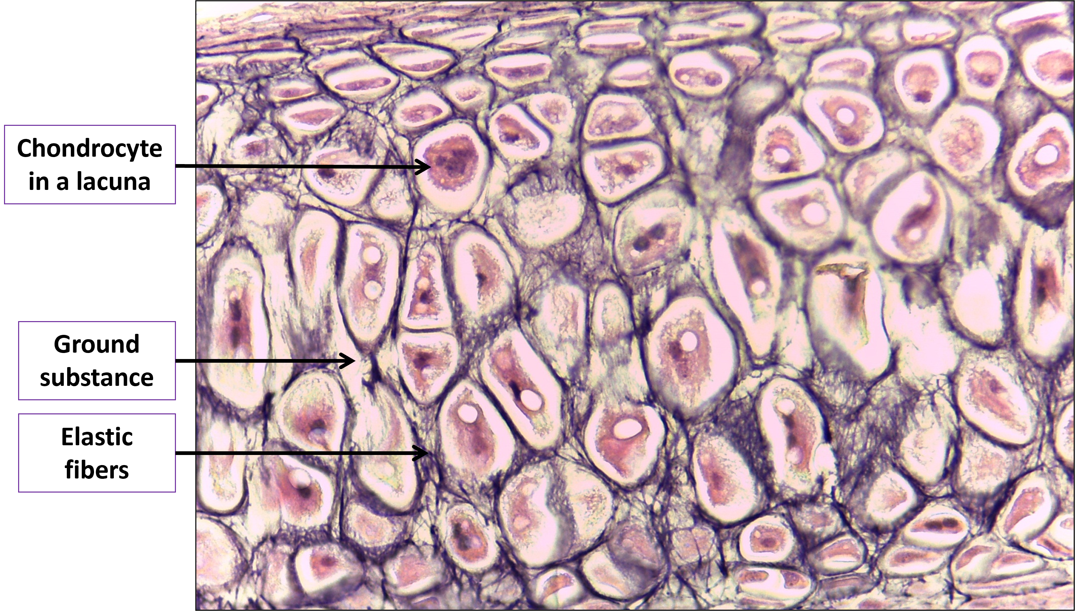
Elastic Cartilage Connective Tissue (2 of 2)

Slide 13
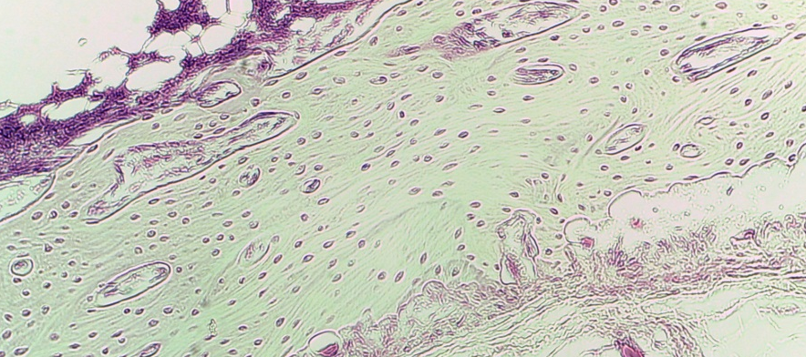
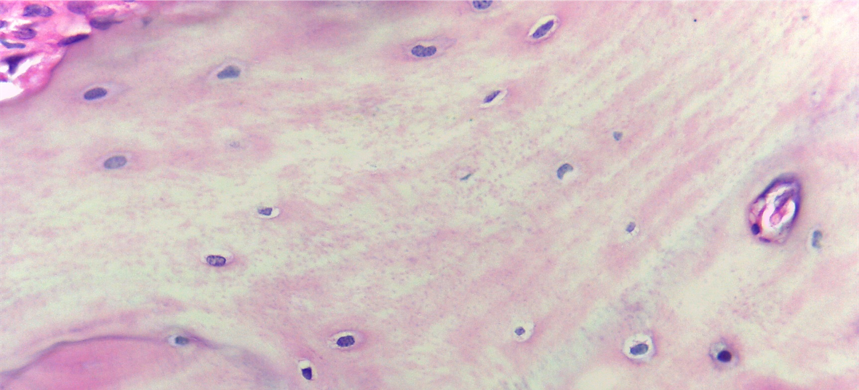
Fibrocartilage Connective Tissue (1 of 3)
100X
400X
Notes:
Fibrocartilage Connective Tissue 100X and 400X

Slide 14
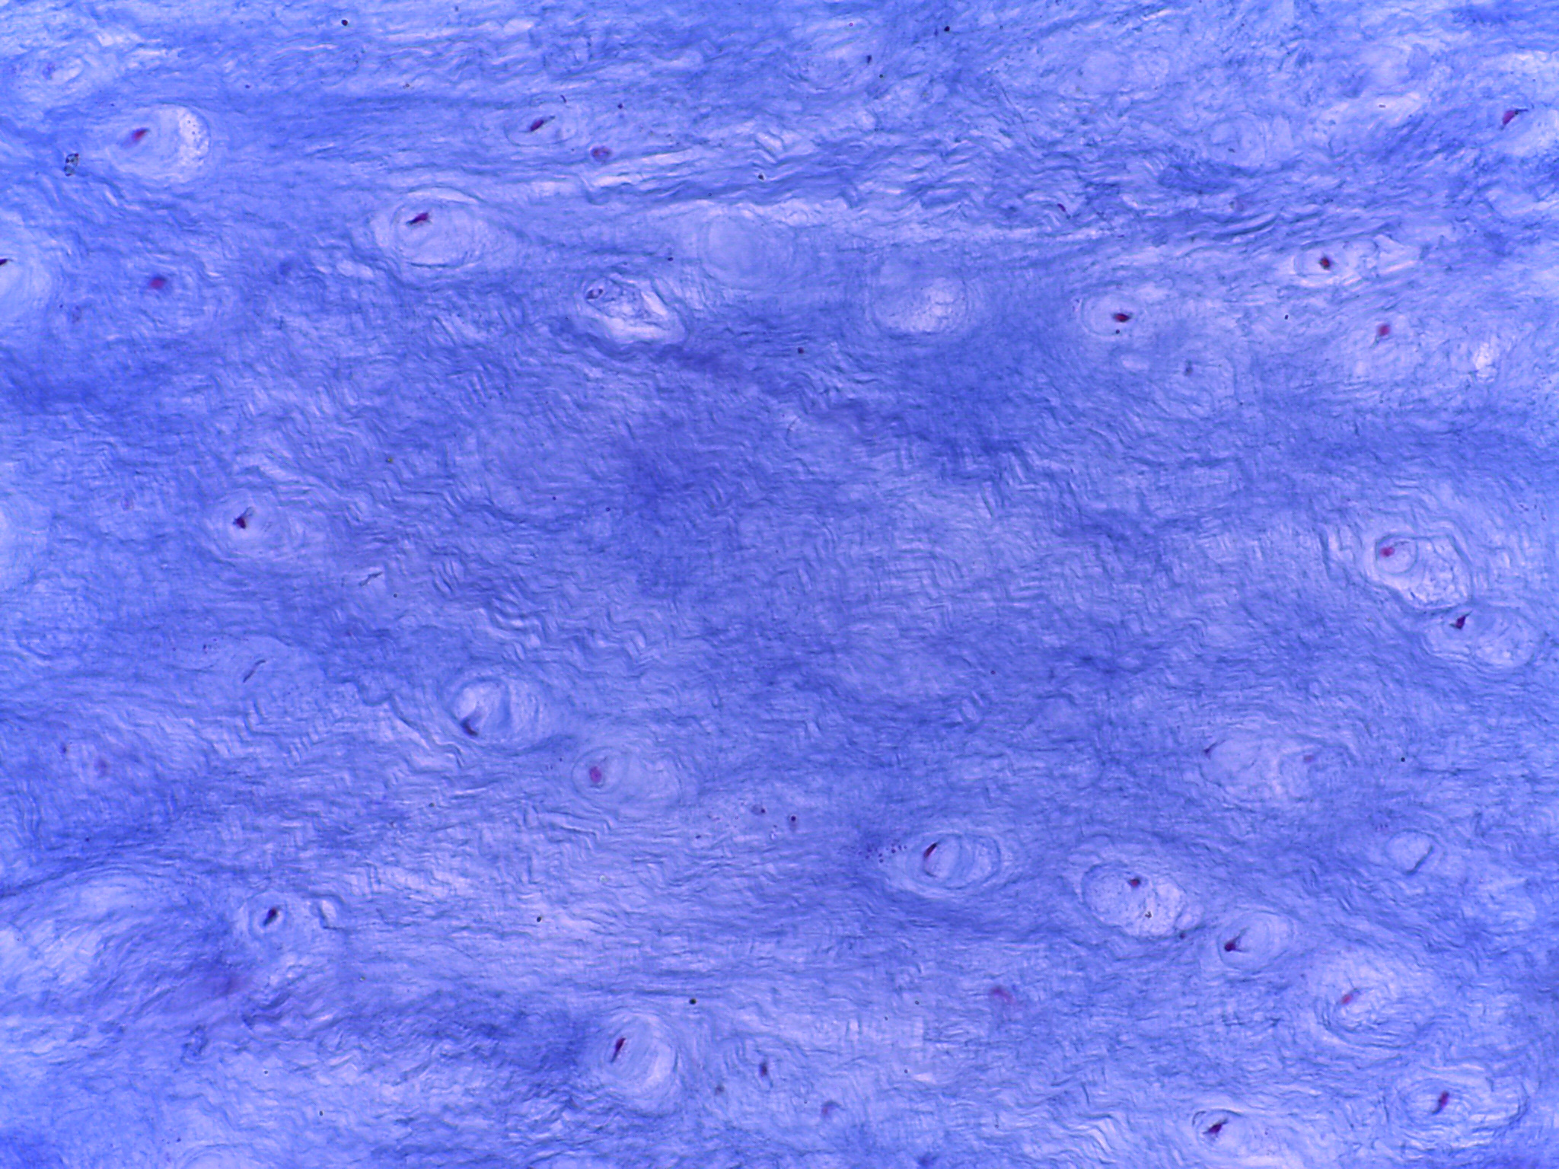
Fibrocartilage Connective Tissue (2 of 3)
Chondrocyte in a lacuna
Collagen fibers
400X
Notes:
Fibrocartilage Connective Tissue 400X

Slide 15
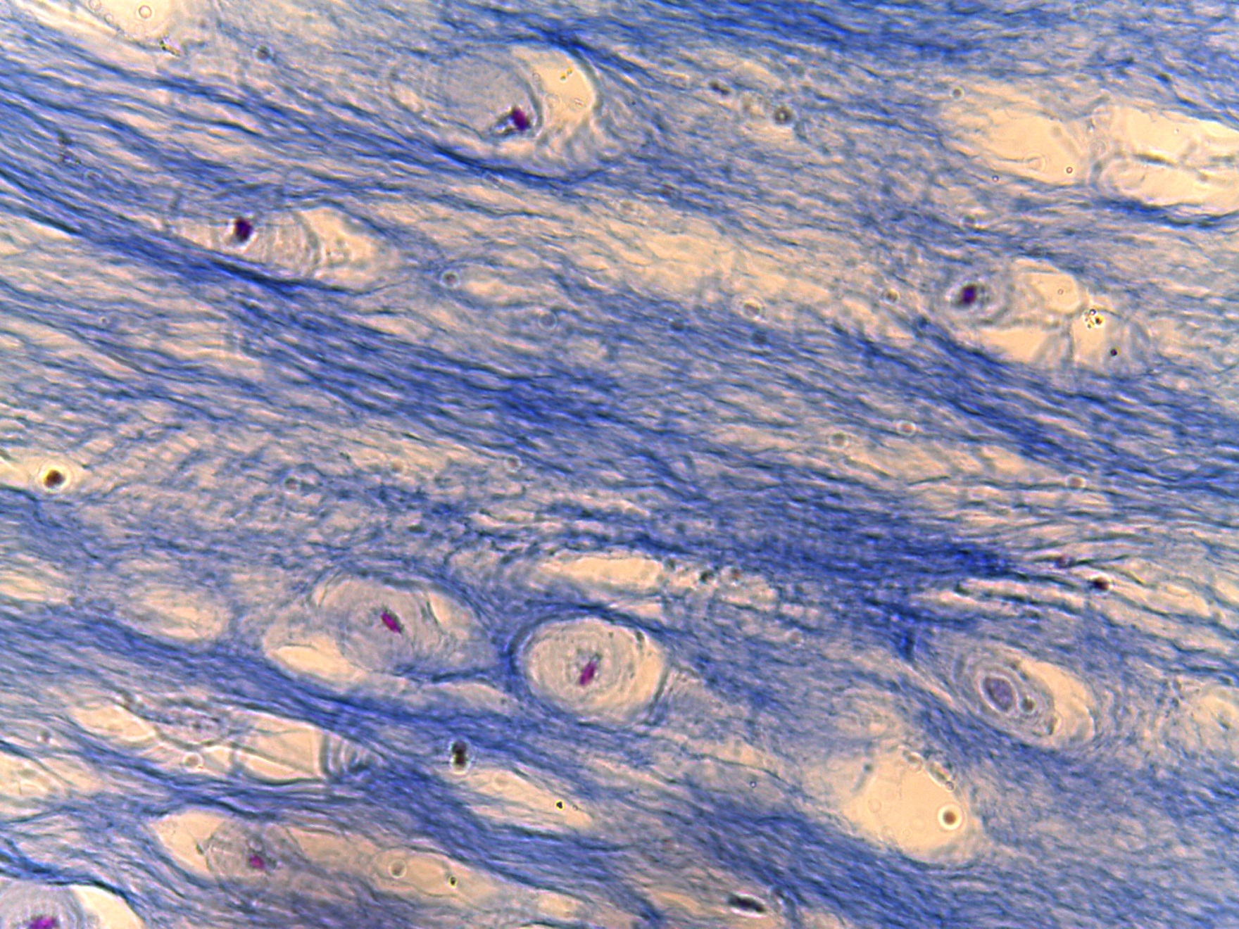
Fibrocartilage Connective Tissue (3 of 3)
Chondrocyte in a lacuna
Ground substance
Collagen fibers
400X
Notes:
Fibrocartilage Connective Tissue 400X

Slide 16
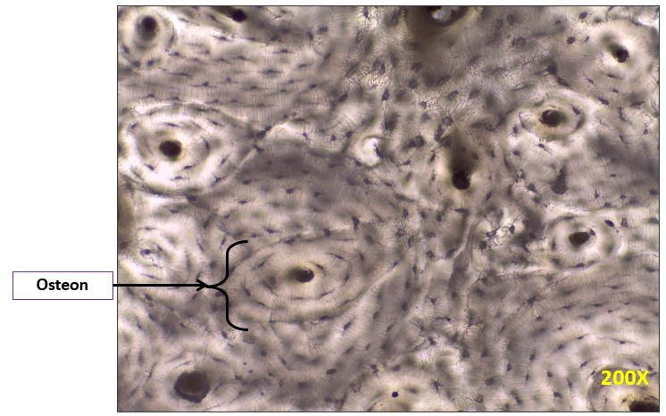
Compact Bone Connective Tissue

Slide 17
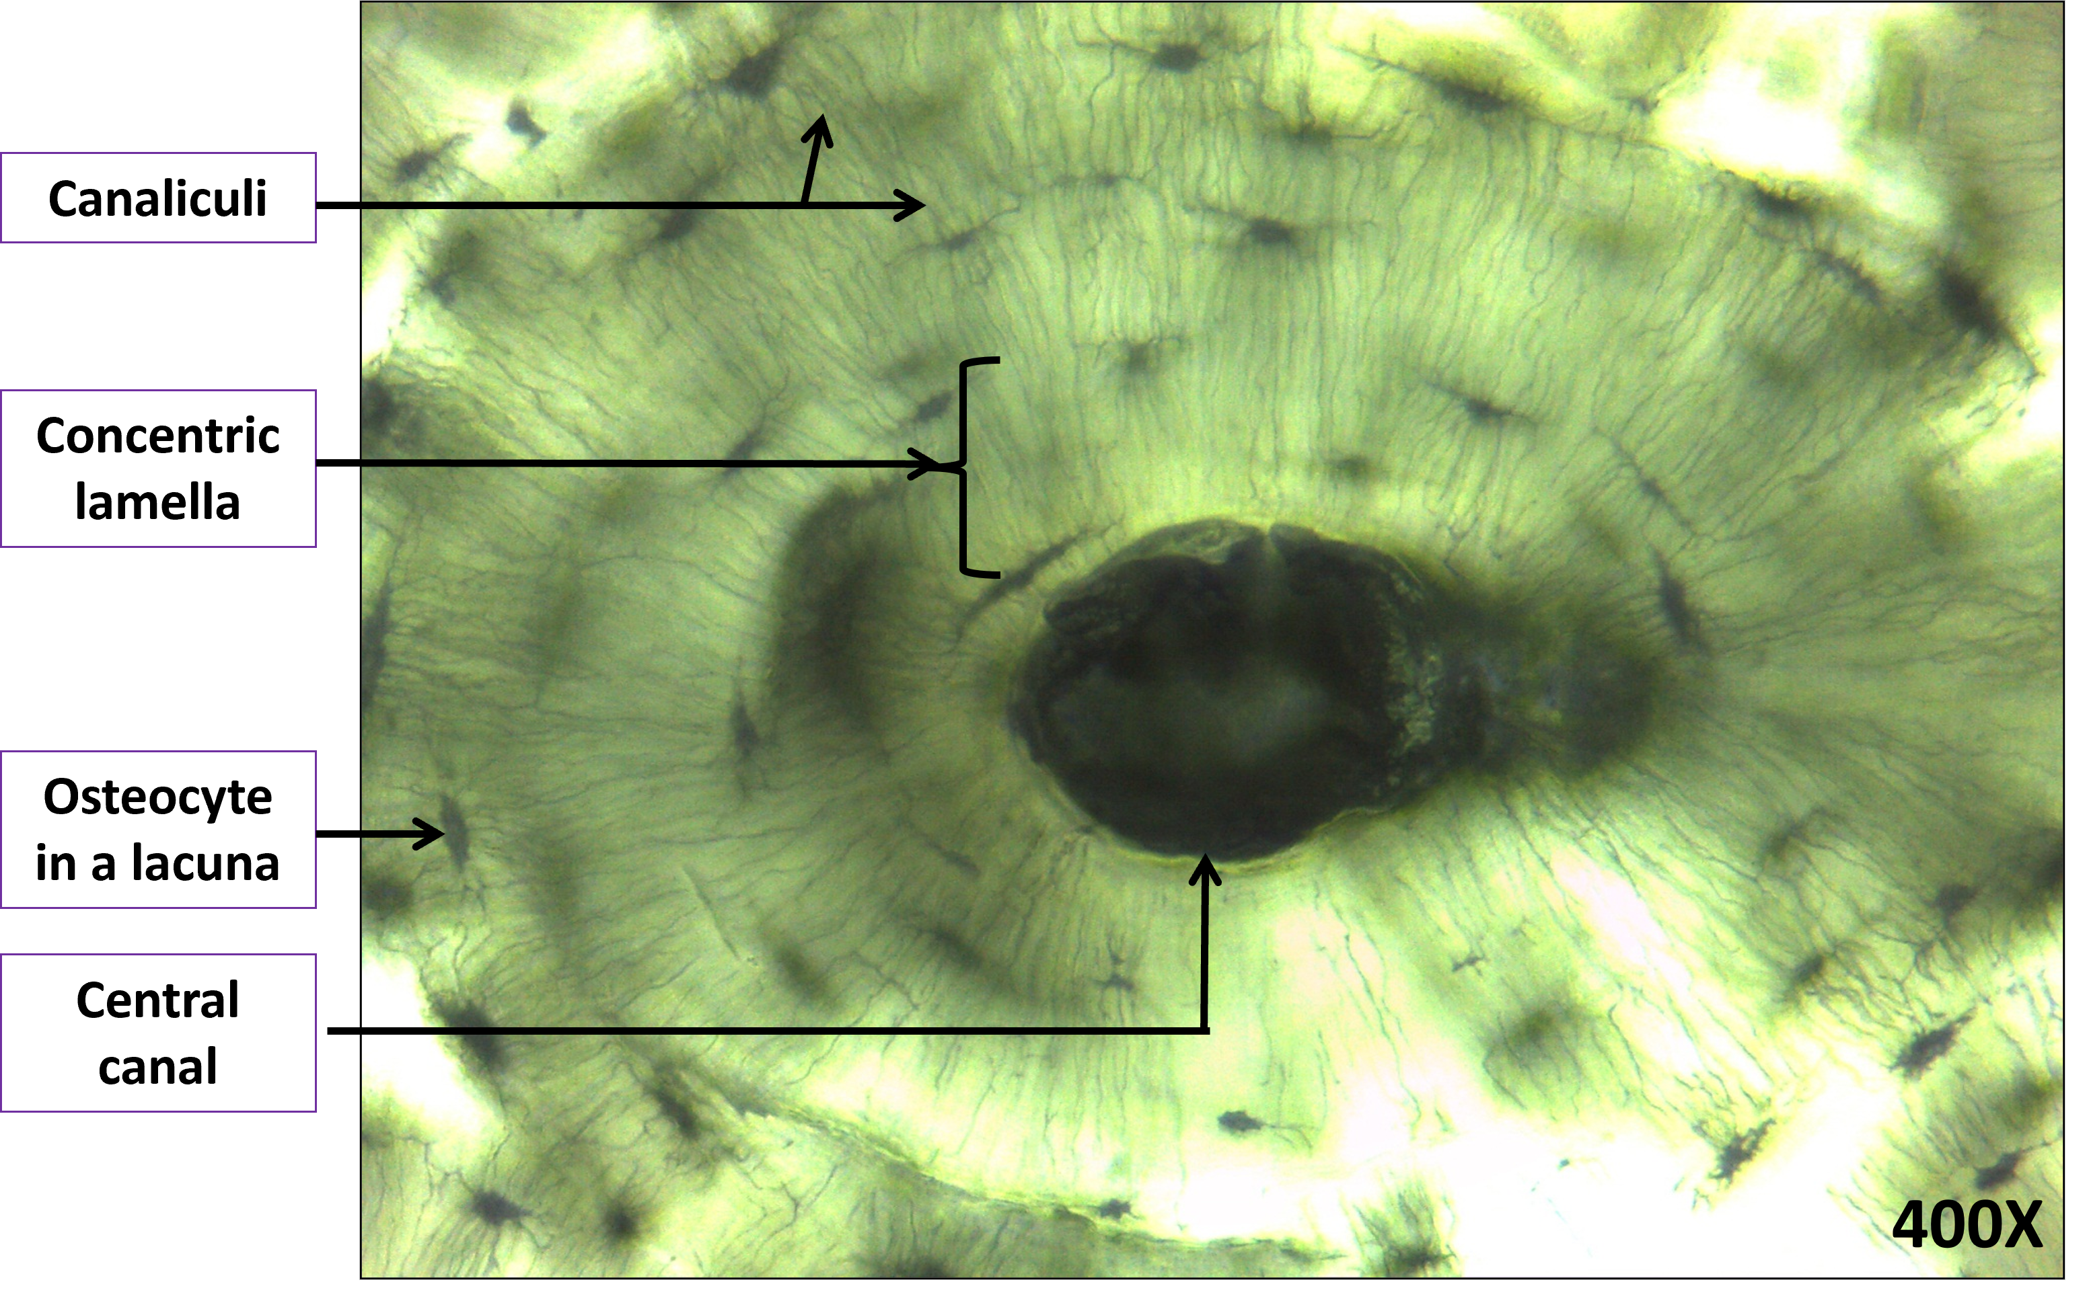
Osteon of Compact Bone Connective Tissue (1 of 2)

Slide 18
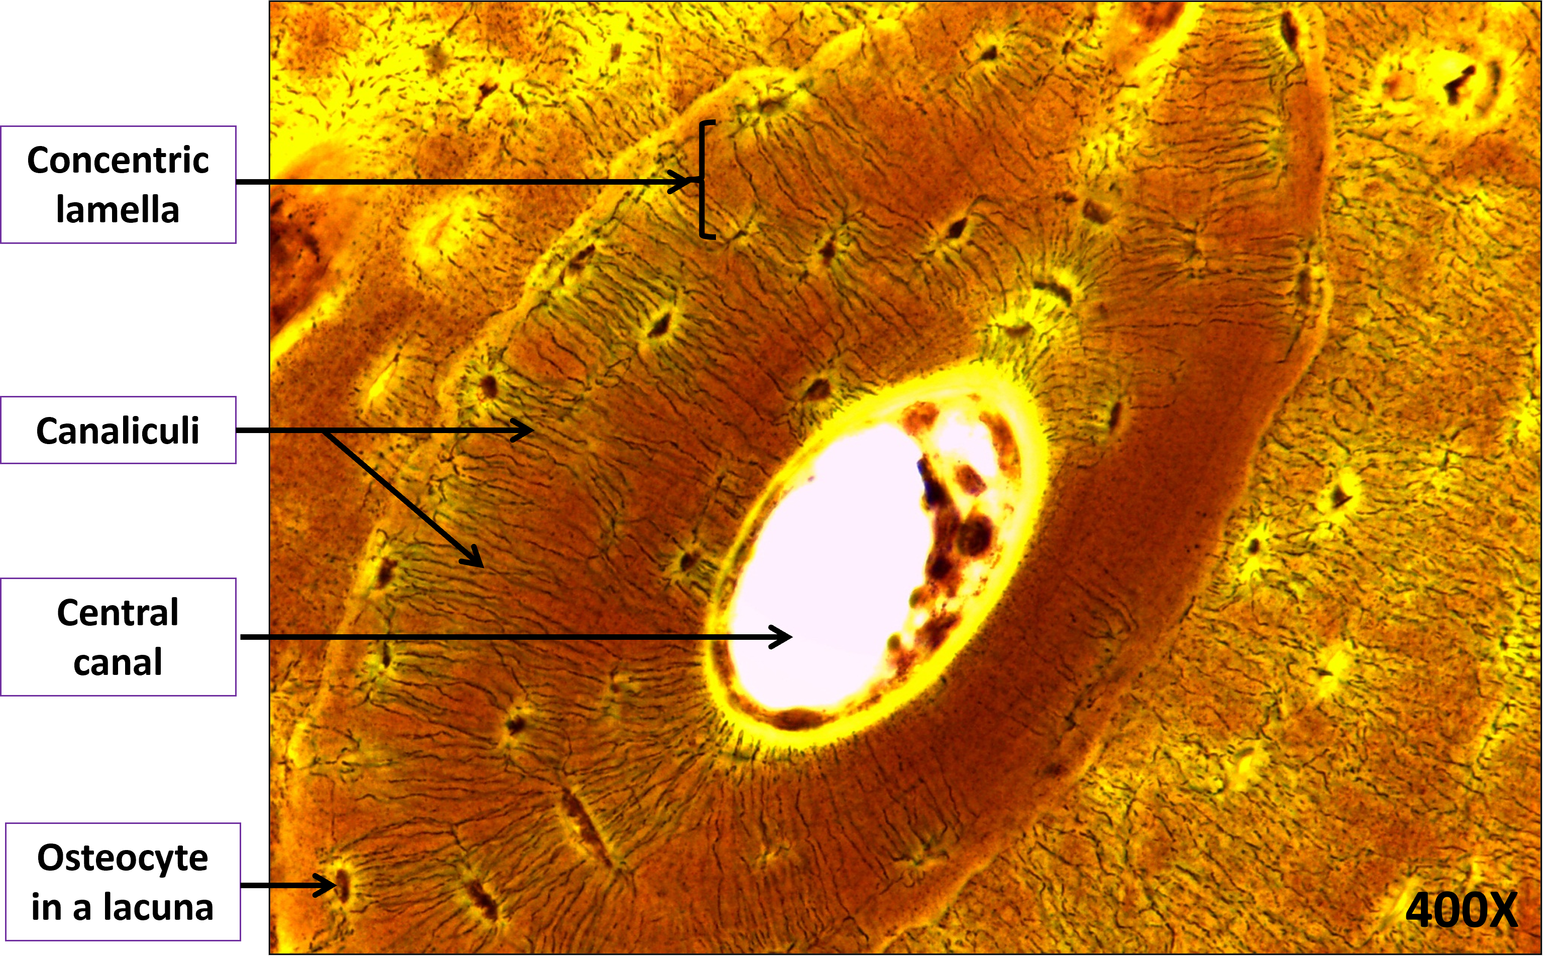
Osteon of Compact Bone Connective Tissue (2 of 2)

Slide 19
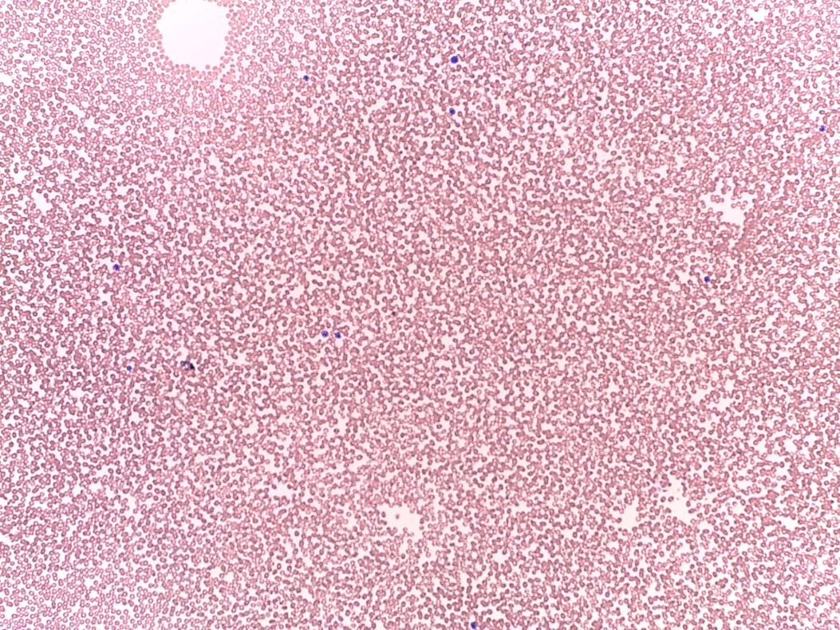
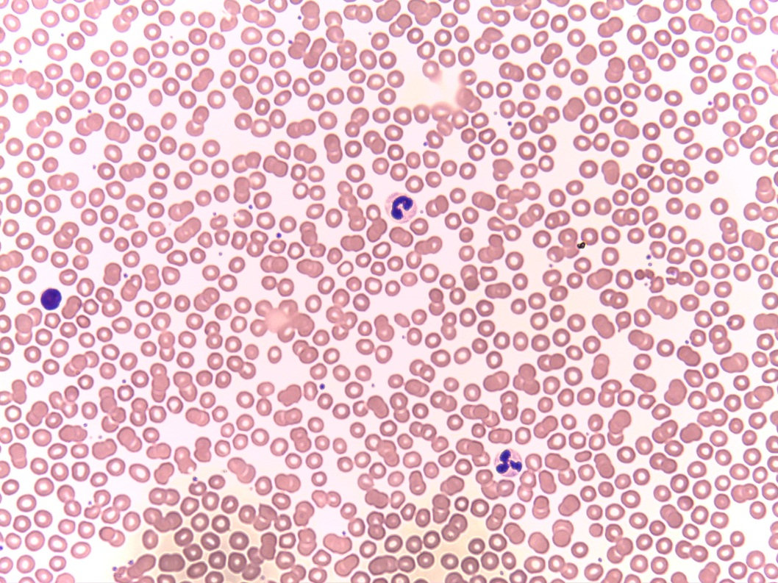
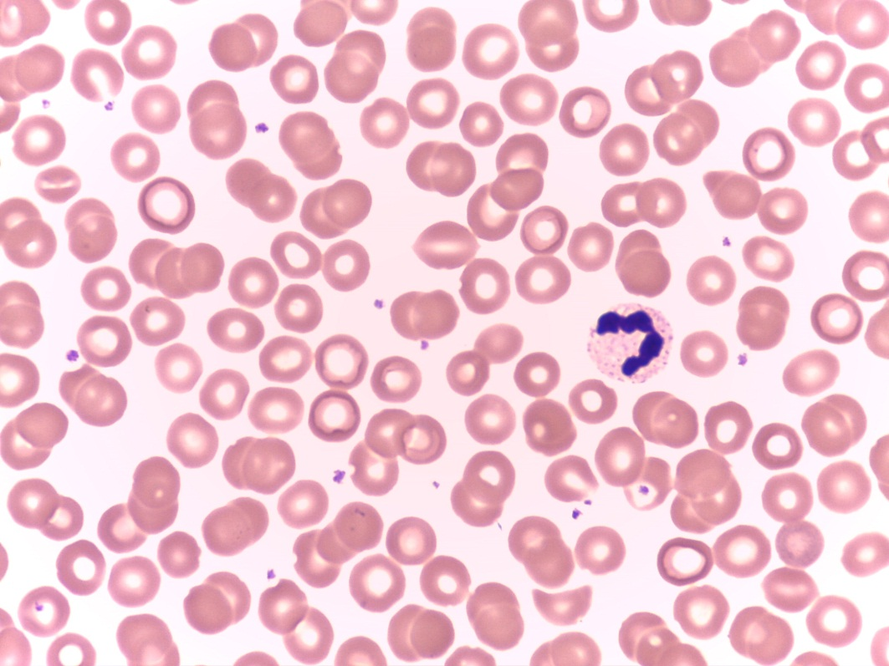
Fluid Connective Tissue: Blood (1 of 2)
100X
400X
1000X
Notes:
Fluid Connective Tissue: Blood 100X, 400X, and 1000X

Slide 20
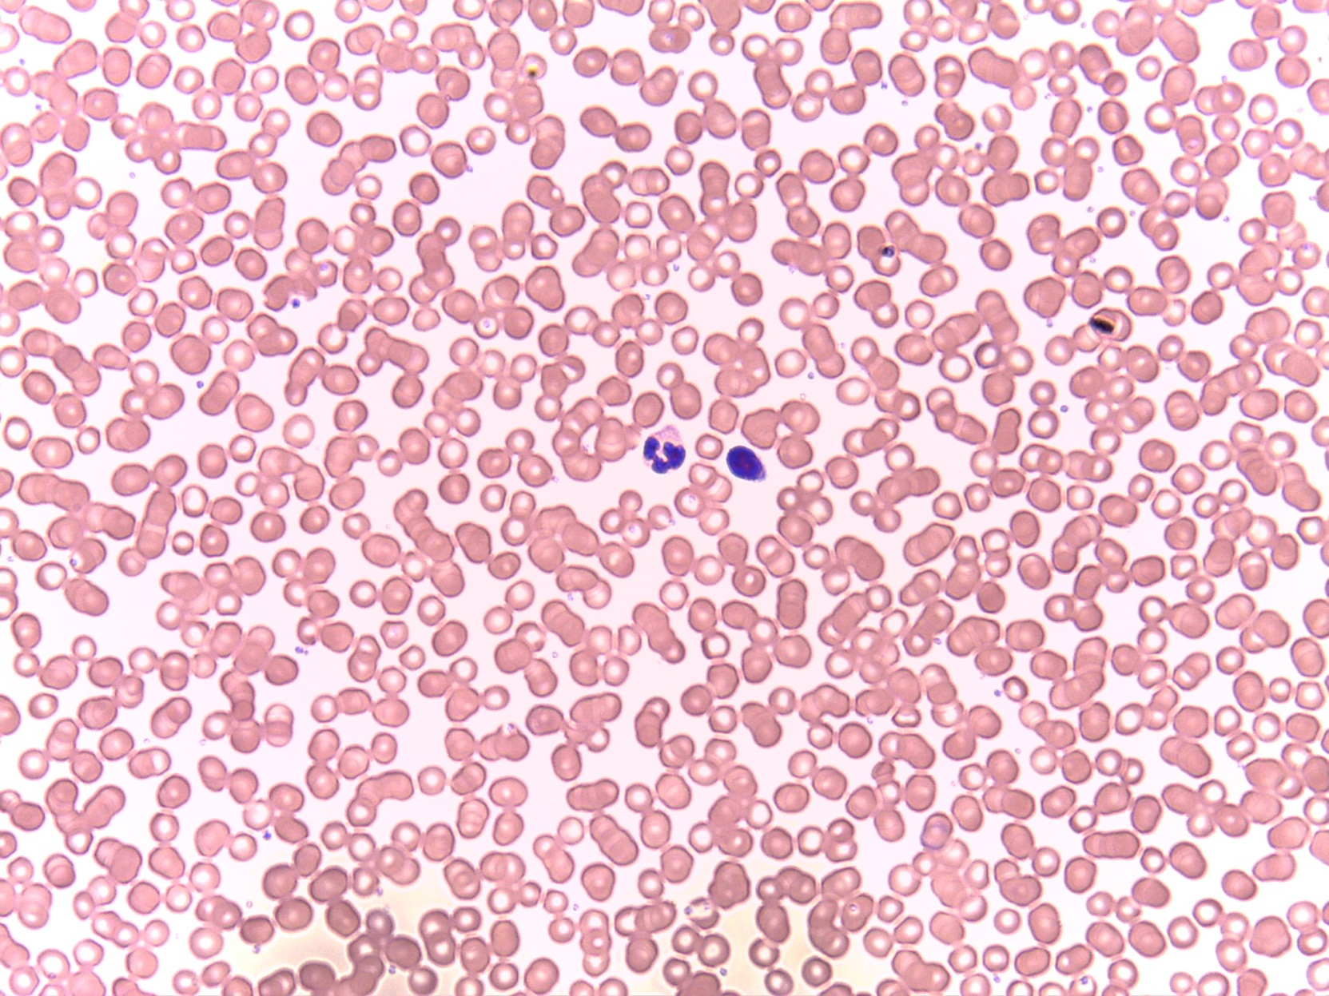
Fluid Connective Tissue: Blood (2 of 2)
Erythrocyte
(red blood cell)
Platelet
Neutrophil (white blood cell)
Lymphocyte (white blood cell)
Plasma
400X
Notes:
Fluid Connective Tissue: Blood 400X

