Slide 1
Cow Eye Dissection
Cow Eye Dissection
Photographed by:
Mr. James Henry
Dr. Laila Nimri
Labeled and Made Accessible by:
Dr. Laila Nimri
Edited by:
Dr. Maya Byfield Mr. James Henry
Dist. Prof. Mary Dolnack Dr. Syed Arif Humayun
Dr. Essa Farah Dr. Laila Nimri

Slide 2
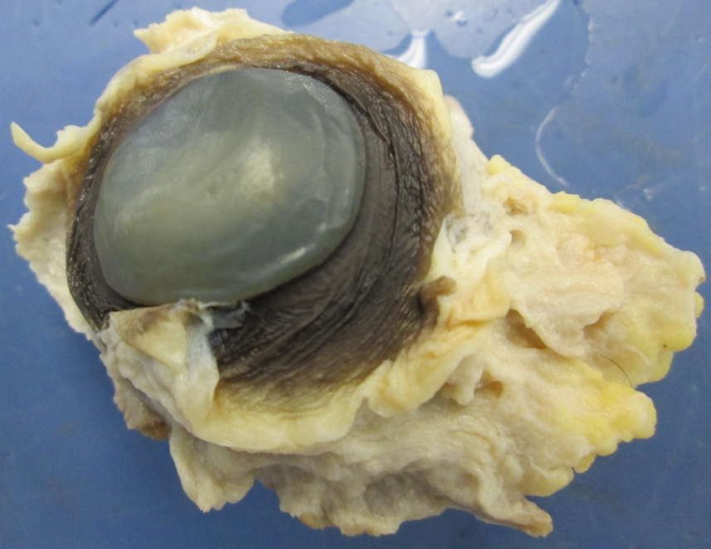
Cow Eye Removed From the Orbit
Adipose tissue cushion
Cornea
Ocular conjunctiva

Slide 3
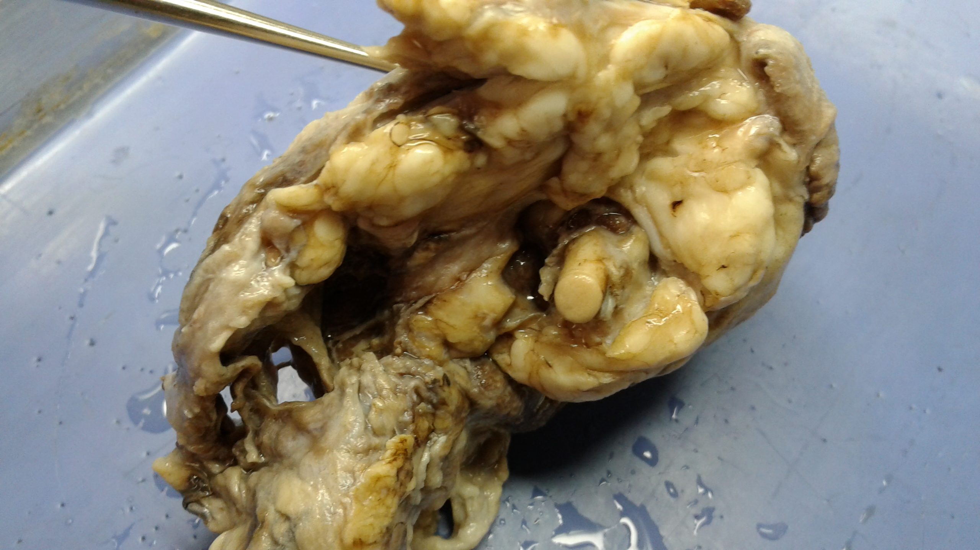
Cow Eye Removed From the Orbit (Posterior View)
External muscle & adipose tissues
Optic nerve (CN II)

Slide 4
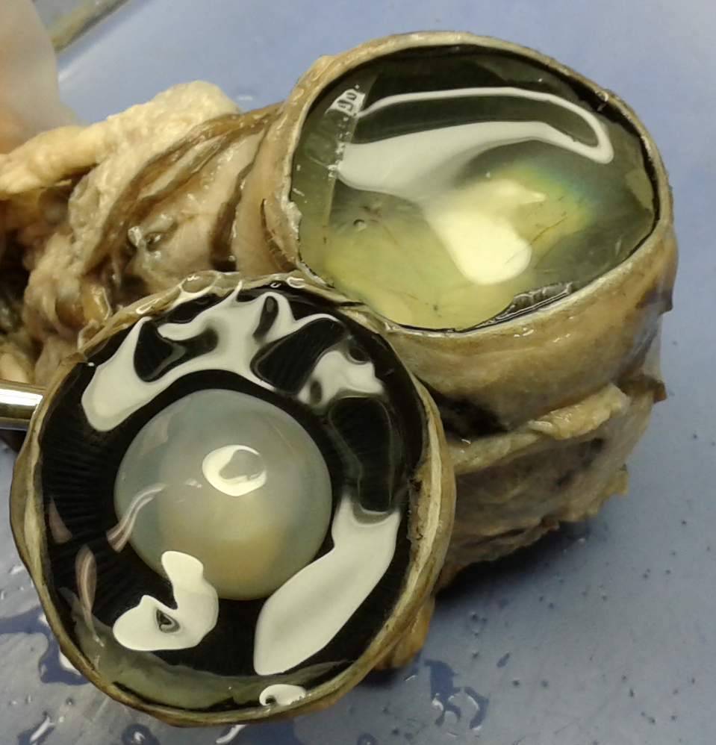
Coronal Section of Cow Eye
Posterior Cavity With the Vitreous Humor

Slide 5
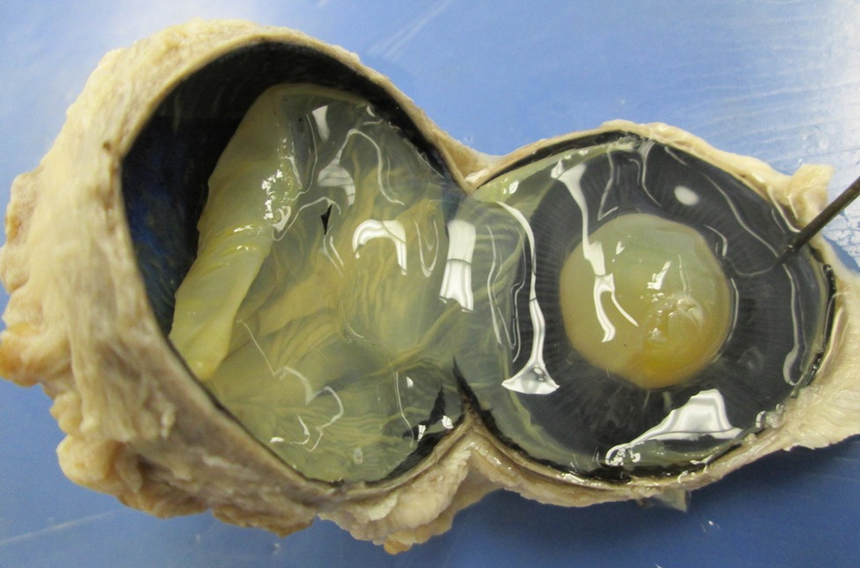
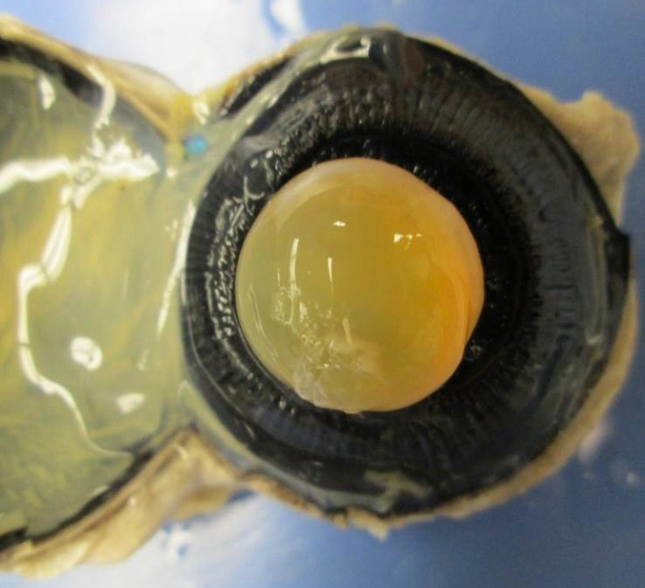
Coronal Section of Cow Eye
Posterior View of Lens With (A) and Without (B) the Vitreous Humor
A
B

Slide 6
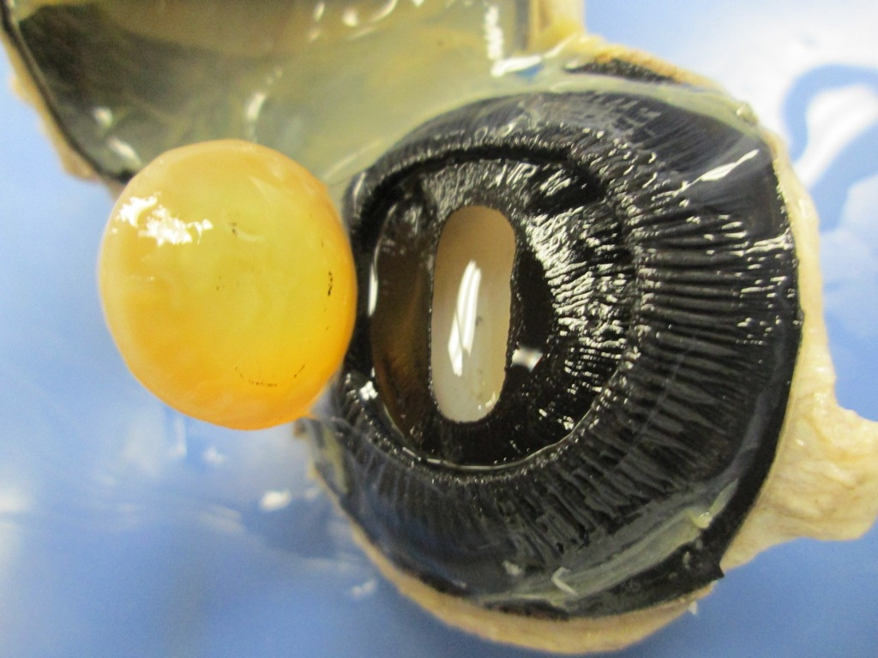
Coronal Section of Cow Eye
(Posterior View of the Ciliary Body With Lens Moved to the Side)
Lens
Pupil
Iris
Ciliary body

Slide 7
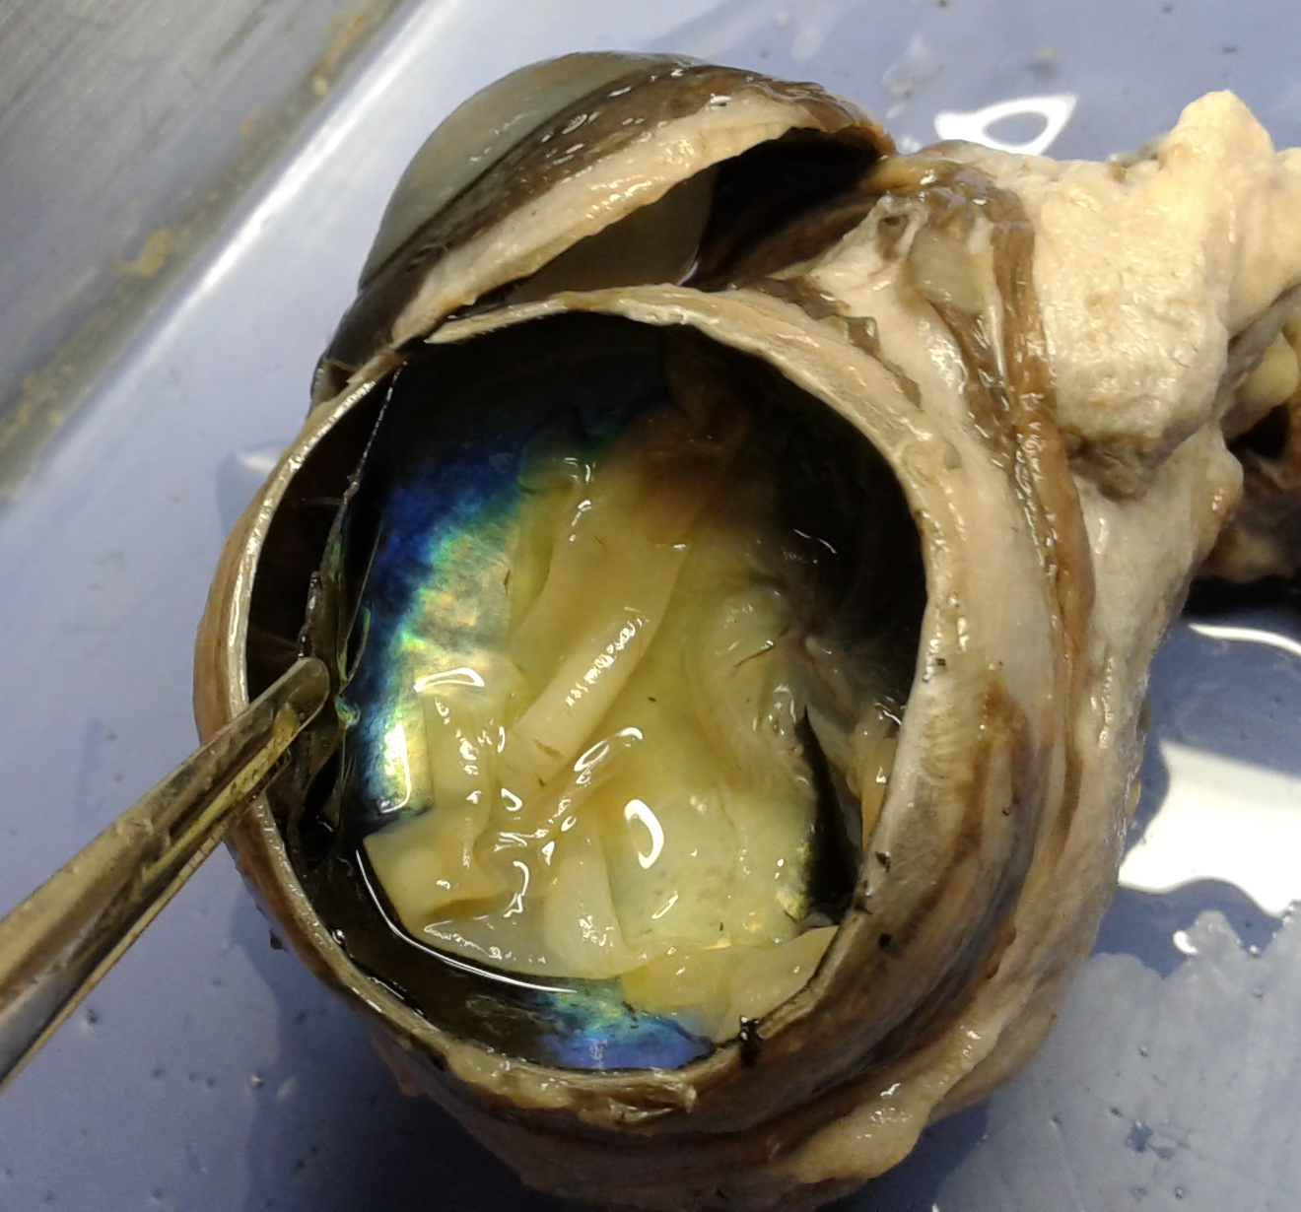
Coronal Section of Cow Eye / Layers of the Eyeball
Sclera
Choroid
(pulled away from sclera)
Tapetum lucidum
(reflecting surface of choroid)
Retina (folded)

Slide 8
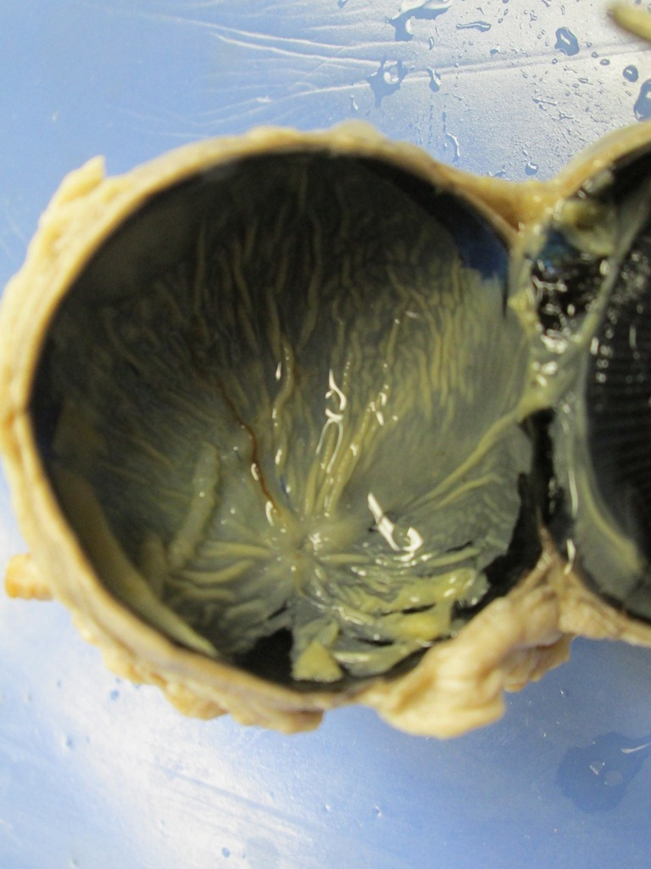
Coronal Section of Cow Eye / The Retina
Optic disc (Blind spot)
Retina

Slide 9
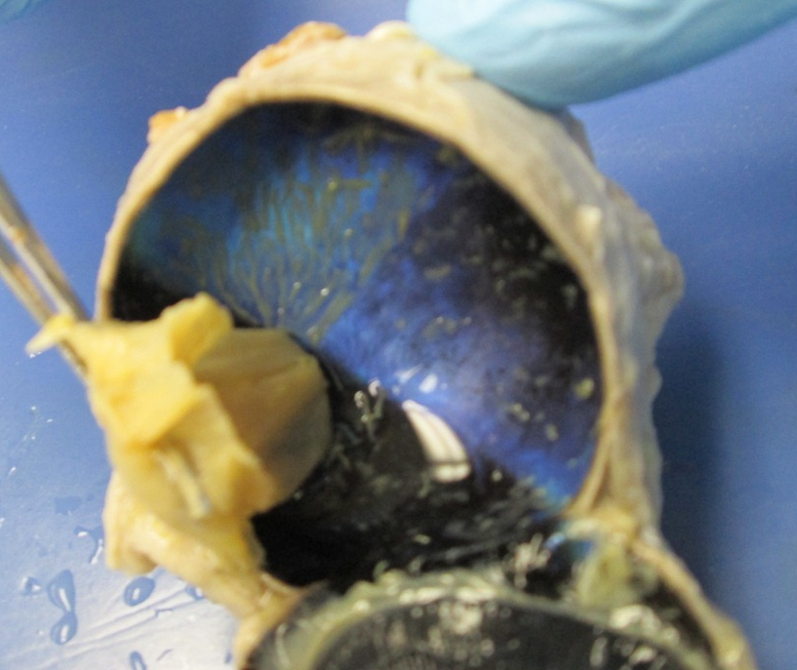
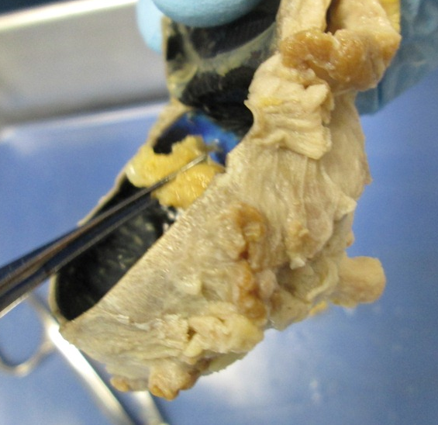
Coronal Section of Cow Eye
(Retina is Pulled Away to Show Its Point of Exit = Optic Disc )
Retina
Optic disc (Blind spot)
Retina
Optic nerve
(CN II)

Slide 10
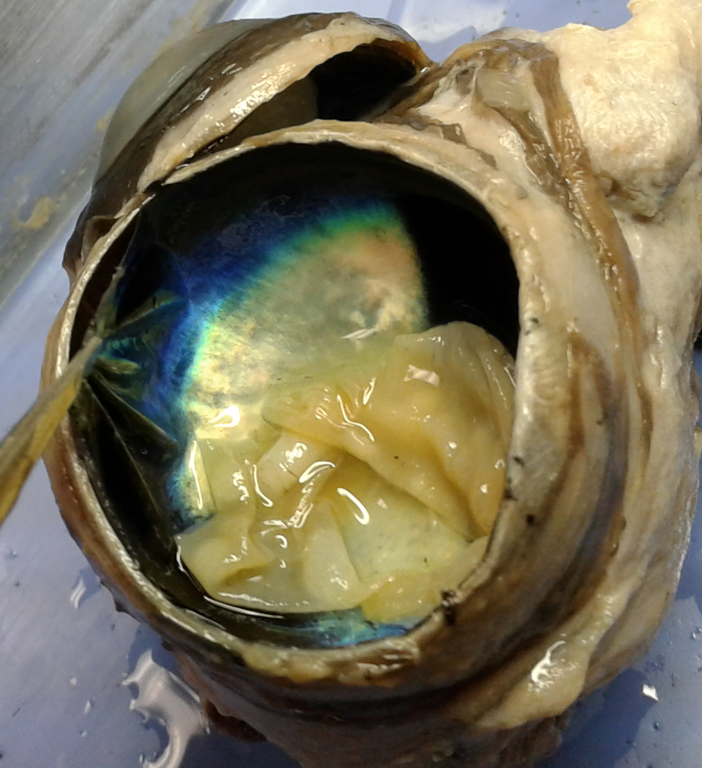
Coronal Section of Cow Eye / Tapetum Lucidum
Choroid
(pulled away from sclera)
Tapetum lucidum
(reflecting surface of choroid)

